Slide 1
Extending the Reach of GPS-assisted Femtocell Synchronization and Localization through Tightly-Coupled Opportunistic Navigation
Ken Pesyna, Kyle Wesson, Robert Heath Jr., Todd Humphreys
Presentation at Globecom 2011 | December 5, 2011

Slide 2
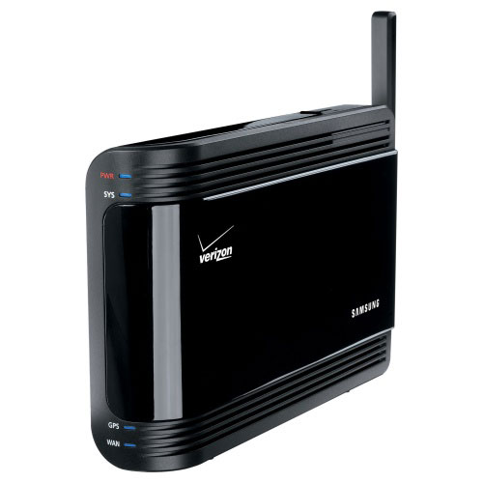
Why Synchronization & Localization?
Ensure reliable handover
Reduce interference
Operate within licensed spectrum
Locate emergency calls
Synchronization and Localization are key requirements for femtocells

Slide 3
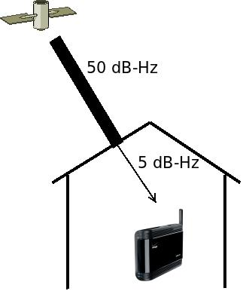
Challenges of Satellite-based Synchronization
Femtocells placed indoors
GPS signals weak: -155 dBW
Up to 45 dB penetration loss

Slide 4
Time and Frequency Requirements
Minimum synchronization requirements [Rakon]:
These are very stringent requirements!

Slide 5
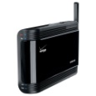
Location Requirements
Spectrum licensing & operator control
Emergency caller location identification (E911)
20km
Spectrum Licensing
10m
E911
Challenging!
Big Issue: E911

Slide 6
Prior Work
Precision time protocol (PTP) [Eidson02]
Cellular network listen [Edwards08]
GPS-based solutions [Lewandowski99, Smith09]
1-20 km
5m
20km
10m
50 - 300m

Slide 7
Challenges of GPS
High signal sensitivity is required to acquire GPS signals indoors
5 dB-Hz to cover 90% of residences
Sensitivity attainable today:
State-of-the art via EGPS/AGPS is 14 dB-Hz [RoDuJaGra08]
Goal: Close this 9 dB gap

Slide 8
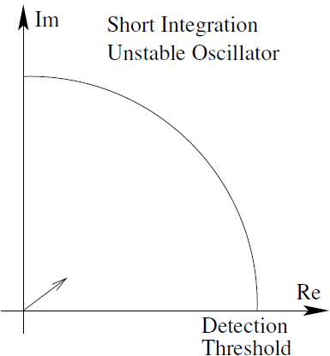
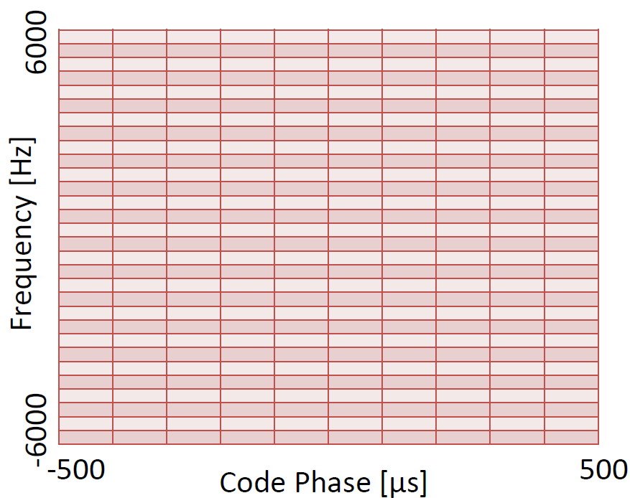
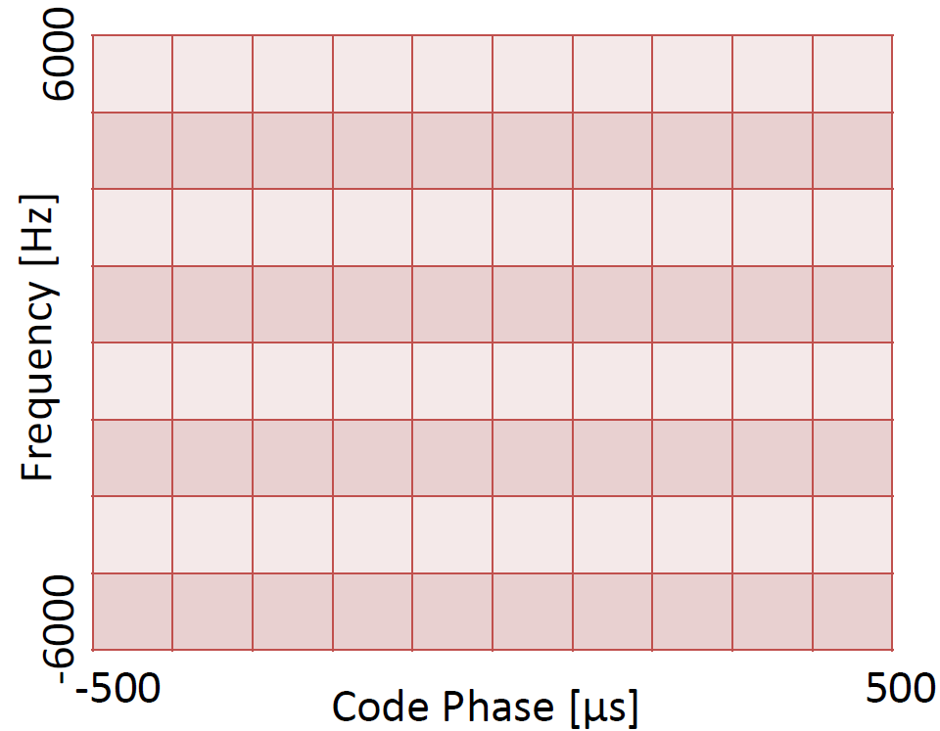
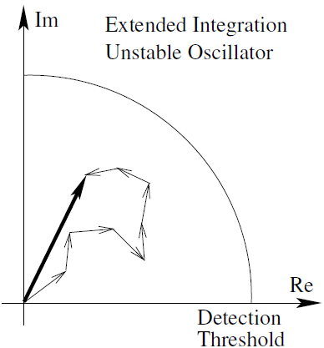
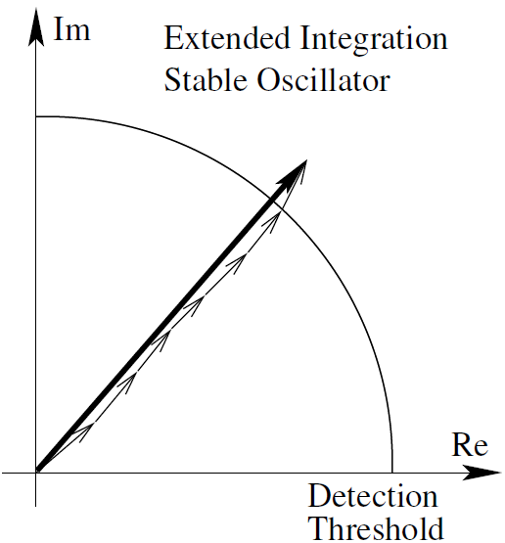
Closing the 9 dB gap: Requirements
Coherently integrate GPS signal over extended interval
Local oscillator drifts
→ This requires a more stable oscillator
# of time-frequency search cells explodes
Increases probability of false alarm
→ The search space must be reduced

Slide 9
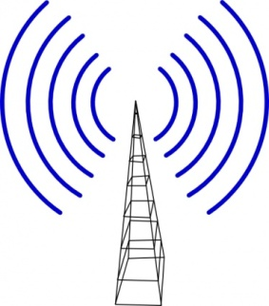
Proposed Solution: Tightly-Coupled Opportunistic Navigation
Use ambient radio “signals of opportunity”:
Stabilize femtocell’s local oscillator
Narrow the GPS search space
Cellular
HDTV

Slide 10
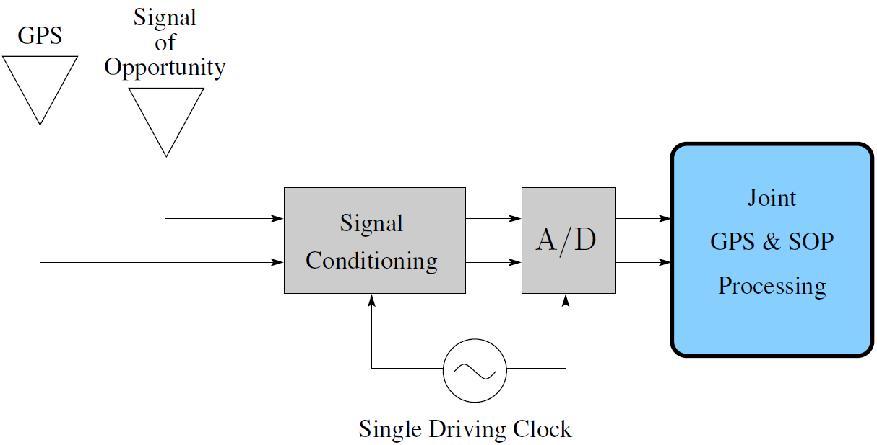
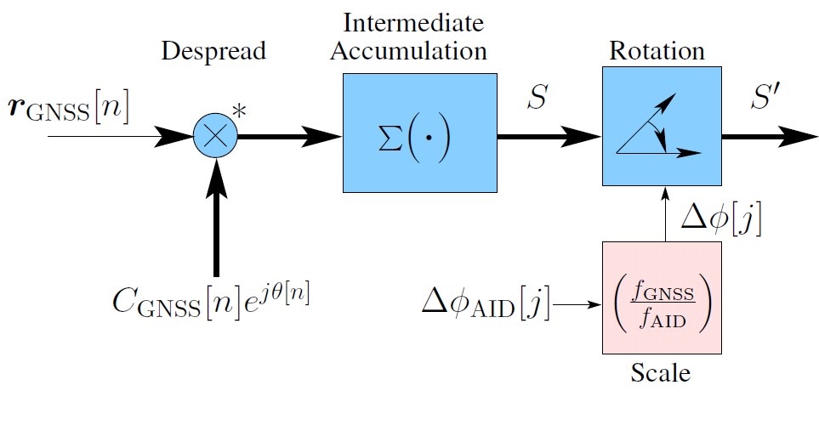
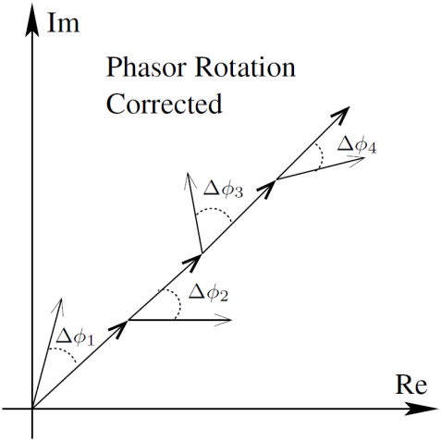
Tightly-Coupled Opportunistic Navigation
Estimator
Final
Accumulation

Slide 11
Benefits of Proposed TCON
Frequency stability transfer
Correct its local clock variations to allow extended integration
Search space contraint
Aiding of precise time and frequency information
Decreases time & frequency uncertainty

Slide 12
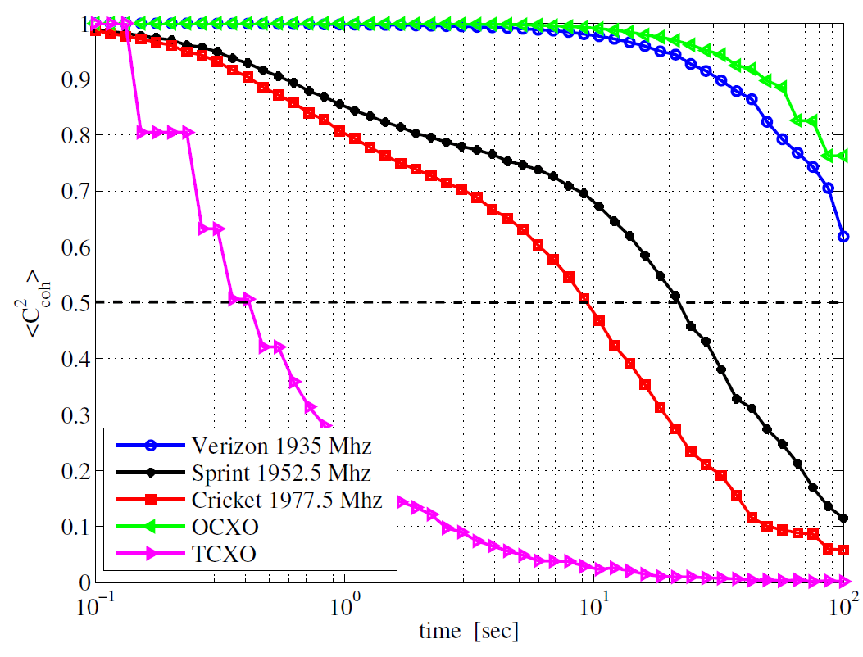
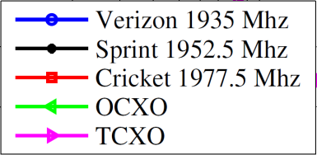
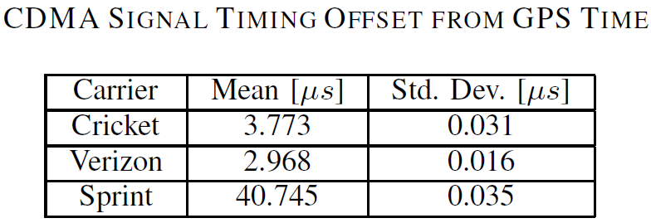
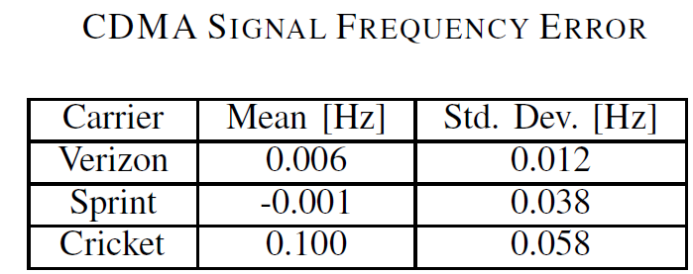
Ambient Signal Analysis
Analyzed ambient CDMA signals
Extremely stable and synchronous
Signals remain stable beyond 9 seconds
Time synchronized to 4 µs (2 of 3)
Frequency accurate to 0.3 Hz
20 s
9.5 s
100+ s
Mean-squared Coherence vs Time

Slide 13
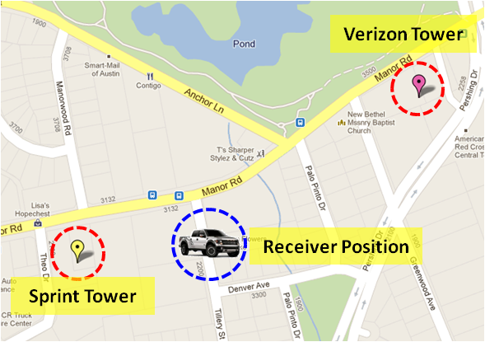
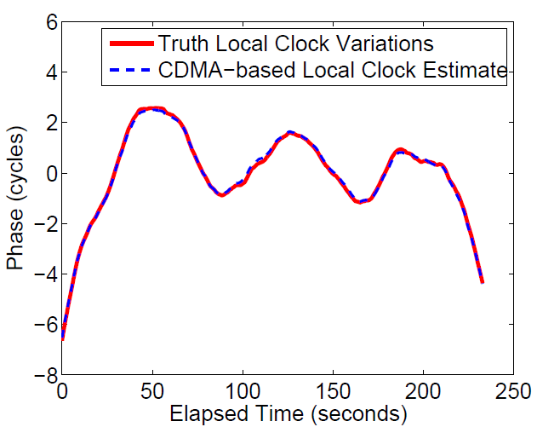
Field Demonstration
Cellular CDMA signals recorded in Austin, TX
TCON used to estimate the local clock variations using only CDMA signals

Slide 14
Conclusions
Synchronization is required for femtocell operation
Location is required to meet FCC regulations
Existing approaches may not meet requirements
Propose TCON to exploit other available signals
Increases the GPS-sensitivity of the femtocell
GPS meets the syncrhonization requirements
Allows femtocells to be located further indoors

Slide 15
Conclusions
Requirements to acquire a 5 dB-Hz GPS signal:
Coherent integration time of 7 seconds
Time certainty to within 6 µs of GPS time
Frequency certainty to within 0.5 Hz
TCON achieves the needed gain in sensitivity
Femtocells synchronized indoors using GPS

Slide 16
Questions?

