Slide 1

Robust Precise Location
Todd Humphreys
Department of Aerospace Engineering and Engineering Mechanics, The University of Texas at Austin
ION GNSS+ Ubiquitous Navigation Panel | September 27, 2017

Slide 2
Alan Cameron, editor of GPS World:
What is the issue of the year for PNT
generally and for GNSS in particular in 2017?

Slide 3
My response:
What role will GNSS play in automated vehicles?
Notes:
Waymo, Uber, Tesla, GM, and others have adopted standard-precision GNSS as an indispensable component of their automated vehicle sensor suite. But it's viewed as a secondary sensor -- not accurate or reliable enough for positioning the vehicle within the lane. Yet these same companies haven't figured out how to drive in whiteout or foggy conditions. Precise GNSS could play a key role in bad weather if it can prove its reliability.

Slide 4
Data Point 1:
Elon Musk believes Tesla HW2 sufficient for Level 5

Slide 5
Q: What role does GNSS play in Tesla HW2?

Slide 6
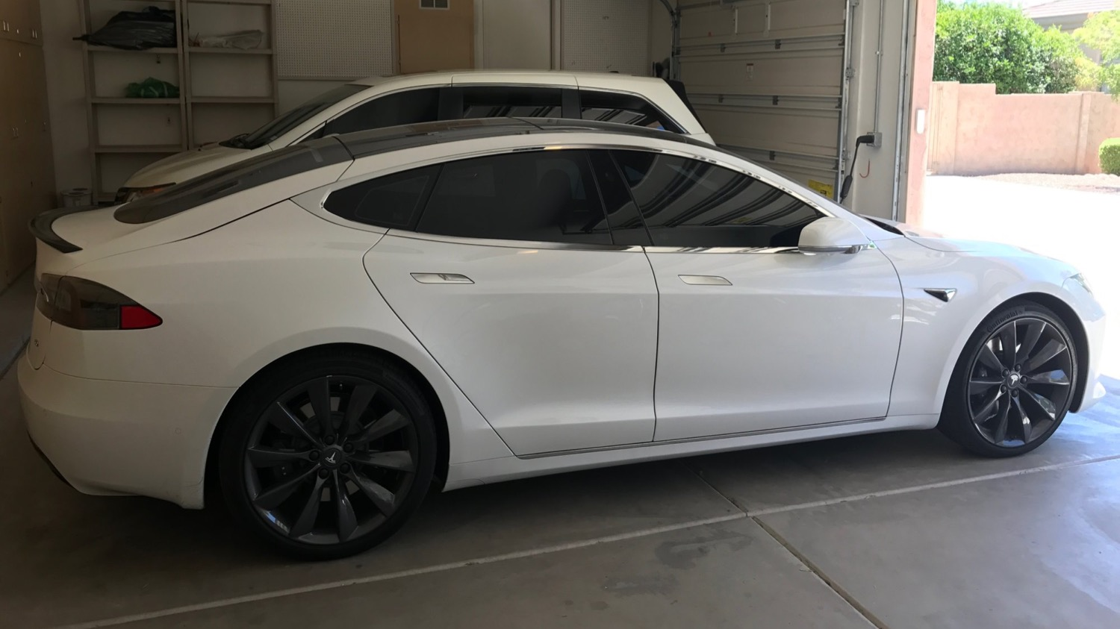
Teardown of Model S sensor fusion module courtesy of a curious owner

Slide 7
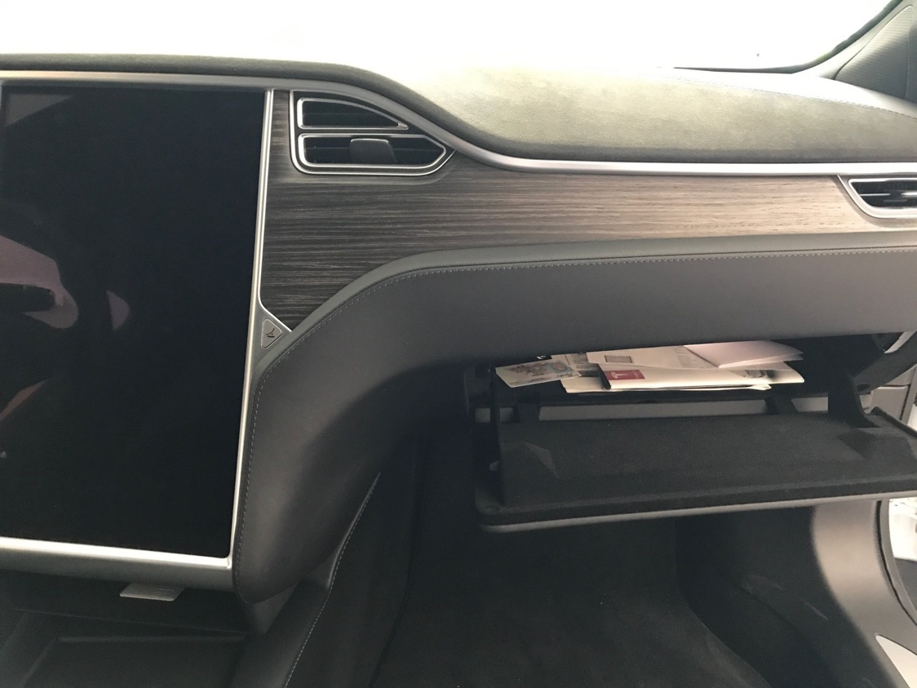
Just behind the glove box …

Slide 8
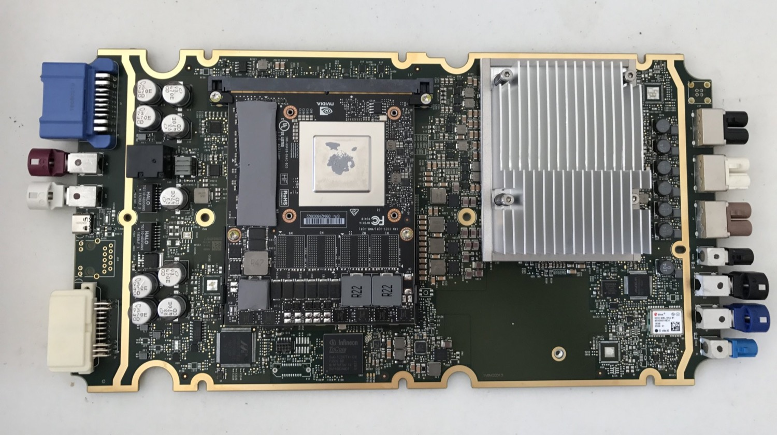
… lies the sensor fusion module …

Slide 9
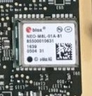
… equipped with a ublox M8L

Slide 10
Q: The ublox M8L offers a single-frequency IMU-aided code-based solution. Together with 8 cameras, radar, and proximity sensors, is this enough for Level 5?

Slide 11
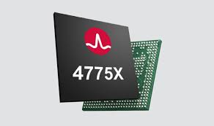
Data Point 2:
Broadcom just released the first dual-frequency mass-market GNSS chip: L1/E1 + L5/E5a + raw observables

Slide 12
Q: Now that multi-frequency has been commoditized, why wouldn’t OEMs opt for it?

Slide 13
Q: How will commodity precise positioning be realized? Location as a service? OEMs provide corrections? PPP or PPP-RTK?

Slide 14
Claim 1:
Some form of precise GNSS will be required for poor-weather lane keeping in areas with few pre-mapped radar reflectors

Slide 15
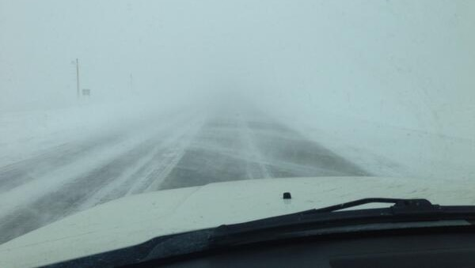
In low-visibility conditions, LIDAR and cameras will fail. If pre-mapped
radar reflectors are too sparse, lane keeping may be compromised

Slide 18
Claim 2:
We should be designing for Level 6:
Continued operation under conditions in which a human couldn’t manage

Slide 19
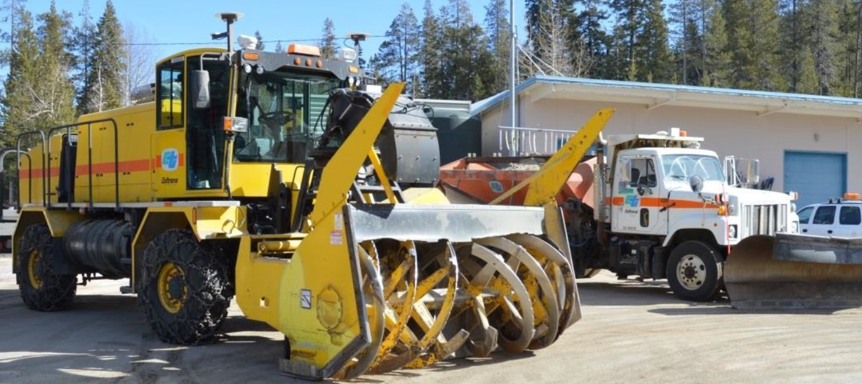
If professional snowplow drivers can’t manage, you know the weather’s bad:
University of Minnesota GNSS snowplow driver assistance system

Slide 20
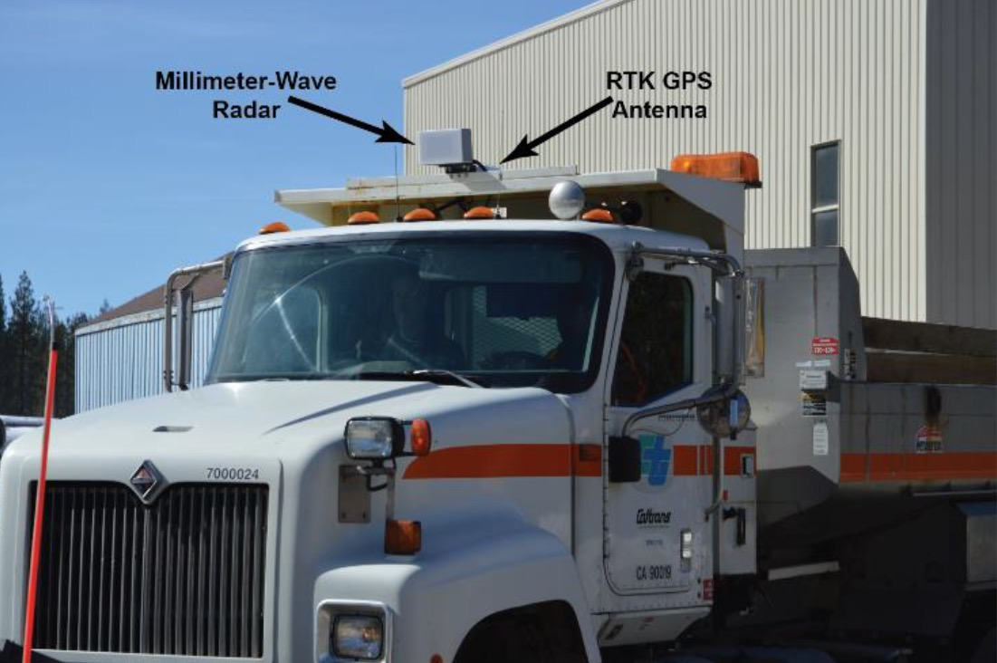
2015 Caltrans implementation of U. Minnesota system

Slide 21
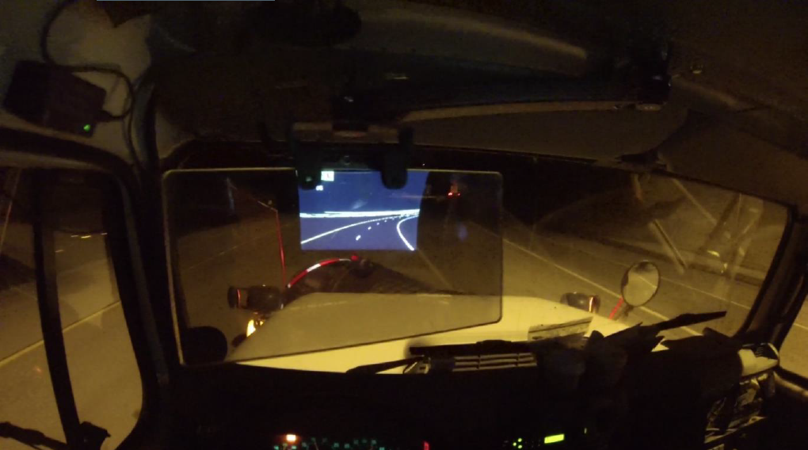
Zero visibility no deterrent for these drivers from their appointed rounds

Slide 22
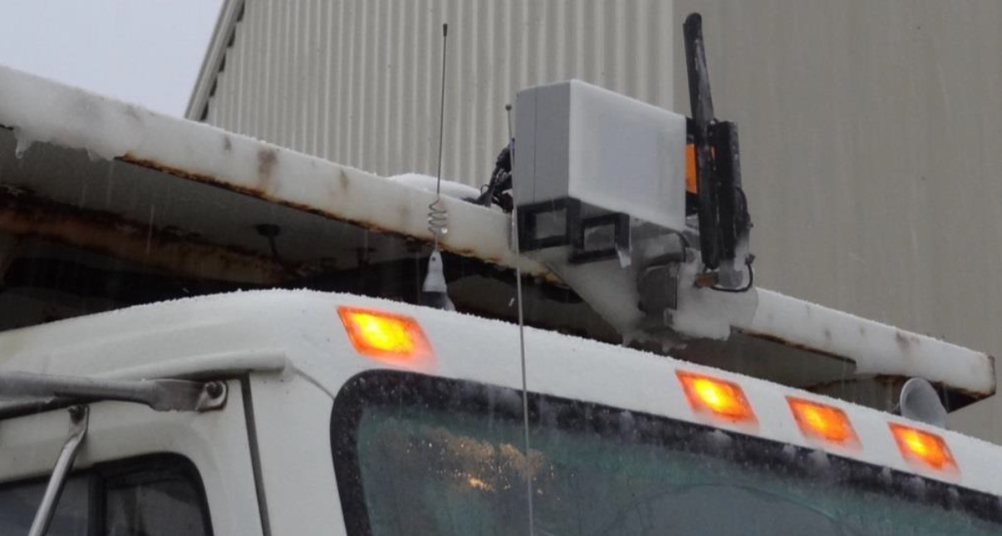
Radar requires heated fascia and blade to prevent icing over

Slide 23
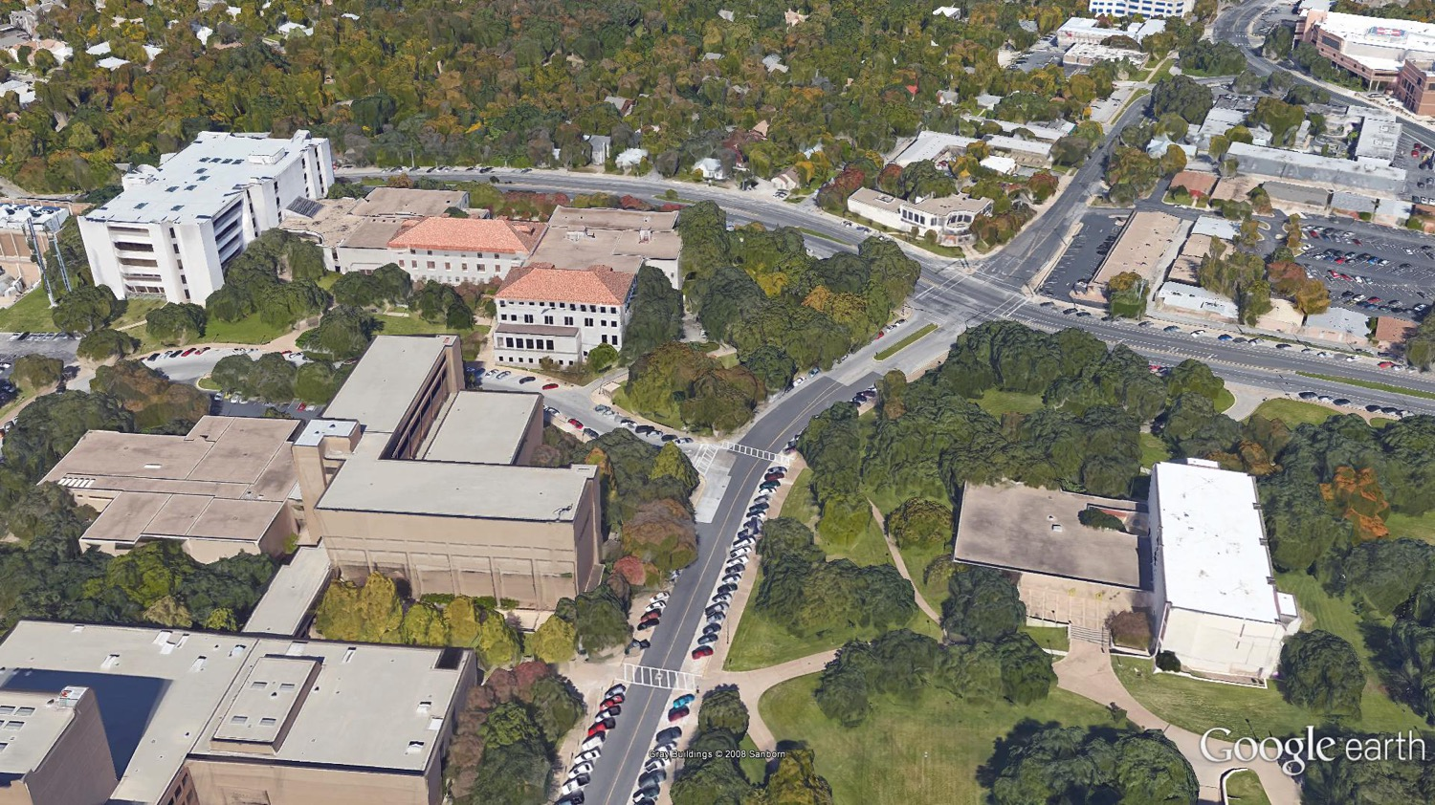
Light urban setting

Slide 24

Urban setting

Slide 25
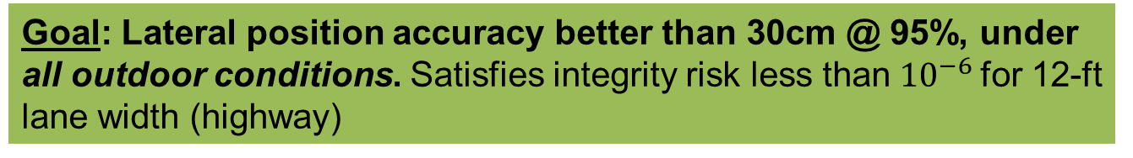
Goal: Lateral position accuracy better than 30cm @ 95%, under all outdoor conditions. Satisfies integrity risk less than${10}^{−6}$for 12-ft lane width (highway)

Slide 26
Q: What about urban areas? What vehicle positioning techniques will suffice?

Slide 27

Current Affiliates:
Toyota, Honda, Qualcomm, AT&T, National Instruments, Fujitsu

Slide 28
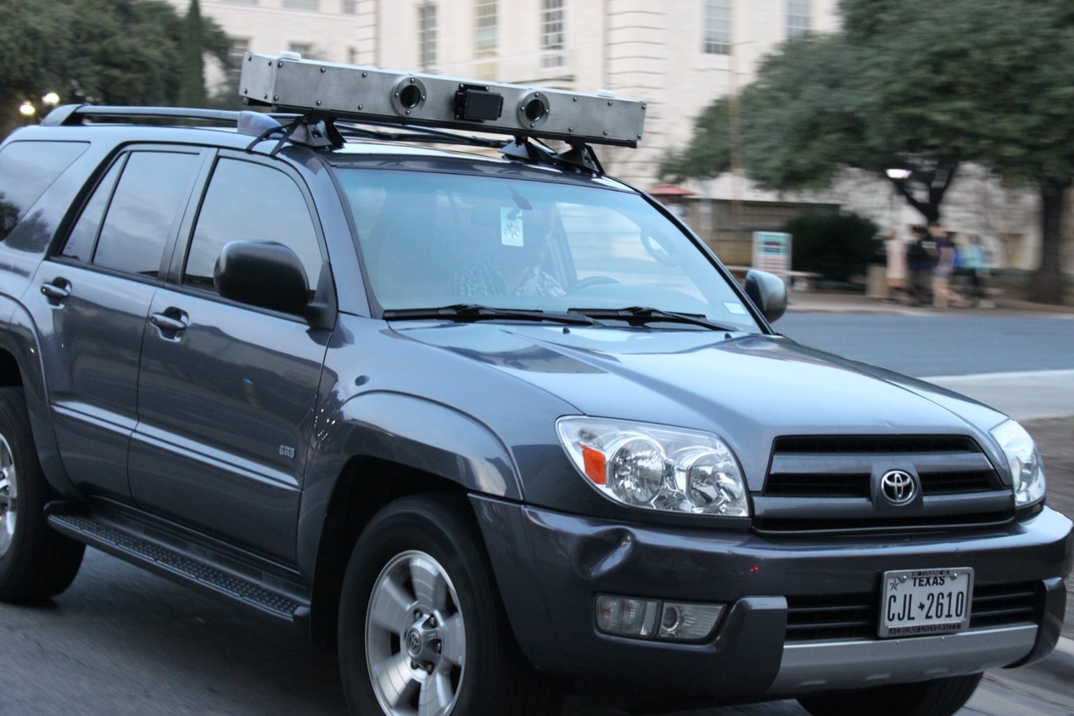
UT Sensorium:
50 MB per second data from cameras + radar + GNSS + inertial sensors

Slide 29
Claim 3:
Counterintuitively, in urban areas, the GNSS precision requirement may be less than for rural areas. With fleet mapping using radar, cameras, lidar, what matters is the degree of correlation between GNSS errors (in space and time).

Slide 30
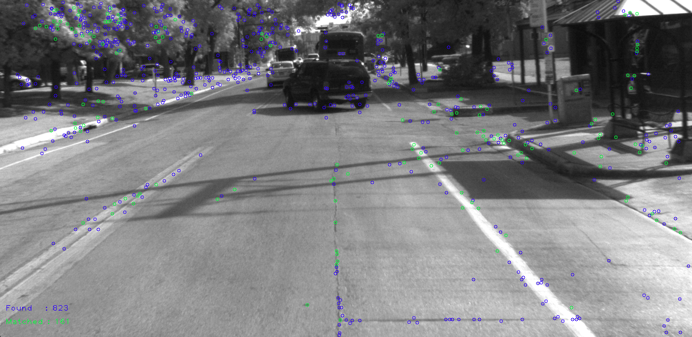
Robust image features offer excellent 3D
constraints when visibility is good

Slide 31
Feature ID: 8898
Descriptor:
0f 40 21 01 00 00 01 01 38 15 02 00 00 04 22 46 01 00 00 01 03 2b 45 24 00 00 00 02 09 3e 16 00 5e 21 0a 02 03 04 07 1a 89 36 06 04 08 18 2d 89 18 0d 0a 36 89 89 3f 2b 00 00 16 37 2b 10 01 00 2e 08 00 00 00 04 14 32 89 89 66 16 05 03 01 14 0f 3b 89 89 67 0c 01 03 00 07 44 4c 13 00 00 00 13 02 01 01 01 01 01 0d 03 15 2d 10 10 08 00 02 04 09 42 2c 04 04 02 01 02 04 0b 0c 02 04 08 02

Slide 32
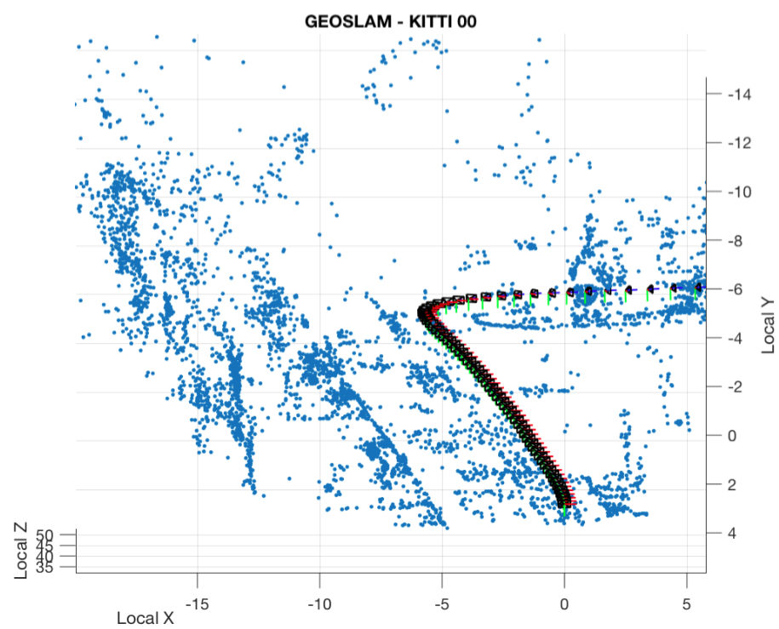
UT GEOSLAM:
Global Electro-Optical SLAM
GNSS provides input to camera pose a priori estimate
Goal: 3D feature points accurate to within 10 cm in ITRF

Slide 33
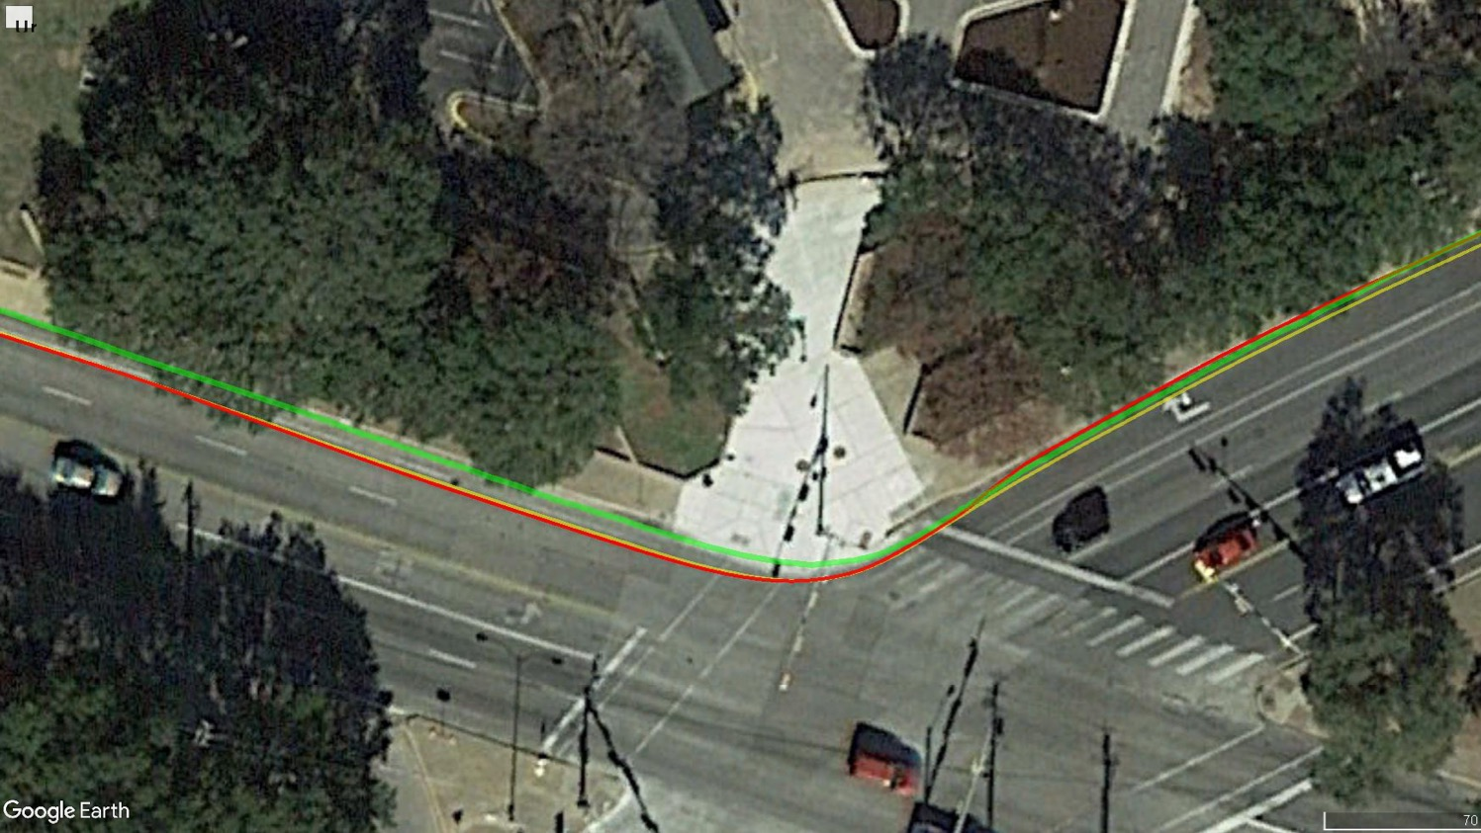
ublox M8T code-based solution
UT pprx code-based solution
UT pprx+ppengine CDGNSS solution
Code-based solutions exhibit 1-2 m errors. But if these are
substantially independent in space or time, then 10-cm-accurate
map can be achieved with fleet mapping

Slide 34
Map of 3D camera image features is means to an end: it can’t be relied on when visibility poor, but when visibility good, it can be used (jointly with GNSS) to obtain highly accurate vehicle pose with which a radar map can be built

Slide 35
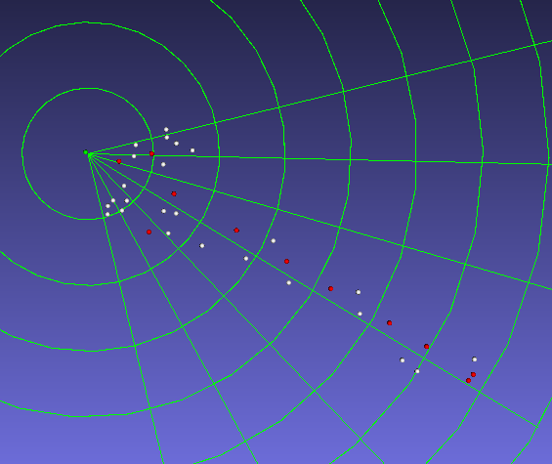
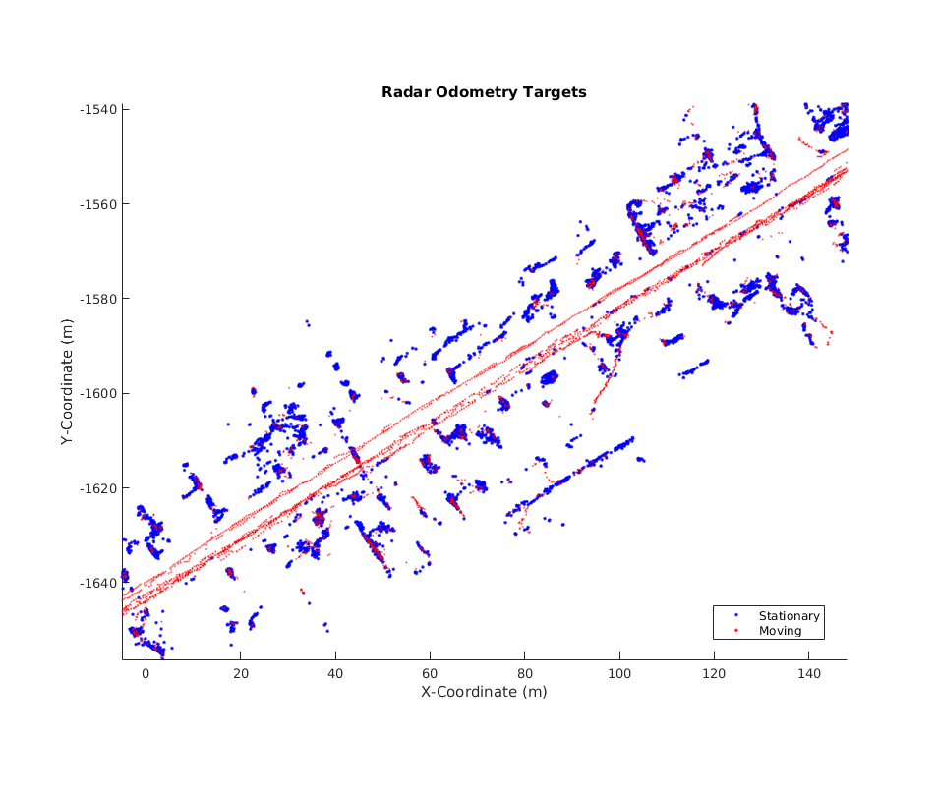
Sensorium radar data: Delphi unit
A radar map is useful in all weather conditions.
Our conjecture: In urban areas rich with radar reflectors, a radar map together with GNSS will be sufficient for 30 cm @ 95% accuracy

Slide 36
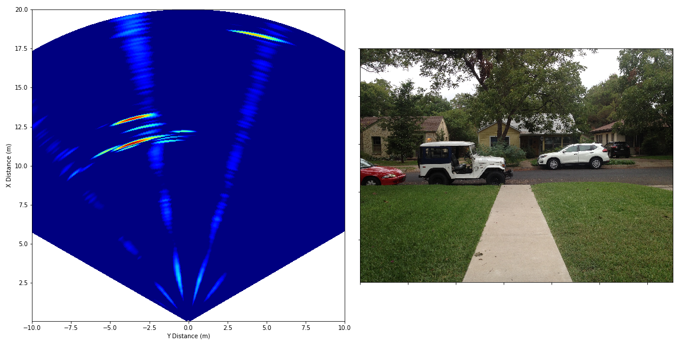
Sensorium radar data: Raw-data unit
New experimental radar allows us to create our own waveforms and access the raw returns (not just processed tracking points) to create more informative radar maps

Slide 37
Q: What about location for pedestrians and cyclists?

Slide 38

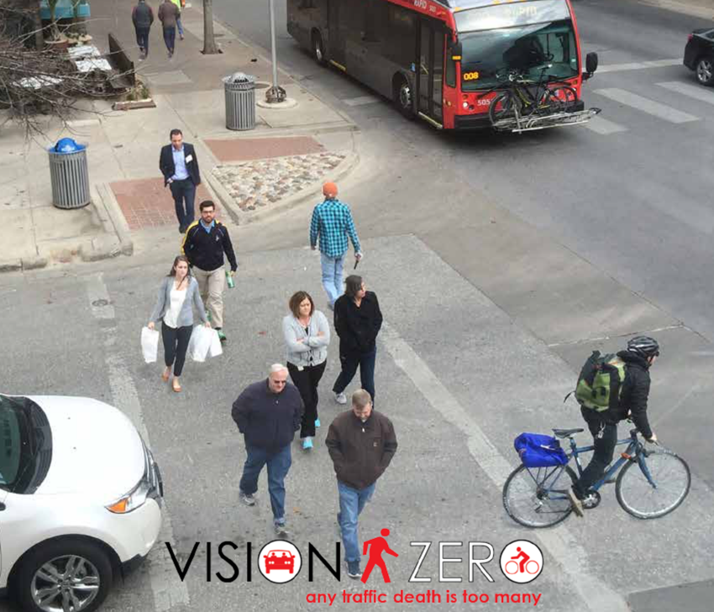



Slide 39


How San Diegans are getting around the streets?
in cars
on bikes
on foot
on foot
in cars
on bikes
How San Diegans are dying on the streets?

Slide 40
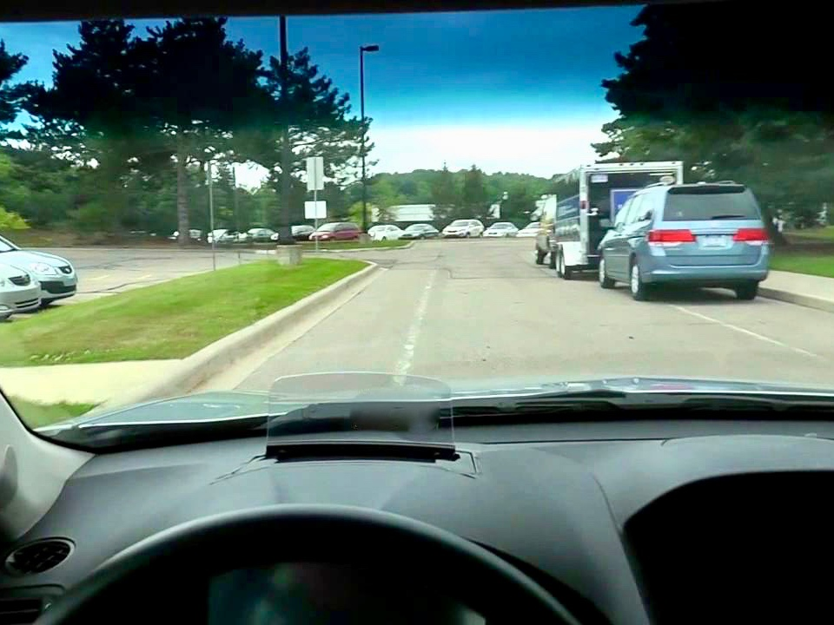
Risk Here!
The Crawling Car Conundrum
Pedestrian and cyclist unpredictability, together with sensor occlusions,
will leave a “vision zero” automated vehicle no option but to crawl.

Slide 41
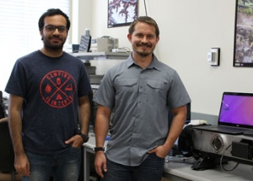
UT graduate students Lakshay Narula and Matthew Murrian
win 2017 Qualcomm Innovation Fellowship for
“Robust and Secure Precise Location for Connected Vehicles and Pedestrians”

Slide 42
Q: What technology could enable pedestrians and cyclists to locate themselves to within 30cm?

Slide 43
Q: How far can we push CDGNSS in urban areas?

Slide 44
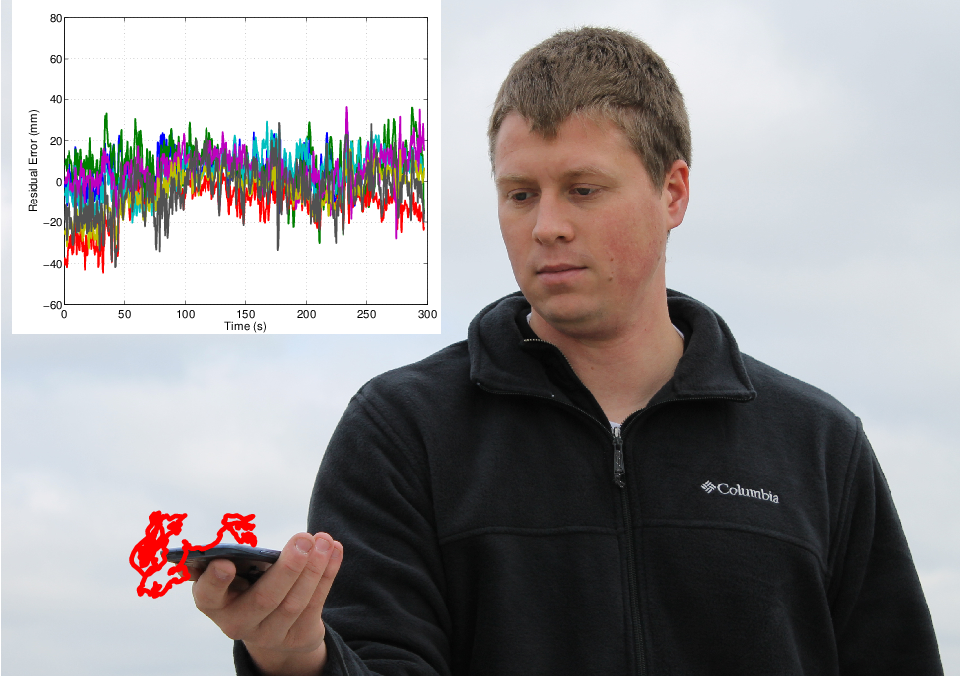
Dec. 2014: First successful RTK solution with a smartphone antenna. But this was a rooftop test. What about down on the streets?

Slide 45
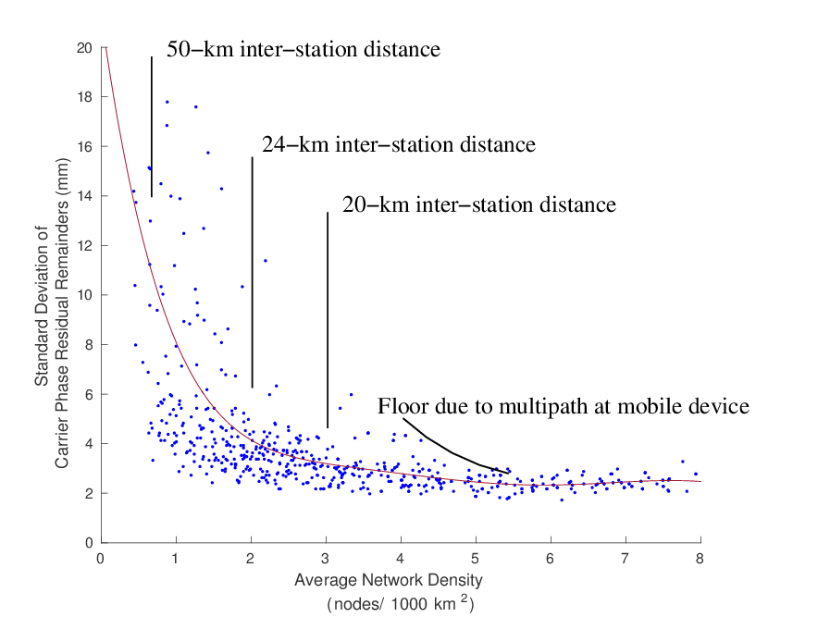


$σ_{ι}=7$mm
Step 1: Completely eliminate ionospheric and tropospheric errors as a factor
$σ_{ι}=2$mm
Corrections uncertainty is a highly nonlinear function of density. Culprit: medium-scale ionospheric irregularities. Floor due to multipath at mobile device reached with < 20km inter-station distance.

Slide 46
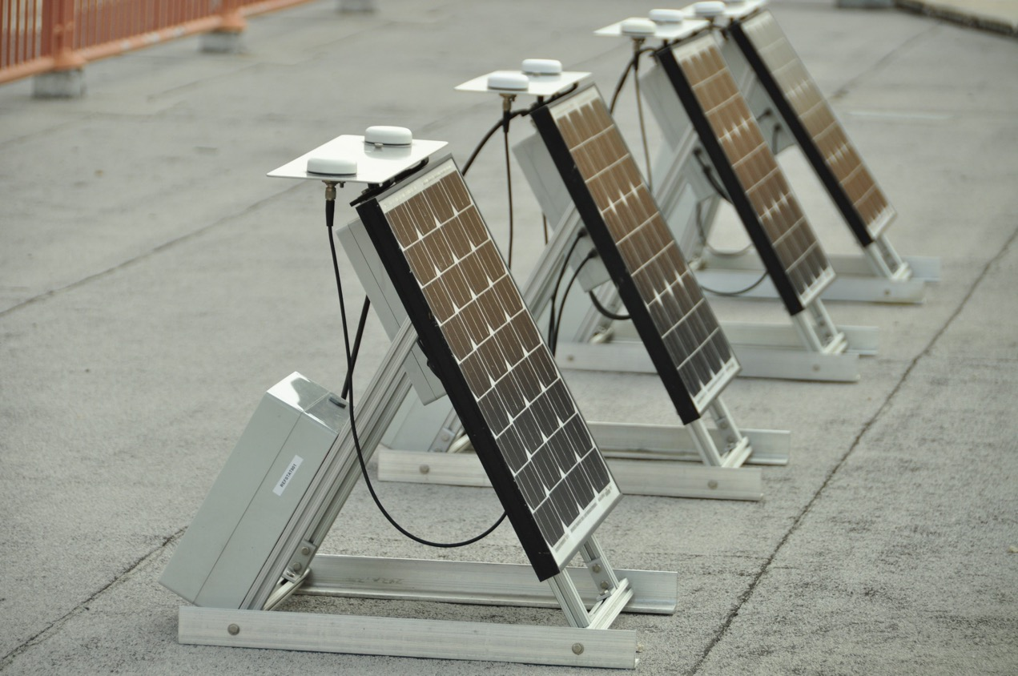
Longhorn Dense Reference Network stations under test prior to deployment

Slide 47
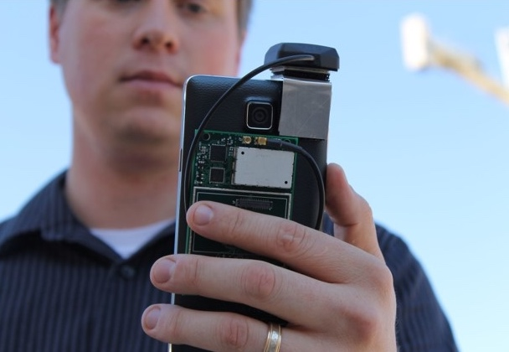
Step 2:
Fusion with camera (GEOSLAM)

Slide 48
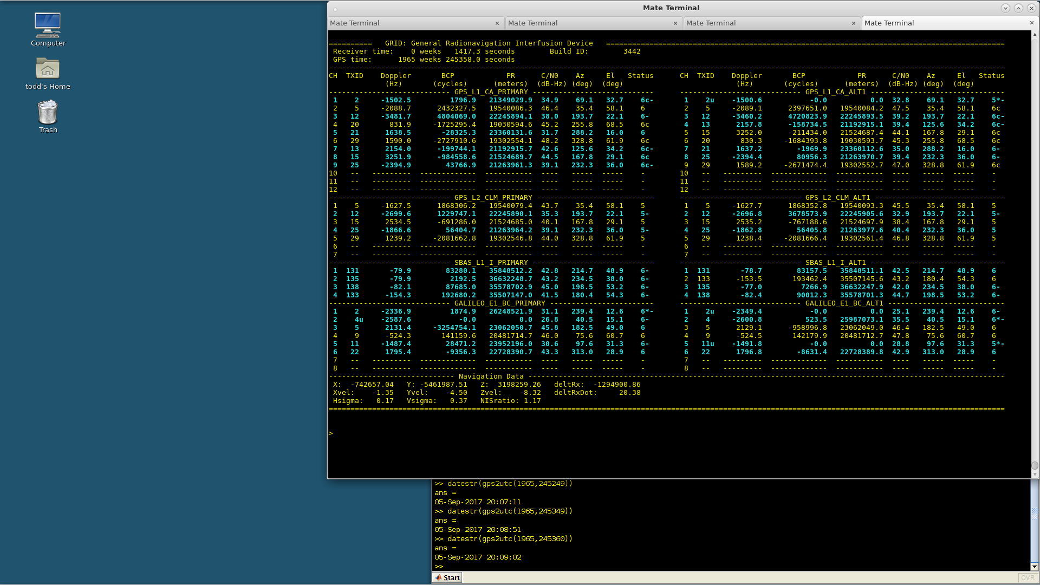
Step 3:
Re-design
RTK engine
for urban
environment

Slide 49


Slide 50
Backup slides

Slide 51
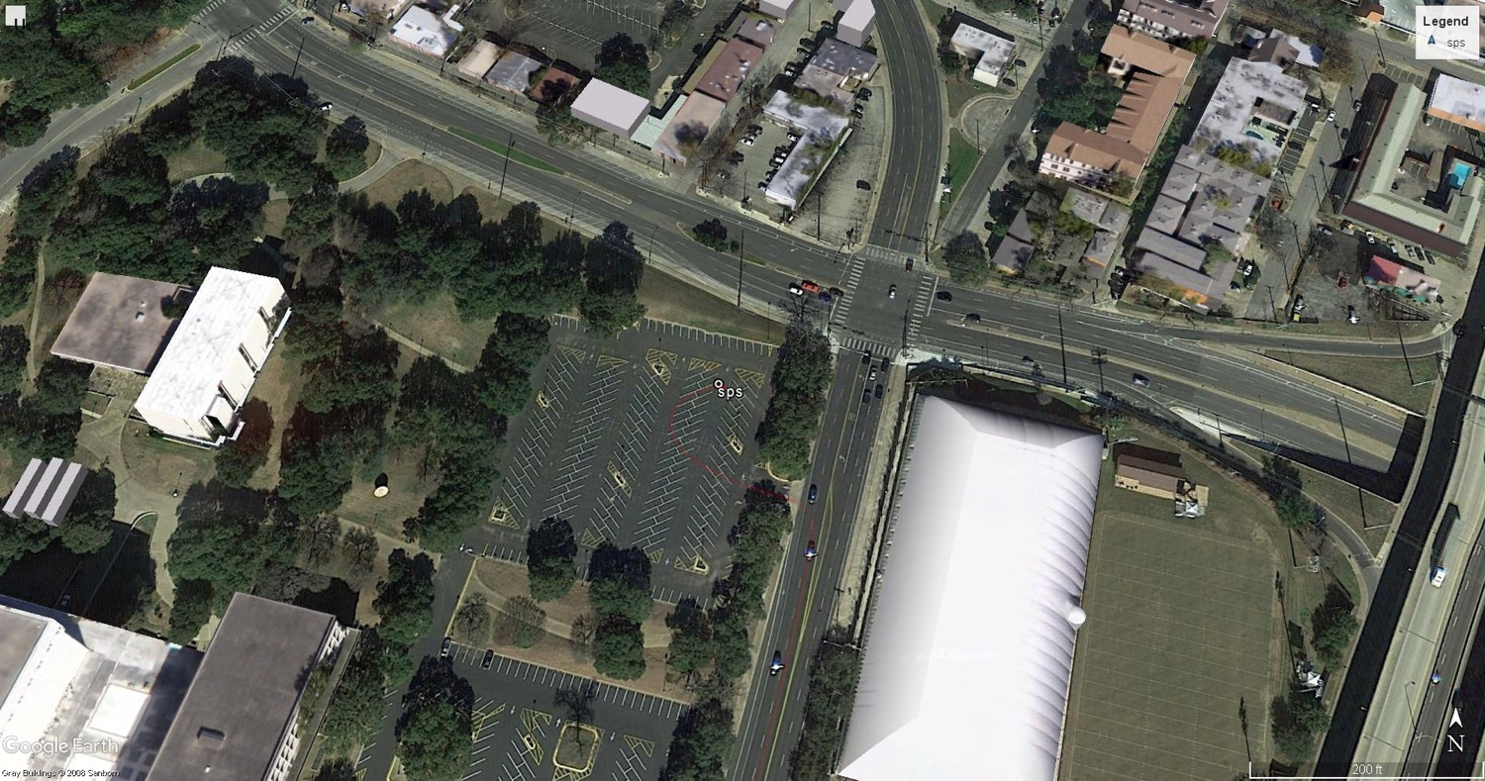

Slide 52
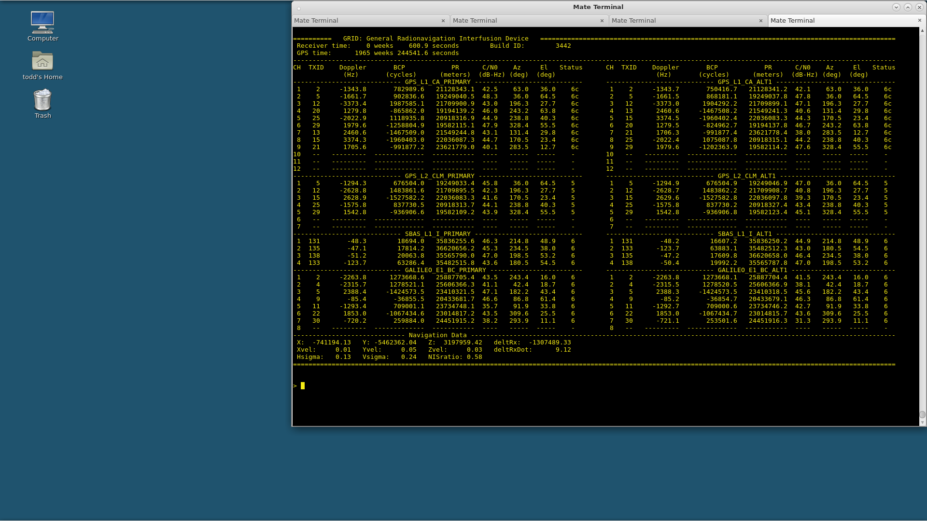

Slide 53
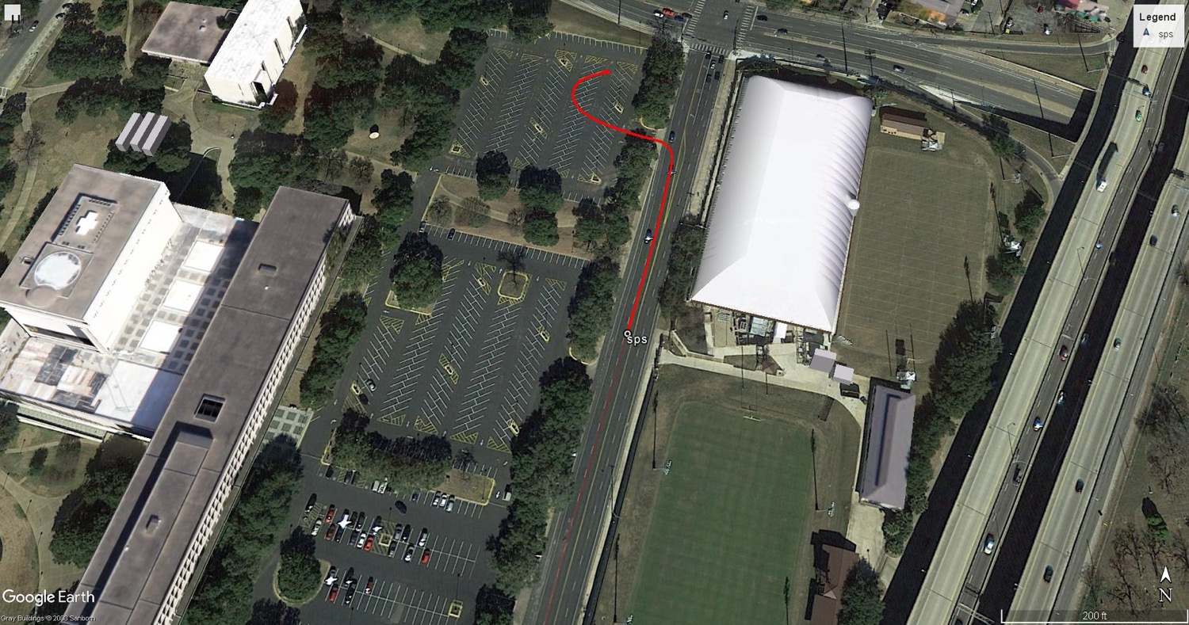

Slide 54
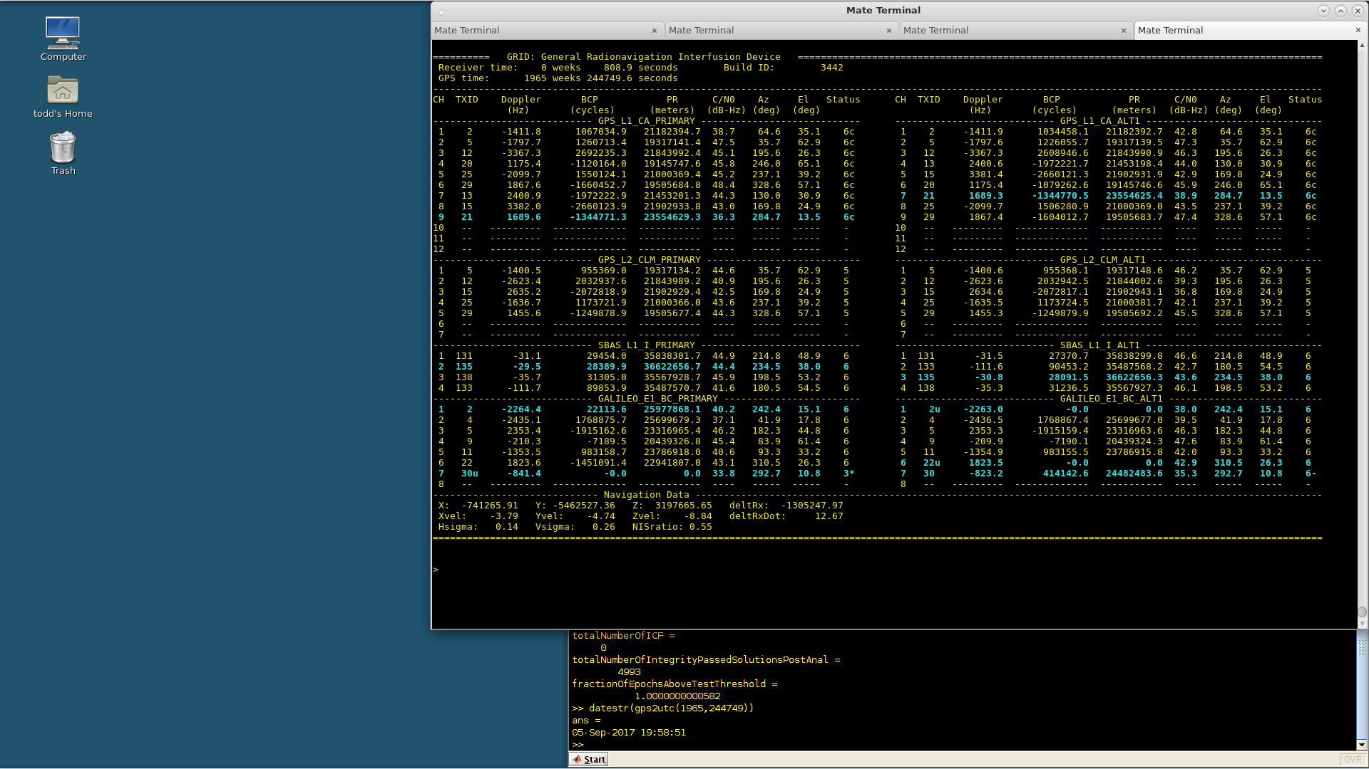

Slide 55
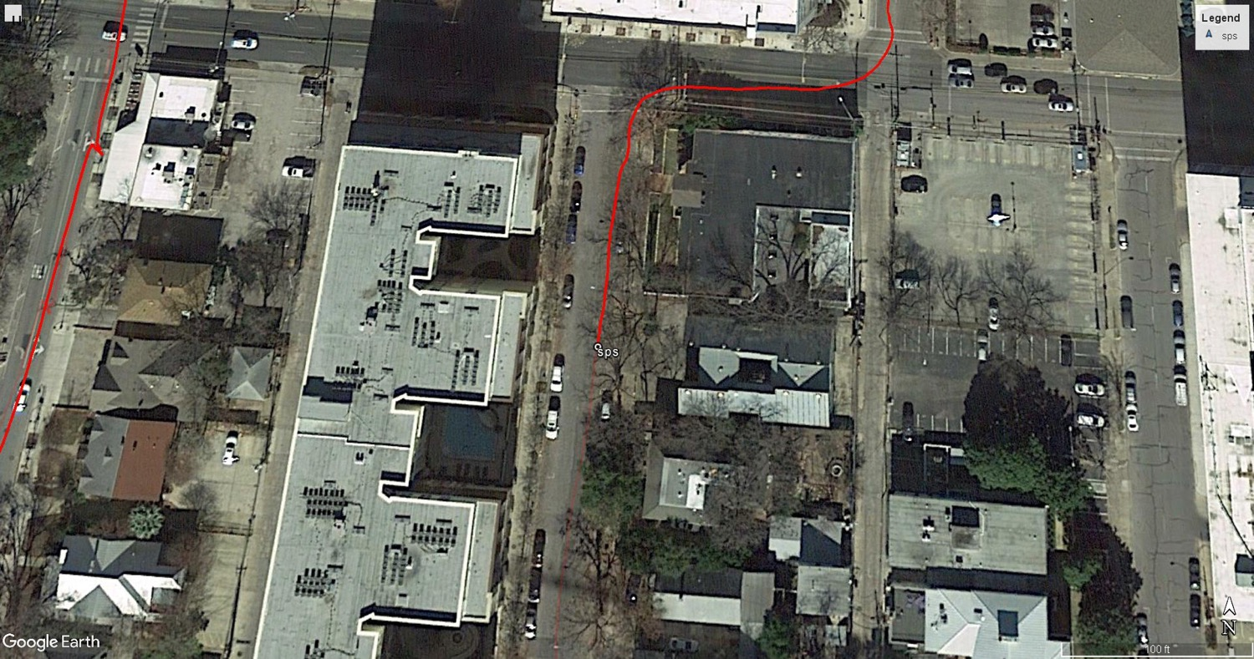

Slide 56
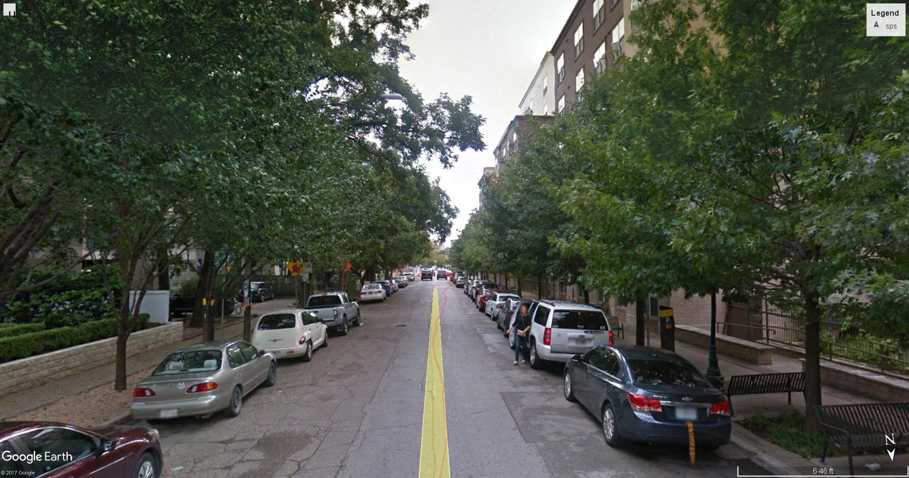

Slide 57
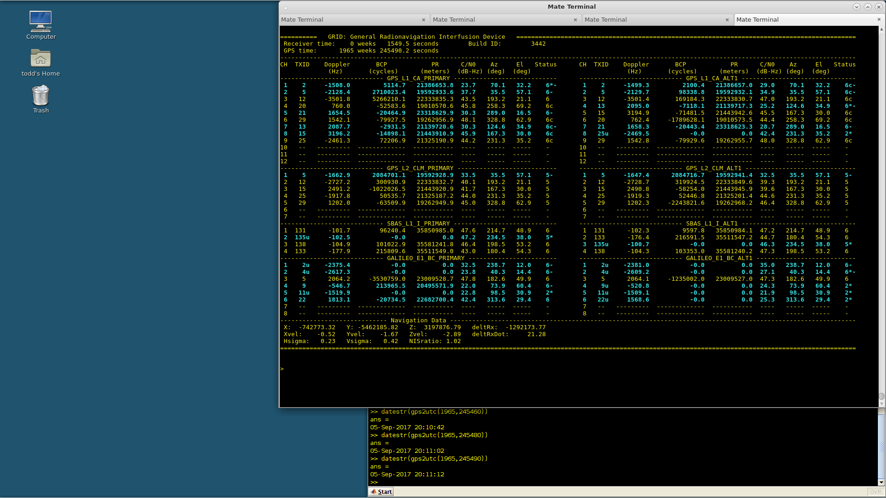

Slide 60
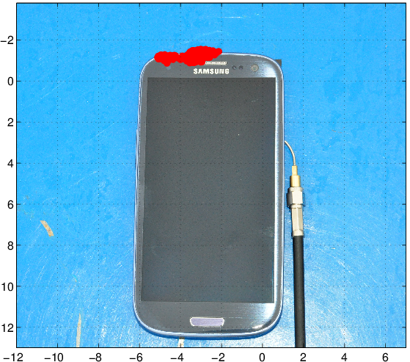
Dec. 2014: First successful RTK positioning solution with a smartphone antenna

Slide 61
Handheld RTK result with some signals passing through Ken’s body

Slide 62
Reliable/Fast
Goal: Single-epoch (instantaneous) integer ambiguity resolution on >99% of epochs in a “light urban” setting; >90% in “urban” setting

Slide 63
Urban setting

Slide 64
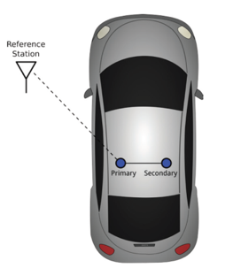
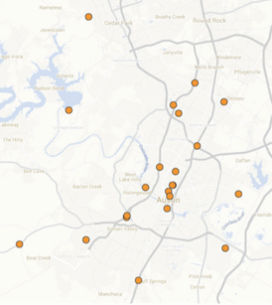
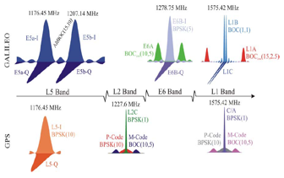
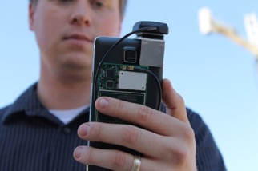
Keys to Reliable/Fast CDGNSS Positioning
Multiple Rover
Antennas
Multiple Frequencies
Dense Reference Network
Coupling With Vision/Radar

Slide 65
Keys to Reliable/Fast CDGNSS Positioning
Multiple Rover
Antennas
Multiple Frequencies
Dense Reference Network
Coupling With Vision/Radar

Slide 66
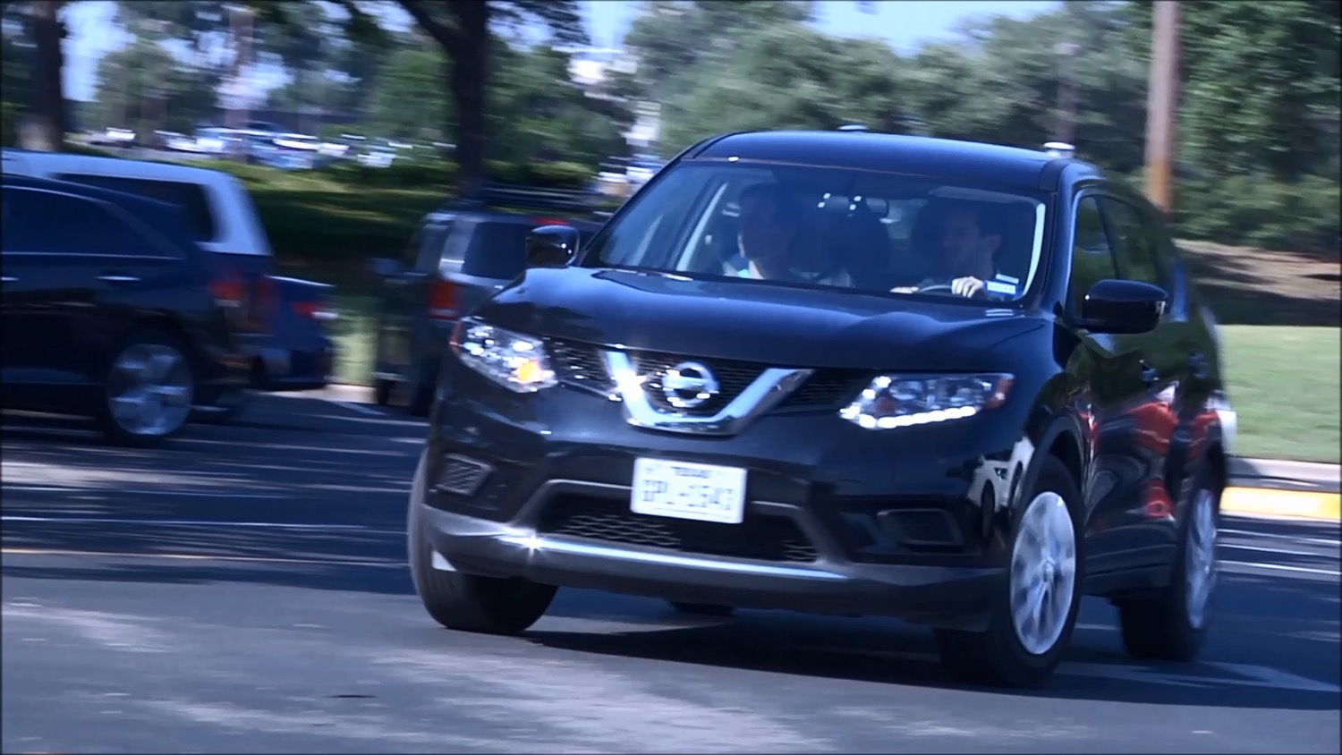

Slide 67
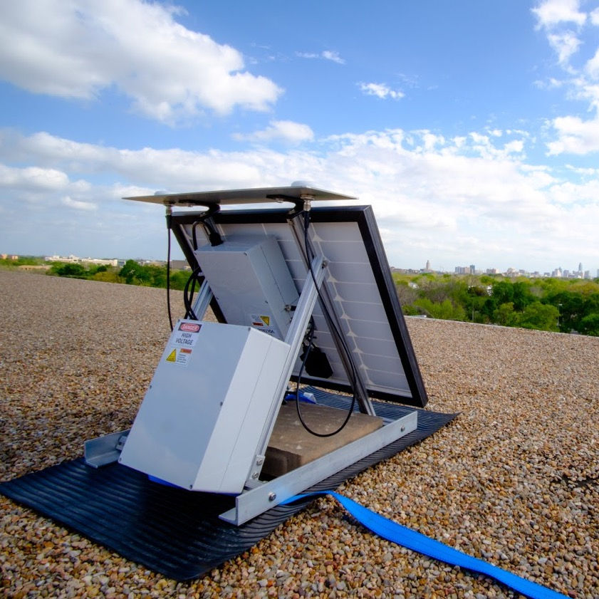

Slide 68
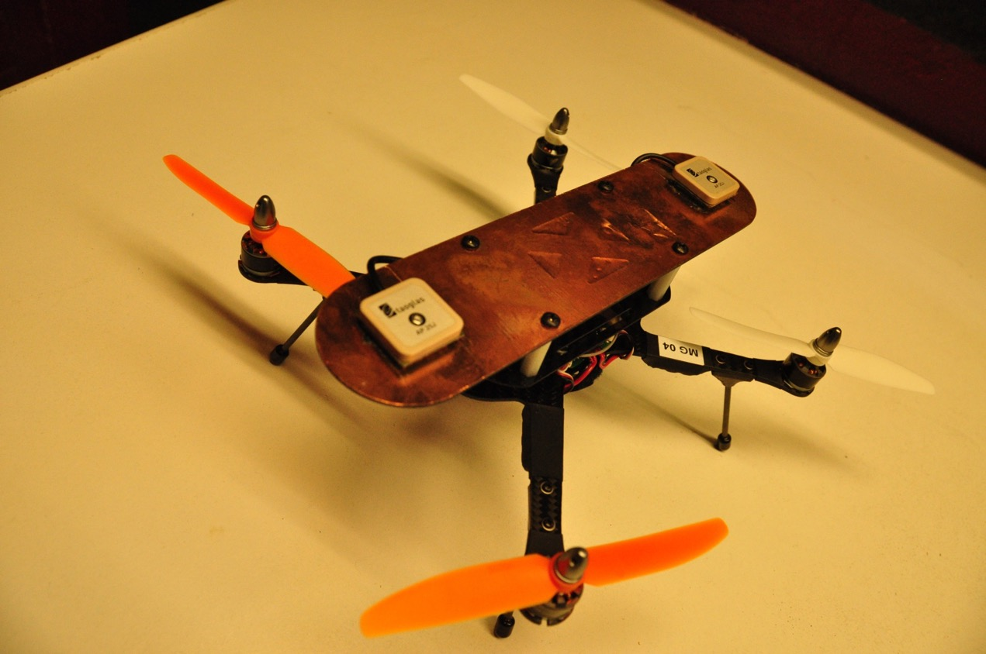

Slide 69
Keys to Reliable/Fast CDGNSS Positioning
Multiple Rover
Antennas
Multiple Frequencies
Dense Reference Network
Coupling With Vision/Radar

Slide 70
Keys to Reliable/Fast CDGNSS Positioning
Multiple Rover
Antennas
Multiple Frequencies
Dense Reference Network
Coupling With Vision/Radar
Dual Frequency Alliance!

Slide 71
Q: Why have a second frequency?
  Reduce ionospheric errors
  Add robustness to the precise solution to better combat multipath and signal blockage

Slide 72
Q: Why have a second frequency?
  Reduce ionospheric errors
  Add robustness to the precise solution to better combat multipath and signal blockage
In urban environments, we need all the help we can get to overcome multipath and signal blockage. We shouldn’t waste the second-frequency observables trying to estimate ionospheric delay.

Slide 73
Keys to Reliable/Fast CDGNSS Positioning
Multiple Rover
Antennas
Multiple Frequencies
Dense Reference Network
Coupling With Vision/Radar

Slide 74
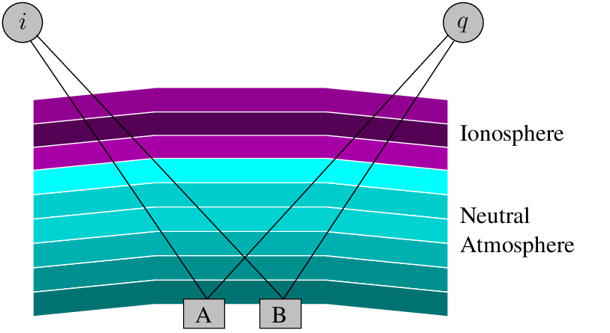

Slide 75
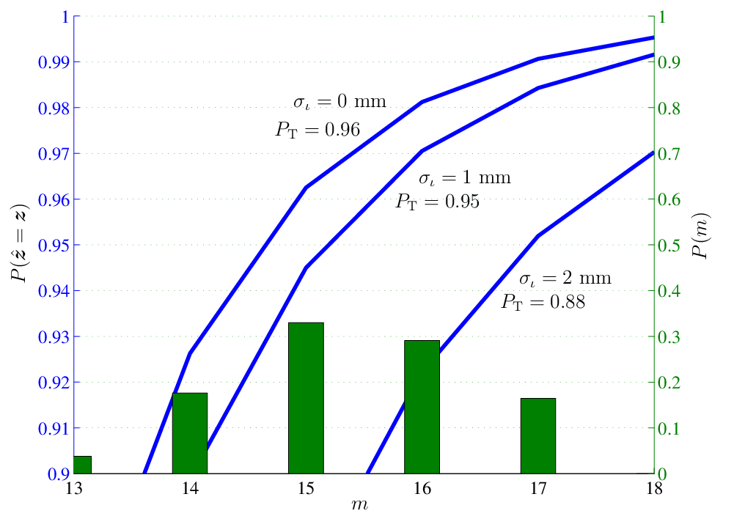
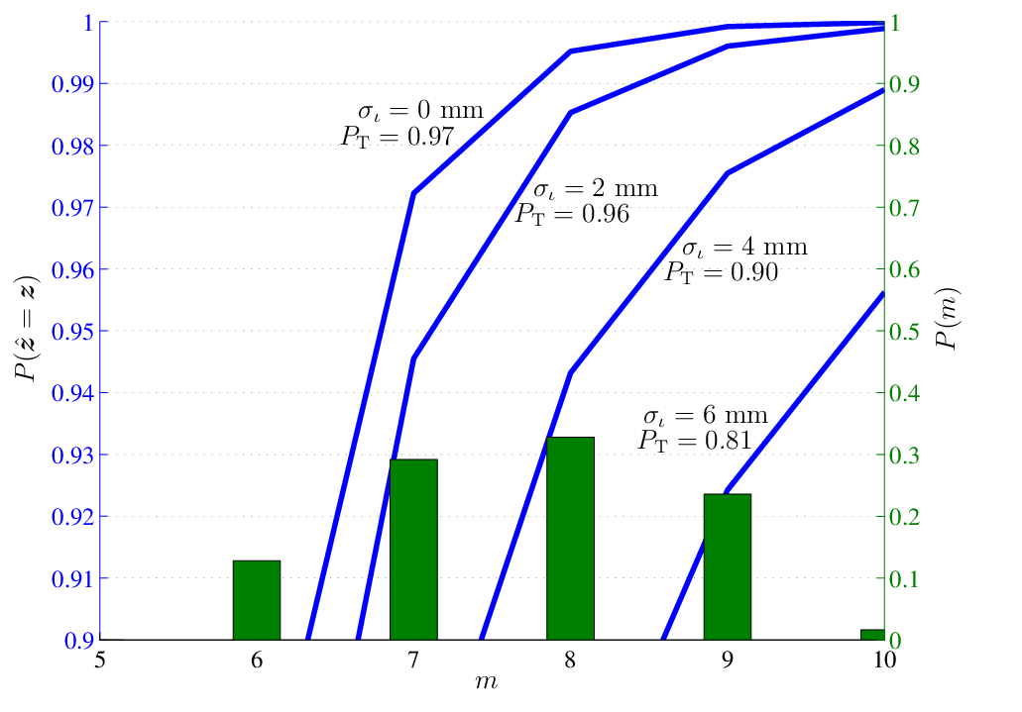
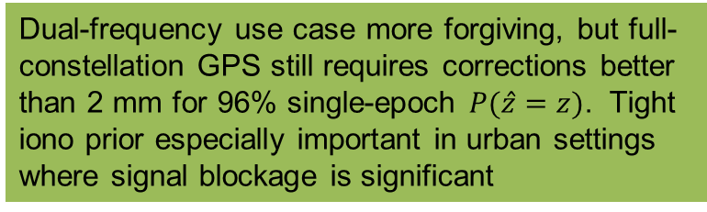
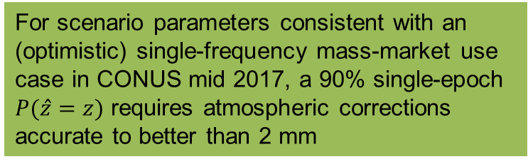
For scenario parameters consistent with an (optimistic) single-frequency mass-market use case in CONUS mid 2017, a 90% single-epoch $P(\hat{z}=z)$ requires atmospheric corrections accurate to better than 2 mm
Dual-frequency use case more forgiving, but full-constellation GPS still requires corrections better than 2 mm for 96% single-epoch $P(\hat{z}=z)$. Tight iono prior especially important in urban settings where signal blockage is significant
Don’t waste observables estimating iono delay

Slide 76
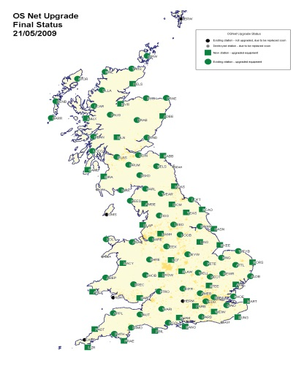
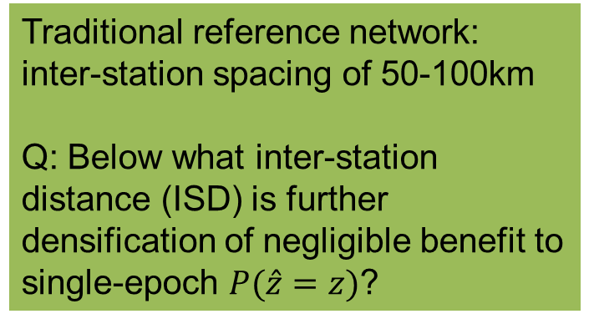
Traditional reference network: inter-station spacing of 50-100km
Q: Below what inter-station distance (ISD) is further densification of negligible benefit to single-epoch $P(\hat{z}=z)$?

Slide 77
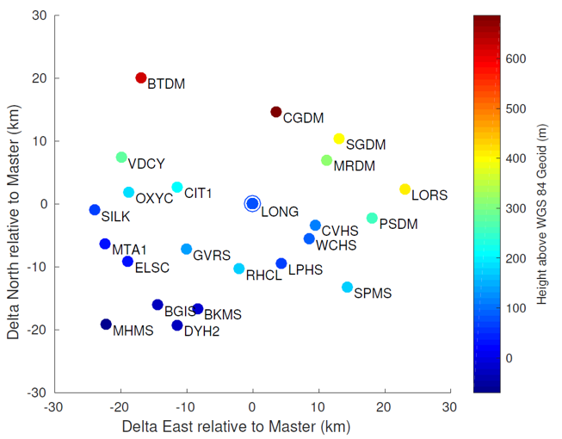


$σ_{ι}=7$mm
$σ_{ι}=2$mm
Empirical data drawn from 23 stations in existing high-density public reference network in California
Corrections uncertainty is a highly nonlinear function of density. Culprit: medium-scale ionospheric irregularities. Floor due to multipath at mobile device reached only with < 20km inter-station distance.

Slide 78


Longhorn Reference Network: dense GNSS reference network in Austin, Texas, with site hosting courtesy of TxDOT

Slide 79

Longhorn Reference Network: dense GNSS reference network in Austin, Texas, with site hosting courtesy of TxDOT

Slide 80

Longhorn Reference Network: dense GNSS reference network in Austin, Texas, with site hosting courtesy of TxDOT

Slide 81
Keys to Reliable/Fast CDGNSS Positioning
Multiple Rover
Antennas
Multiple Frequencies
Dense Reference Network
Coupling With Vision/Radar

Slide 82
whiteout
conditions
signal blockage
in urban canyon
heavy rain
dense fog/dust
Vision
GNSS
featureless or periodic
landscapes
multipath in
urban environment
sun blinding
GNSS signal
jamming
laser jamming
Vision/LIDAR sensors and precise GNSS have different failure modes

Slide 83


Slide 84


Slide 85


Slide 86


Slide 87


Slide 88




Joint Maximum Likelihood solution
Jointly fuse GNSS carrier phase and vision measurement in the same non-linear estimator:
CDGNSS Integer Ambiguities
Point Feature Positions
Vision Measurements
2
2
Phase Measurements
Camera Positions
Camera Orientations
Our technique preserves both the sparsity of bundle adjustment and the integerness of the carrier phase ambiguities

Slide 89
UT Sensorium:
50 MB per second data from cameras + radar + GNSS + inertial sensors

