Slide 1
Secure Navigation and Timing
Todd Humphreys | Aerospace Engineering
The University of Texas at Austin
LAAFB GPS Directorate | December 5, 2012

Slide 2
Acknowledgements
University of Texas Radionavigation Lab graduate students Jahshan Bhatti, Kyle Wesson, Ken Pesyna, Zak Kassas, and Daniel Shepard
Mark Psiaki, Brady O’Hanlon, Ryan Mitch (Cornell)

Slide 3

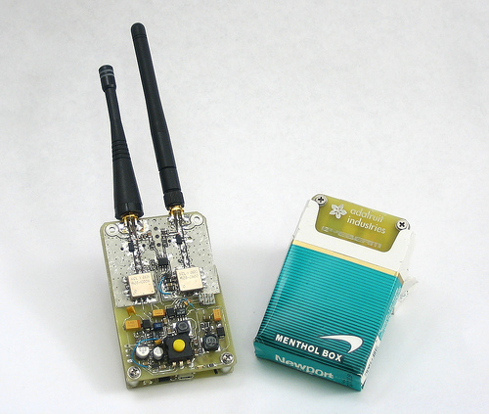
GPS Jammers

Slide 4
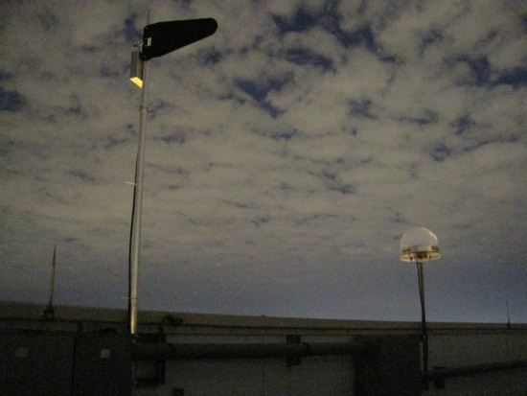
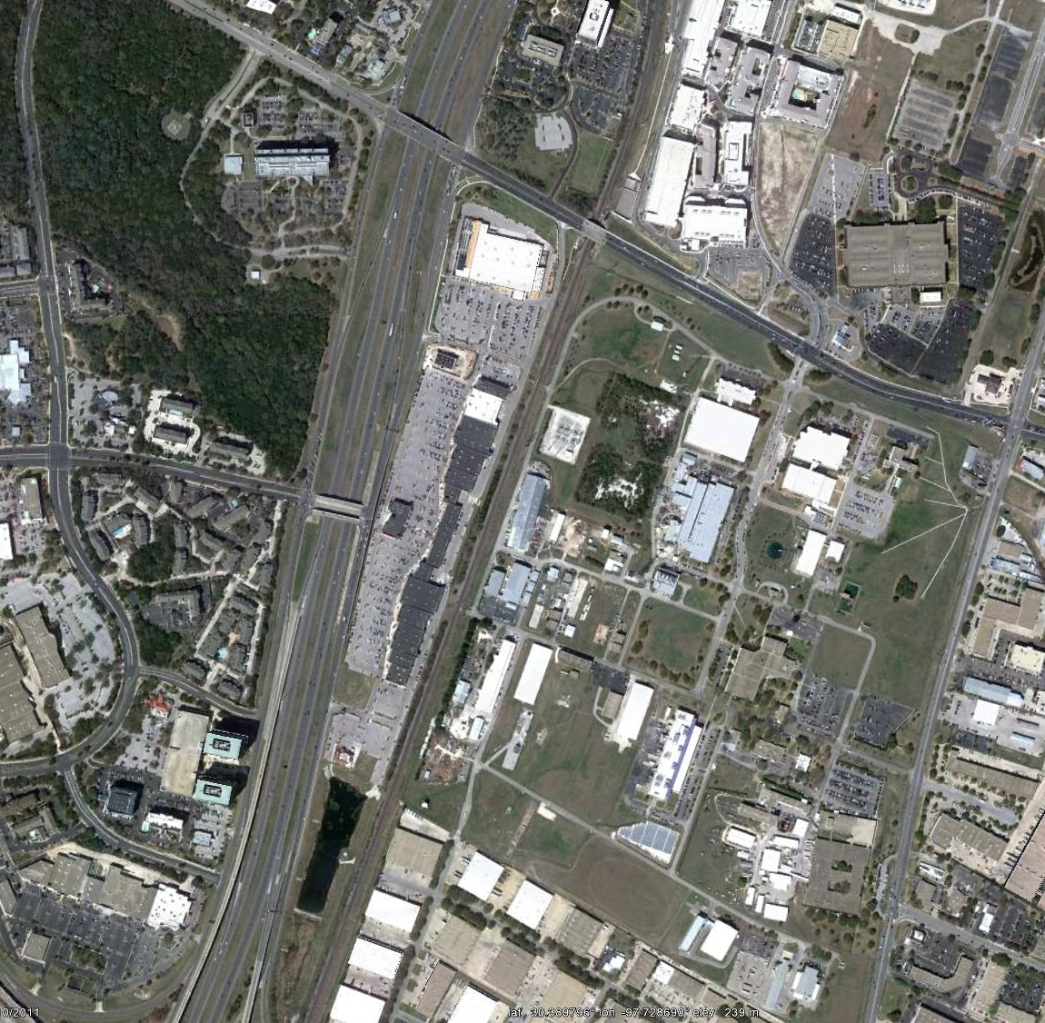
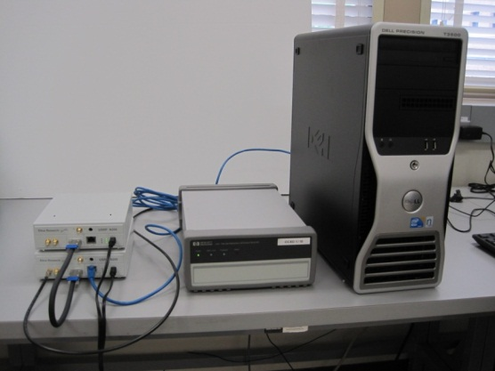
University of Texas Emitter-Localization Network
(Coherent Navigation and University of Texas)
CSR
MBL
Fixed
EMLOC
Sensor
ARL
Mobile
EMLOC
Sensor

Slide 5
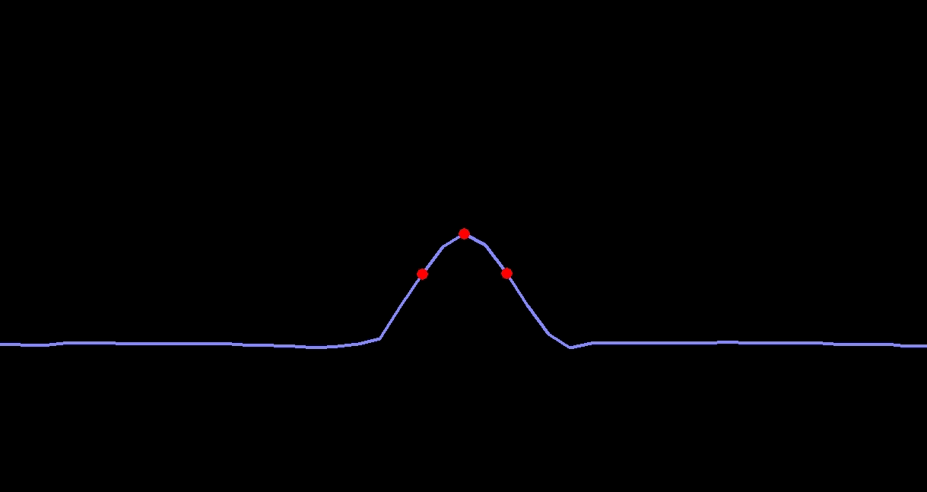
GPS Spoofer

Slide 6
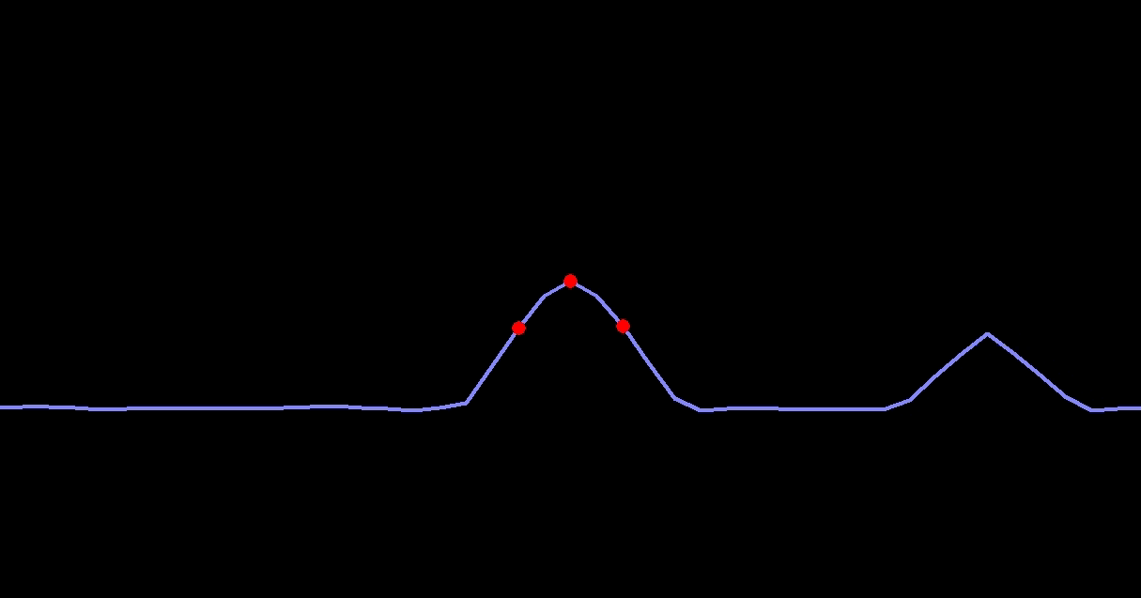
GPS Spoofer

Slide 7
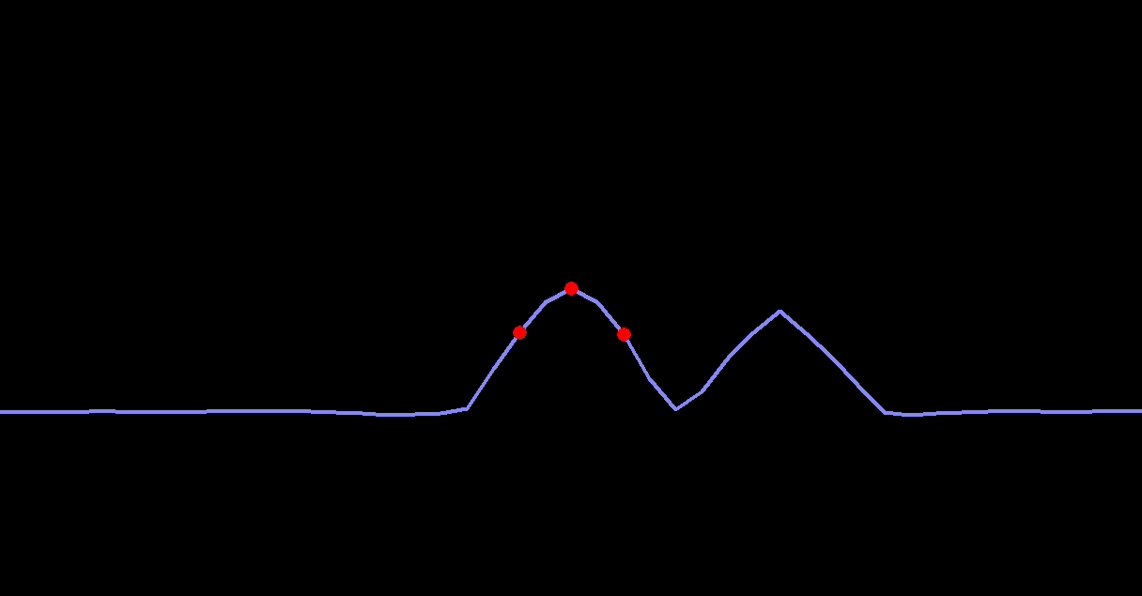
GPS Spoofer

Slide 8
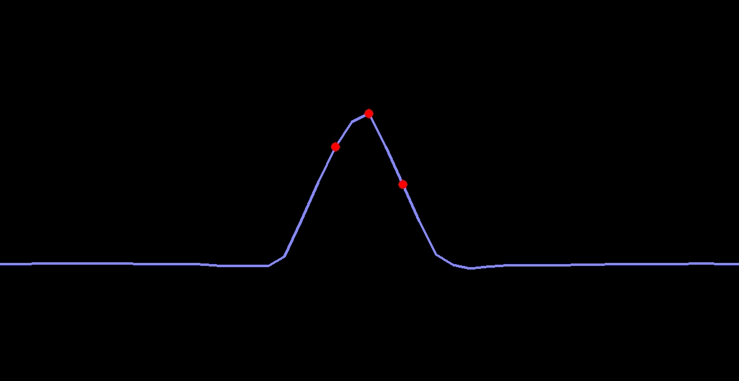
GPS Spoofer

Slide 9
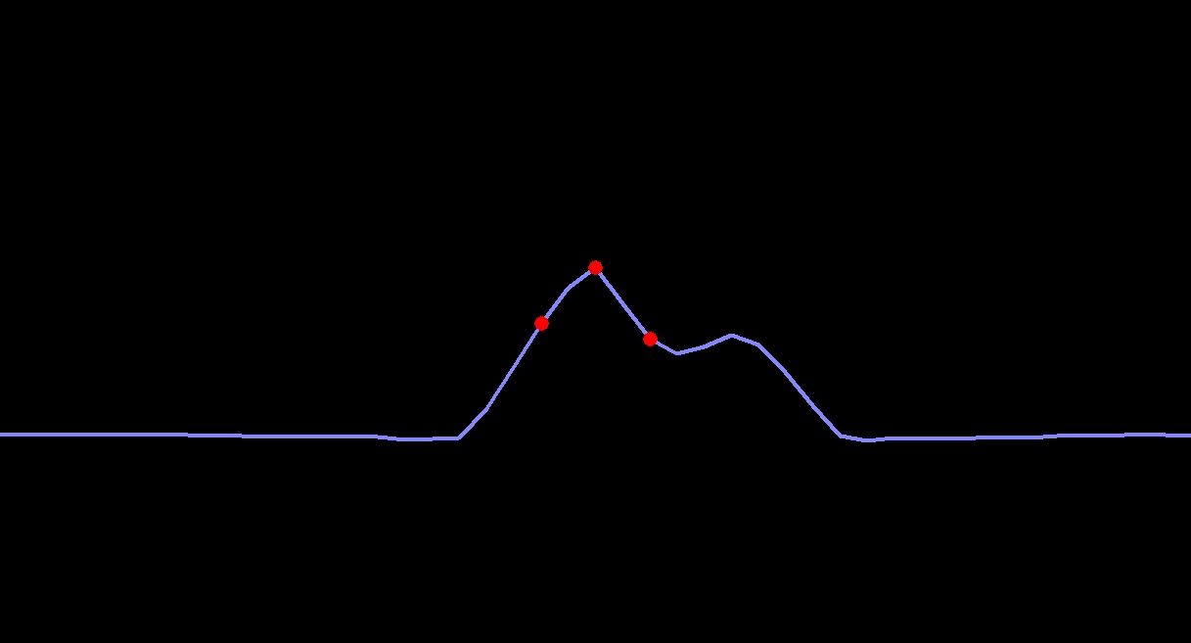
GPS Spoofer

Slide 10
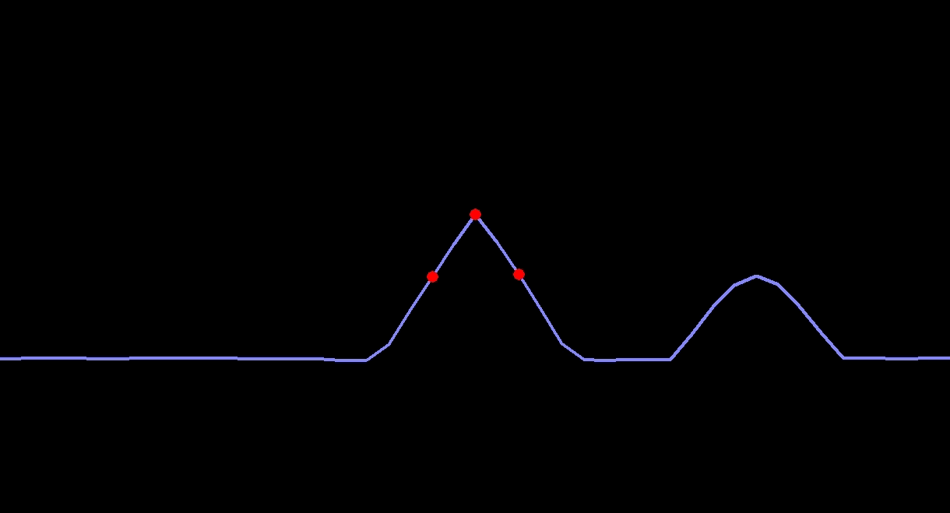
GPS Spoofer

Slide 11
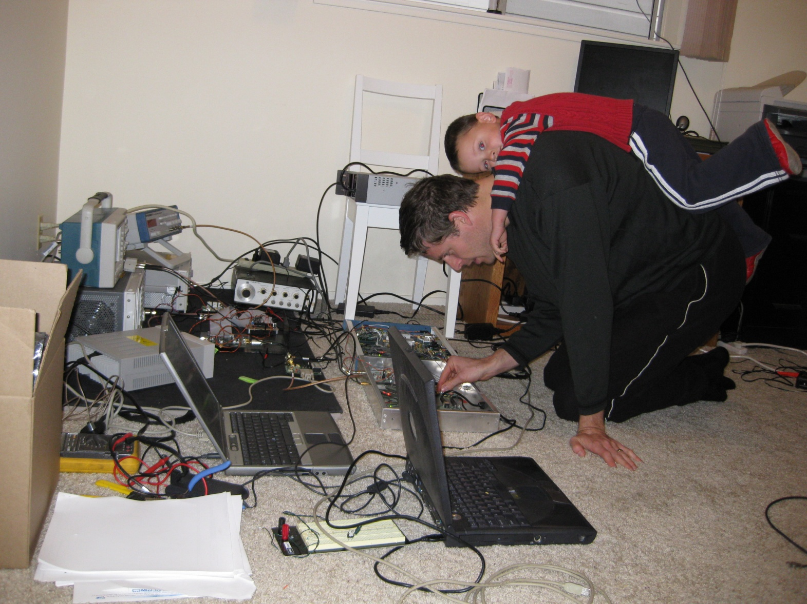

Slide 12
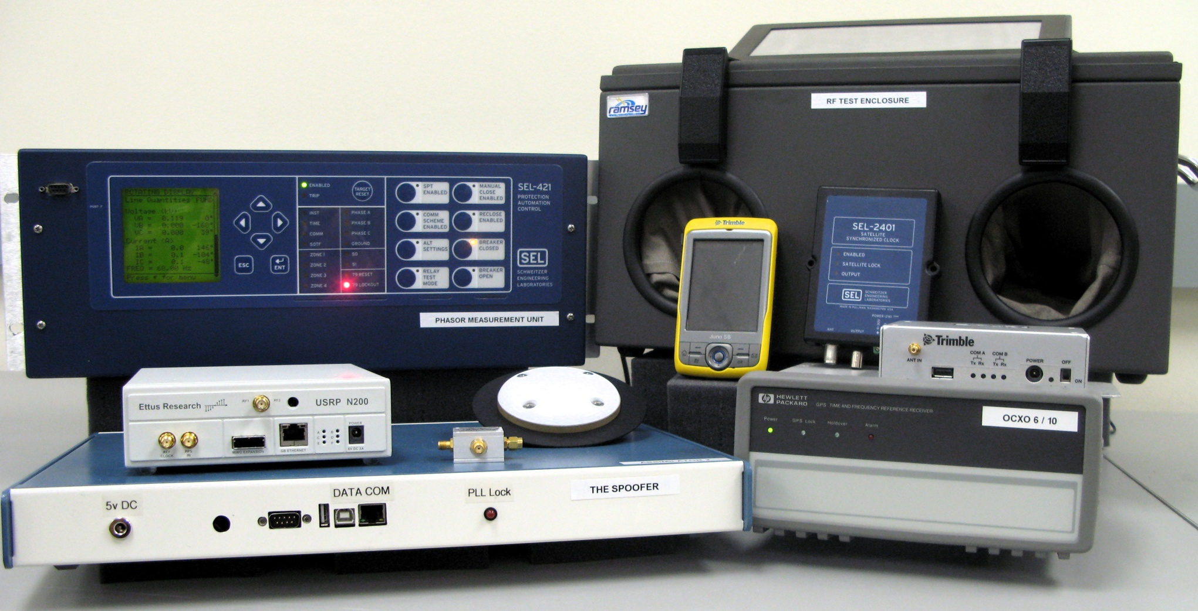
University of Texas Spoofing Testbed

Slide 13
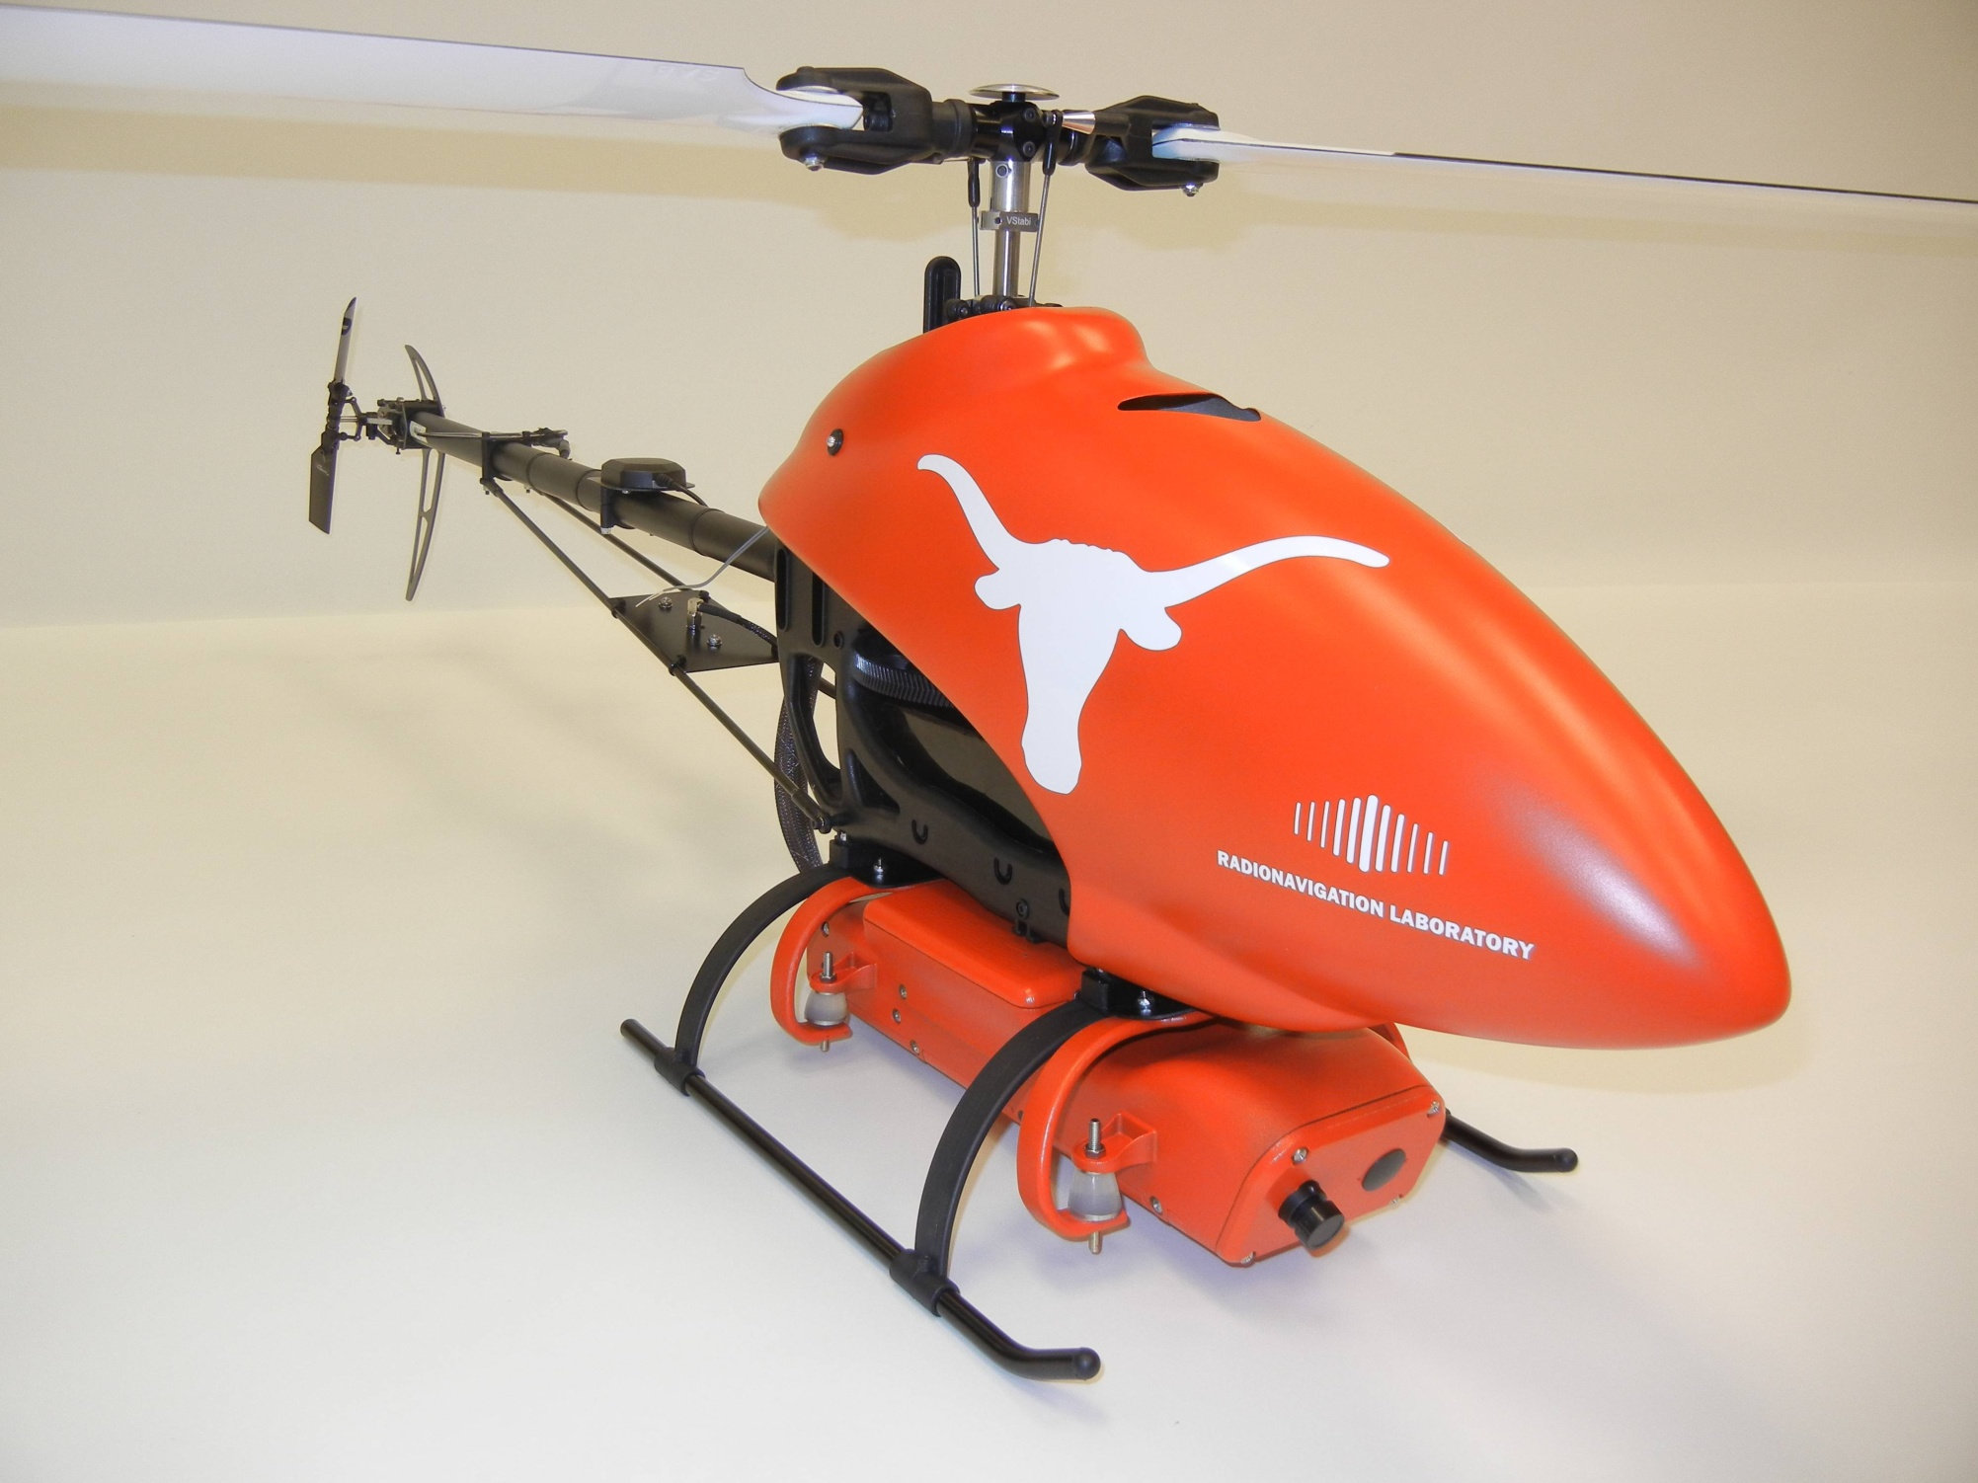

Slide 14
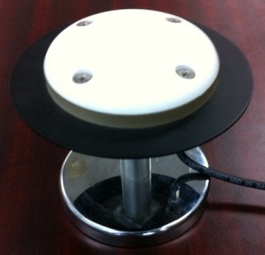
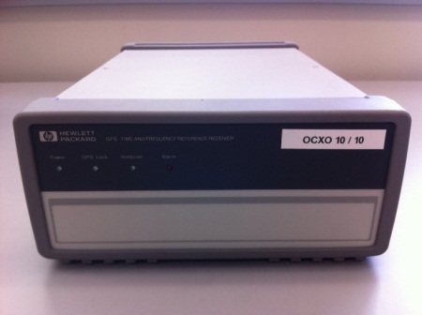
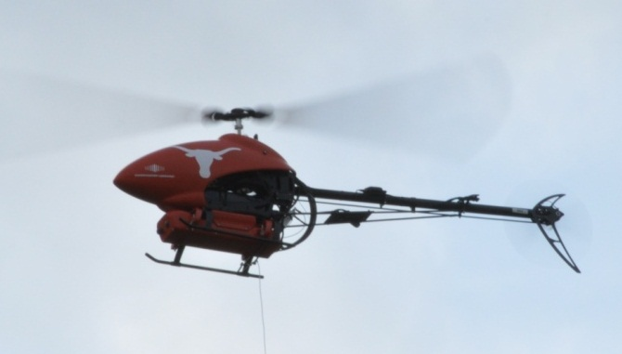
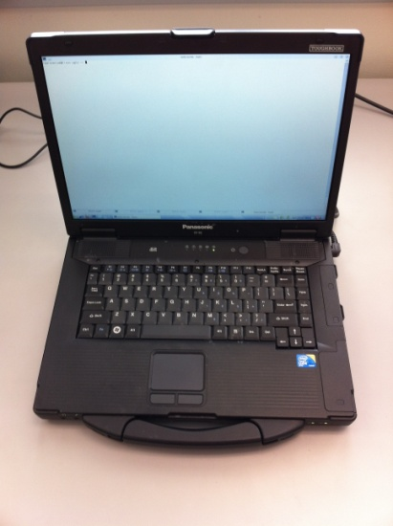
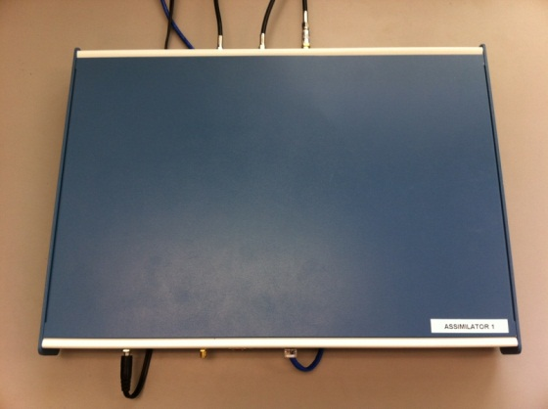
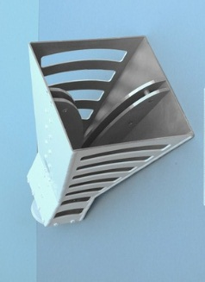
Commandeering a UAV via GPS Spoofing
Receive Antenna
External Reference Clock
Target UAV
Spoofed Signals as a
“Virtual Tractor Beam”
Control Computer
Internet or LAN
GPS Spoofer
Transmit Antenna
UAV coordinates from tracking system

Slide 15
UAV Video

Slide 16
Observations (1/2)
RAIM was helpful for spoofing: we couldn’t spoof all signals seen by UAV due to our reference antenna placement, but the Hornet Mini’s uBlox receiver rejected observables from authentic signals, presumably via RAIM.
Overwhelming power is required for clean capture: A matched-power takeover leads to large (50-100 m) multipath-type errors as the authentic and counterfeit signals interact.
The UAV’s heavy reliance on altimeter for vertical position was easily overcome by a large vertical GPS velocity.

Slide 17
Observations (2/2)
GPS capture breaks flight controller’s feedback loop; now spoofer must play the role formerly assumed by GPS. Implication: Fine control of UAV requires accurate radar or LIDAR UAV tracking system.
Seamless capture (no code or carrier phase unlock) requires target position knowledge to within ~50 m and velocity knowledge better than ~2 m/s. This is quite challenging for small UAV targets at long stand-off ranges (e.g., several km).
Compensating for all system and geometric delays to achieve meter-level alignment is challenging but quite possible.

Slide 18
Recommendations
From testimony to House Committee on Homeland Security, July 19, 2012
Require navigation systems for UAVs above 18 lbs to be certified “spoof-resistant”
Require navigation and timing systems in critical infrastructure to be certified “spoof-resistant”
“Spoof resistant” defined by ability to withstand or detect civil GPS spoofing in a battery of tests performed in a spoofing testbed (e.g., TEXBAT)

Slide 19
Spoofing Defenses
Cryptographic
Non-Cryptographic
SSSC on L1C
(Scott)
J/N Sensing
(Ward, Scott, Calgary)
Stand-Alone
NMA on L2C, L5, or L1C
(MITRE, Scott, UT)
Sensor Diversity Defense
(DARPA, BAE, UT)
SSSC or NMA on WAAS
(Scott, UT)
Single-Antenna Spatial Correlation
(Cornell, Calgary)
Correlation Anomaly Defense
(TENCAP, Ledvina, Torino, UT)
P(Y) Cross-Correlation
(Stanford, Cornell)
Networked
Multi-Element Antenna Defense
(Keys, Montgomery, DLR, Stanford)

Slide 20
Observations on Defenses (1/3)
Navigation signal authentication is hard. Nothing is foolproof. There are no guarantees. But simple measures can vastly decrease the probability of a successful attack. Probability is the language of anti-spoofing.
Symmetric-key systems (e.g., SAASM) offer short time to authenticate but require key management and tamper-proof hardware: more costly, less convenient. SAASM and M-code will never be a solution for a wide swath of applications (e.g., civil aviation, low-cost location and time authentication).

Slide 21
Observations on Defenses (2/3)
Asymmetric-key (public-private key) systems have an unavoidable delay (e.g., 40 seconds between authentication of any signal) but delay can be accepted in many applications; also, for non-complicit spoofing there is no need to tamper-proof the receiver: cheaper, more convenient.
Proof of location (proving to you where I am) is emerging as a vital security feature. It’s not easy: non-crypto approaches require elaborate tamper proofing; crypto approaches require high-rate security code. Beware black-market vendors with high-gain antennas who will sell an authenticated location.

Slide 22
Observations on Defenses (3/3)
Crypto defenses not a panacea: Ineffective against near-zero-delay replay (entire band record and playback) attacks.
Non-crypto defenses not so elegant mathematically, but can be quite effective.

Slide 23
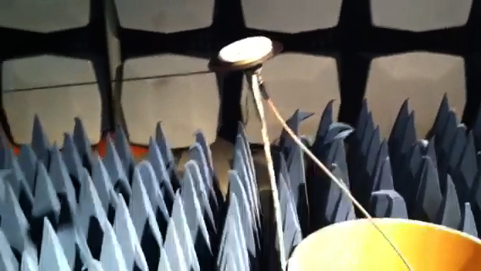
Cornell Moving-Antenna Spoofing Detection
Antenna oscillation induces carrier-phase oscillation
Non-spoofed carrier-phase oscillation diversity
Range & direction of 1-D antenna phase center articulation motion
String to initiate damped oscillations
Articulating GPS patch antenna
Cantilevered beam
Cantilevered beam base attachment point
Successful spoofing detection hypothesis test at WSMR
Spoofed carrier-phase oscillation uniformity
Detection
statistic for
an actual
spoofing
attack
Reliable detection
achievable with 1/4-wave
oscillations (< 5 cm p-p)
Spoofed ←
→Not spoofed

Slide 24
Observations on Defenses (3/3)
Crypto defenses not a panacea: Ineffective against near-zero-delay meaconing (entire band record and playback) attacks.
Non-crypto defenses not so elegant mathematically, but can be quite effective.
Best shield: a coupled crypto-non-crypto defense.
When implemented properly, navigation message authentication (NMA) authenticates not only the data message but also the underlying signal. It is surprisingly effective.

Slide 25
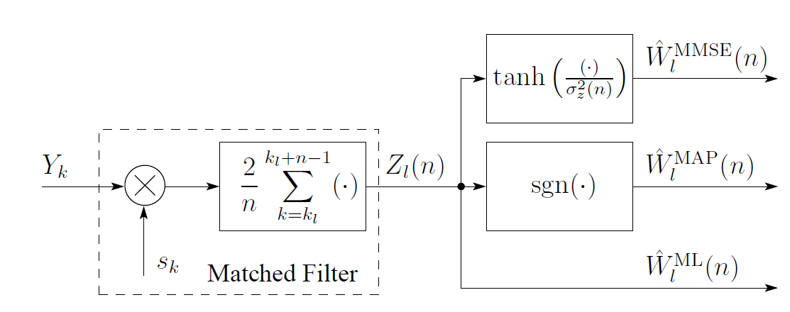
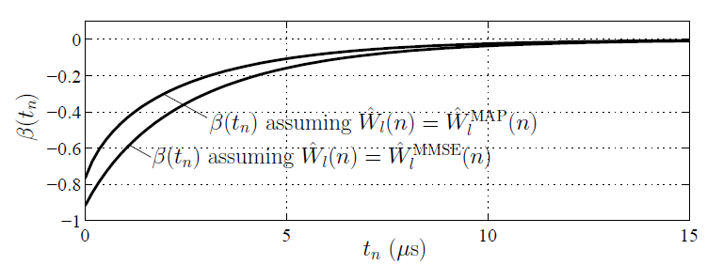
Enemy of NMA: Security Code Estimation and Replay
Inside the Spoofer:
Security Code Chip Estimation
Inside the Defender: Detection Statistic Based on Specialized Correlations

Slide 26
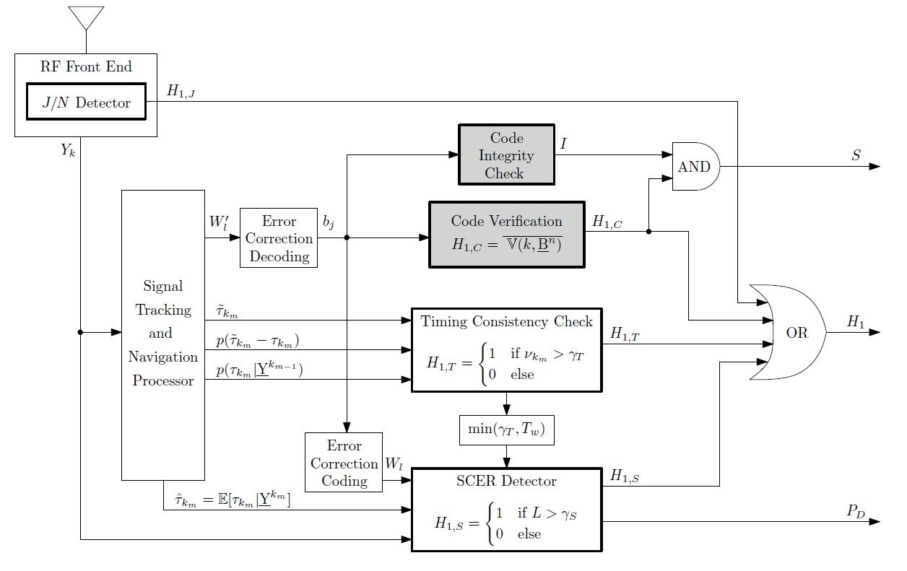
NMA-Based Signal Authentication: Receiver Perspective
Code Origin Authentication
Code Timing Authentication
Wesson, K., Rothlisberger, M., and Humphreys, T. E., “Practical Cryptographic Civil GPS Signal Authentication,”
NAVIGATION: The Journal of the Institute of Navigation, fall 2012.

Slide 27
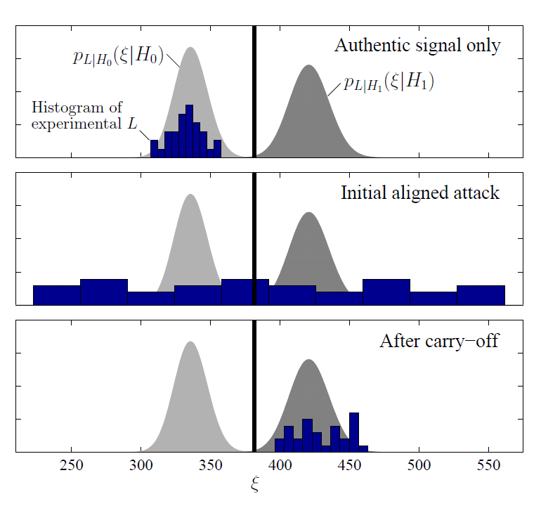
Security Code Estimation and Replay Detection:
Live Signal Demonstration
Humphreys, T. E., “Detection Strategy for Cryptographic GNSS Anti-Spoofing,”
IEEE Transactions on Aerospace and Electronic Systems, to be published.

Slide 28
Operational Definition of GNSS Signal Authentication
GNSS signal is declared authentic if in the time elapsed since some trusted initialization event:
  the logical output S has remained low, and
  the logical output H₁ has remained low, and
  the output P_{D} has remained above an acceptable threshold

Slide 29
Key Ingredients for Developing and
Evaluating GNSS Signal Authentication
Techniques:
Visibility
Testability

Slide 30
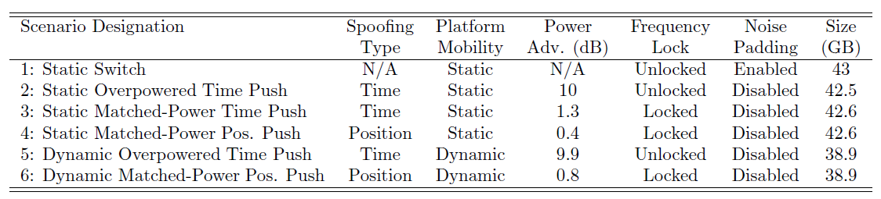
The Texas Spoofing Test Battery (TEXBAT)
6 high-fidelity recordings of live spoofing attacks
  20-MHz bandwidth
  16-bit quantization
  Each recording ~7 min. long; ~40 GB
Can be replayed into any GNSS receiver

Slide 31
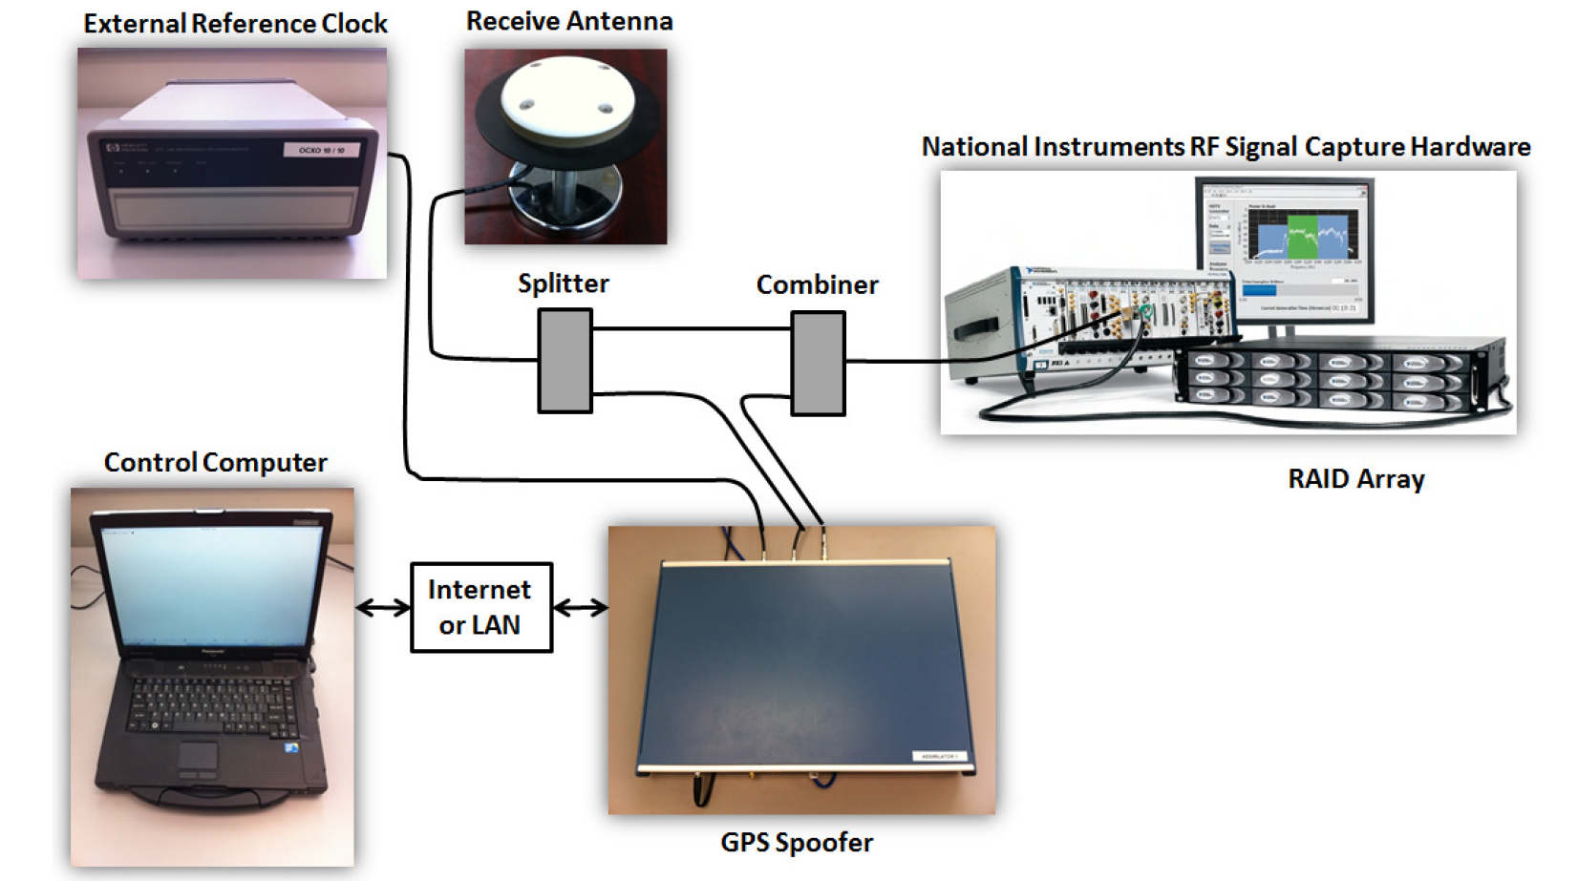
TEXBAT Recording Setup

Slide 32
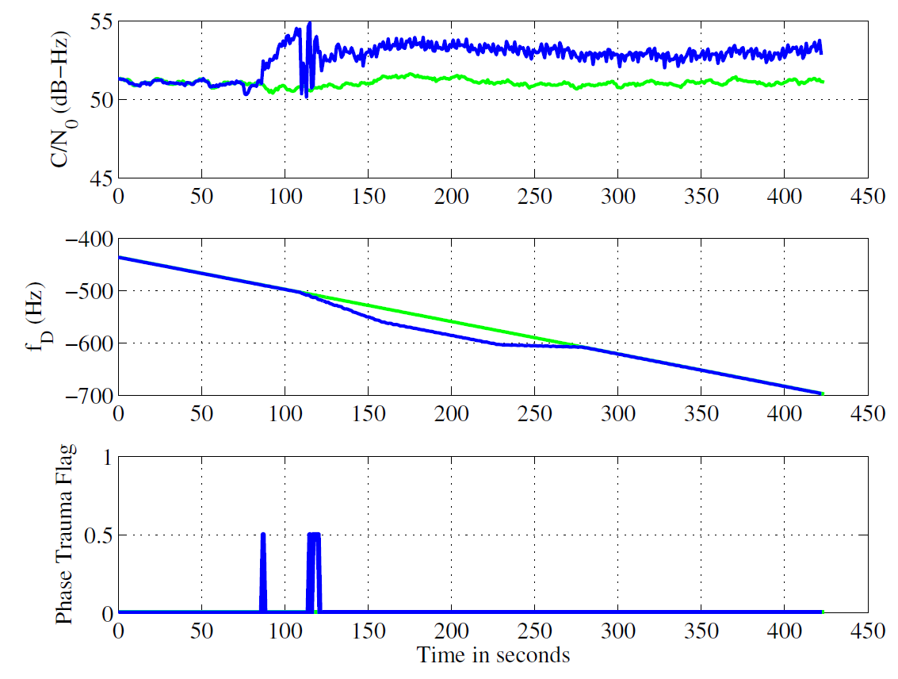
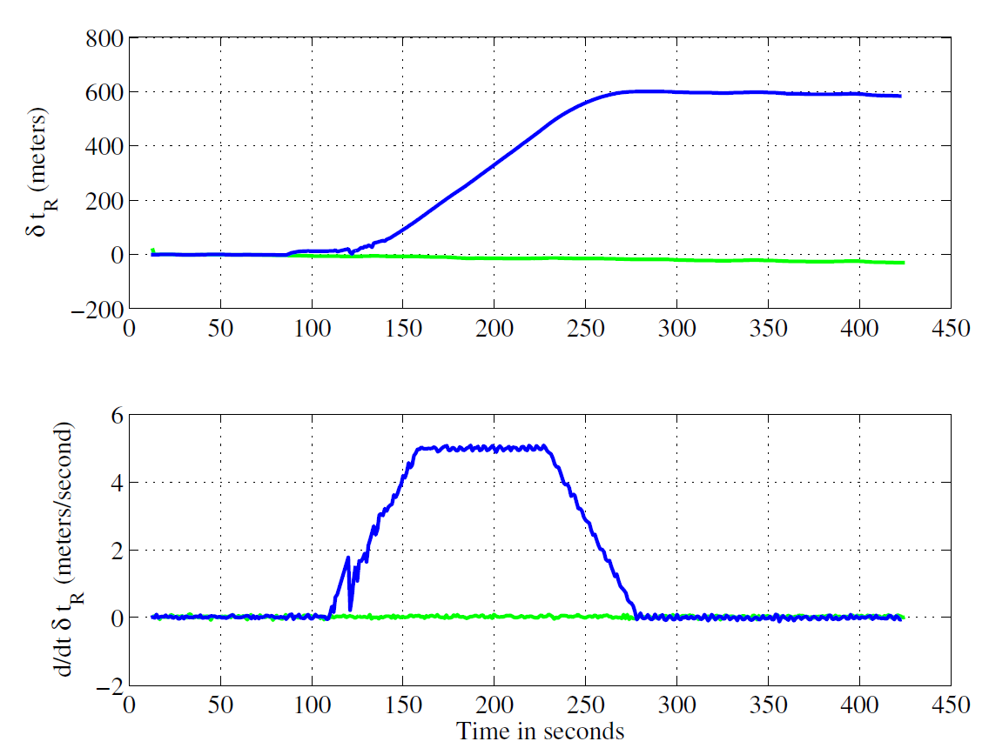
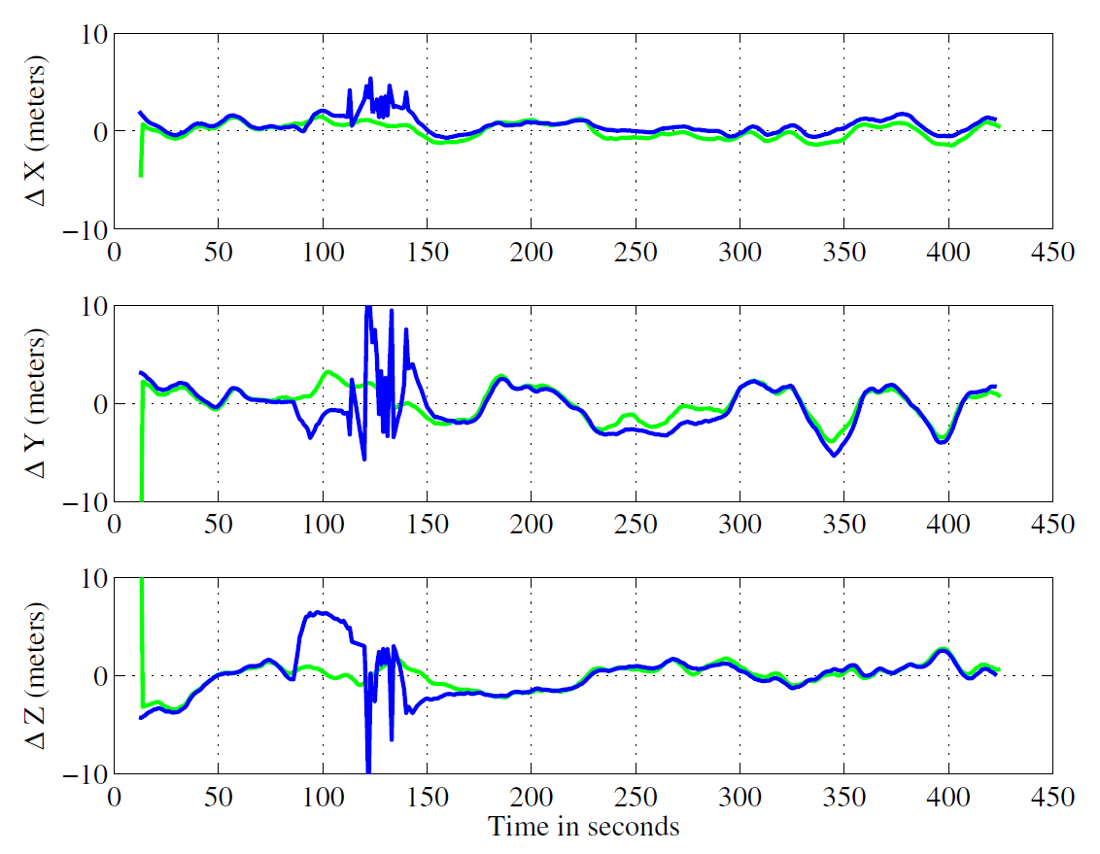
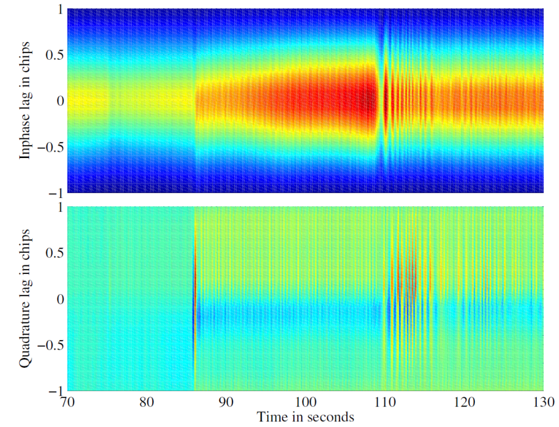
Scenario 2: Static Overpowered Time Push

Slide 33
The Dynamic Matched-Power Position Push
The Dynamic Overpowered Time Push
The Static Matched-Power Position Push
The Static Matched-Power Time Push
The Static Overpowered Time Push
The Static Switch
The University of Texas Radionavigation Lab
and
National Instruments
jointly offer the Texas Spoofing Test Battery
Request: todd.humphreys@mail.utexas.edu

Slide 34
radionavlab.ae.utexas.edu

