Slide 1
Secure Civil Navigation and Timing
Todd Humphreys | Aerospace Engineering
The University of Texas at Austin
MITRE | July 20, 2012

Slide 2
Acknowledgements
University of Texas Radionavigation Lab graduate students Jahshan Bhatti, Kyle Wesson, Ken Pesyna, Zak Kassas, and Daniel Shepard
Mark Psiaki, Brady O’Hanlon, Ryan Mitch (Cornell)
Brent Ledvina (Coherent Navigation)
Aaron Fansler (Northrop Grumman)

Slide 3
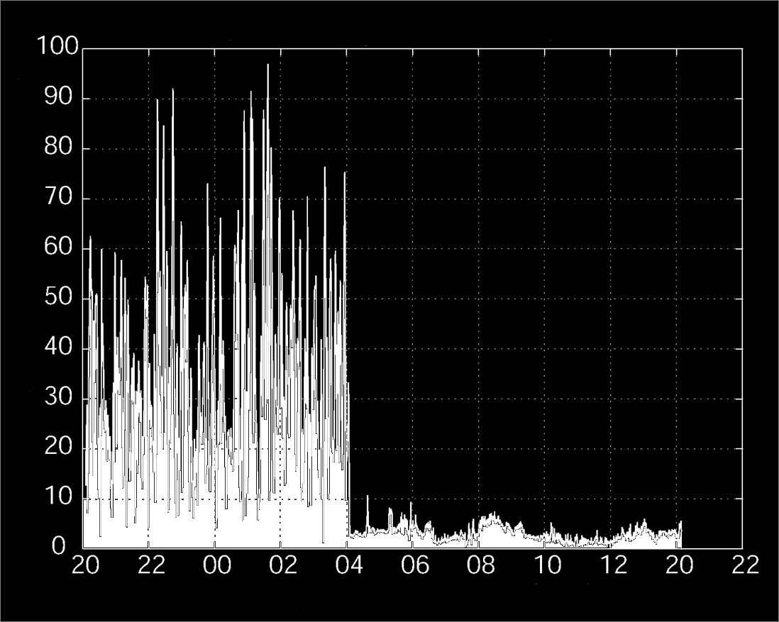
4:00 AM
May 2, 2000
Meters Error
UTC Hours

Slide 4
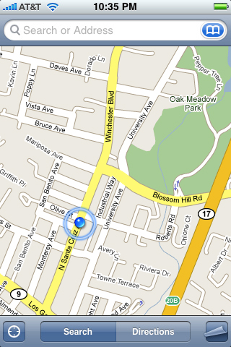

Slide 5
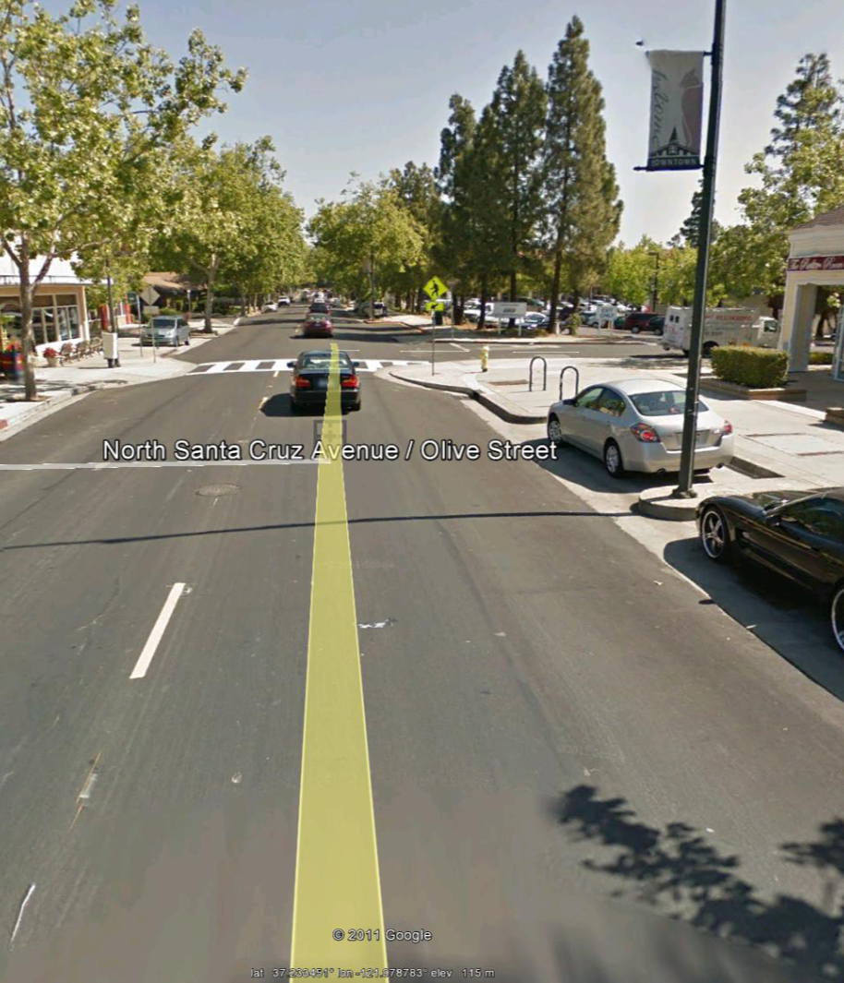

Slide 7
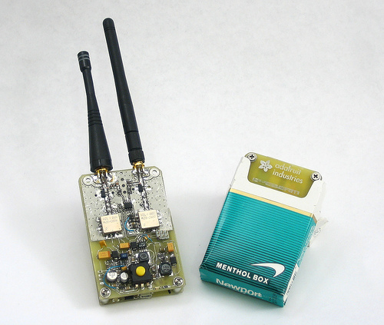
GPS Jammers

Slide 8
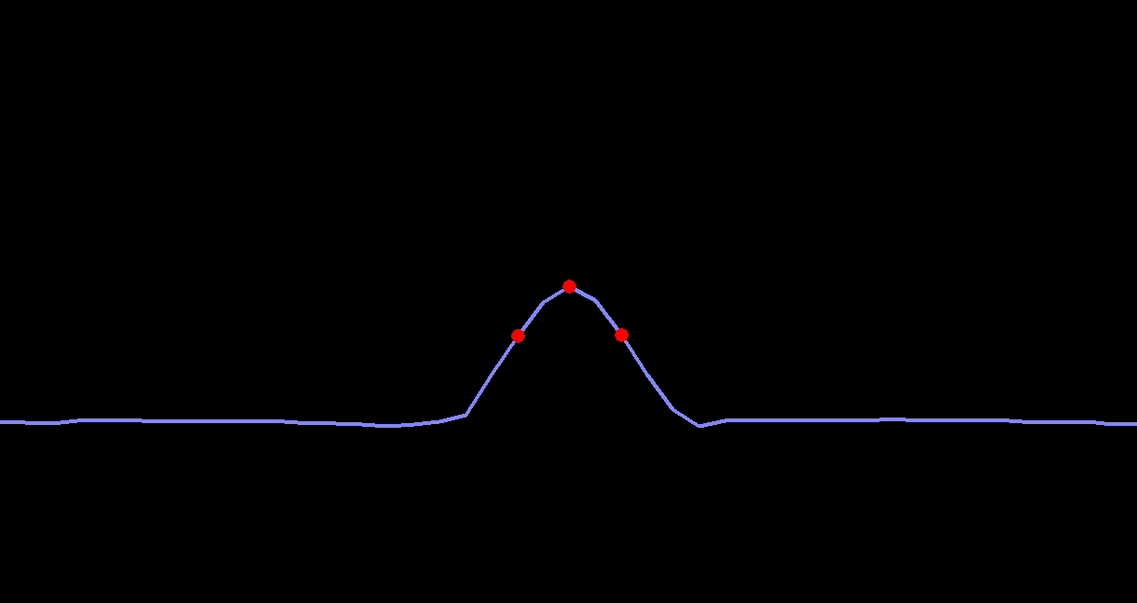
GPS Spoofer

Slide 9
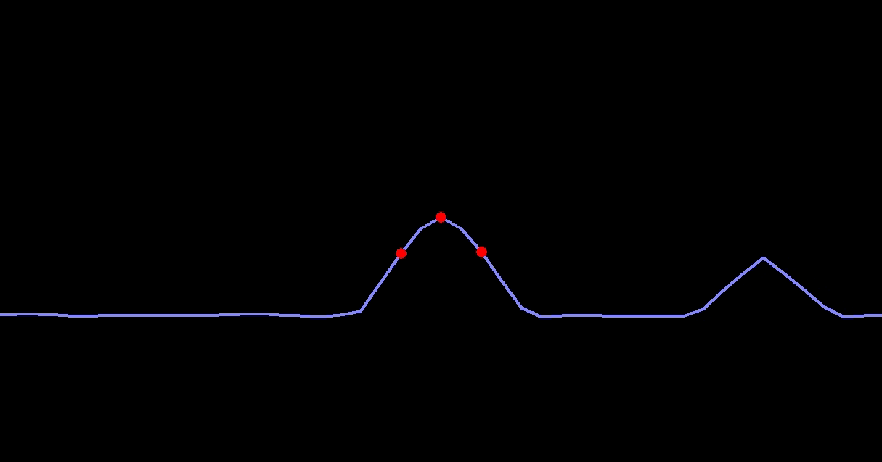
GPS Spoofer

Slide 10
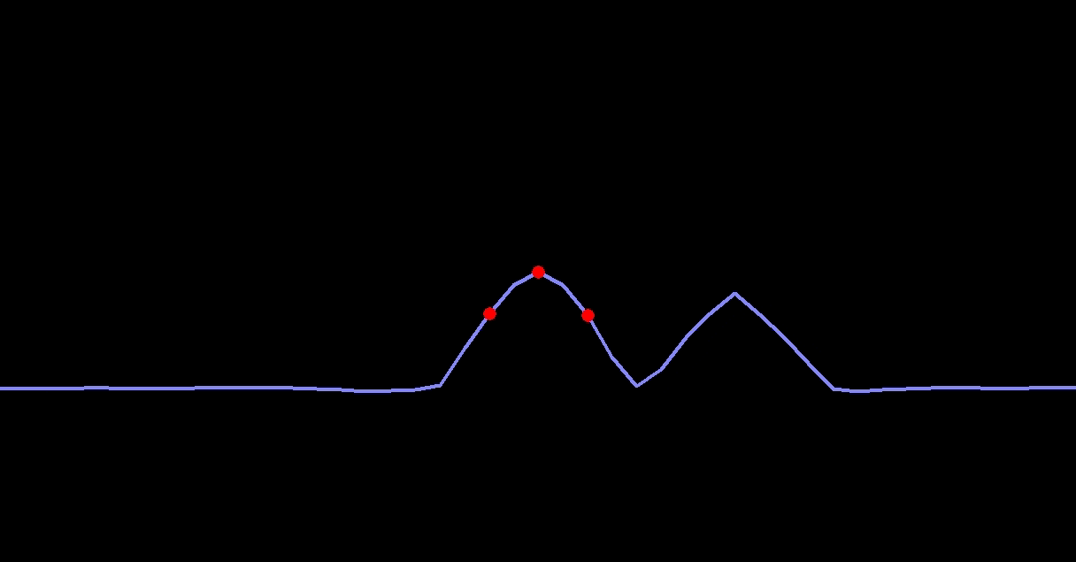
GPS Spoofer

Slide 11
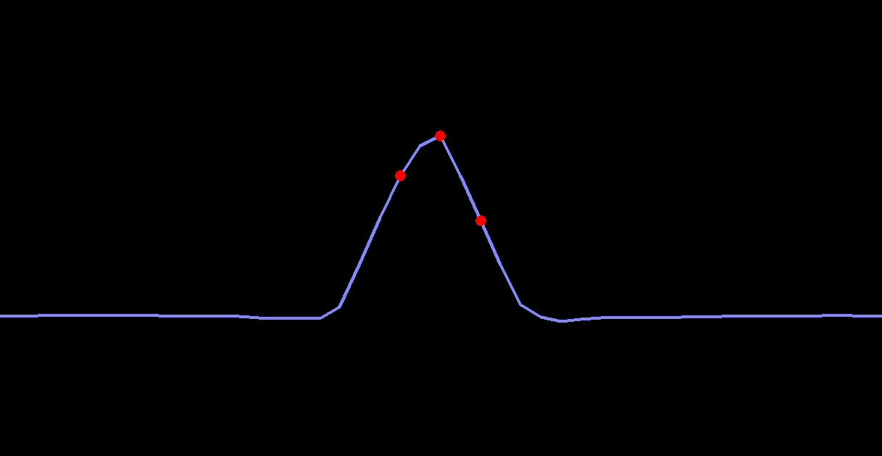
GPS Spoofer

Slide 12
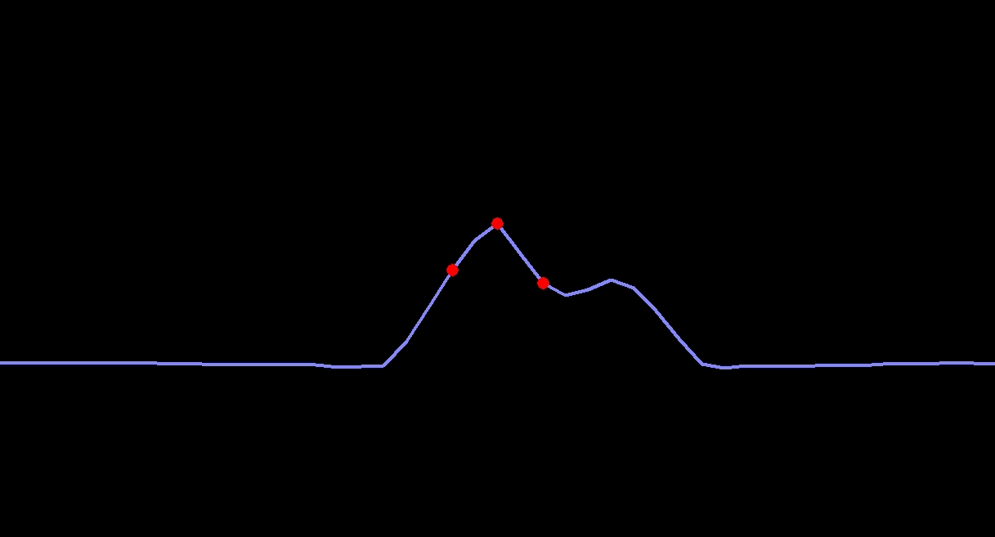
GPS Spoofer

Slide 13
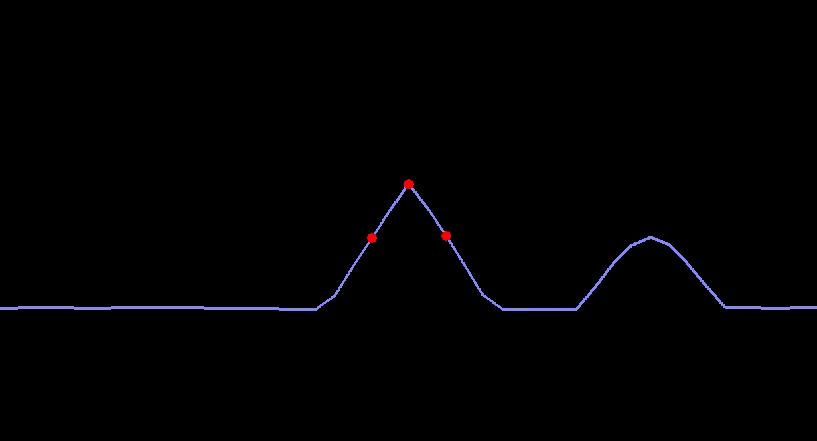
GPS Spoofer

Slide 14
iPhone Video

Slide 15
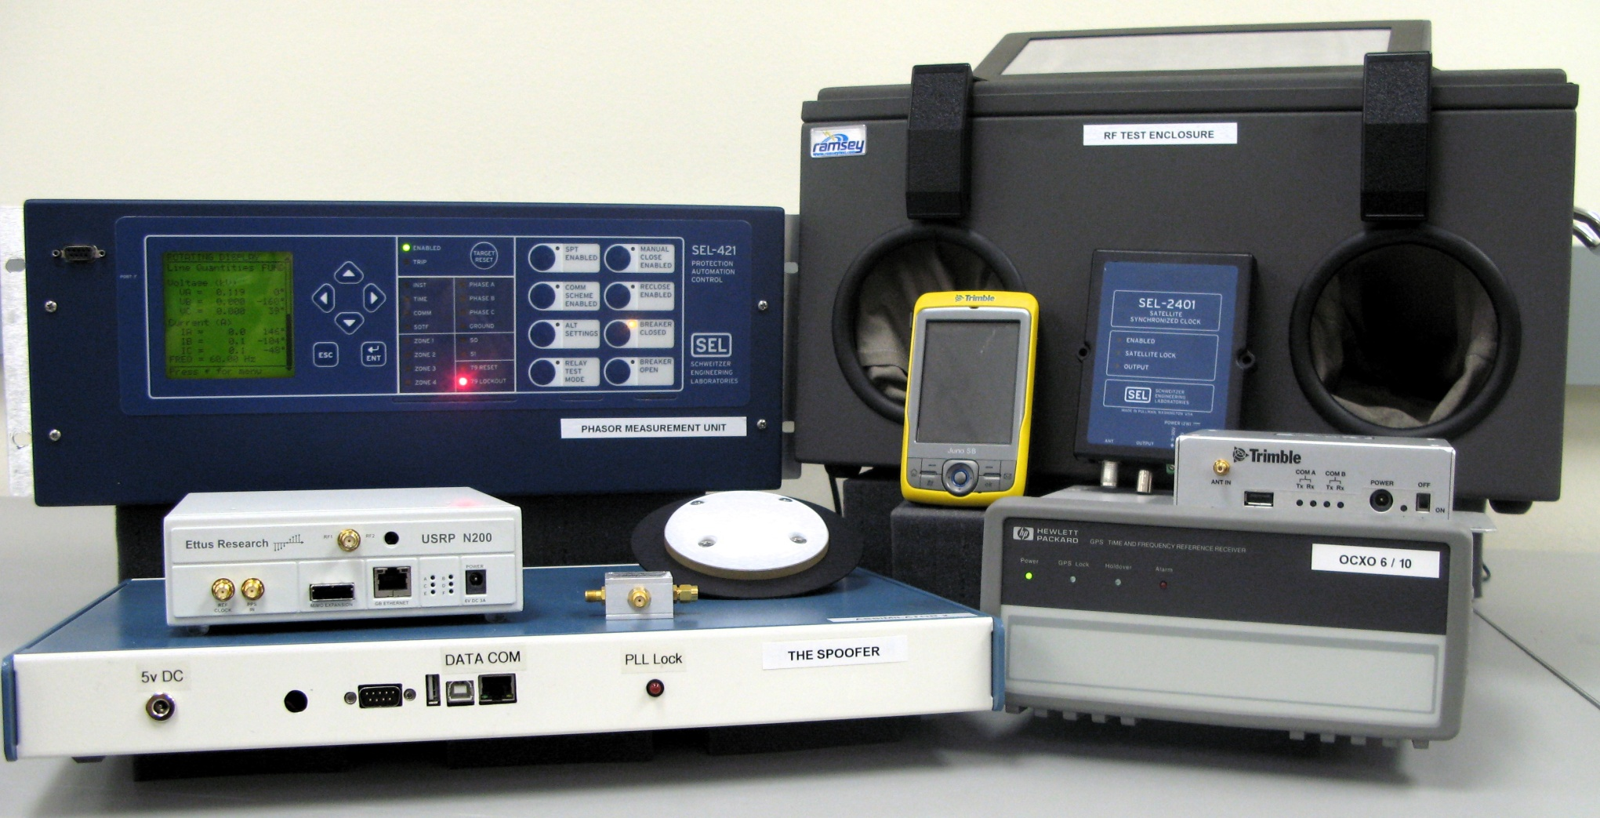
University of Texas Spoofing Testbed

Slide 16
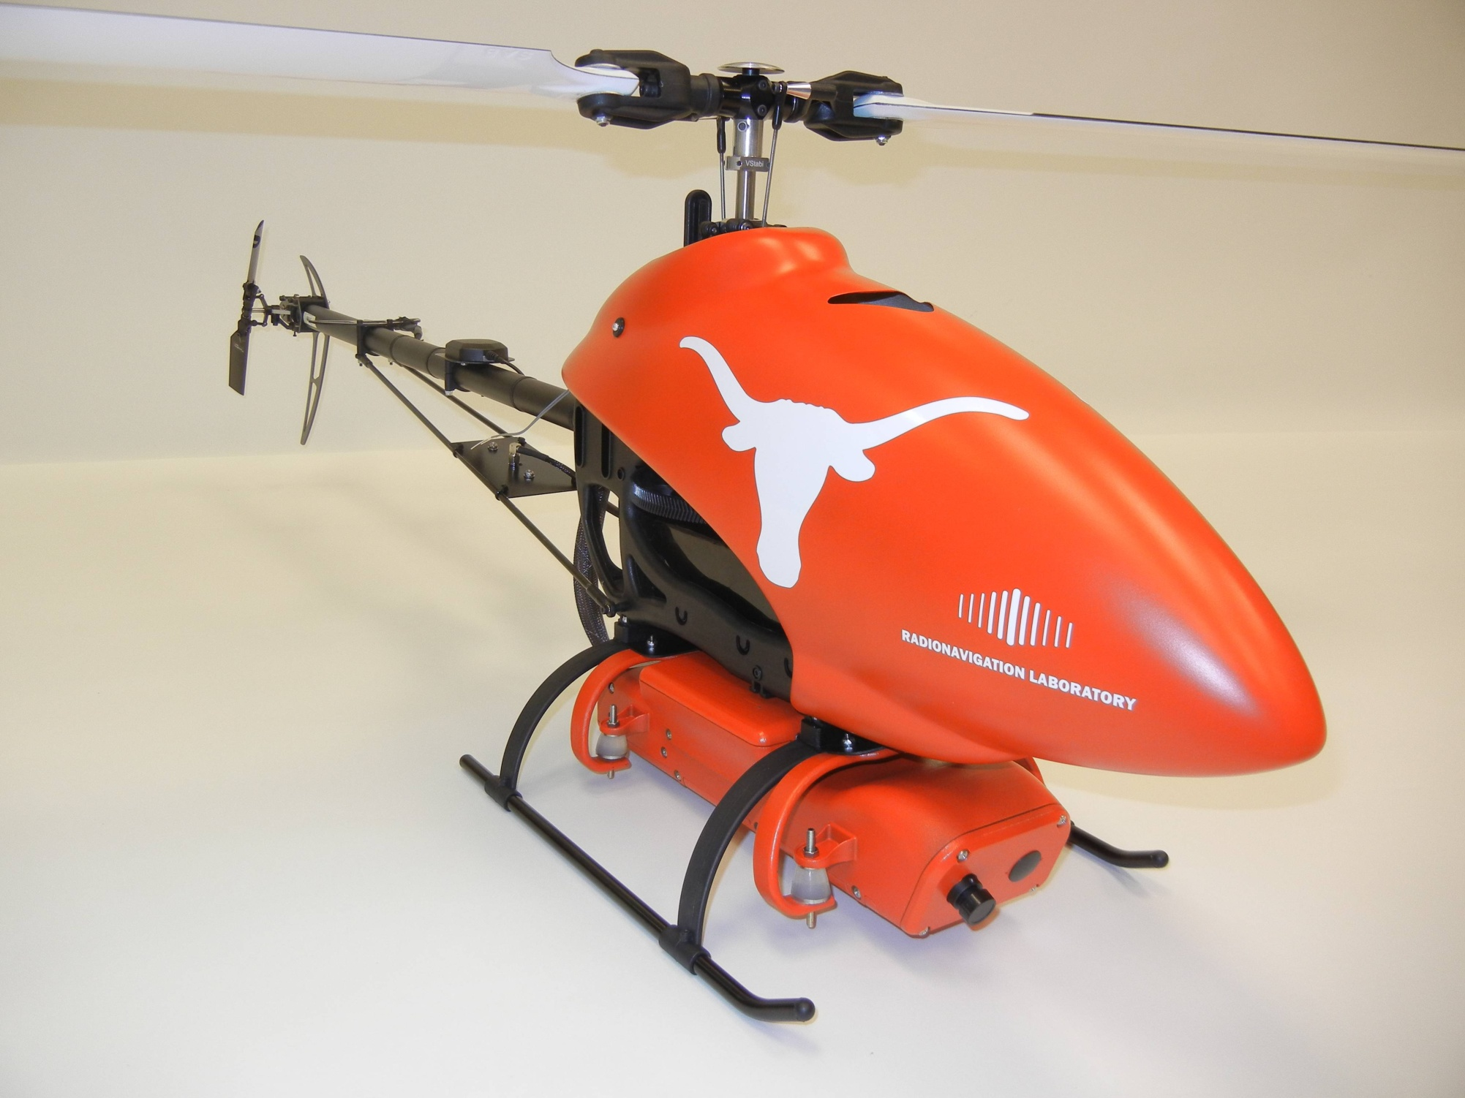

Slide 17
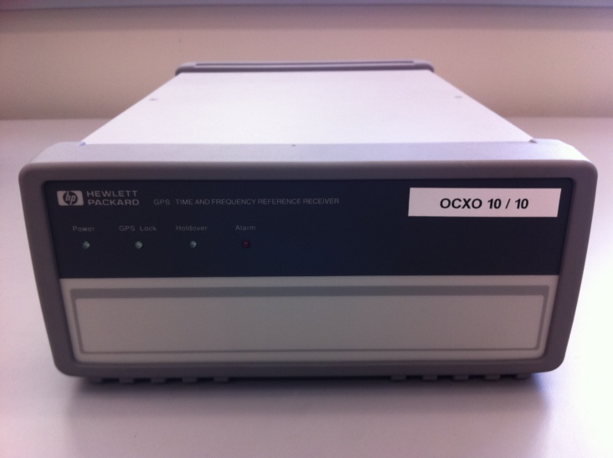
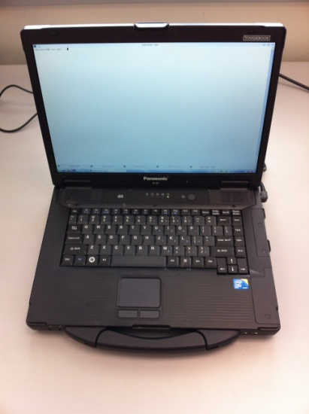
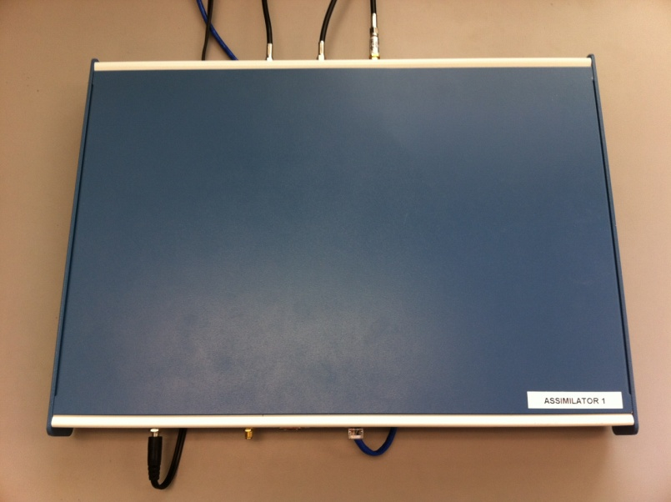
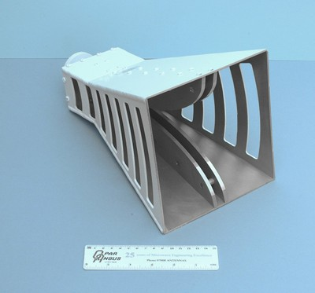
Commandeering a UAV via GPS Spoofing
Receive Antenna
External Reference Clock
Target UAV
Spoofed Signals as a
“Virtual Tractor Beam”
Control Computer
Internet or LAN
GPS Spoofer
Transmit Antenna
UAV coordinates from tracking system

Slide 18
UAV Video

Slide 19
Surprises (1/2)
RAIM was helpful for spoofing: we couldn’t spoof all signals seen by UAV due to our reference antenna placement, but the Hornet Mini’s uBlox receiver rejected observables from authentic signals, presumably via RAIM
Overwhelming power is required for clean capture: A gradual takeover leads to large (50-100 m) multipath-type errors as the authentic and counterfeit signals interact
The UAV’s heavy reliance on altimeter for vertical position was easily overcome by a large vertical GPS velocity

Slide 20
Surprises (2/2)
Not possible even to station keep with a captured UAV based on visual position estimates: GPS capture breaks flight controller’s feedback loop; now spoofer must play the role formerly assumed by GPS. Implication: An accurate radar or LIDAR system would be required for fine “control” of UAV via spoofing
Compensating for all system and geometric delays to achieve meter-level alignment is challenging but quite possible
In high-stakes situations, graduate students are steadier than assistant professors

Slide 21
Recommendations
Require navigation systems for UAVs above 18 lbs to be certified “spoof-resistant”
Require navigation and timing systems in critical infrastructure to be certified “spoof-resistant”
“Spoof resistant” defined by ability to withstand or detect civil GPS spoofing in a battery of tests performed in a spoofing testbed

Slide 22
Spoofing Defenses
Cryptographic
Non-Cryptographic
SSSC on L1C
(Scott)
J/N Sensing
(Ward, Scott, Calgary)
Stand-Alone
NMA on L2C, L5, or L1C
(MITRE, Scott, UT)
All-Signals Defense
(DARPA, BAE, UT)
SSSC or NMA on WAAS
(Scott, UT)
Single-Antenna Spatial Correlation
(Cornell, Calgary)
Signal Forensics
(TENCAP, Ledvina, Torino, UT)
P(Y) Cross-Correlation
(Stanford, Cornell)
Networked
Multi-Antenna Defense
(Keys, Montgomery, DLR, Stanford)

Slide 23
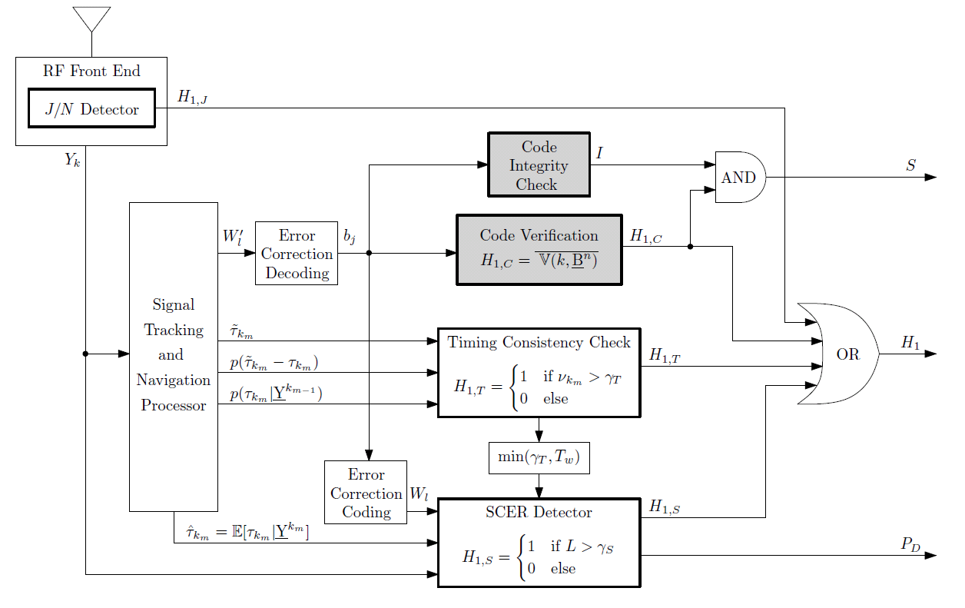
Public-Key Signal Authentication: Receiver Perspective
Code Origin Authentication
Code Timing Authentication
Wesson, K., Rothlisberger, M., and Humphreys, T. E., “Practical Cryptographic Civil GPS Signal Authentication,”
NAVIGATION: The Journal of the Institute of Navigation, to be published.

Slide 24
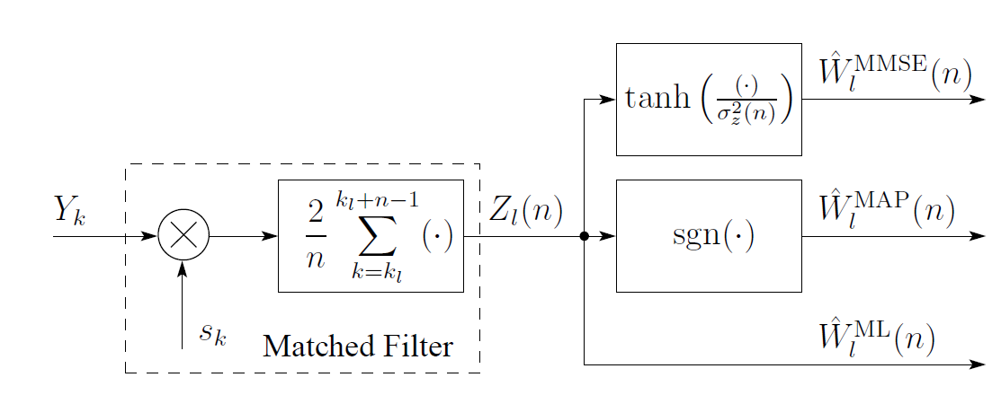
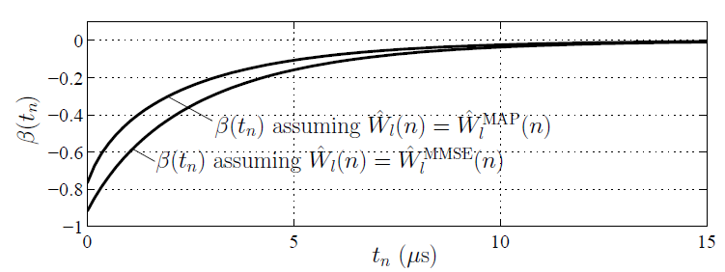
Security Code Estimation and Replay Detection
Inside the Spoofer:
Security Code Chip Estimation
Inside the Defender: Detection Statistic Based on Specialized Correlations

Slide 25
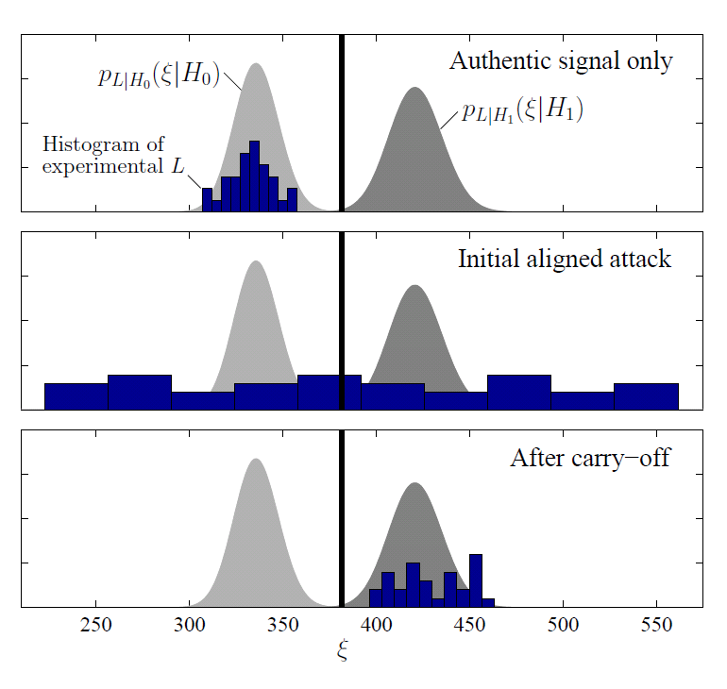
Security Code Estimation and Replay Detection:
Hypothesis Testing During an Attack
Humphreys, T. E., “Detection Strategy for Cryptographic GNSS Anti-Spoofing,”
IEEE Transactions on Aerospace and Electronic Systems, to be published.

Slide 26
Operational Definition of GNSS Signal Authentication
GNSS signal is declared authentic if since some trusted initialization event:
logical output S has remained low, and
logical output H₁ has remained low, and
output P_{D} has remained above an acceptable threshold

Slide 27
Nagging Concerns
Hard to characterize the null hypothesis for a crypto defense on a dynamic platform – hard to keep false alarm rate under control
All crypto defenses ineffective against near-zero-delay meaconing (entire band record and playback) timing attacks
Civil GPS crypto defenses will probably be funded and implemented just before the heat death of the universe
Is envisioning widespread adoption of non-crypto defenses just wishful thinking?

Slide 28
radionavlab.ae.utexas.edu

