Slide 1
Evaluation of Smart Grid and Civilian UAV Vulnerability to GPS Spoofing Attacks
D. P. Shepard, J. A. Bhatti, T. E. Humphreys, The University of Texas at Austin
A. A. Fansler, Northrop Grumman Information Systems
ION GNSS Conference, Nashville, TN | September 21, 2012

Slide 2
Outline
GPS Spoofing Attack
Spoofing Exercises
PMUs
Civilian UAV

Slide 3
Civil GPS Spoofing
Goal: influence a specific GPS receiver’s Position-Velocity-Time (PVT) solution
The proximity spoofing attack looks like this
The spoofer was recently modified to allow spoofing at a distance

Slide 4
University of Texas Spoofing Testbed

Slide 5
PMU Spoofing Exercise Goals
Demonstrate that the IEEE C37.118 Standard “Synchrophasors for Power Systems” can be broken by a spoofer
Defines required accuracy as <1% Total Vector Error (TVE), where
Violated once the timing has been altered by 26.5 µs (0.573º phase angle error)
Show that spoofing can affect PMU-based control schemes

Slide 6
PMU Spoofing Exercise Setup

Slide 7
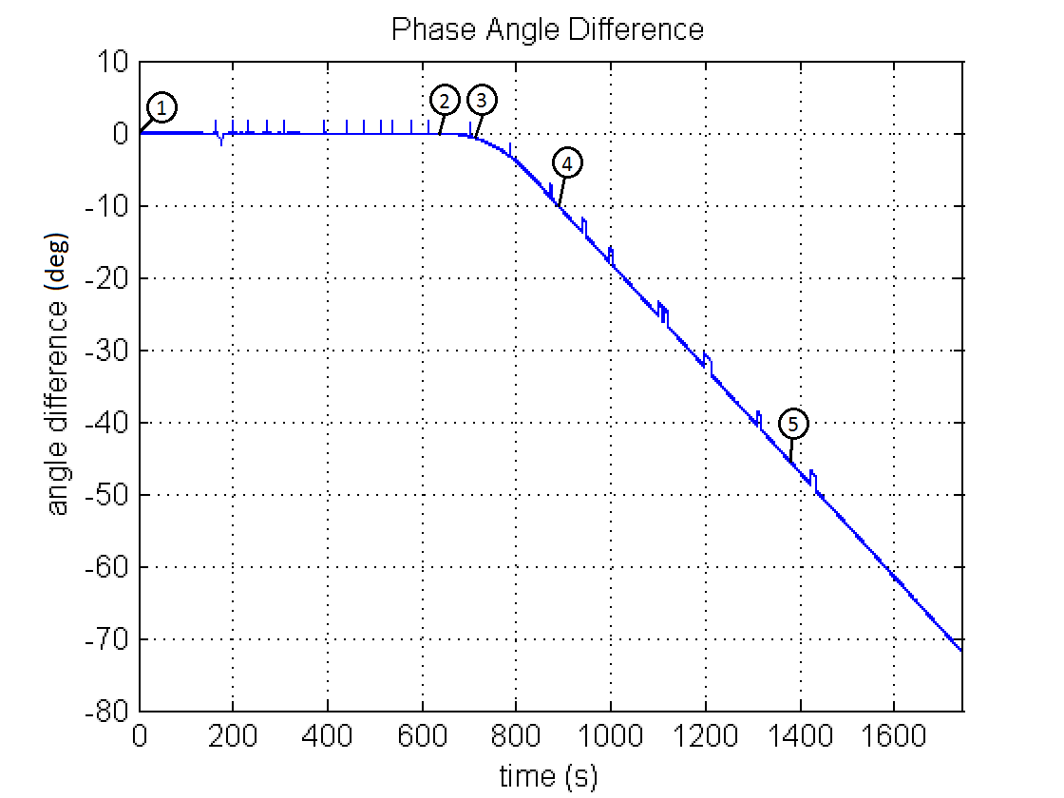
PMU Spoofing Exercise Results
Phase angle difference should nominally be 0, since the PMUs were in the same room
Points 1-5 on the plot indicate benchmarks in the test
The phase angle difference is greater than 70 degrees after half an hour

Slide 8
Test Results (cont.)
Point 1: Start of the test shows time and phase alignment between PMUs
Left plot shows Pulse-Per-Second output from receivers with the reference in yellow
Right plot shows phase angle from the PMUs with the reference in red

Slide 9
Test Results (cont.)
Point 2: 620 seconds into the test
2 µs time offset has been introduced
Receiver is considered fully captured at this point
Spoofer-induced time rate begins accelerating

Slide 10
Test Results (cont.)
Point 3: 680 seconds into the test
Spoofer has broken the IEEE C37.118 Standard
A 26.5 µs timing offset and a 0.573 degree phase angle offset have been introduced

Slide 11
Test Results (cont.)
Point 4: 870 seconds into the test
A 400 µs timing offset and a 10 degree phase angle offset have been introduced
Spoofer has reached final induced time rate of 1000 m/s (i.e. 3.33 µs/s)

Slide 12
Test Results (cont.)
Point 5: 1370 seconds into the test
A 2 ms timing offset and a 45 degree phase angle offset have been introduced
Spoofed signals removed
The receiver’s time offset continued to increase anyways

Slide 13
Smart Grid Vulnerability Conclusions
A spoofing attack can cause PMUs to violate the IEEE C37.118 Standard
Large phase angle offsets can be induced in a matter of minutes (>10 degrees)
These effects can have significant impacts on PMU-based power grid control systems
PMUs were created to help prevent blackout events, but spoofing could make them the cause
Notes:
%Spoofing could trip a generator in a PMU-based control system currently implemented in Mexico, Currently operational system in Mexico using automated PMU-based control on the Chicoasen-Angostura transmission line: Connects large hydroelectric generators to large loads, 2 400-kV lines and 1 115-kV line, Protects against generator instability during double fault by shutting down generators if phase angle difference exceeds 10 degrees, This inappropriate generator tripping could lead to cascading failures like those seen in the 2003 Northeast Blackout

Slide 14
Civilian UAV Spoofing Exercise Motivation
Iranian claims of UAV capture
Possible jamming of communications link and/or military GPS signals could allow UAV capture through civilian GPS spoofing.
FAA Modernization and Reform Act of 2012
Requires the government to develop a plan to safely accelerate the integration of civil UAVs into the national airspace by 9/30/2015.

Slide 15
WSMR Test Setup

Slide 16
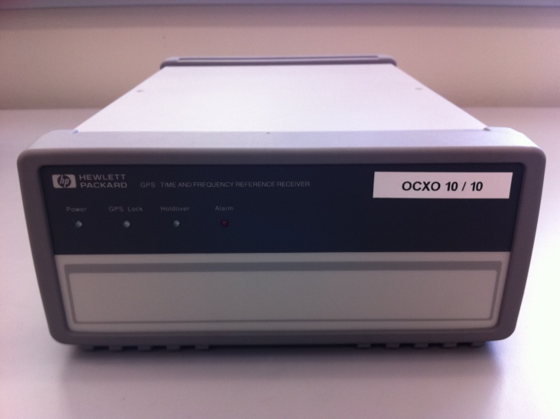
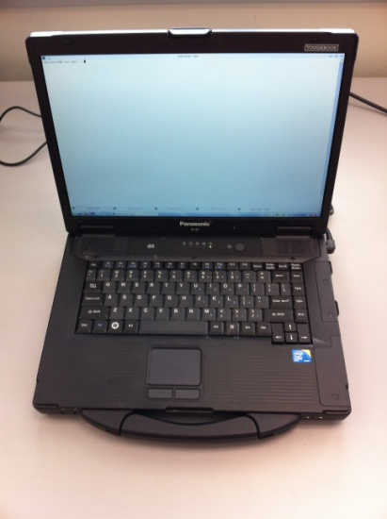
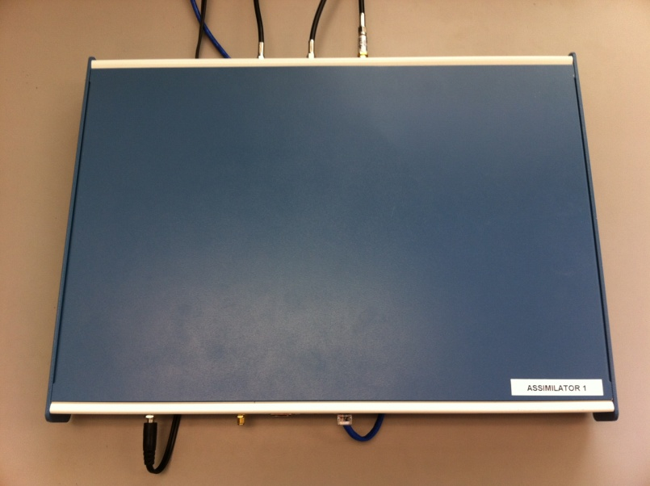
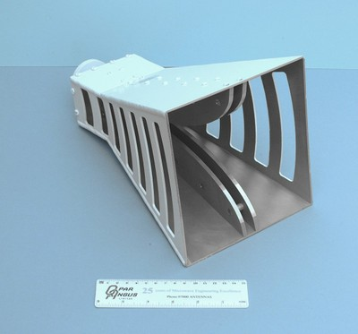
Commandeering a UAV via GPS Spoofing
Receive Antenna
External Reference Clock
Target UAV
Spoofed Signals as a
“Virtual Tractor Beam”
Control Computer
Internet or LAN
GPS Spoofer
Transmit Antenna
UAV coordinates from tracking system

Slide 17
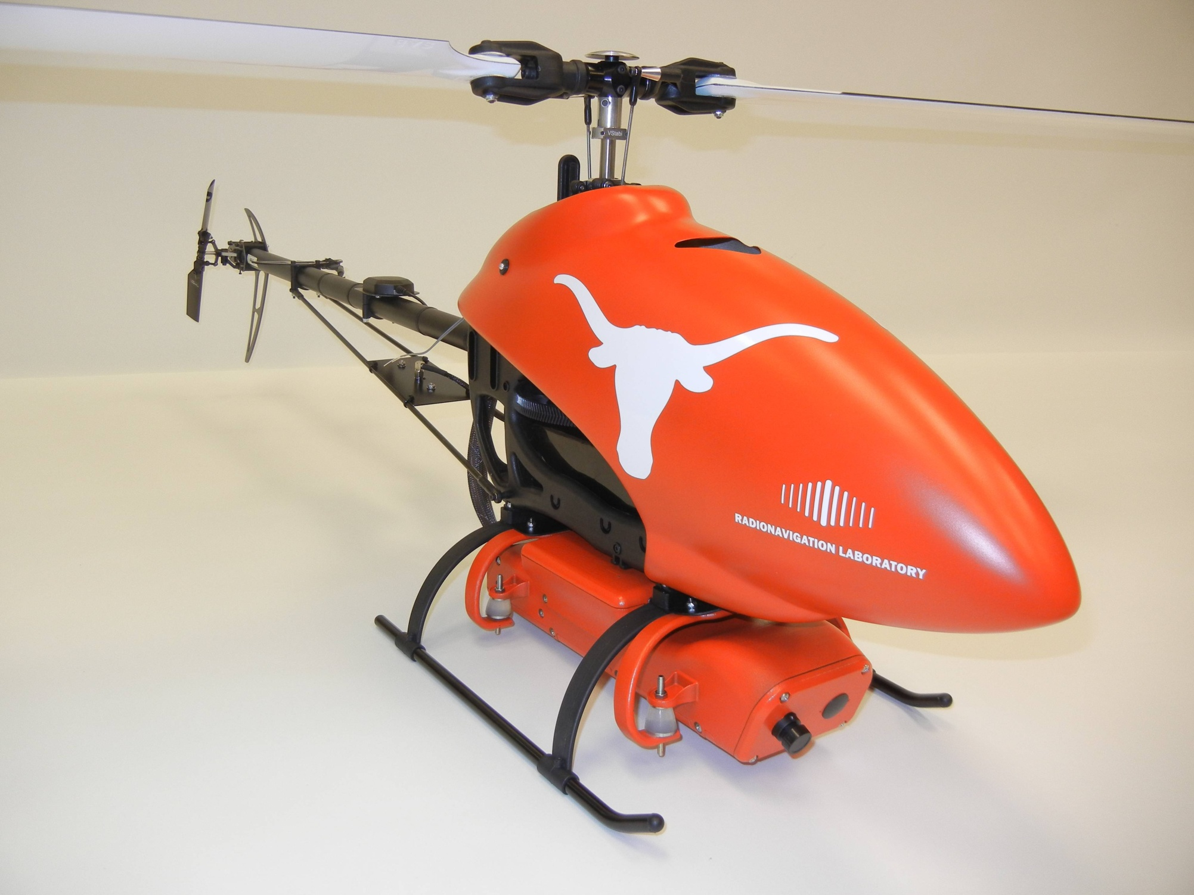

Slide 18
Time Alignment Before Spoofing Attack

Slide 19
Time Alignment During Spoofing Attack

Slide 20
UAV Video

Slide 21
Surprises
RAIM was helpful for spoofing: we couldn’t spoof all signals seen by UAV due to our reference antenna placement, but the Hornet Mini’s uBlox receiver rejected observables from authentic signals, presumably via RAIM
Overwhelming power is required for clean capture: A gradual takeover leads to large (50-100 m) multipath-type errors as the authentic and counterfeit signals interact
The UAV’s heavy reliance on altimeter for vertical position was easily overcome by a large vertical GPS velocity

Slide 22
Surprises
Not possible even to station keep with a captured UAV based on visual position estimates: GPS capture breaks flight controller’s feedback loop; now spoofer must play the role formerly assumed by GPS. Implication: An accurate radar or LIDAR system would be required for fine “control” of UAV via spoofing
Compensating for all system and geometric delays to achieve meter-level alignment is challenging but quite possible

Slide 23
radionavlab.ae.utexas.edu

Slide 24
Civil GPS Spoofing
A discrete spoofing attack typically involves four phases:
Alignment of the authentic and spoofed GPS signals at the target receiver
Increase the power of the spoofed signals above the authentic
Move the spoofed signals slowly away from the authentic signals
Once the spoofed and authentic signals no longer interfere, the spoofer has complete control of the target receiver’s PVT solution
Spoofer-imposed dynamics are limited only by the bandwidth of the target receiver’s tracking loops and it’s quality indicators
No receiver we’ve tested has ever successfully defended against this type of attack
Notes:
BACKUP

Slide 25
Implications of Results
PMUs are being pushed for both automated and human-in-the-loop power grid control
Currently operational system in Mexico using automated PMU-based control on the Chicoasen-Angostura transmission line:
Connects large hydroelectric generators to large loads
2 400-kV lines and 1 115-kV line
Protects against generator instability during double fault by shutting down generators if phase angle difference exceeds 10 degrees
Spoofing could this system to falsely trip in a matter of minutes

Slide 26
Implications of Results
Implications could extend beyond shutting down a single transmission line or generator
Illustrated by the 2003 Northeast Blackout, which begun with the tripping of a single transmission line
As interconnectivity and complexity of the power grid increase, the risk of massive blackouts due to inappropriate control actions increases
PMUs were created to help prevent these events, but spoofing could make them the cause

