Slide 1
Millimeter-accurate Augmented Reality enabled by Carrier-Phase Differential GPS
Ken Pesyna, Daniel Shepard, Todd Humphreys
ION GNSS 2012 Conference, Nashville, TN | September 21, 2012

Slide 2
Outline
Augmented Reality (AR) Definition
Motivation for millimeter-accurate AR
Our AR Hardware
Our AR Software
Demonstration
Conclusions

Slide 3
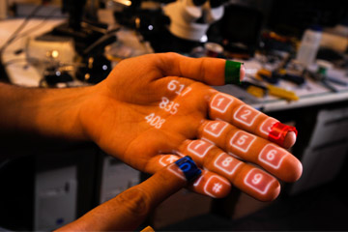
What is Augmented Reality
Augmenting a live view of the world with computer-generated sensory input to enhance one’s current perception of reality^{[1]}
[1] Graham, M., Zook, M., and Boulton, A. "Augmented reality in urban places: contested content and the duplicity of code." Transactions of the Institute of British Geographers.
.

Slide 4
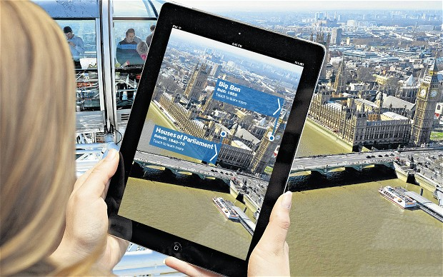
Augmented Reality Today

Slide 5
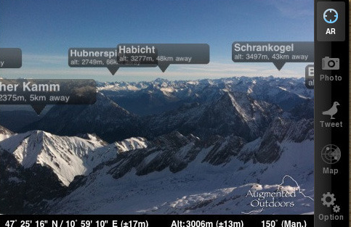
Augmented Reality Today
Landmark identification
Stargazing

Slide 6
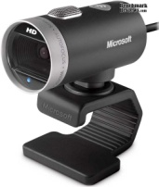
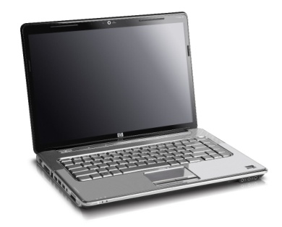
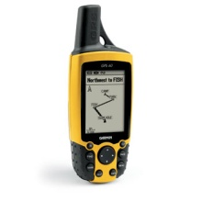
Augmented Reality: How it works
Visual
Capture
Device
Visual Overlays
Textual Information
Other Sensory Inputs
Computer Processing
Orientation
Position

Slide 7
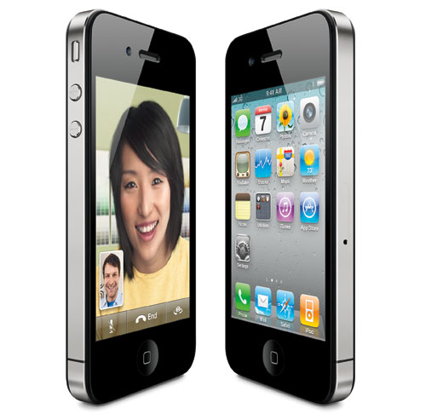
Essential Components for AR
Incorporates seven primary pieces of hardware
GPS receiver
Accelerometer
Gyroscope
Magnetometer
Camera
Computer
Screen

Slide 8
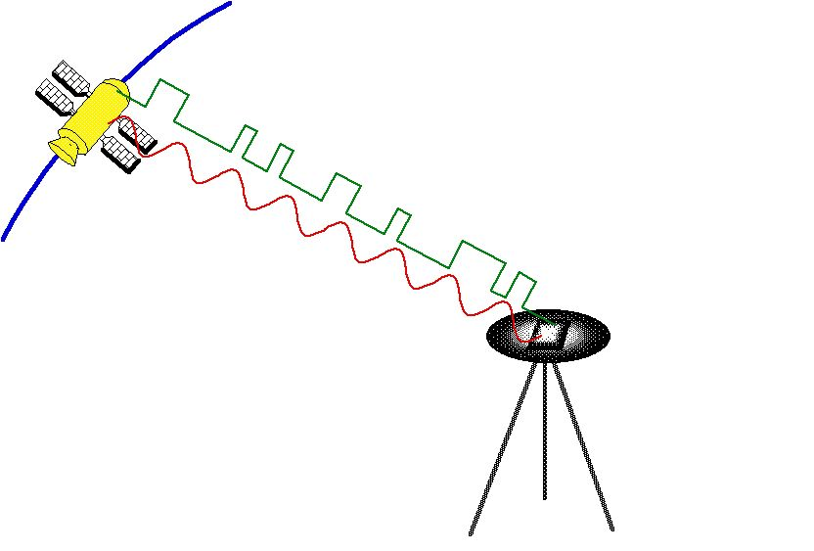
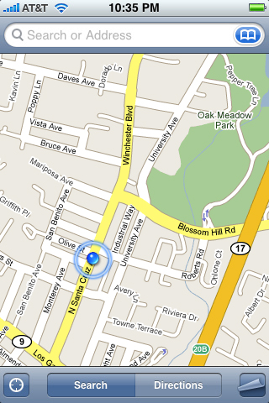
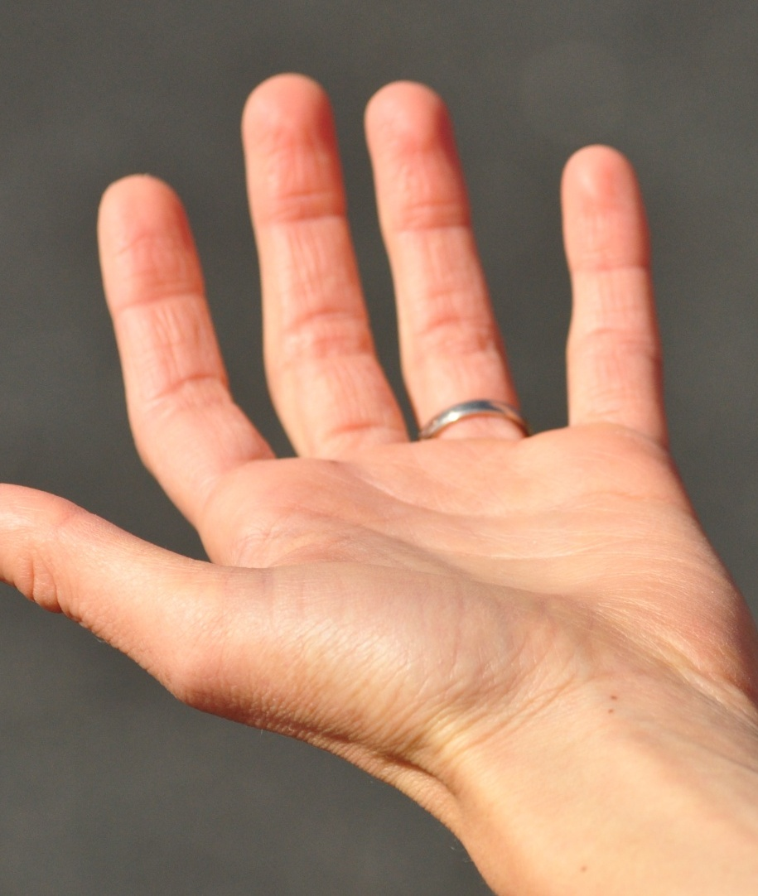
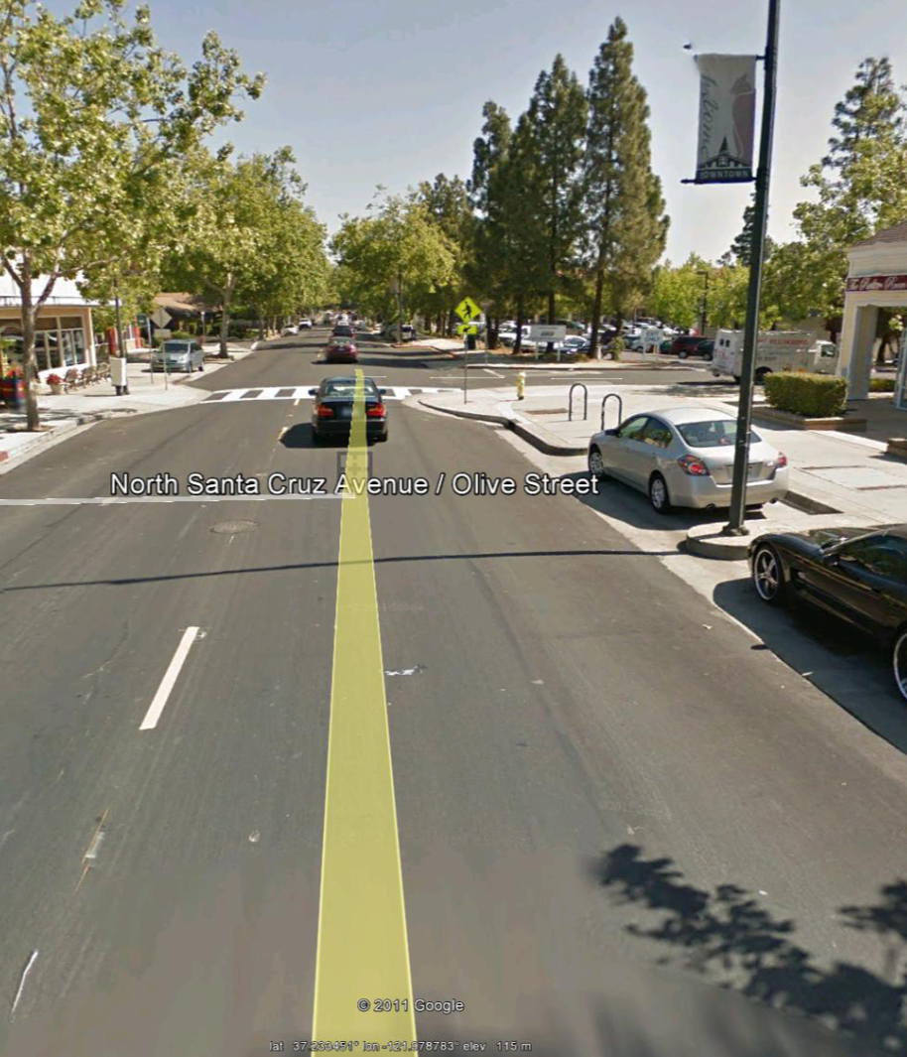
Carrier-phase GPS (CDGPS) Positioning
Very Accurate!

Slide 9
Ultra-Precise Augmented Reality
Incorporate CDGPS-generated hyper-precise location information
Incorporate in IMU (gyroscopic, magnetometer, accelerometer) orientation measurements
IMU Measurements
--Ultra-precise Position
--Ultra-precise Velocity
--Orientation information
CDGPS Measurements

Slide 10
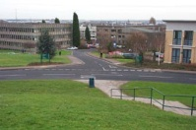
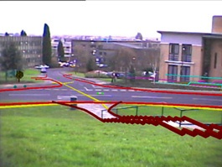
Prior Art: Subsurface data visualization
RTK capable receiver: Leica Geosystems
Gyroscope + Magnetometer
Did not couple GPS and INS together
[2] Roberts, G.W. and Evans, A. “The use of augmented reality, GPS and INS for subsurface data visualization.” FIG XXII International Congress, 2002, University of Nottingham
.
Notes:
http://www.fig.net/pub/fig_2002/Ts5-13/TS5_13_roberts_etal.pdf

Slide 11
Great Potential: Google Glass

Slide 12
Ultra-precise Google Glass

Slide 13
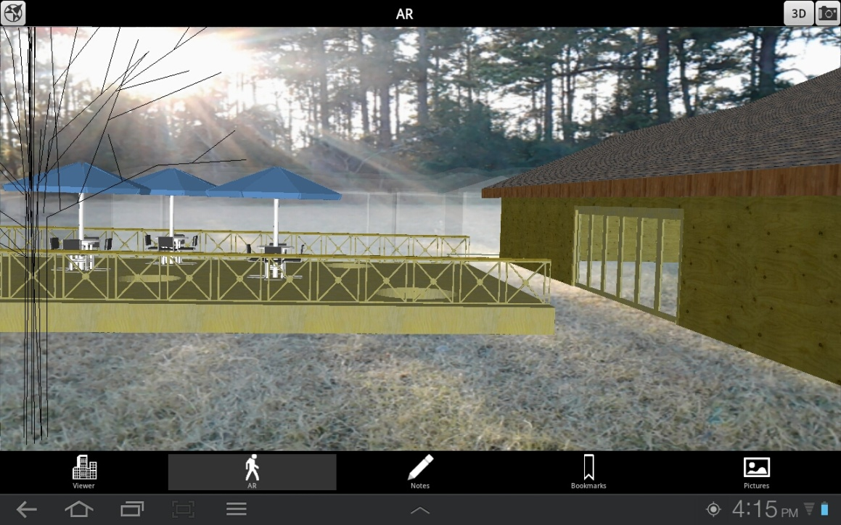
Ultra-precise Google Glass

Slide 14
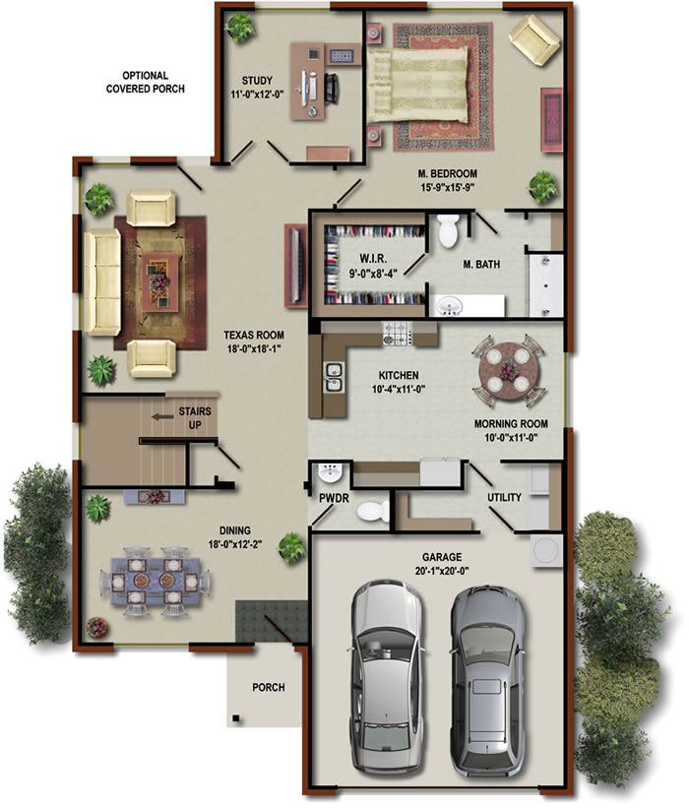
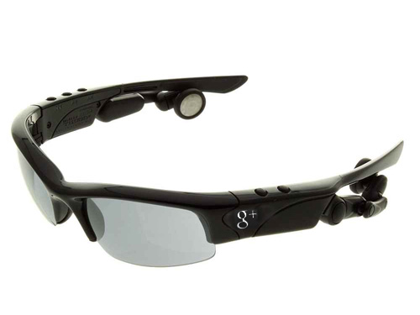
Ultra-precise Google Glass

Slide 15
Our Augmented Reality System

Slide 16
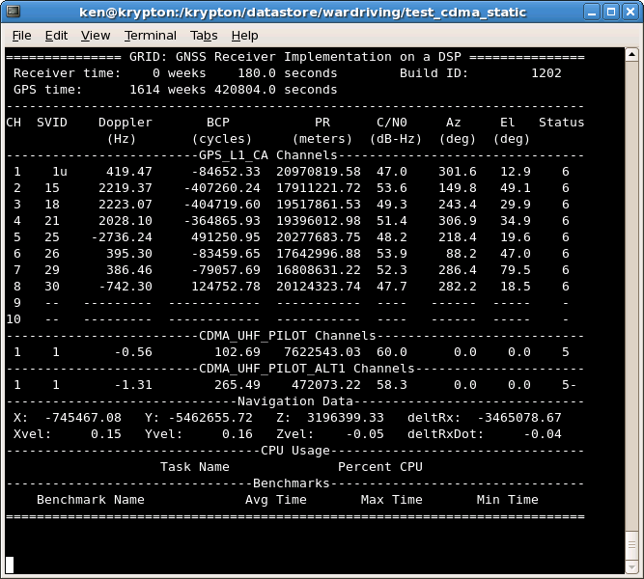
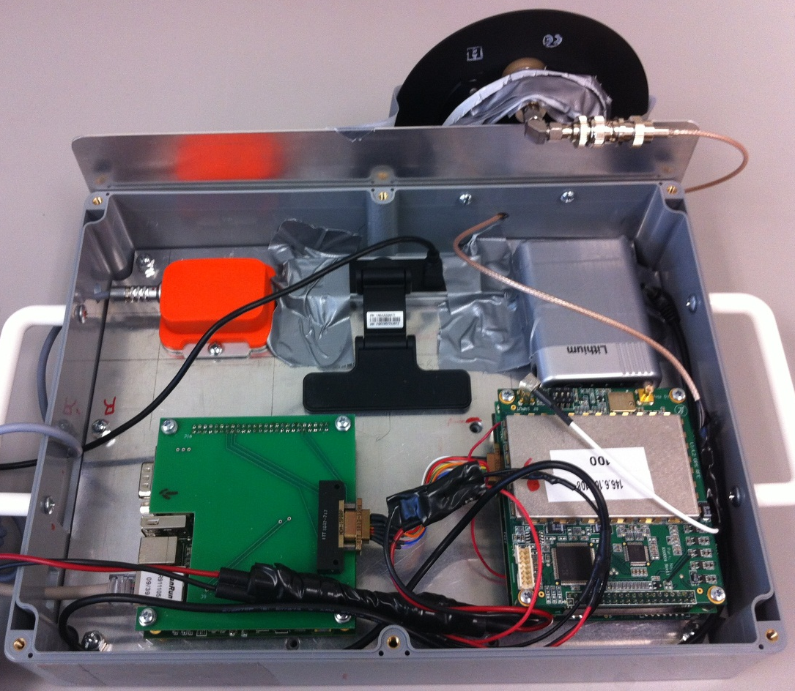
Ultra-Precise Augmented Reality System
FOTON Software-Defined GPS Receiver
Runs GRID software receiver developed by UT and Cornell
Dual frequency (L1 C/A and L2C)
Data bit wipe-off capable
5 Hz output of observables (carrier phase and psuedorange)
Enables rapid testing

Slide 17
Ultra-Precise Augmented Reality System (cont.)
IMU, Medium-grade, from Xsens
accelerometer, gyro, and magnetometer measurements
100 Hz output rate
Single Board Computer (SBC)
Handles communications with Software-receiver over Ethernet

Slide 18
Ultra-Precise Augmented Reality System (cont.)
Antcom Active L1/L2 GPS Antenna
Webcam
HD webcam from FaceVision
22 fps 720P Video
Rechargeable Lithium Ion Battery
Provides power for over 3 hours

Slide 19
Ultra-Precise Augmented Reality System
System hosted by a tablet computer
Retrieves data from the reference station
Records and processes the GPS+IMU data (currently post-processing)
Overlays the webcam video with virtual objects

Slide 20
Extended Kalman Filter
Goal: Provide sub-centimeter level positioning and degree-level orientation
IMU provides orientation to degree-level accuracy
Tightly coupled IMU and CDGPS EKF will provide the desired positioning accuracy
EKF state, $\overset{⃑}{X}$:
$\overset{⃑}{r}≡$ ECEF position of the IMU
$\dot{\overset{⃑}{r}}≡$ ECEF velocity of the IMU
$\overset{⃑}{b}≡$ accelerometer biases
$\overset{⃑}{x}≡{\left[\begin{matrix}{\overset{⃑}{r}}^{T} & {\dot{\overset{⃑}{r}}}^{T} & {\overset{⃑}{b}}^{T}\end{matrix}\right]}^{T}$
$\overset{⃑}{N}≡$ integer ambiguities from double-differenced carrier phase
$$\overset{⃑}{X}=\left[\begin{aligned}\overset{⃑}{x} \\ \overset{⃑}{N}\end{aligned}\right]=\left[\begin{aligned}\overset{⃑}{r} \\ \dot{\overset{⃑}{r}} \\ \overset{⃑}{b} \\ \overset{⃑}{N}\end{aligned}\right]$$

Slide 21
Block Diagram of our EKF
Visual Overlay Stage
K+1 =======> K+2
K =======> K+1
INS Stage
CDGPS Stage
Notes:
Take omega and cross it with the IMU→Antenna relative position vector to get the relative velocity of the GPS antenna in the b-frame. Then, use the quaternian to convert this relative velocity from the b-frame to the ECEF-frame. Finally, add this to the velocity in X.

Slide 22
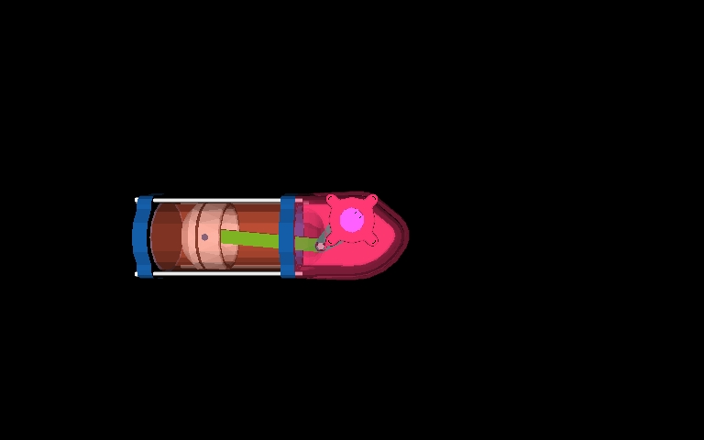
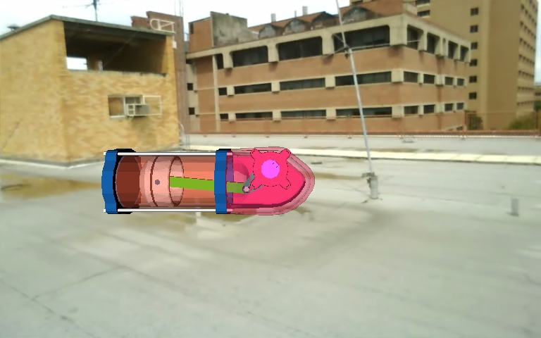
Augmented Reality Overlay
Take the precise user position and orientation from the EKF
Use MATLAB 3d toolbox to obtain correct perspective of object
Object overlayed on camera feed

Slide 23
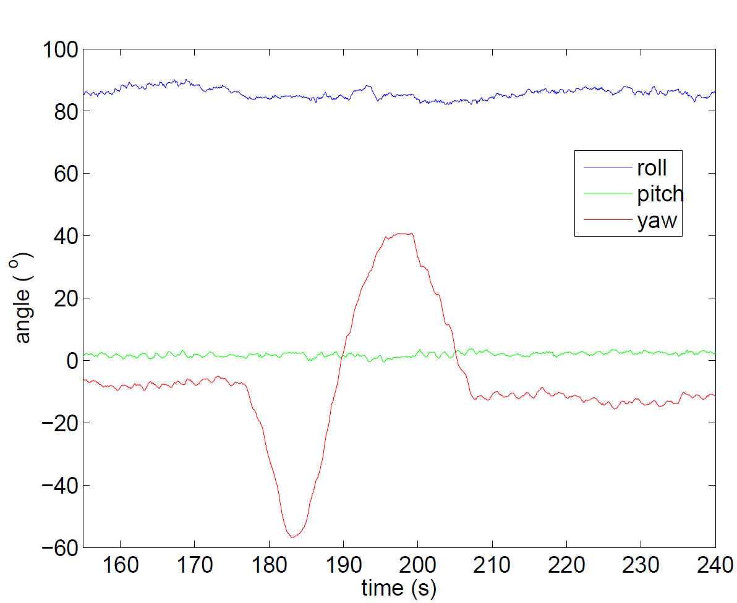
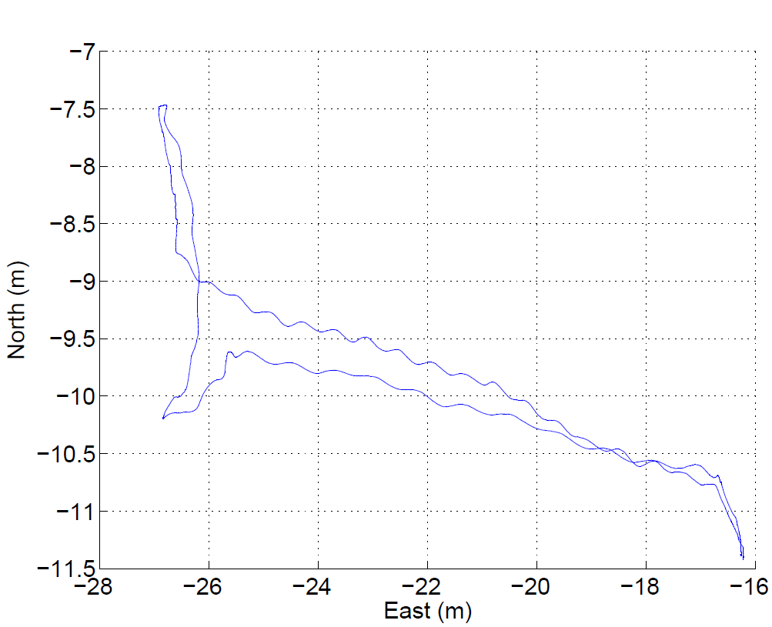
System Demonstration
East-North Position
Orientation vs Time

Slide 24
System Demonstration

Slide 25
Conclusions
Demonstrated ultra-precise augmented reality is possible by coupling together CDGPS and IMU measurements
Discussed applications, specifically those tailored toward the mobile arena
Future challenges include overcoming interference and power constraints that will be present in small-mobile systems

Slide 26
Questions

Slide 27
Conclusions
Developed an augmented reality prototype system incorporates CDGPS and IMU measurements
Designed an EKF to compute hyper-precise position and orientation of camera at 5 Hz
Used this information to overlay 3-dimensional objects onto the live video stream

Slide 28
Augmented Reality Overlay
Take the precise position and orientation from the EKF
Create of virtual overlay (Using MATLAB 3d toolbox)
Place overlay onto the camera feed (using MATLAB 3d toolbox)

Slide 29
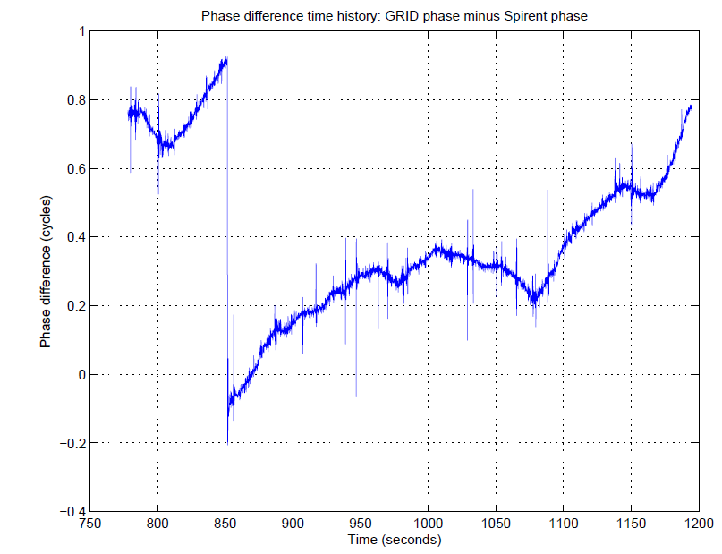
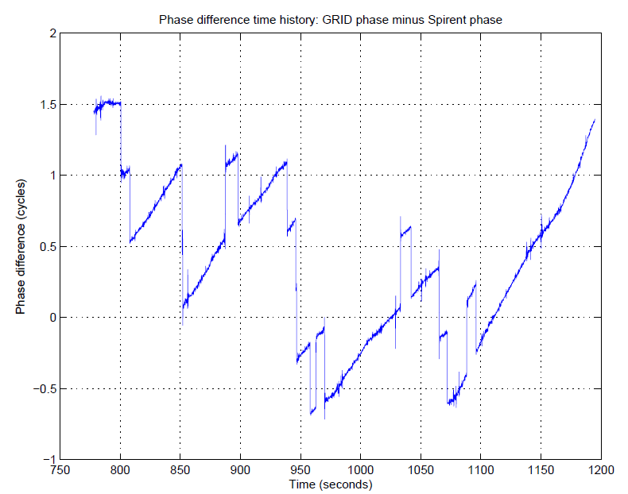
GRID Software Receiver

Slide 31
EKF: INS in charge of propagation
IMU measurements propagate state between GPS updates
Accelerometer measurement / dynamics model
Discrete-time propagation step (zero-order hold of IMU measurements):
$$\frac{d\overset{⃑}{r}}{dt}=\dot{\overset{⃑}{r}}$$
$$\frac{d\dot{\overset{⃑}{r}}}{dt}=R_{ECEF}^{IMU}\left(\overset{⃑}{f}−\overset{⃑}{b}\right)+\overset{⃑}{g}−2{\overset{⃑}{ω}}_{E}×\dot{\overset{⃑}{r}}+{\overset{⃑}{v}}_{A}$$
$$\frac{d\overset{⃑}{b}}{dt}={\overset{⃑}{v}}_{B}$$
$$\frac{d\vec{N}}{dt}=0$$
State at time k+1
State at time k
Notes:
Omega term is the Coriolis Term, We use Euler integration, i.e. a zero-order hold of the imu measurments (orientation and acc. Measurments) over the update interval.

Slide 32
Block Diagram of the EKF
Notes:
Take omega and cross it with the IMU→Antenna relative position vector to get the relative velocity of the GPS antenna in the b-frame. Then, use the quaternian to convert this relative velocity from the b-frame to the ECEF-frame. Finally, add this to the velocity in X.

Slide 33
EKF: CDGPS Measurement Update
Double-differenced measurement model
where
The measurement model is linearized using the a priori state estimate (from INS)
In square-root information form, the a posteriori state is given by the solution to
hhhh
$$λ_{L1}∆∇φ^{ij}=∆∇r_{AB}^{ij}+λ_{L1}N^{ij}+∆∇w_{φ}^{ij}$$
$$∆∇r_{AB}^{ij}=\left(\left\|{\overset{⃑}{r}}_{SV}^{i}−{\overset{⃑}{r}}_{A}\right\|−\left\|{\overset{⃑}{r}}_{SV}^{j}−{\overset{⃑}{r}}_{A}\right\|\right)−\left(\left\|{\overset{⃑}{r}}_{SV}^{i}−{\overset{⃑}{r}}_{B}\right\|−\left\|{\overset{⃑}{r}}_{SV}^{j}−{\overset{⃑}{r}}_{B}\right\|\right)$$
$$z_{φ}^{i}=λ_{L1}∆∇φ_{AB}^{ij}−∆∇{\overline{r}}_{AB}^{ij}={\left({\hat{r}}_{SV}^{j}−{\hat{r}}_{SV}^{i}\right)}^{T}δ{\overset{⃑}{r}}_{B}+λ_{L1}N^{ij}+∆∇w_{ρ}^{ij}$$
$$\left[\begin{aligned}{\overset{⃑}{z}}_{ρ} \\ {\overset{⃑}{z}}_{φ} \\ {\overline{R}}_{xN}\overset{⃑}{N} \\ {\overline{\overset{⃑}{z}}}_{N}\end{aligned}\right]=\left[\begin{matrix}H_{ρ}^{x} & \left[0\right] \\ H_{φ}^{x} & H_{φ}^{N} \\ {\overline{R}}_{xx} & {\overline{R}}_{xN} \\ \left[0\right] & {\overline{R}}_{NN}\end{matrix}\right]\left[\begin{aligned}δ\overset{⃑}{x} \\ \overset{⃑}{N}\end{aligned}\right]+\overset{⃑}{w}$$

Slide 34
EKF: CDGPS Measurement Update (cont.)
$$\left[\begin{aligned}{\overset{⃑}{z}}_{x} \\ {\overset{⃑}{z}}_{N} \\ {\overset{⃑}{z}}_{R}\end{aligned}\right]=\left[\begin{matrix}R_{xx} & R_{xN} \\ \left[0\right] & R_{NN} \\ \left[0\right] & \left[0\right]\end{matrix}\right]\left[\begin{aligned}δ\overset{⃑}{x} \\ \overset{⃑}{N}\end{aligned}\right]+\overset{⃑}{w}′$$
$$\overset{⃑}{w}′\sim N(\overset{⃑}{0},\left[I\right])$$
$$δ\overset{⃑}{x}=R_{xx}^{−1}\left({\overset{⃑}{z}}_{x}−R_{xN}{\overset{⃑}{N}}_{opt}\right)$$
[1] Xiao-Wen Chang, Xiaohu Xie and Tianyang Zhou, MILES: MATLAB package for solving Mixed Integer Least Squares problems, Version 2.0, http://www.cs.mcgill.ca/∼chang/software.php, October 2011.

Slide 35
Block Diagram of the EKF
Notes:
Take omega and cross it with the IMU→Antenna relative position vector to get the relative velocity of the GPS antenna in the b-frame. Then, use the quaternian to convert this relative velocity from the b-frame to the ECEF-frame. Finally, add this to the velocity in X.

