Slide 1
GPS Spoofing & Implications for Telecom
Kyle Wesson
The University of Texas at Austin
Sprint Synchronization Conference | September 18, 2013

Slide 2
Talk Overview
Civil GPS Spoofing Vulnerability
Anti-Spoofing Techniques
Cryptographic: Navigation Message Authentication
Non-Cryptographic: “Sandwich” Defense
Securing and Testing

Slide 3
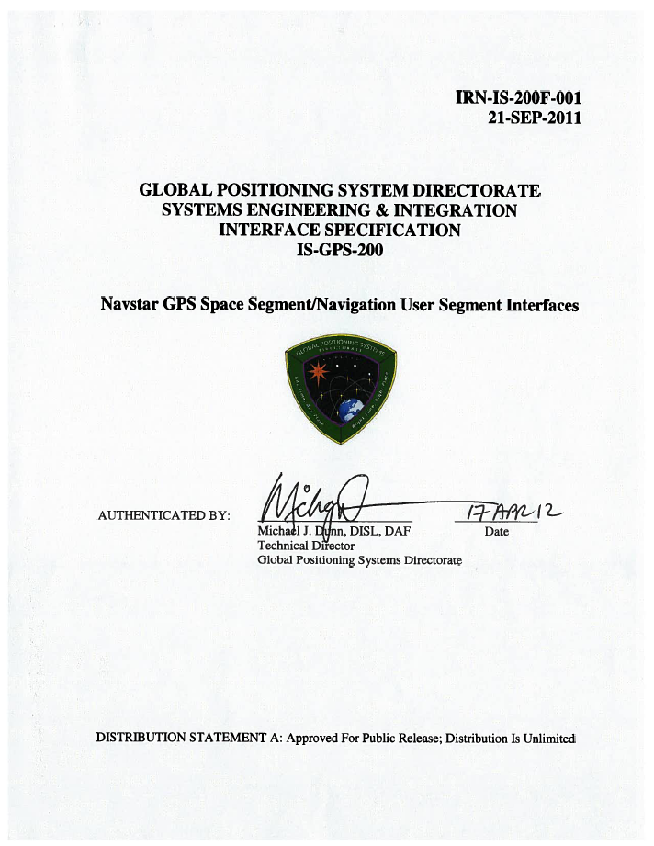
Civil GPS is Vulnerable to Spoofing
An open GPS standard makes GPS popular but also vulnerable to spoofing
[HumLed&08]

Slide 4
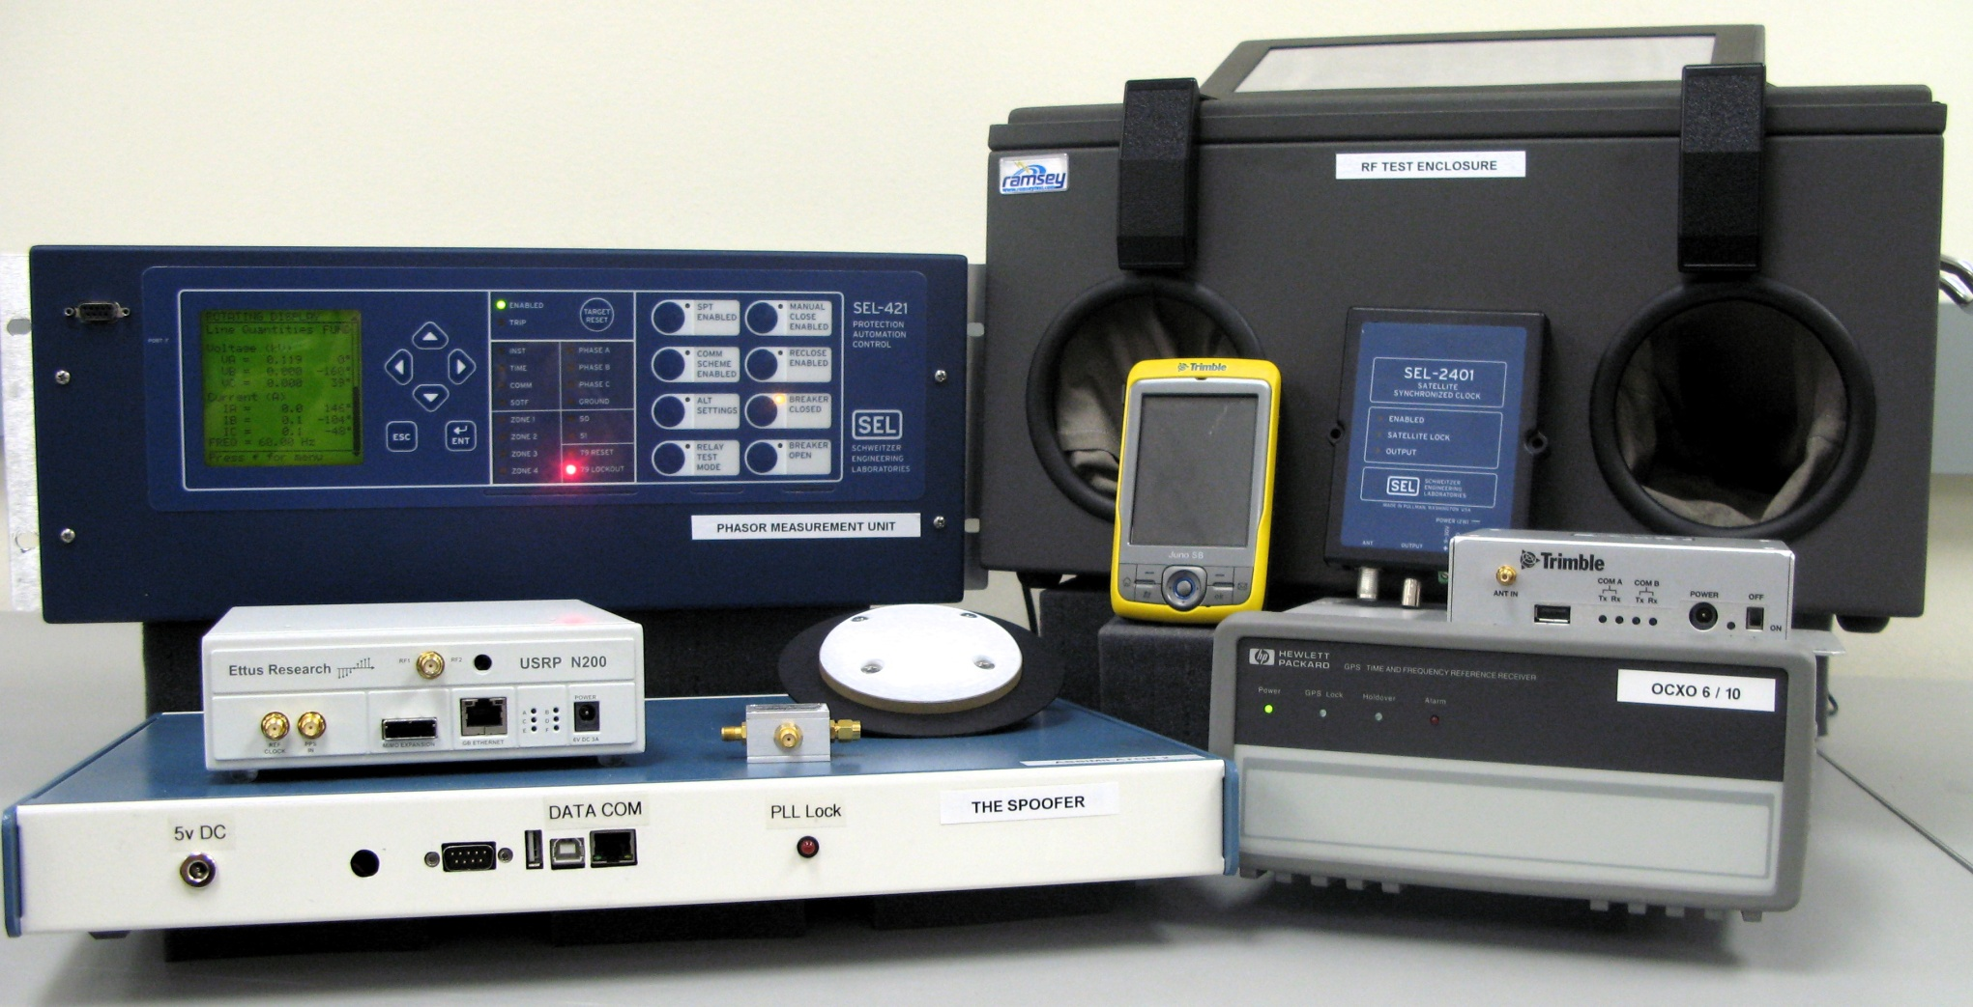
University of Texas Spoofing Testbed

Slide 5
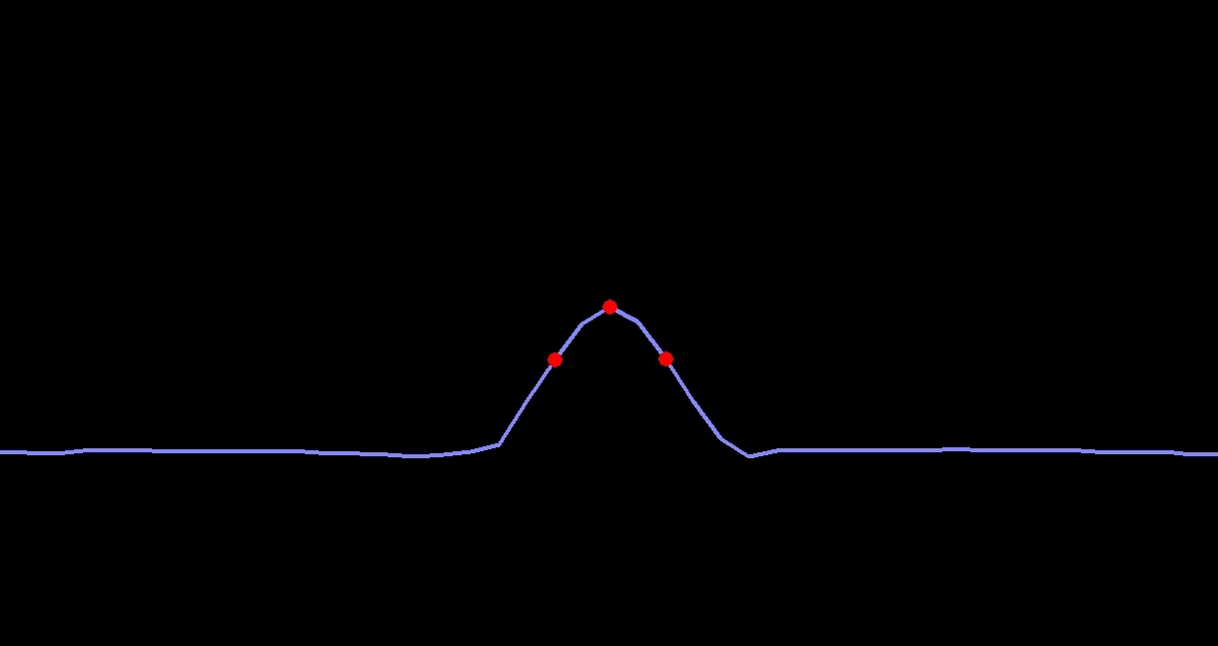
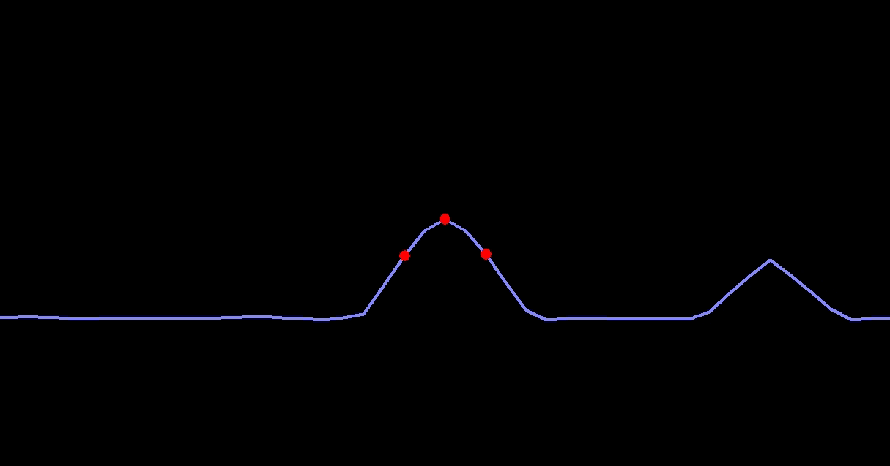
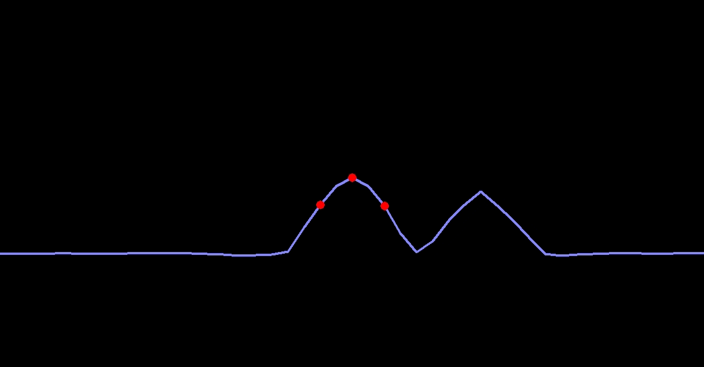
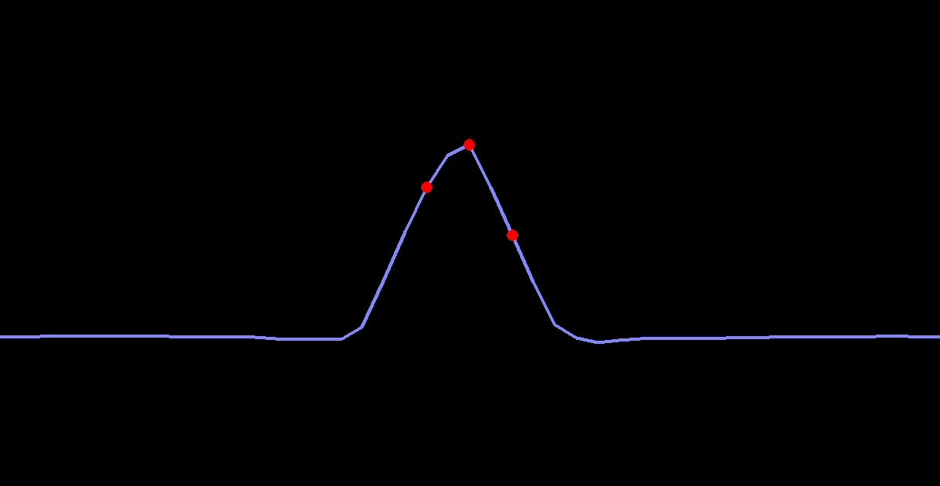
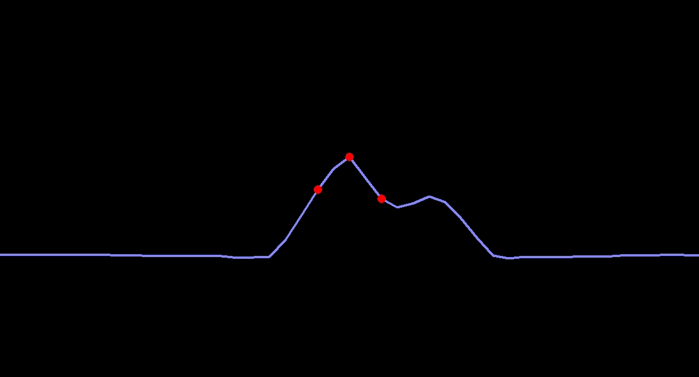
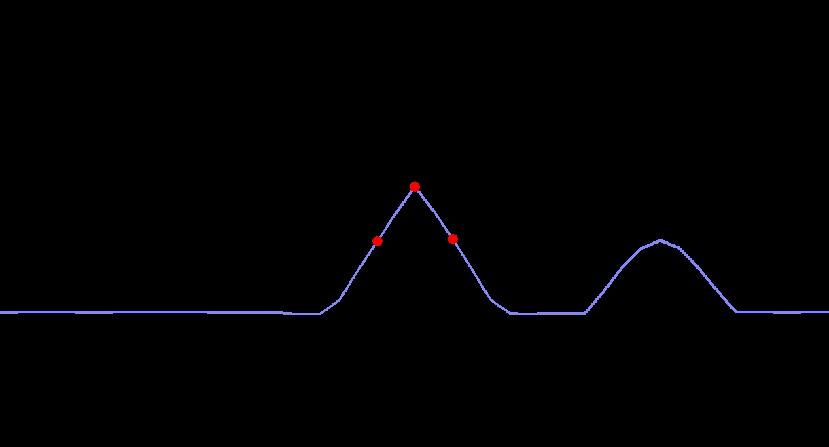
Inside a Spoofing Attack

Slide 6
Civil GPS Spoofing
A discrete spoofing attack typically involves four phases:
Alignment of the authentic and spoofed GPS signals at the target receiver
Increase the power of the spoofed signals above the authentic
Move the spoofed signals slowly away from the authentic signals
Once the spoofed and authentic signals no longer interfere, the spoofer has complete control of the target receiver’s PVT solution
Spoofer-imposed dynamics are limited only by the bandwidth of the target receiver’s tracking loops and it’s quality indicators
No receiver we’ve tested has ever successfully defended against this type of attack
D.P. Shepard and T.E. Humphreys, “Characterization of Receiver Response to Spoofing Attacks,” Proceedings of ION GNSS, Portland, Oregon, 2011.

Slide 7
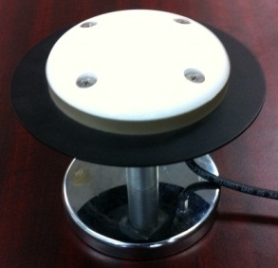
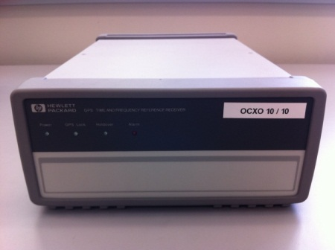
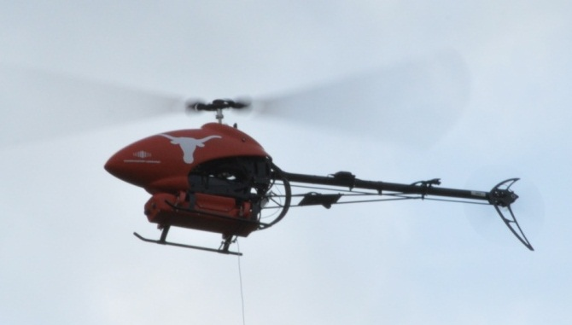
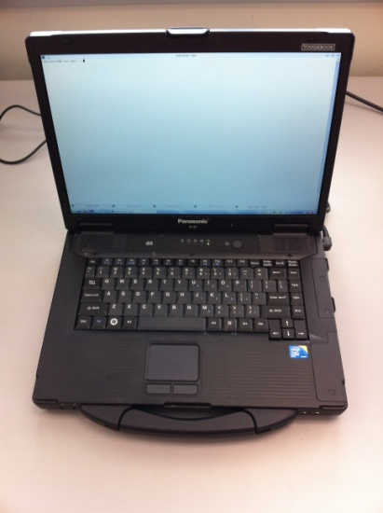
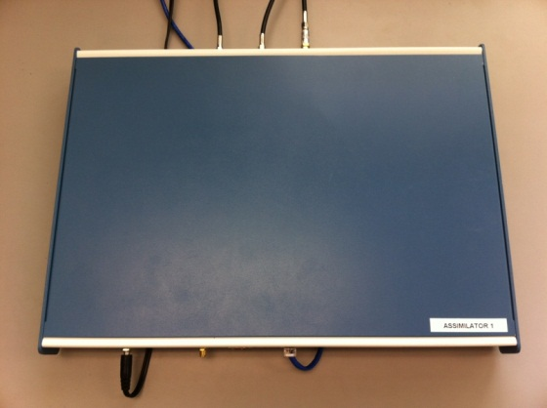
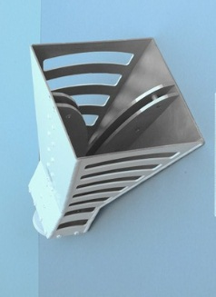
Spoofing a UAV (2012)
Receive Antenna
External Reference Clock
Target UAV
Spoofed Signals as a
“Virtual Tractor Beam”
Control Computer
Internet or LAN
GPS Spoofer
Transmit Antenna
UAV coordinates from tracking system

Slide 8
Surprises (1/2)
Receiver Autonomous Integrity Monitoring (RAIM) was helpful for spoofing: we couldn’t spoof all signals seen by unmanned aerial vehicle (UAV) due to our reference antenna placement, but the Hornet Mini’s uBlox receiver rejected observables from authentic signals, presumably via RAIM
Overwhelming power is required for clean capture: A gradual takeover leads to large (50-100 m) multipath-type errors as the authentic and counterfeit signals interact
The UAV’s heavy reliance on altimeter for vertical position was easily overcome by a large vertical GPS velocity

Slide 9
Surprises (2/2)
Not possible even to station keep with a captured UAV based on visual position estimates: GPS capture breaks flight controller’s feedback loop; now spoofer must play the role formerly assumed by GPS. Implication: An accurate radar or LIDAR system would be required for fine “control” of UAV via spoofing
Compensating for all system and geometric delays to achieve meter-level alignment is challenging but quite possible

Slide 10
Spoofing a Super Yacht (2013)

Slide 11
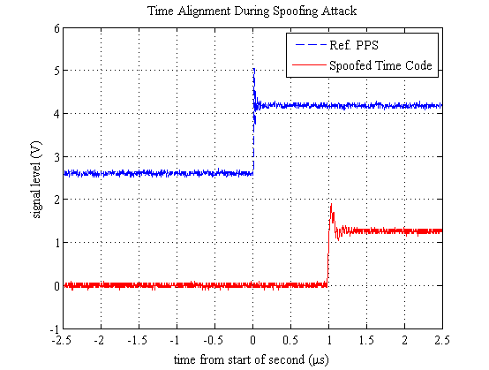
Telecom Network Vulnerabilities
Standard | Timing (Air) | Frequency (Transport / Air)
CDMA2000 | ± 3 – 10 µs | ± 16 ppb / ± 50 ppb
GSM | – | ± 16 ppb / ± 50 ppb
LTE (FDD) | – | ± 16 ppb / ± 50 ppb
LTE (TDD) | ± 1.5 µs | ± 16 ppb / ± 50 ppb
TD-SCDMA | ± 1.5 µs | ± 16 ppb / ± 50 ppb
In 35 minutes, spoofer can shift time 10 μs, which would disrupt CDMA2000 call hand-off

Slide 12
Misconceptions about Timing Security (1/2)
“Holdover” capability of GPS-disciplined oscillator (GPSDO) protects against spoofing
Holdover will not be triggered by a sophisticated spoofing attack
The reference oscillator’s drift rate is the upper limit of speed at which a GPSDO can be spoofed (e.g., 1 us per day)
Drift rate only matters if GPSDO is configured to alarm on a mismatch between GPS rate and internal clock rate
Even then, spoofer can push GPS timing at about 5x the calibrated clock drift rate because of need to keep false alarm rate low

Slide 13
Misconceptions about Timing Security (2/2)
Timing errors only become a problem at the level of seconds, or maybe milliseconds.
Microseconds matter in comm, finance, and energy sectors
Cross-checking against an atomic clock affords foolproof timing security
Rubidium clock with stability of 10⁻¹² can be pushed off by about 100 ns per day
PTP/NTP are a potential solution to GPS spoofing problem
These are getting better, but, due to network asymmetry, they still not accurate enough for most demanding applications non-dedicated networks

Slide 14
Recommendations
Humphreys’ testimony to House Committee on Homeland Security, July 19, 2012
Require navigation systems for UAVs above 18 lbs to be certified “spoof-resistant”
Require navigation and timing systems in critical infrastructure to be certified “spoof-resistant”
“Spoof resistant” defined by ability to withstand or detect civil GPS spoofing in a battery of tests performed in a spoofing testbed (e.g., Texas Spoofing Battery)

Slide 15
Anti-Spoofing

Slide 16
Spoofing Defenses
Cryptographic
Non-Cryptographic
SSSC on L1C
(Scott)
J/N Sensing
(Ward, Scott, Calgary)
Stand-Alone
NMA on L2C, L5, or L1C
(MITRE, Scott, UT)
Sensor Diversity Defense
(DARPA, BAE, UT)
SSSC or NMA on WAAS
(Scott, UT)
Single-Antenna Spatial Correlation
(Cornell, Calgary)
Correlation Anomaly Defense
(TENCAP, Ledvina, Torino, UT)
P(Y) Cross-Correlation
(Stanford, Cornell)
Networked
Multi-Element Antenna Defense
(Keys, Montgomery, DLR, Stanford)

Slide 17
Cryptographic Anti-Spoofing
Anti-Spoofing

Slide 18
Security-Enhanced GPS Signal Model
Security code :
Generalization of binary modulating sequence
Either fully encrypted or contains periodic authentication codes
Unpredictable prior to broadcast

Slide 19
Attacking Security-Enhanced GPS Signals
Record and Playback (Meaconing): record and re-broadcast RF spectrum
Security Code Estimation and Replay (SCER) Attack: estimate security code on-the-fly without additional noise
re-broadcast with delay and amplitude
security code estimate

Slide 20
How to authenticate a GPS signal?
Code Timing Authentication
Code Origin Authentication
Metrics
Standard Receiver
[WesRot&12]

Slide 21
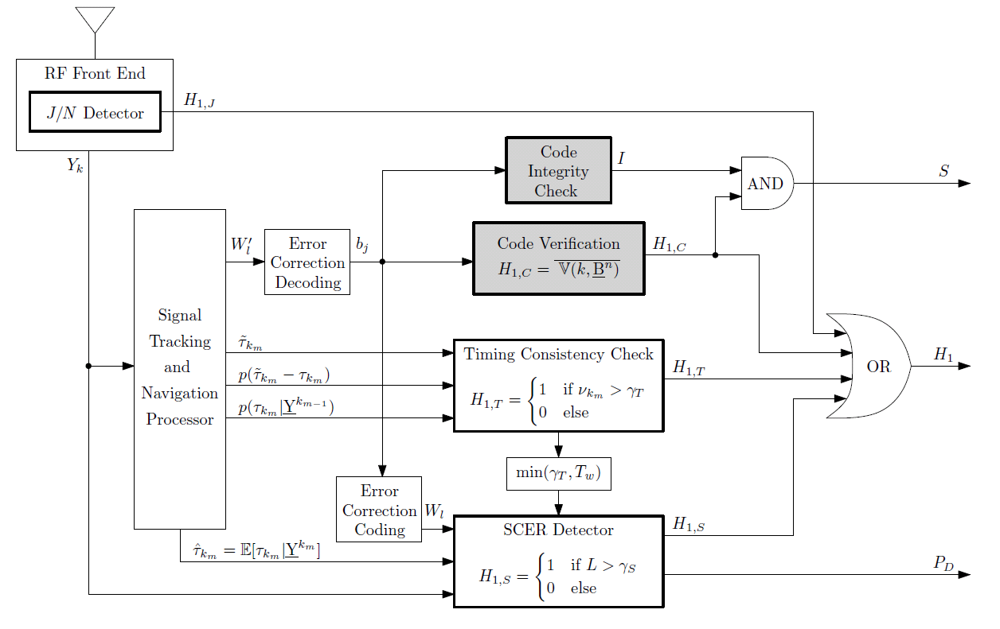
Declaring a Signal Authentic
From time of verifiable non-spoofing event:
Logical remained low
Logical remained low
remains above acceptable threshold

Slide 22
Embedding the Signature
Civil Navigation (CNAV) Message
Flexible & extensible
Packet-like structure:
300 bits in 12 sec
Message Type ID field can identify up to 64 messages of which only 15 are defined

Slide 23
Non-Cryptographic Anti-Spoofing
Anti-Spoofing

Slide 24
Spoofing Requirement and Difficulty
Q: What is a requirement of a successful spoofing attack?
A: Spoofed signal power greater than authentic signal power
Q: What is a difficulty of a successful spoofing attack?
A: Suppressing authentic signals while remaining below J/N sensor detector

Slide 25
“Sandwich” Defense
Constrain spoofer between
total in-band received power detector &
cross-correlation function distortion monitor
Features
Use multiple correlator taps (RAKE-like)
Check multipath signatures across channels
Real-time, software defense

Slide 26
Spoofed Signal Distortions

Slide 27
Clean vs. Spoofed Scenarios
Nominal Power and Minimal Distortions
Additional Power and Large Distortions

Slide 28
Securing and testing
So what is there to do?

Slide 29
Options for Secure ns-Accurate Timing (1/2)
Obtain required permissions to purchase SAASM-equipped GPSDO
Lots of paperwork, special handling
Expensive
Fairly secure against spoofing
Not secure against replay attack
Wait for GPS Directorate to insert digital signatures into modernized GPS signals
They’re making progress! (The University of Texas is helping.)
Not so strong as SAASM for timing security, but quite effective
Eventually inexpensive, but will require new GPSRO

Slide 30
Options for Secure ns-Accurate Timing (2/2)
Cross-check GPS timing against redundant high-quality (e.g., atomic) clocks
Self-contained
Expensive
Absolutely secure to within about 5x the drift rate of ensemble
“All Signals” Approach: Develop a GPSDO that pulls in signals from GPS + Glonass + Galileo and rigorously cross-checks these
None on market yet (so far as I’m aware)
Potentially inexpensive: uBlox LEA-7 runs ~$50
Spoofer’s job gets much harder with each new signal
PTP/NTP over a dedicated network

Slide 31
The Texas Spoofing Test Battery (TEXBAT)
6 high-fidelity recordings of live spoofing attacks
20-MHz bandwidth
16-bit quantization
Each recording ~7 min. long; ~40 GB
Can be replayed into any GNSS receiver

Slide 32
FREE
The Dynamic Matched-Power Position Push
The Dynamic Overpowered Time Push
The Static Matched-Power Position Push
The Static Matched-Power Time Push
The Static Overpowered Time Push
The Static Switch
The University of Texas Radionavigation Lab
and
National Instruments
jointly offer the Texas Spoofing Test Battery
Request: todd.humphreys@mail.utexas.edu

Slide 33
Observations on Defenses
Crypto defenses not a panacea: Ineffective against near-zero-delay meaconing (entire band record and playback) attacks.
Non-crypto defenses not so elegant mathematically, but can be quite effective.
Best shield: a coupled crypto-non-crypto defense.
When implemented properly, navigation message authentication (NMA) authenticates not only the data message but also the underlying signal. It is surprisingly effective.

Slide 34
Thank you
email: kyle.wesson@utexas.edu
web: http://radionavlab.ae.utexas.edu

Slide 35
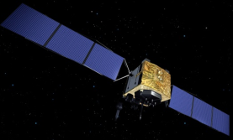
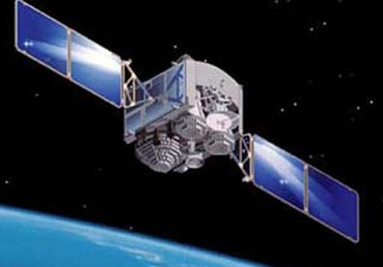
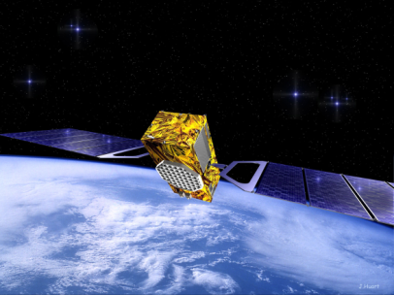
Radionavigation
Radionavigation
Systems
GPS
GNSS
Radionavigation
Systems
GPS
GNSS
Notes:
The scope of our research in the UT Radionavigation Laboratory covers GPS, GNSS, and other radionavigation systems -- or systems that can be repurposed as radionavigation systems -- such as the Iridium low-earth-orbiting communications constellation, HDTV, cellular telephony systems, and the NIST timing dissemination system. We’re also looking to create our own local navigation systems: ad-hoc collaborative radionavigation networks in which each node benefits from assistance data and ranging signals transmitted by the other nodes. Hence, GPS is at the core of our work, but our scope extends well beyond it.

Slide 36
GPS Errors & Accuracy
Ephemeris errors in r ^{i}: 2 m
Transmitter clock errors: 2 m
Residual Ionospheric delay: 4 m*
Tropospheric delay: 0.5 m
Multipath (reflected signals): 1 m#
Receiver noise: 0.5 m
Multiplicative effect of geometry (GDOP)
Typical accuracy: 10 m/axis, 30 nsec in time, 0.01 m/sec velocity
* for single-frequency receiver w/model corrections, error > 15 m possible in unusual ionospheric conditions, low elevation
# error > 15 m possible in strong multipath environments
Notes:
Be sure mention GDOP as a multiplicative factor and the final accuracies.

Slide 37
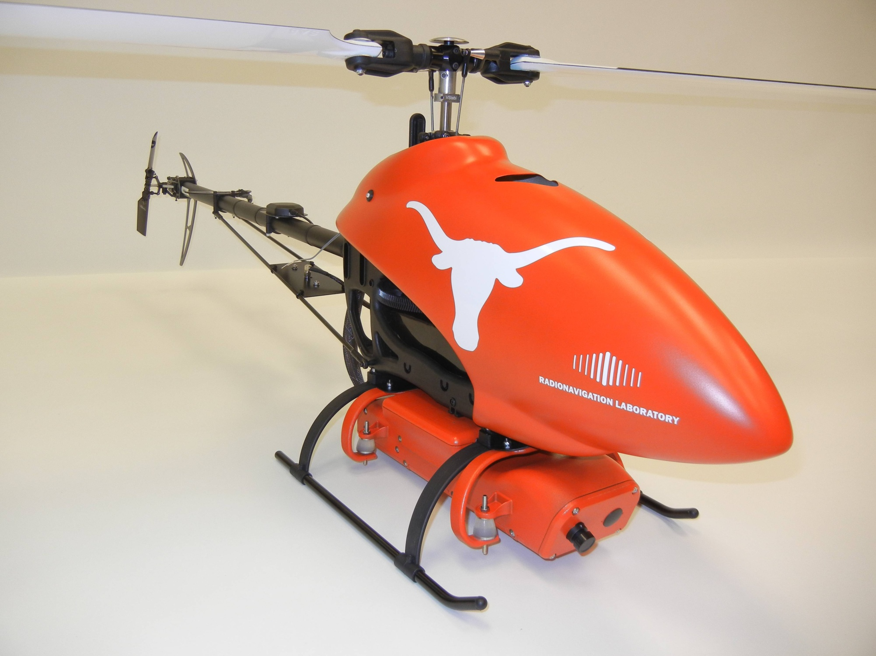

Slide 38
Smart Grid Vulnerabilities
Operational system in Mexico on the Chicoasen-Angostura transmission line
Automated PMU-based control
Connects large hydroelectric generators to large loads
Two 400-kV lines and a 115-kV line
Large phase angle offsets (>10○) induced in minutes
Protects against generator instability during double fault by shutting down generators
Spoofing attack can cause PMUs to violate IEEE C37.118 Standard
[SheHum&12]

Slide 39
Observations on Defenses (1/3)
Navigation signal authentication is hard. Nothing is foolproof. There are no guarantees. But simple measures can vastly decrease the probability of a successful attack. Probability is the language of anti-spoofing.
Symmetric-key systems (e.g., SAASM) offer short time to authenticate but require key management and tamper-proof hardware: more costly, less convenient. SAASM and M-code will never be a solution for a wide swath of applications (e.g., civil aviation, low-cost location and time authentication).

Slide 40
Observations on Defenses (2/3)
Asymmetric-key (public-private key) systems have an unavoidable delay (e.g., 40 seconds between authentication of any signal) but delay can be accepted in many applications; also, for non-complicit spoofing there is no need to tamper-proof the receiver: cheaper, more convenient.
Proof of location (proving to you where I am) is emerging as a vital security feature. It’s not easy: non-crypto approaches require elaborate tamper proofing; crypto approaches require high-rate security code. Beware black-market vendors with high-gain antennas who will sell an authenticated location.

Slide 41
Observations on Defenses (3/3)
Crypto defenses not a panacea: Ineffective against near-zero-delay meaconing (entire band record and playback) attacks.
Non-crypto defenses not so elegant mathematically, but can be quite effective.
Best shield: a coupled crypto-non-crypto defense.
When implemented properly, navigation message authentication (NMA) authenticates not only the data message but also the underlying signal. It is surprisingly effective.

Slide 42
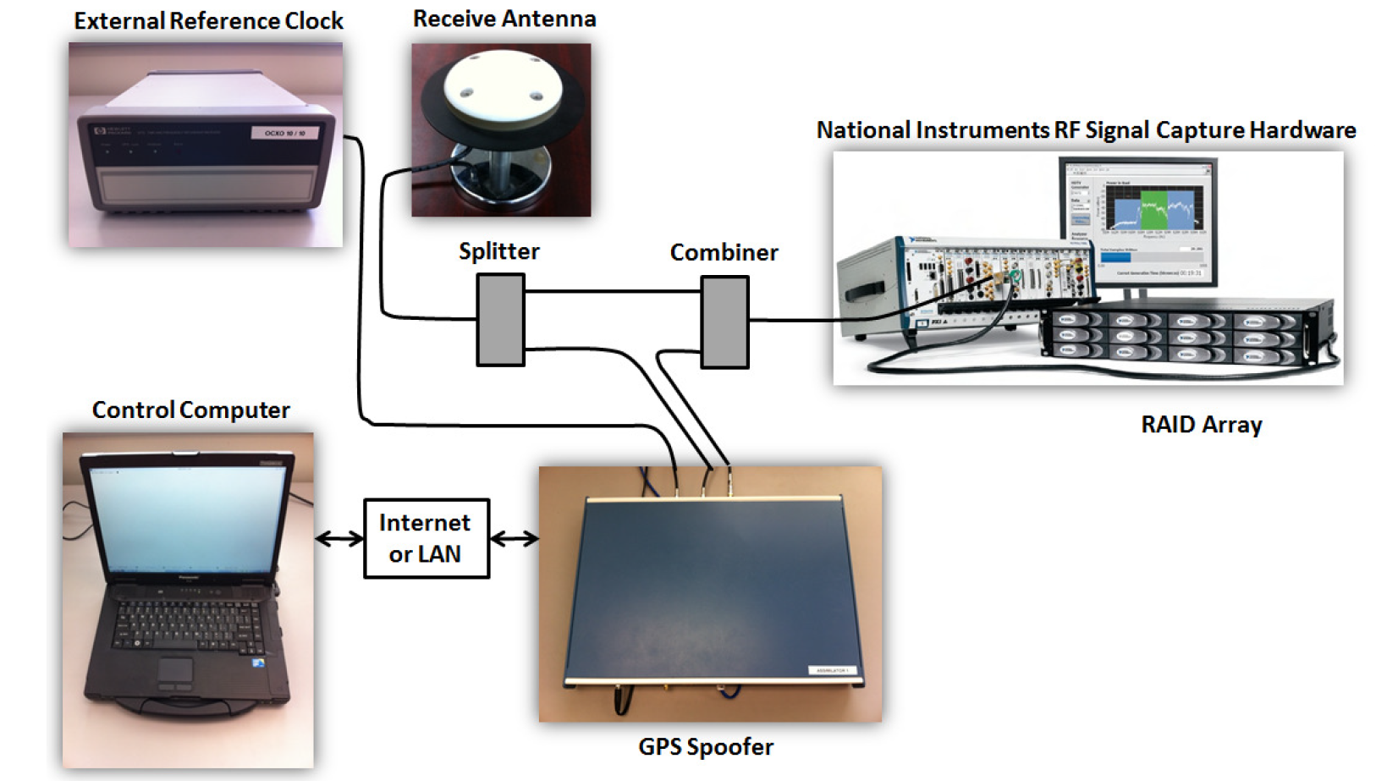
TEXBAT Recording Setup

Slide 43
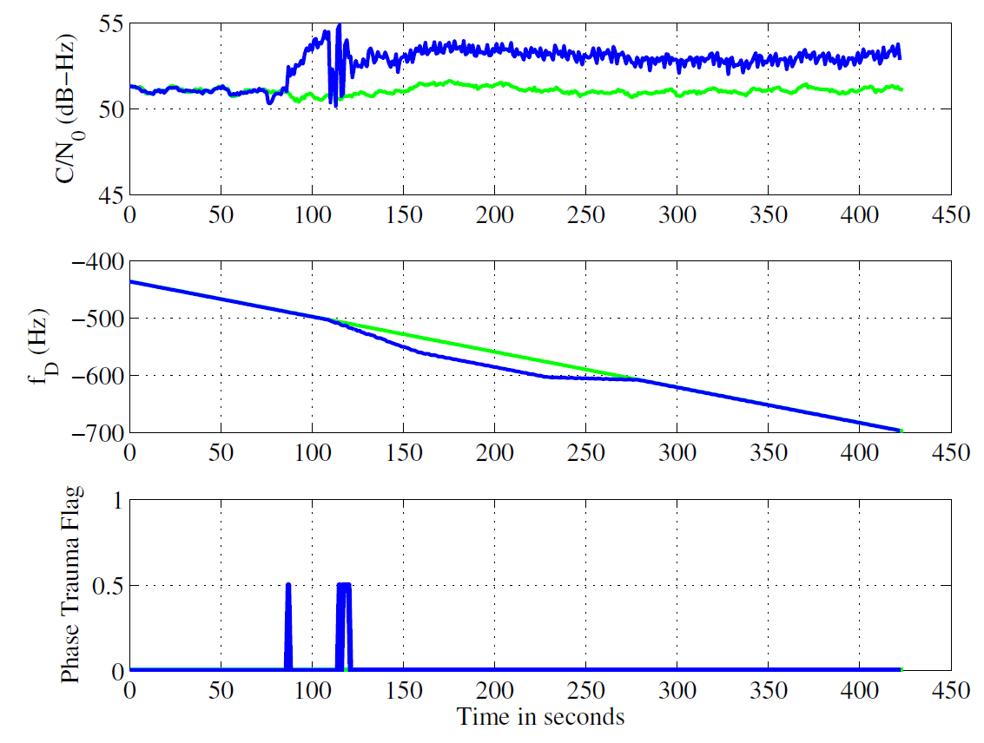
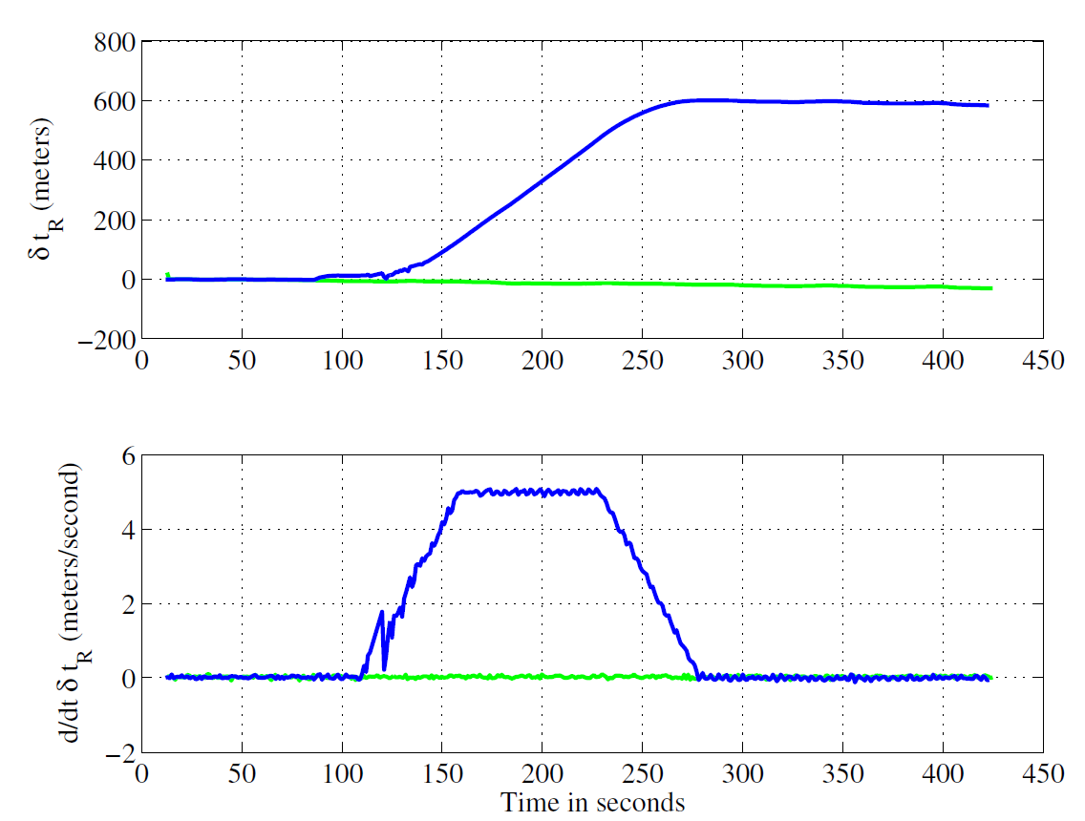
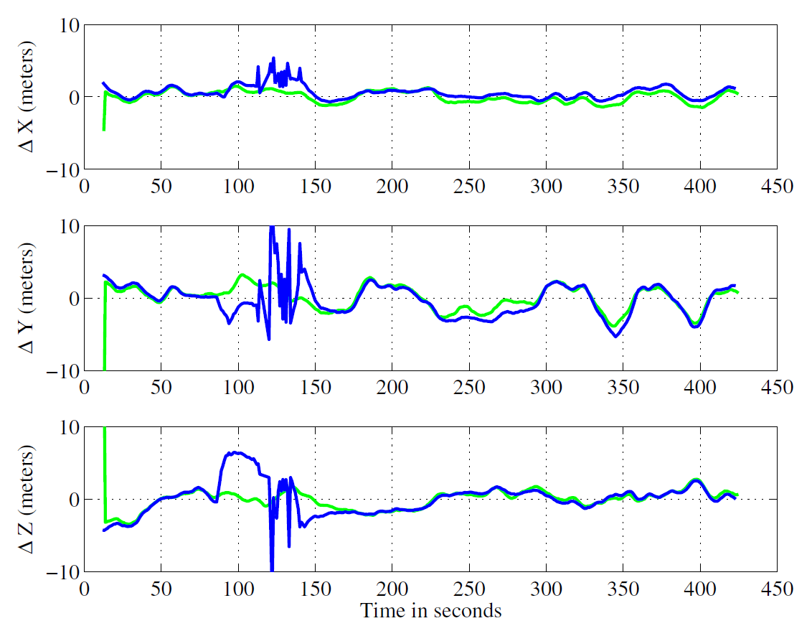
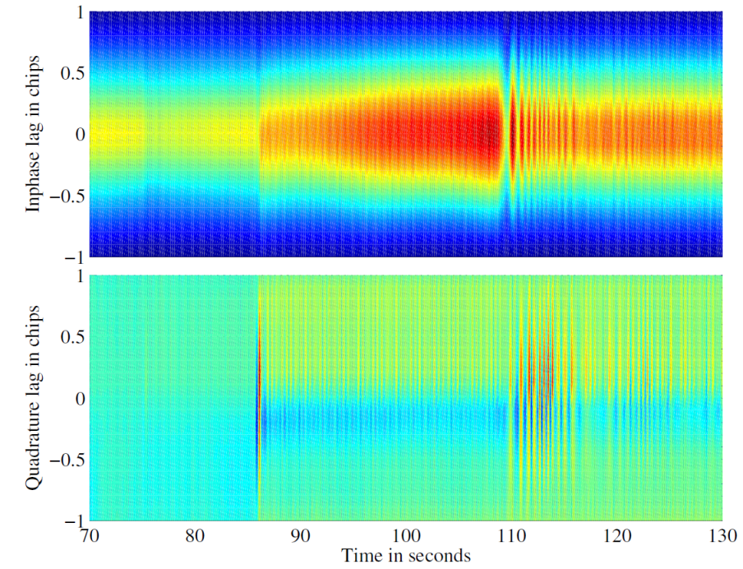
Scenario 2: Static Overpowered Time Push

Slide 44
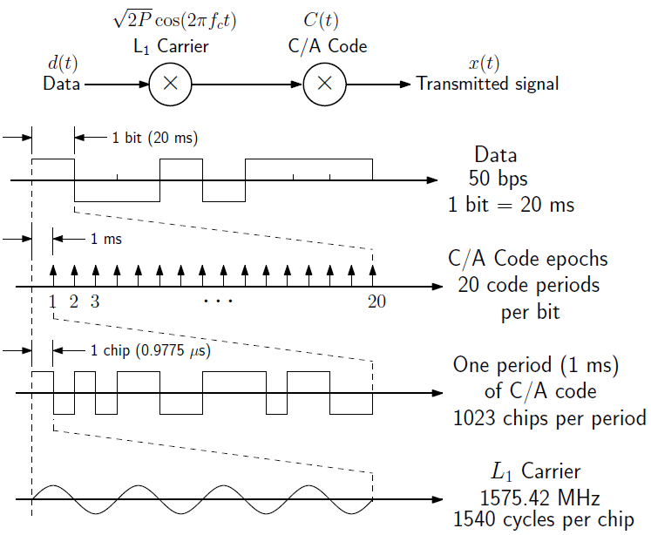
GNSS Signal Processing Basics

Slide 45
GNSS Signal Processing Basics

Slide 46
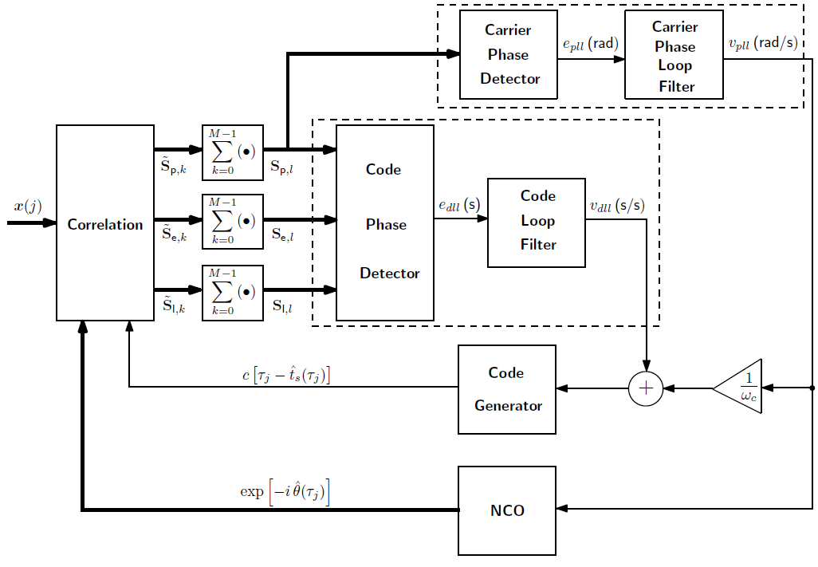
GNSS Receiver Block Diagram
Notes:
Correlation: correlate with code to produce prompt, early, late complex accumulation phasors
Coherent summations: For weak signals (C/N0 < 45dB) M of them
Code Tracking: Phase Detector & Code Loop Filter
Carrier Tracking: Carrier Phase Detector & Carrier Phase Loop Filter
Code Generator: Generate delayed code (like a long measuring tape of consecutive codes)
NCO: Integrator
Why Carrier-Aided Code Tracking instead of Code-Only Tracking?
Code @ 1.023 MHz & Carrier @ 1575.42 MHz -> Code wavelength @ 300 m & Carrier wavelength @ 19 cm
To get same precision in code as in carrier we need a filter with a time constant 1,000 times as high as carrier. But for typical Noise scenarios and fD dynamics (Bwcode ~ 0.2 Hz and Bwcarrier ~ 20 Hz) stable code-loop only filter are impossible to realize.

