Slide 1
The GPS Assimilator A Method for Upgrading Existing GPS User Equipment to Improve Accuracy, Robustness, and Resistance to Spoofing
Todd Humphreys and Jahshan Bhatti, UT Austin
Brent Ledvina, Coherent Navigation
ION 2010, Portland Oregon

Slide 2
Q: What will GNSS receivers look like 5 years from today?

Slide 3
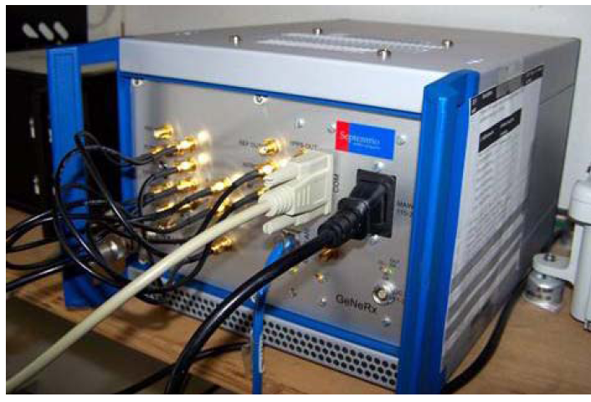
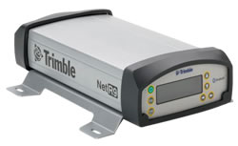
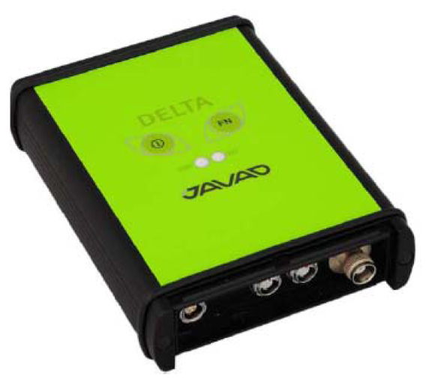
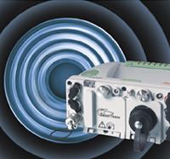
All-In-View Commercial RXs (2010)
Septentrio GeNeRx1
Trimble NetR9
Javad G3T
Leica GRX1200+GNSS
Topcon NET-G3A

Slide 4
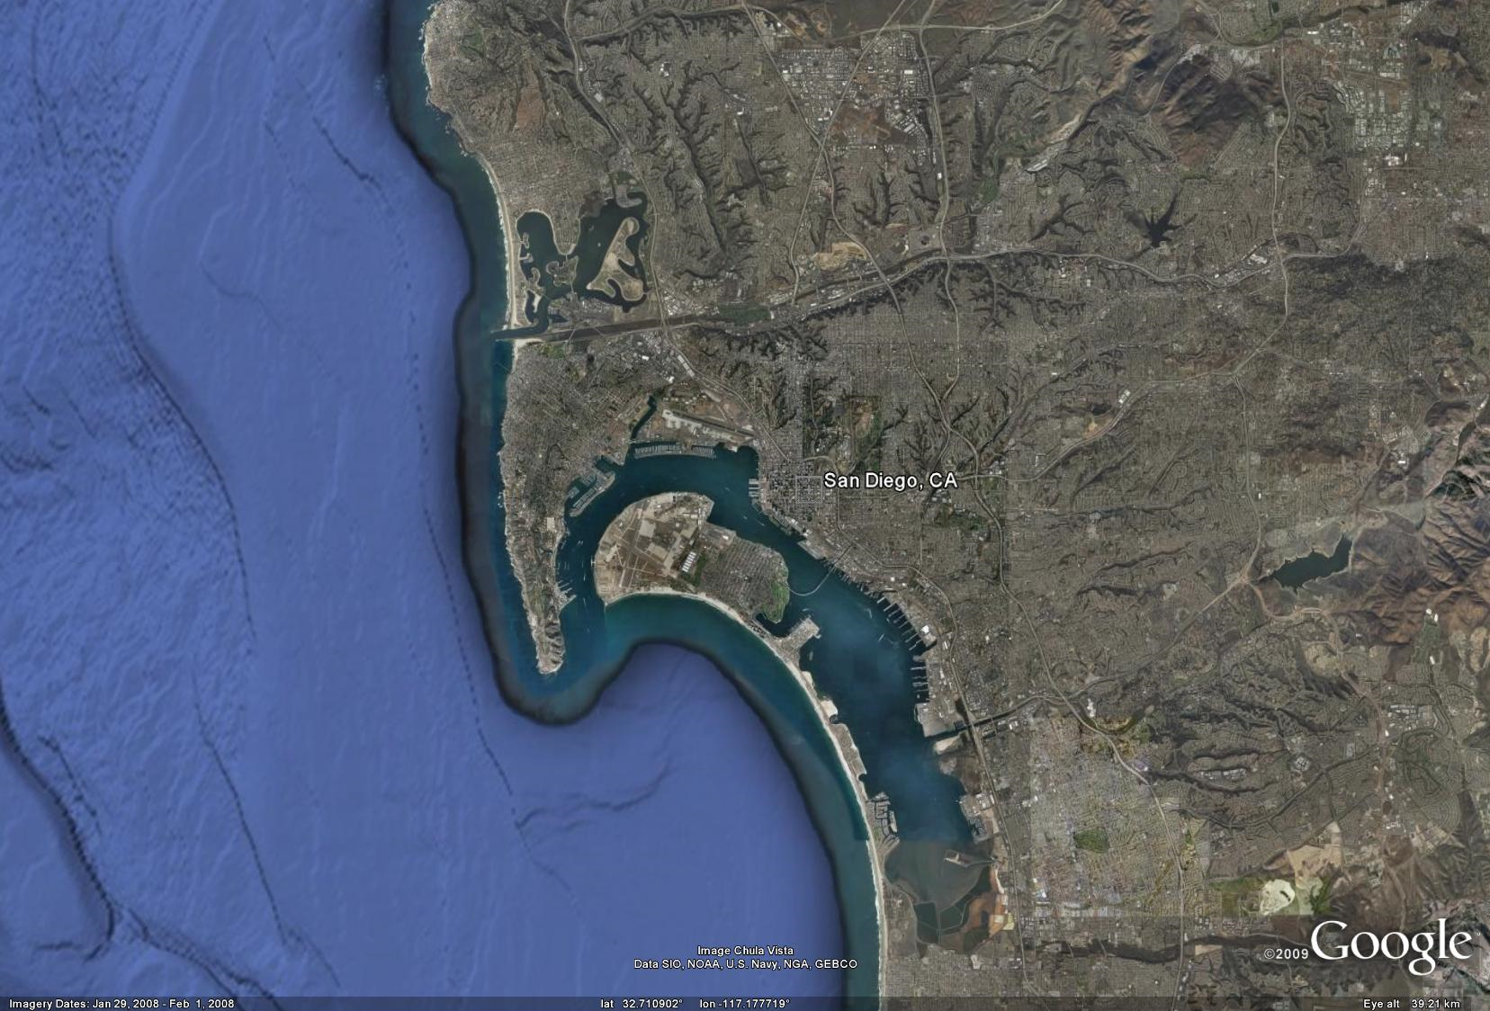
Emerging Threat: GPS RF Interference
Notes:
Imagine a hypothetical scenario in which GPS is disrupted over a wide area, say, in the San Diego harbor and surrounding area. If GPS were denied in this area, flights into the San Diego international airport would have to get by without GPS, local cell phone base stations would shut down or show degraded performance, ATM machines would go off line, and the self-organizing vessel-to-vessel communication and collision avoidance system used to manage harbor traffic would be rendered inoperable.
We know so much about the effects of a GPS outage in this hypothetical scenario because it’s not hypothetical at all: it happened in 2007. A couple of hapless Navy technicians testing communications equipment accidentally jammed GPS in the San Diego harbor area for 3 hours. All of the above-listed effects are real.
Once the technicians discovered their mistake, they promptly shut down the jamming source. It took about a day and a half for the Coast Guard, the FAA, and the FCC to identify the likey location of the interference source, but they settled on Coronodo Island whereas the actual jammer source was more than a mile away.
In other words, this was a serious incident that exposed our vulnerability to GPS interference.

Slide 5
Emerging Threat: Civil GPS Spoofing
Notes:
The weakness of GPS signals leaves them vulnerable to jamming, but it is their lack of signal authentication that makes them vulnerable to spoofing.
(Double-click on the dark panel to see video footage of a correlation function during an actual spoofing attack.)
To better assess and defend against the spoofing threat, Dr. Humphreys and
collaborators recently built a fully operational portable civil GPS spoofer. They
demonstrated that a malefactor in possession of such a device could dupe any
off-the-shelf civil GPS receiver into reporting erroneous position and time
data, and they warned that such spoofing could threaten cell telephone
systems, power grids, and financial transactions, which all depend on
GPS-based synchronization, as well as location-based regulatory practices such
as fishing regulation and road-user charging schemes. To address this threat,
investigators at the Radionavigation Laboratory are busy developing effective
and practical methods for defending against civil GPS spoofing.

Slide 6
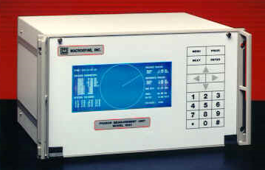
Example Systems Relying on Embedded GPS
Phasor Measurement Unit
GPS Time and Frequency Receiver

Slide 7
Goal: Upgrade Path for GPS Receivers
All-in-view capability
Weak-signal tracking
RF Interference robustness
Spoofing resistance
No software modifications to RX required
No hardware modifications to RX required

Slide 8
Conceptual GPS Assimilator

Slide 9
Assimilator Software Structure

Slide 10
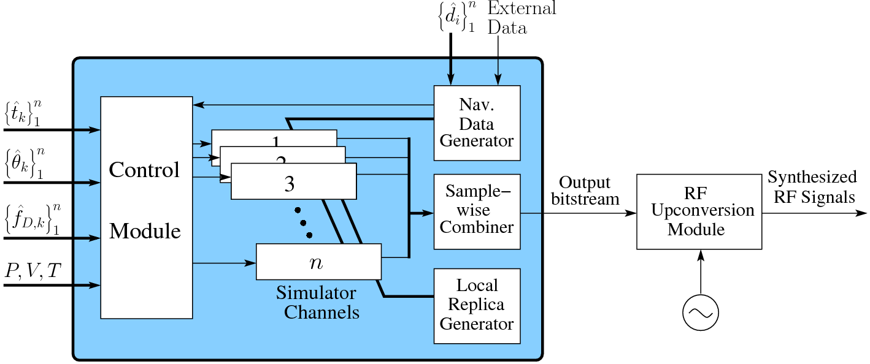
The Embedded GPS Signal Simulator

Slide 11
Assimilator Prototype

Slide 12
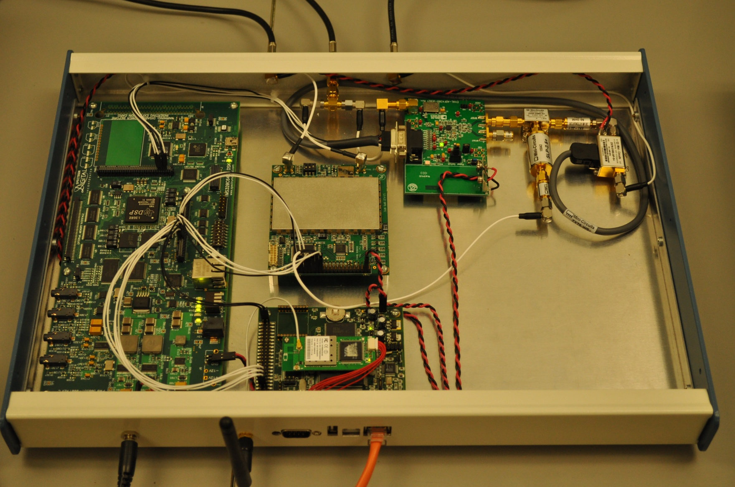
Inside the Box
Dual-Frequency RF Front End

Slide 13
Inside the Box
RF Back End

Slide 14
Inside the Box
Interface Board

Slide 15
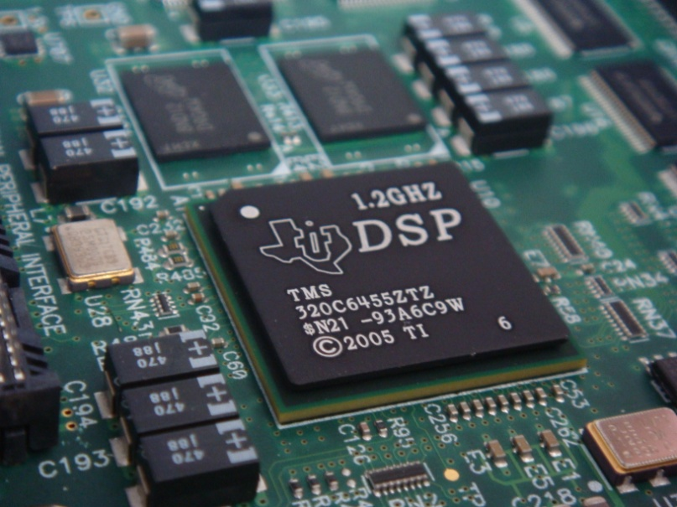
Inside the Box
Digital Signal Processor

Slide 16
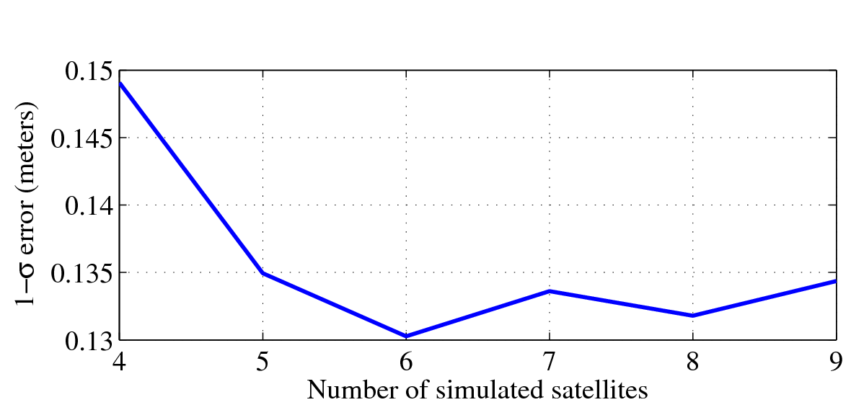
Optimal Output Signal Composition

Slide 17
Usage Example: Protecting a GPS Time and Frequency Receiver

Slide 18
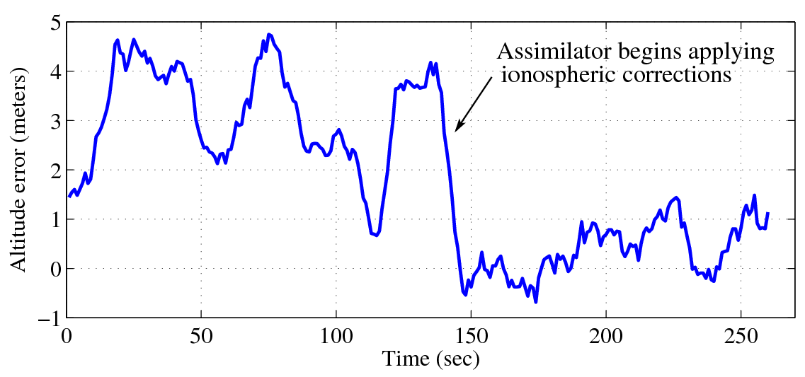
Usage Example: Reducing Ionospheric Errors

Slide 19
Usage Example: Harnessing CDMA Cellular Signals as Aid for Weak GPS Signal Tracking

Slide 20
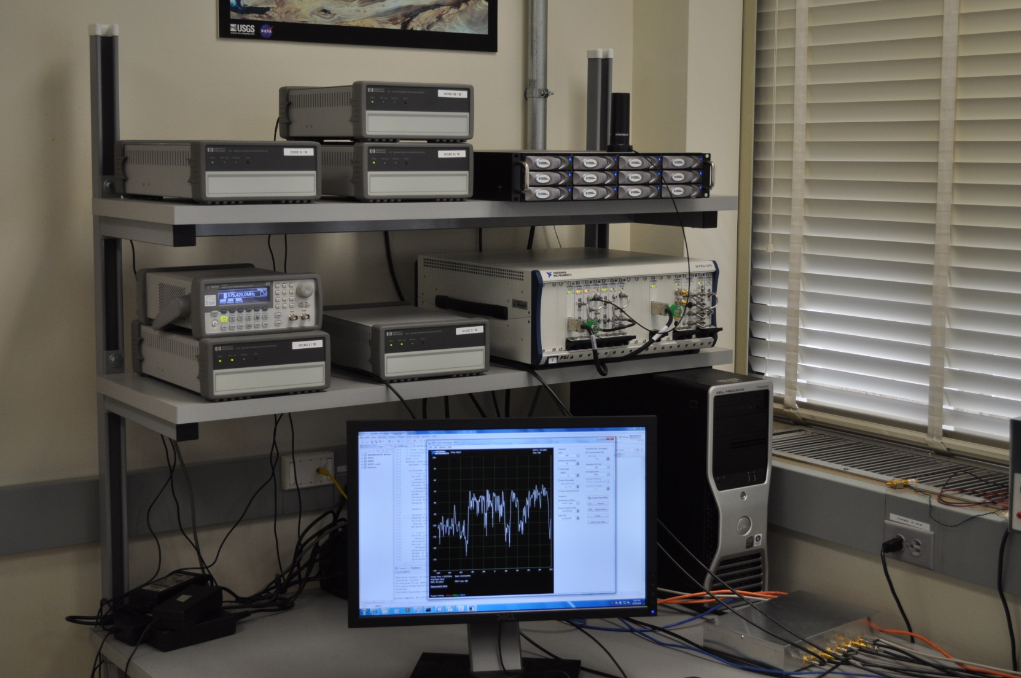
Assimilator Prototype II

Slide 21
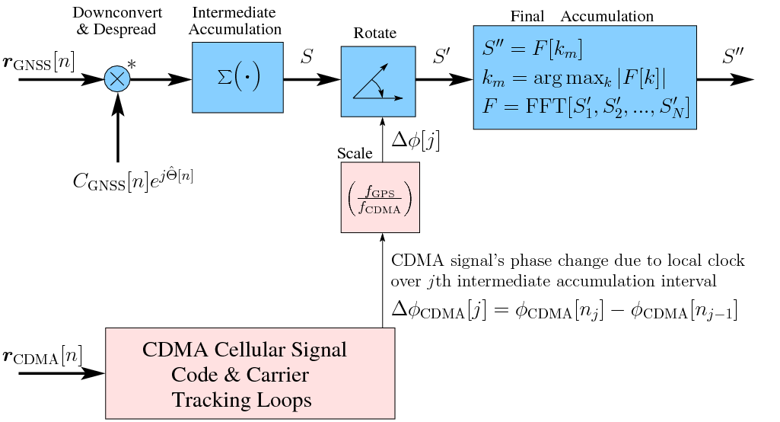
Receiver Clock Corrections via CDMA Cellular Signal Aiding

Slide 22
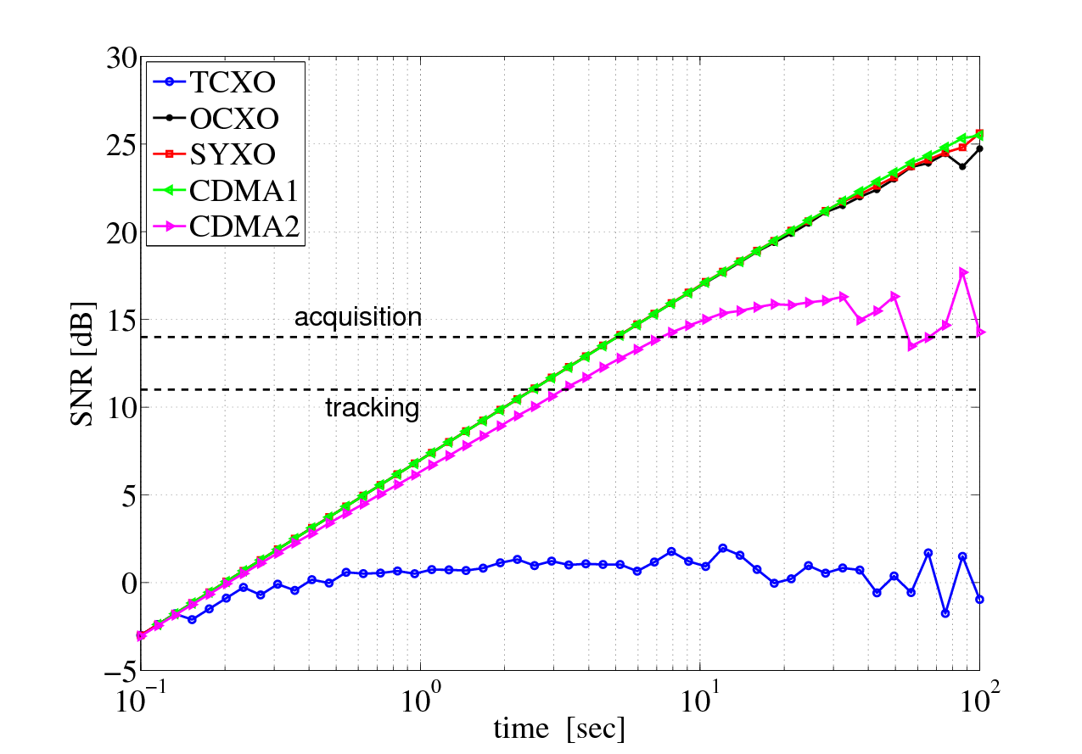
Benefit of CDMA Cell Signal Aiding
Pre-detection SNR for received C/No = 7 dB-Hz

Slide 23
Summary
Assimilative technique offers:
Weak-signal tracking
RF Interference robustness
Spoofing resistance
No hardware or software modifications required
L1 C/A + L2C prototype reduces ionospheric errors
L1 C/A + CDMA cellular prototype suggests extended coherent integration possible for weak-signal tracking

