Slide 1
Secure PNT for Autonomous Systems
Todd Humphreys | Aerospace Engineering
The University of Texas at Austin
Stanford PNT Challenges and Opportunities Symposium | November 14, 2013

Slide 2
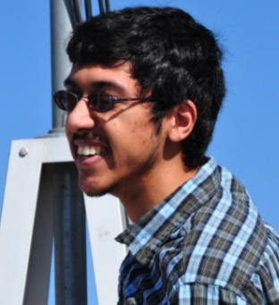
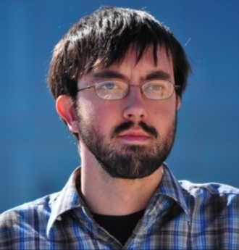
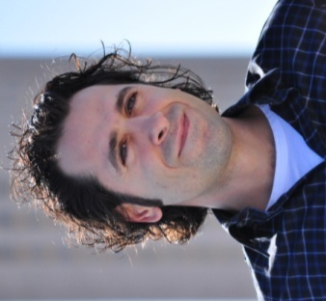
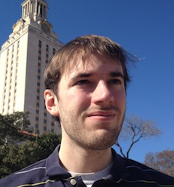
Acknowledgements
University of Texas Radionavigation Lab graduate students Jahshan Bhatti, Kyle Wesson, Ken Pesyna, Zak Kassas, Daniel Shepard, and Andrew Kerns
Master Andrew Schofield,
The White Rose of Drachs

Slide 3
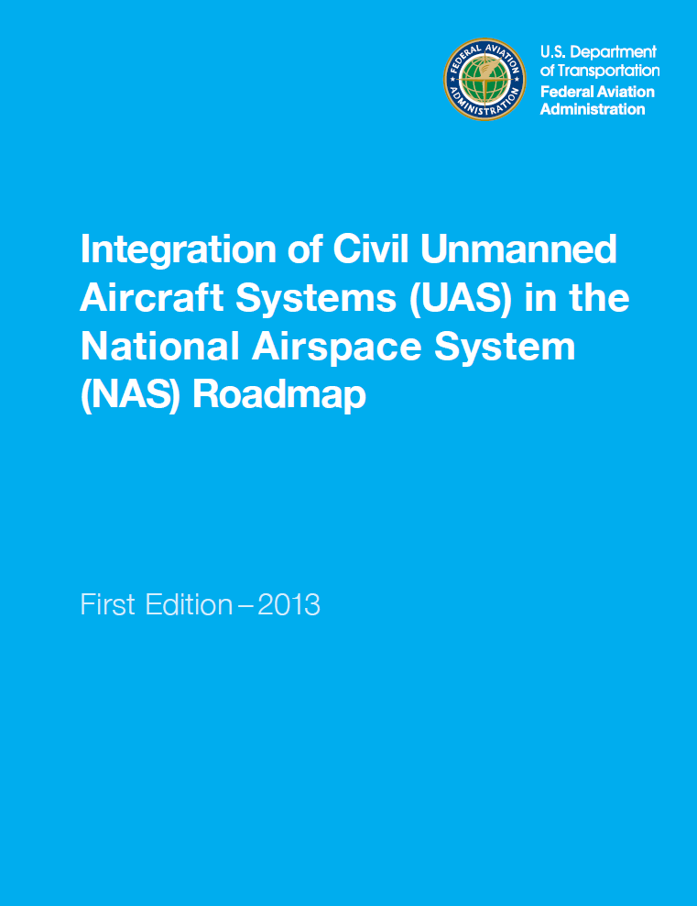
“routine UAS operations will not require the creation of a new
special airspace, or modification of existing special use airspace”
Notes:
To some fanfare, the FAA released last week the first edition of a long-awaited roadmap for integration of civil UAS into the NAS.
The age of autonomous vehicles is upon us.
The next few decades will see pervasive autonomous control systems become critical to the world
economy—from autonomous cars and aircraft to smart homes, smart cities, and vast energy, communication,
and financial networks controlled at multiple scales. Protecting these systems from
malicious attacks is a matter of urgent societal interest. The study of secure control has made
important advances over the past few years, but these constitute not solutions so much as
problem framing and an emerging consensus that traditional fault detection and mitigation fails
when confronted with a deliberate attacker: outlaws are different from outliers; fraud is different
from faults. Moreover, the vast majority of this early literature focuses only on cyber
attacks—infiltration of the communications networks over which sensor measurements y and control
commands u are conveyed.

Slide 4
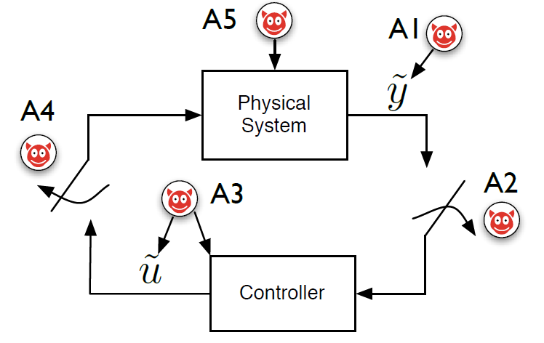
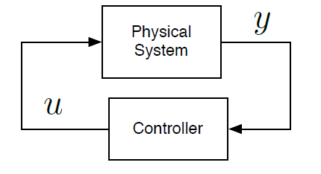
Autonomous Control System Security
The general concept of secure control covers any manipulation of
y and u (e.g, deception and DoS attacks), but almost all research is
focused on attacks on the communications and computer networks.

Slide 5
DARPA’s $60M HACMS program is focused on high-assurance code and network protocols, but what about the sensors?

Slide 6
Security research in the UT Radionavigation Laboratory is concerned with field attacks:
attacks on the physical fields (e.g., electromagnetic, acoustic, pressure, etc.) measured by system sensors – especially navigation system sensors.
Notes:
This presentation focuses on a new category of attack models that has not been previously treated
in the secure control literature. Like cyber attacks, these attacks are hard to detect and can be
executed from a distance, but unlike cyber attacks, they are effective even against control systems
whose communications networks are secure, and so can be considered a more menacing long-term
threat. Moreover, this category is subject to realistic physical (as opposed to questionable artificial)
constraints on how y can be manipulated, which offers hope for substantial theoretical progress
toward effective attack detection and survival. These are field attacks: attacks on the physical
fields—electromagnetic, acoustic, pressure, etc.—measured by system sensors. We emphasize field
attacks against control systems performing precise navigation and timing functions, as these are of
special importance to the rise of autonomous vehicles.

Slide 7
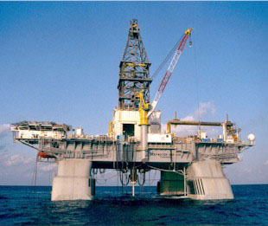
Example: Deep water drilling
Dynamic positioning is a key technology for drilling and production
In deepest waters, only GNSS and acoustic navigation sensors are practical
The usual 3-system redundancy is waived so long as there are multiple DGPS receivers
Deepwater Horizon (~2009)
Vulnerable to a coordinated attack against GNSS and acoustic sensors

Slide 8
Deception and DoS field attacks have a long history in navigation warfare, but military defenses are of little use to the civilian community:
Details of military protection schemes are classified
Military defenses typically assume a trusted and trained user base willing to submit to onerous security protocols
Fundamentally new technologies enable field attacks with which military has little experience (e.g., software-defined radio)
The civilian community will need to develop novel
solutions to its own unique threats
Notes:
Securing navigation and timing systems at the sensor level against both deception and DoS field
attacks has a long history in electronic warfare. But the theory and techniques developed
for military purposes have not satisfied the needs of the broad civilian community, for three reasons.
First, the details of military protection schemes are highly classified and thus find no outlet beyond
national security circles. Second, military defenses against field attacks often assume a user base
that can be trusted with secrets and that is willing to submit to onerous security protocols; such
assumptions are inapt for the general population. Third, fundamentally new technologies have
been introduced in the recent past with which military researchers have no more experience than
academia and private industry. Software-defined radio is a good example: its low cost and awesome
flexibility enable field attacks which are fundamentally new in terms of access and sophistication.
Our own software-defined GPS spoofer is evidence of this. To summarize, protecting nonmilitary
systems from field attacks is not merely a question of transferring techniques from the
classified world, or of re-discovering them: The civilian community will need to develop novel
solutions to its own unique threats.

Slide 9
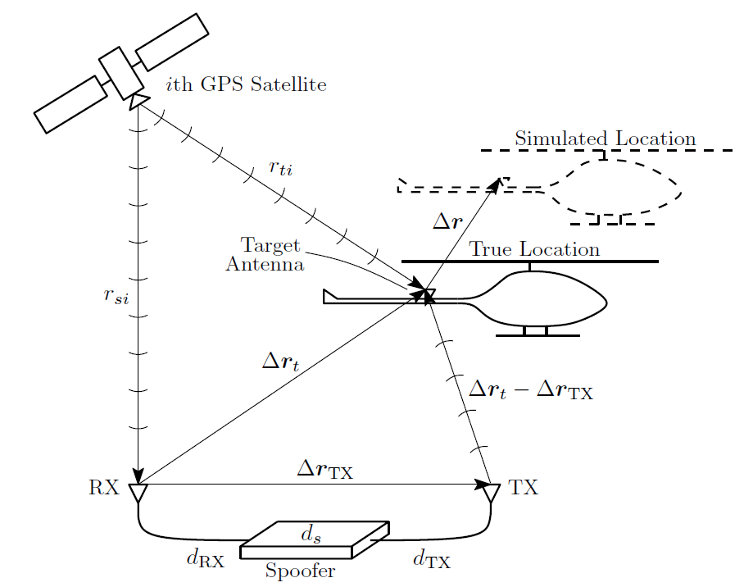
UAV GPS Spoofing Attack
Notes:
By contrast to the so-called proximity spoofing attacks treated in (Humphreys et al., 2008) and (Shepard
et al., 2012b), where the spoofer is effectively co-located with the target receiver, the current paper considers
spoofing from a distance, as illustrated in Fig. 1. Through its receive antenna, marked RX, the spoofer receives authentic signals from all visible GPS satellites. The vectors rTX and rt represent, respectively,
the 3-dimensional coordinates of the spoofer’s transmit antenna, marked TX, and the target aircraft’s GPS
antenna relative to the spoofer’s receive antenna. The spoofer and target antennas are assumed to be located
at respective distances rsi and rti from the ith GPS satellite.
The spoofer generates a counterfeit signal for each authentic signal received. In the case of an initially-aligned
attack, the spoofer’s counterfeit signal ensemble arrives at the target antenna in such a way that each signal
is approximately spreading-code-phase aligned (within a few meters) with its authentic counterpart. After
capture of the target receiver’s carrier- and code-phase tracking loops, the spoofer adjusts the relative code
phases of its spoofing signals to induce the target receiver to report the simulated (false) location r relative
to its true location; the target receiver’s apparent time offset from true time can also be adjusted by a common
displacement of the counterfeit code phases.
An aligned attack is only possible if the spoofer (1) measures all relevant system delays to within a few
nanoseconds, and (2) compensates for these delays by generating a slightly advanced (predicted) version of
the signals it receives. For civil GPS signals, reliable prediction is trivial because the spreading codes are
unencrypted and openly documented, the satellites follow regular orbits, and the modulating navigation data
follow regular patterns. Military GPS signals, by contrast, enjoy strong encryption of the spreading code;
indeed spreading code unpredictability is the very basis of their security.
For the ith GPS satellite, the total distance-equivalent system delay that must be compensated is given by the equation above.

Slide 10
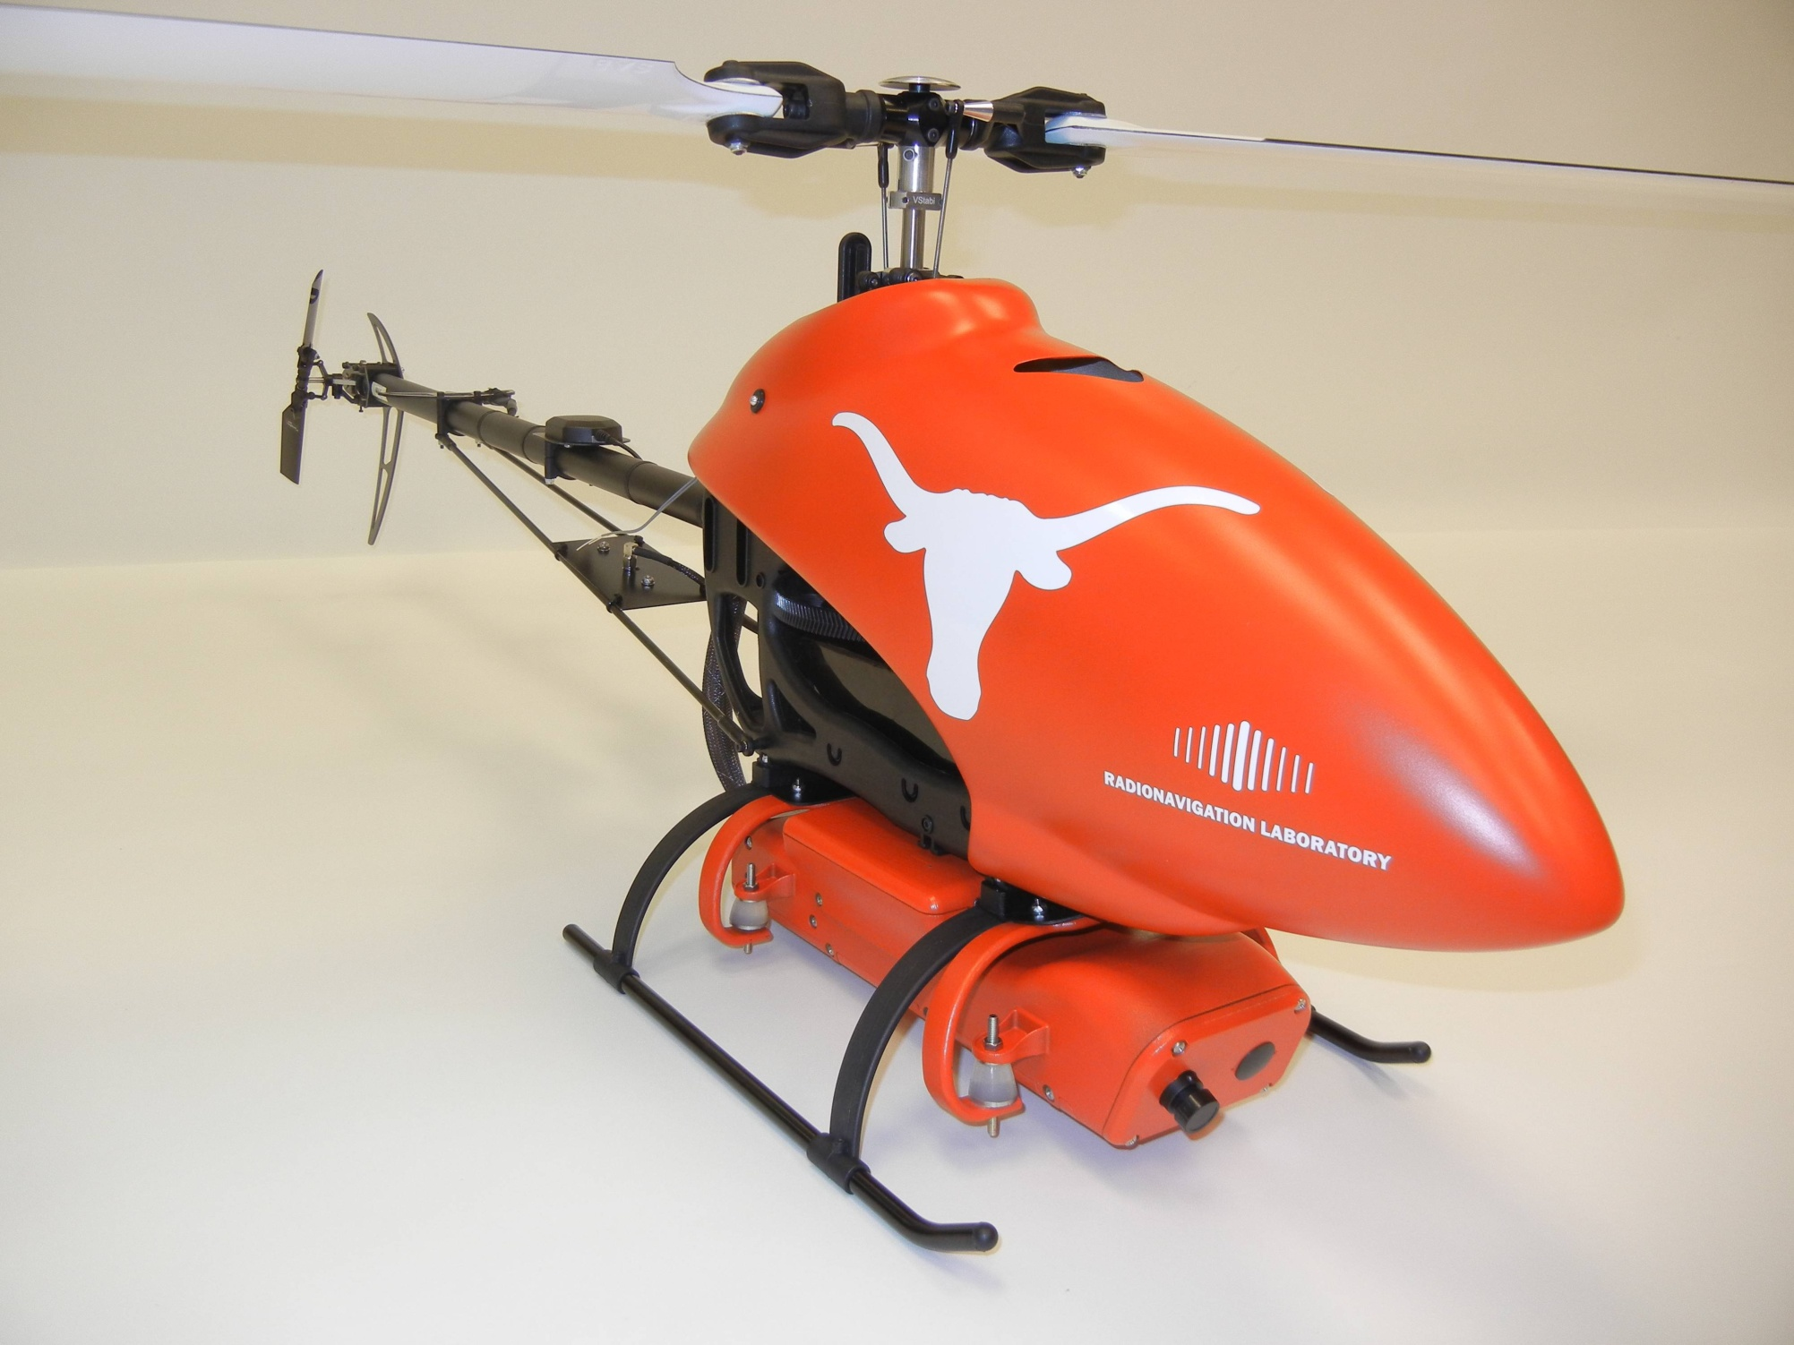

Slide 12
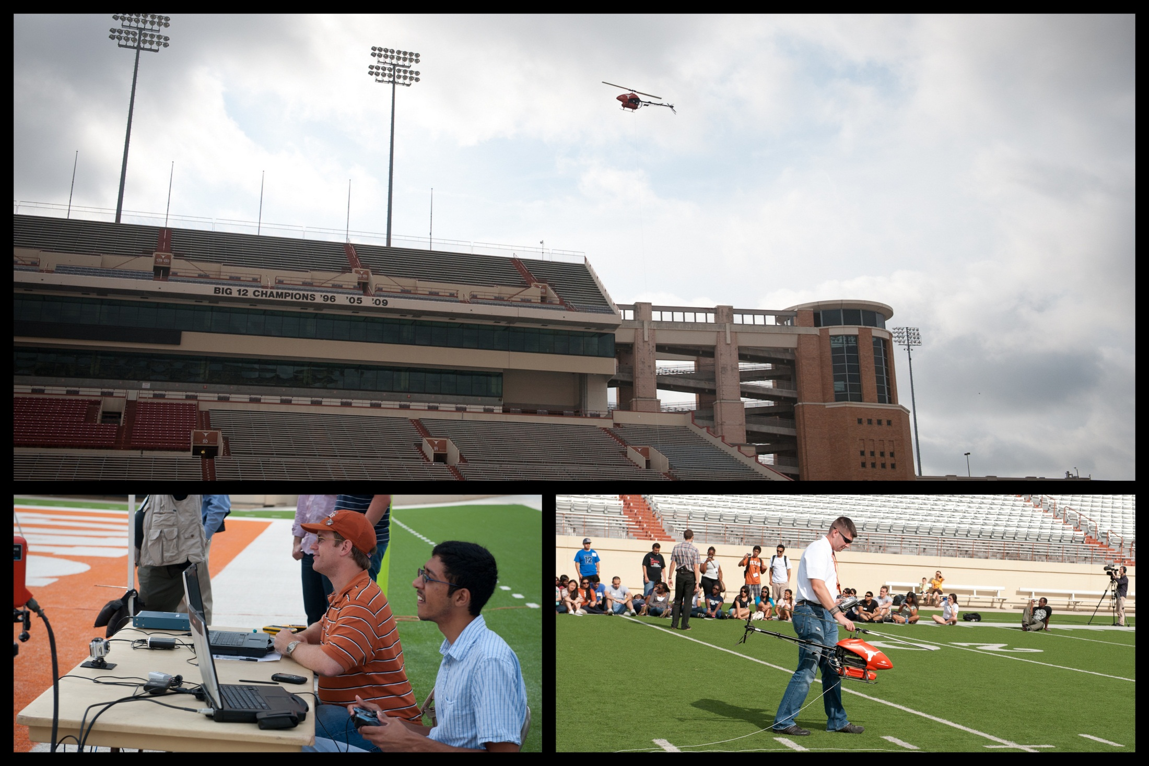
D.P. Shepard, J.A. Bhatti, T.E. Humphreys, A.A. Fansler, "Evaluation of Smart Grid and Civilian UAV Vulnerability to GPS Spoofing Attacks," Proc. ION GNSS, Nashville, TN, 2012.

Slide 13
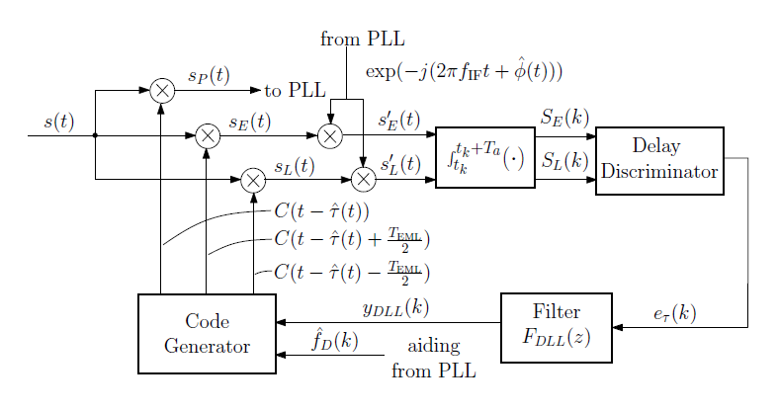
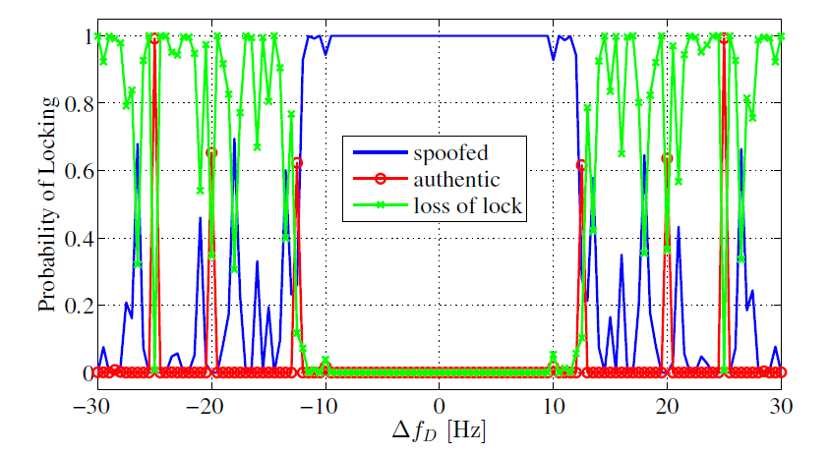
Covert GNSS Receiver Capture
DLL
PLL
Results from live tests
Allowable Doppler uncertainty
Ironically, commercial receivers’ robustness makes them easier to covertly capture

Slide 14
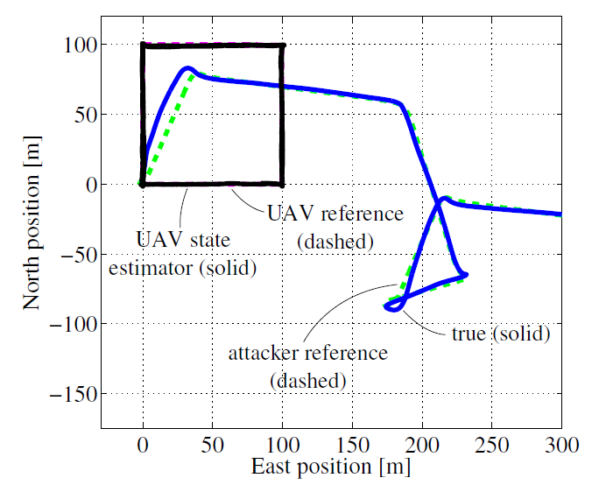
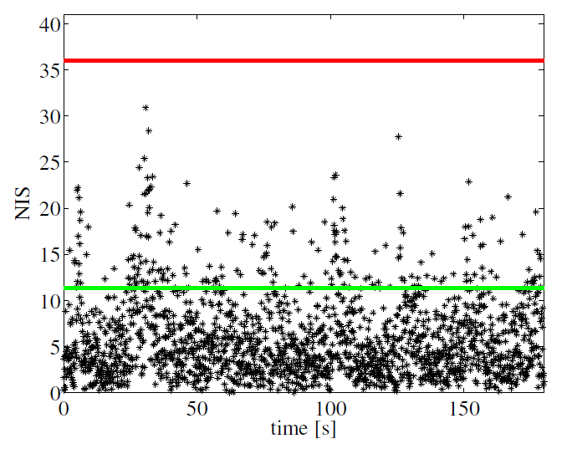
Covert Post-Capture UAV Control
Stable covert post-captue UAV control is possible provided the spoofer can learn the target’s flight pattern

Slide 15
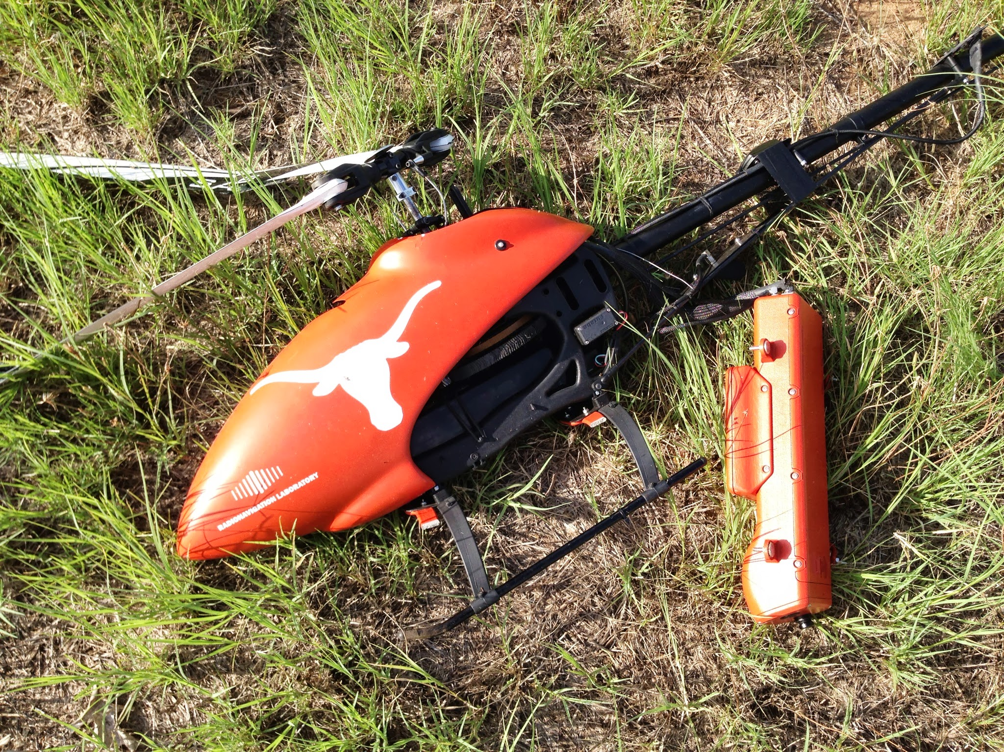
Crashing is easier than control
A.J. Kerns, D.P. Shepard, J.A. Bhatti, T.E. Humphreys,
"Unmanned Aircraft Capture and Control via GPS Spoofing,“ Journal of Field Robotics, submitted.

Slide 16
Notes:
Master Andrew Schofield of the White Rose of Drachs approached me after I gave a presentation at SXSW Interactive 2013.

Slide 17
Notes:
The 213-foot, $80M White Rose of Drachs motoryacht.

Slide 18
Notes:
WROD experiment team (from left): Kenneth Himschoot, Master Andrew Schofield, Prof. Todd Humphreys, Jahshan Bhatti.

Slide 19
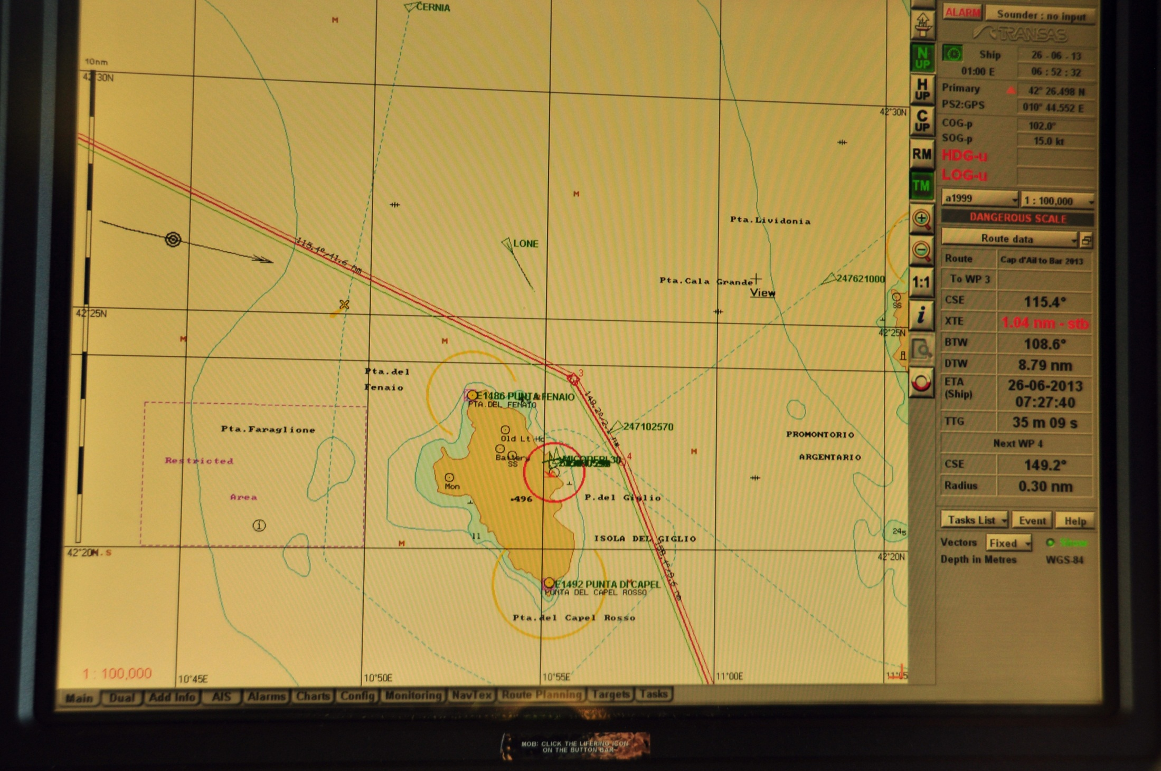
Notes:
We passed by the isle of Gigio, off the west coast of Italy.

Slide 20
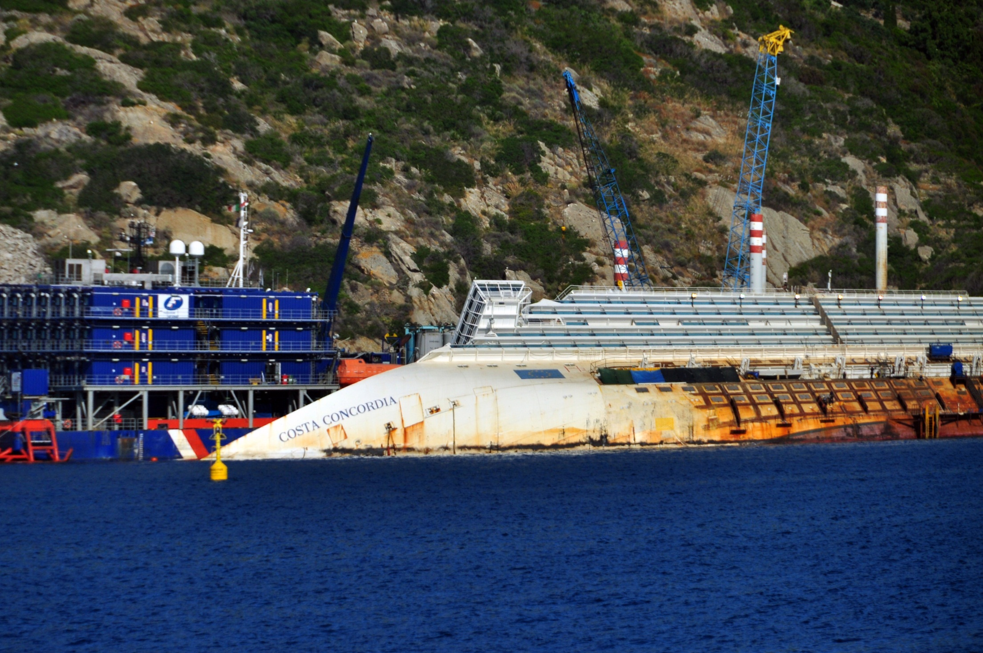
Notes:
and saw a tragic, fitting backdrop to our experiment

Slide 21
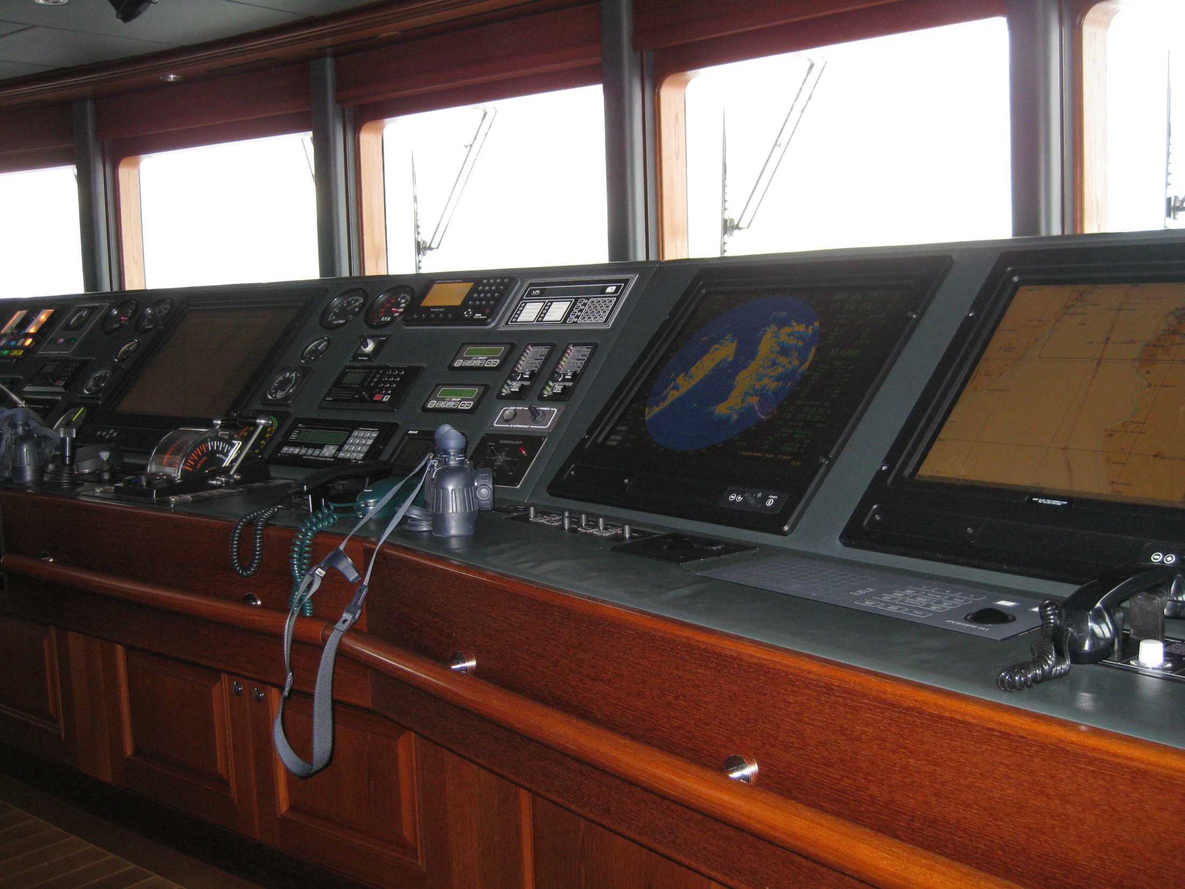
Notes:
WROD navigation and surveillance equipment: 2 independent GPS units, magnetic compass, 2 independent gyrocompasses, dual-band radar, down-facing sonar, electronic chart display

Slide 22
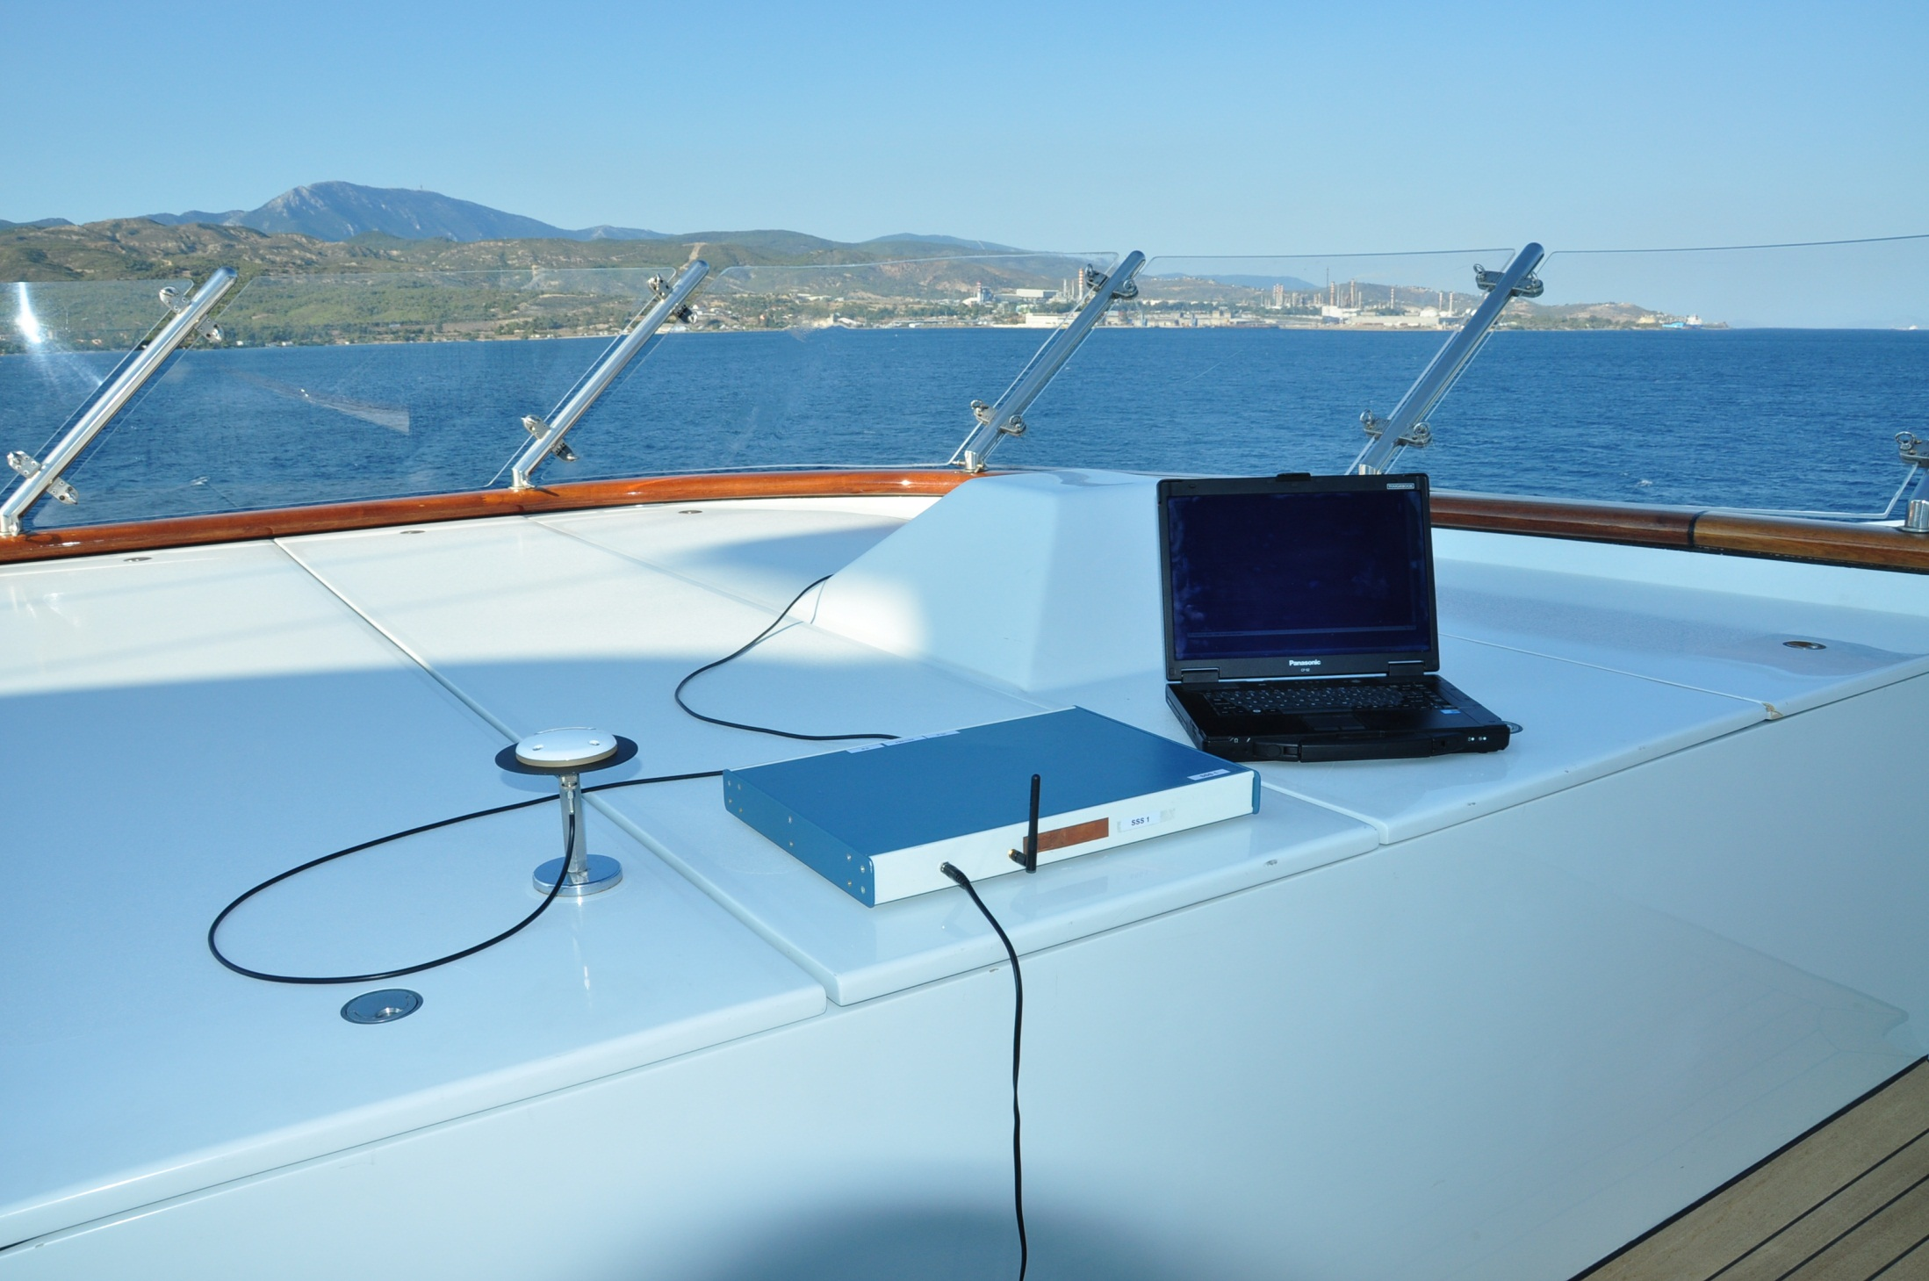

Slide 23
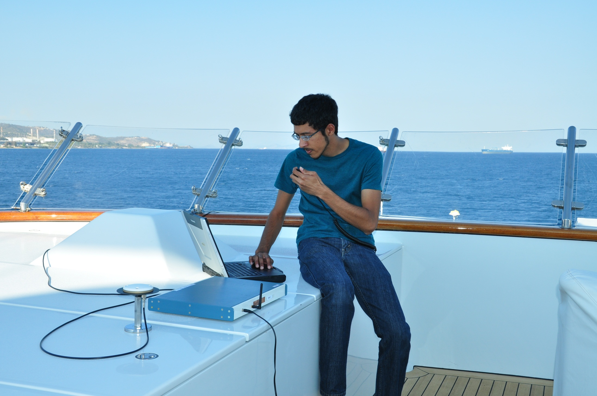

Slide 24
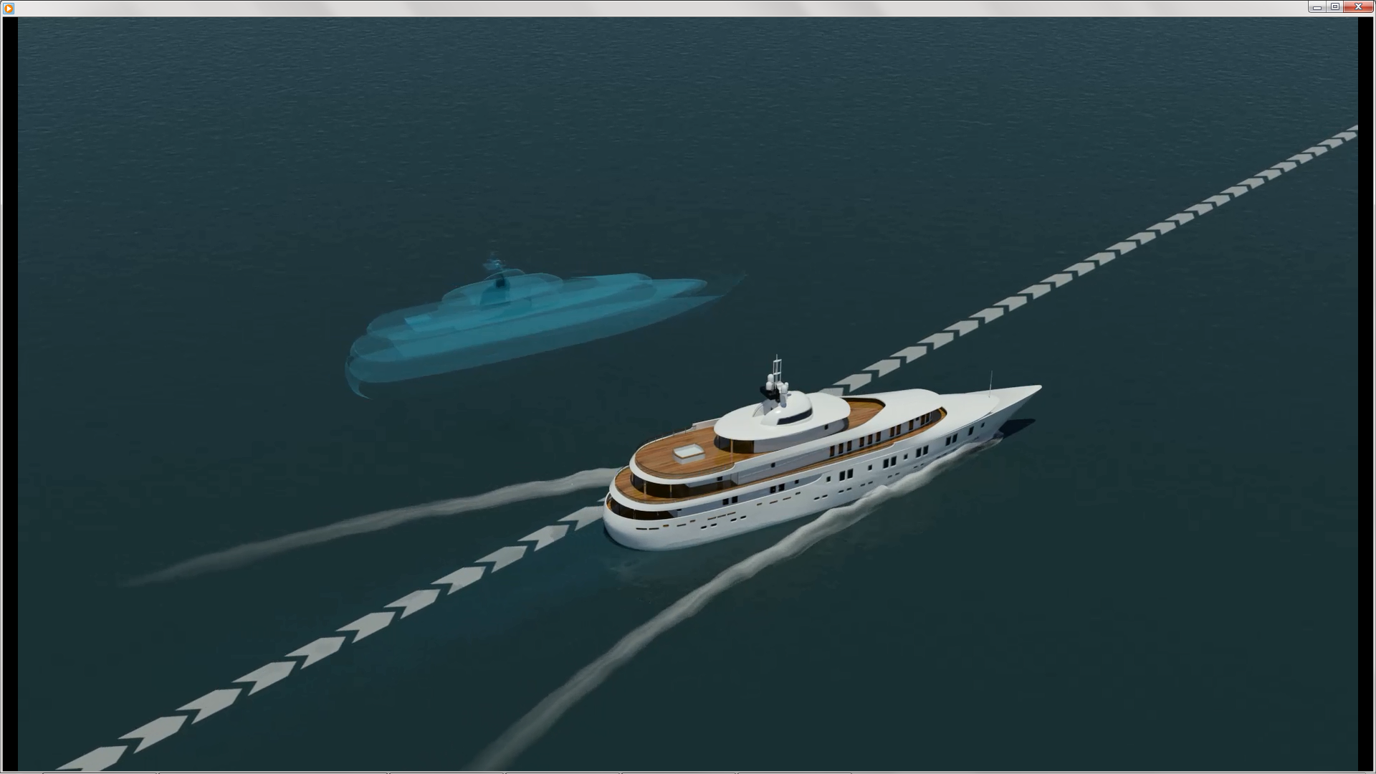

Slide 25
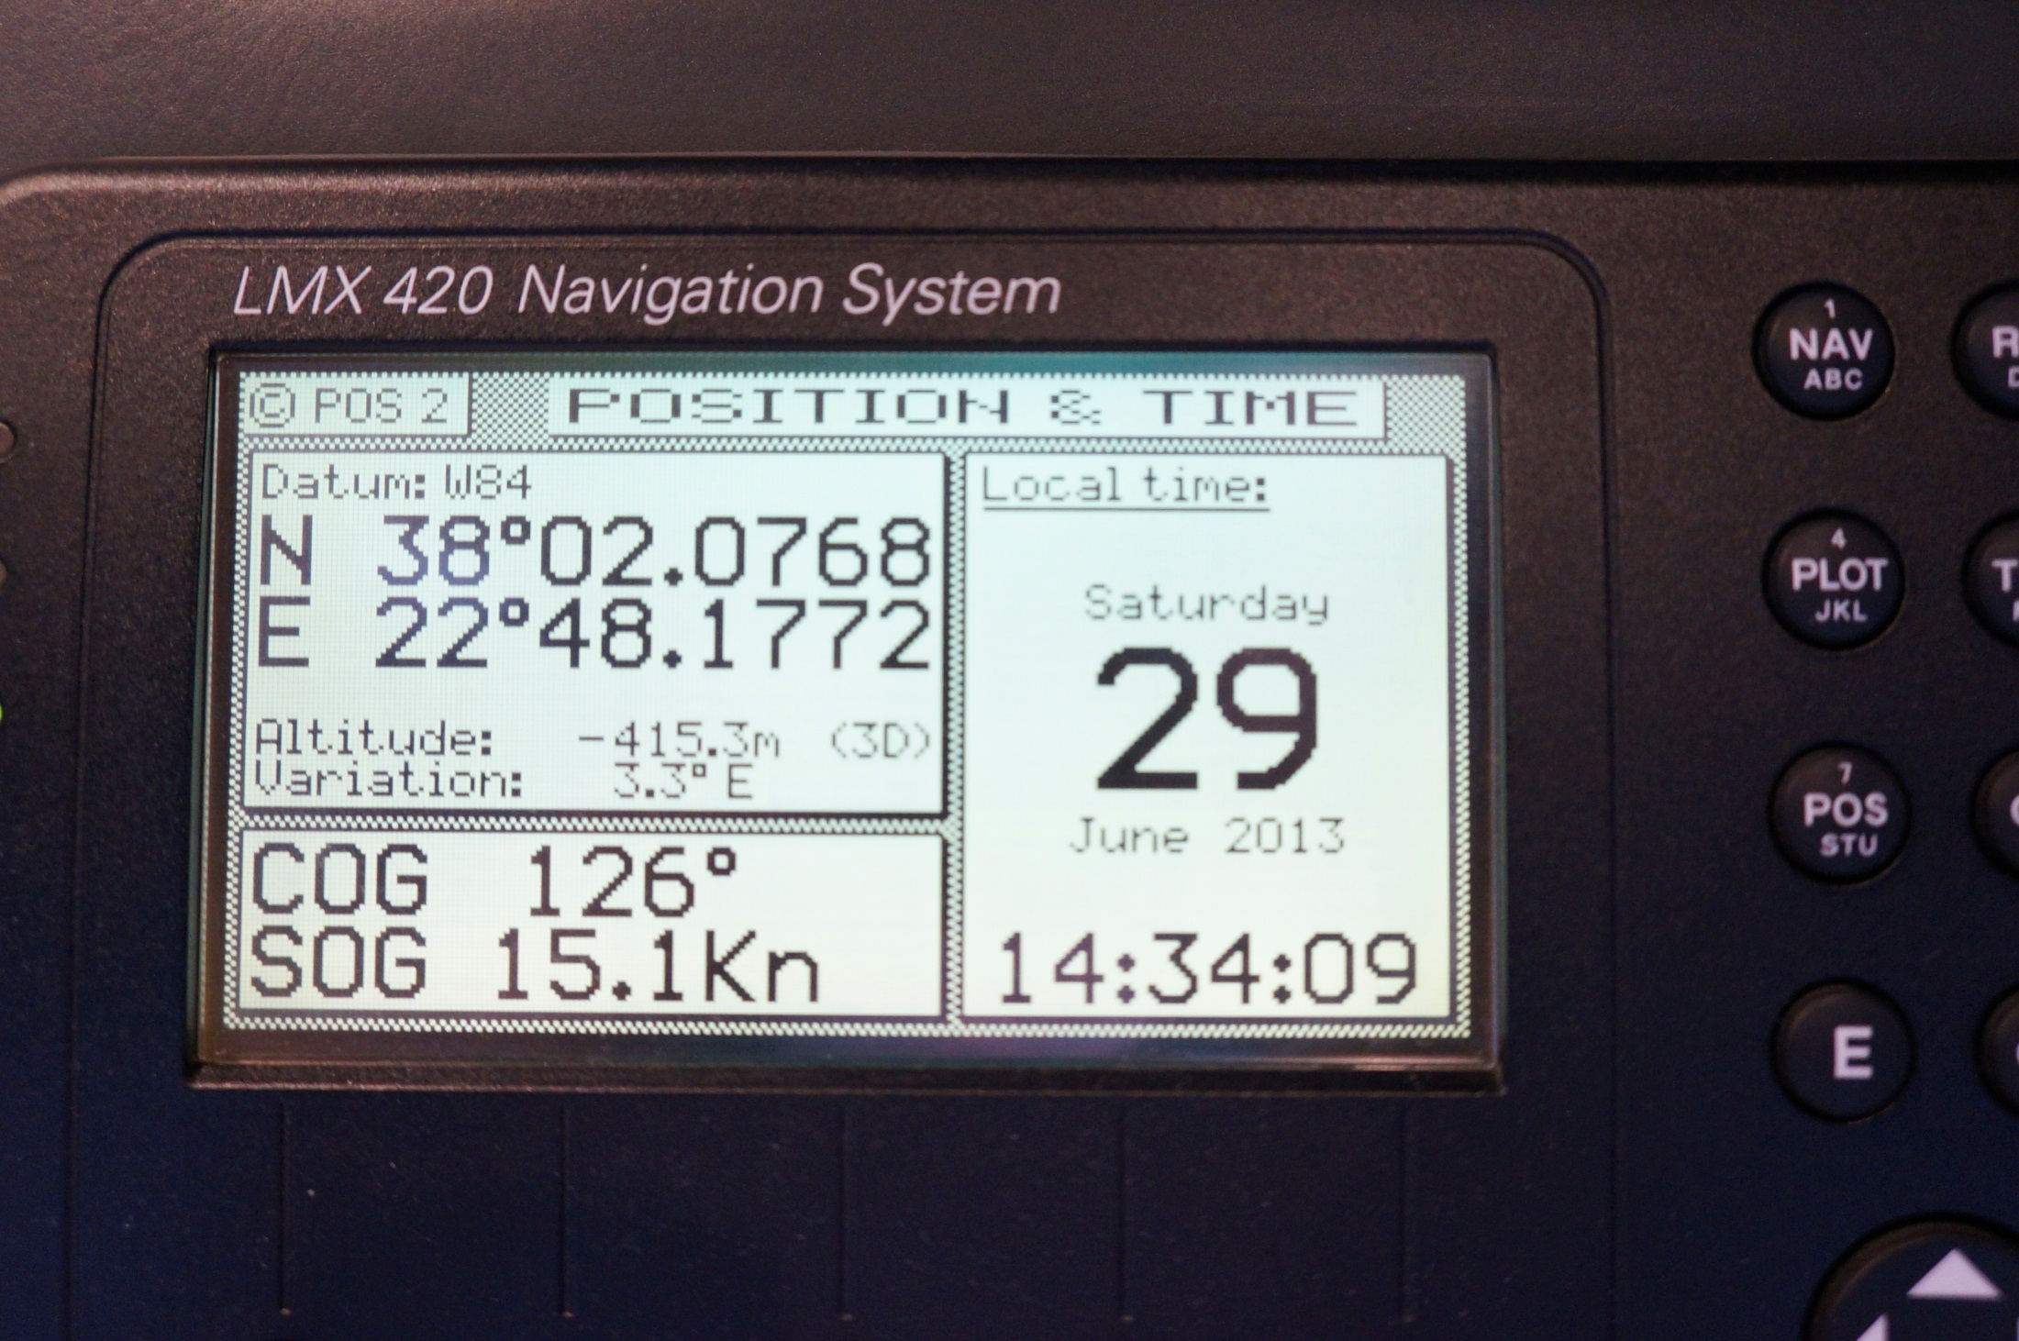

Slide 26
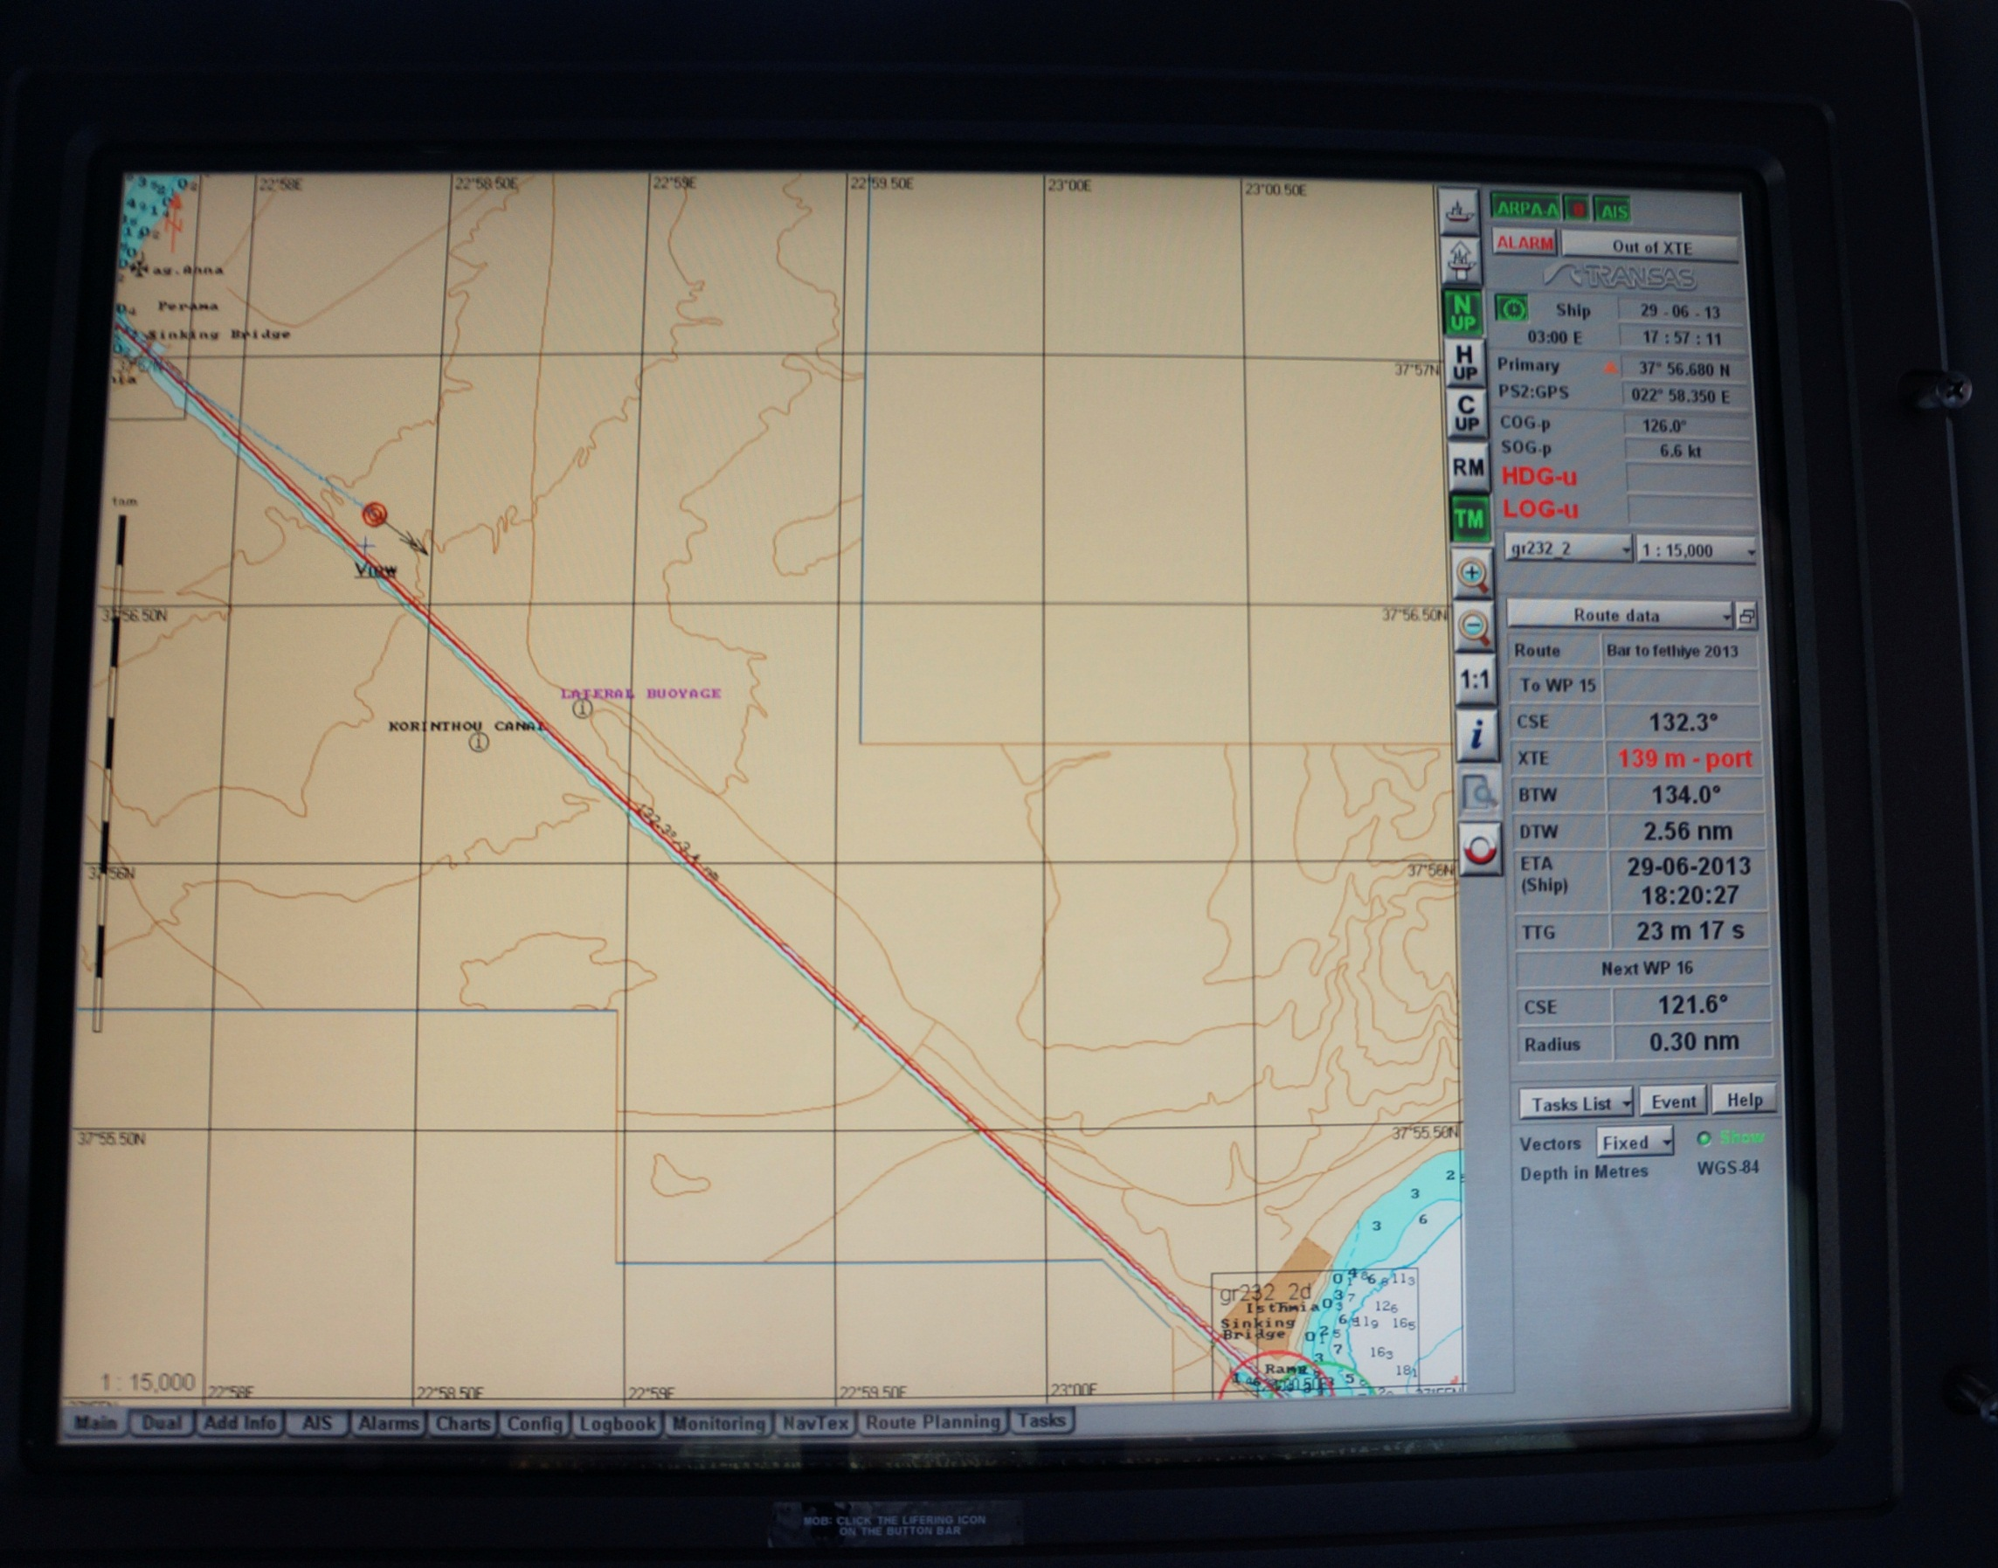

Slide 27
Covert Post-Capture Ship Control
If the spoofer has an estimate of the rhumb line that the ship is following, then the spoofer can employ a saturating PD controller to covertly force the ship to track a reference cross-track position
y (true)
y (spoof)
+
-C
P
sat
-K
1/s
1/s
+
+
y (reference)

Slide 28
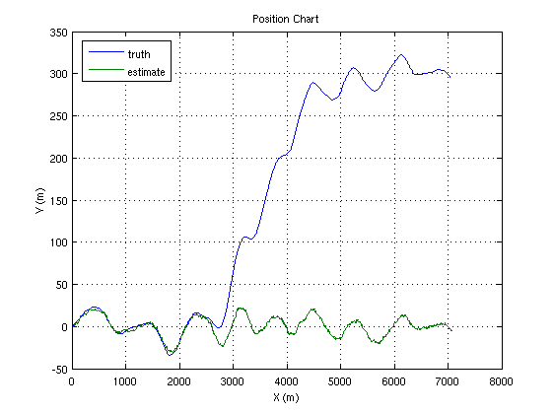
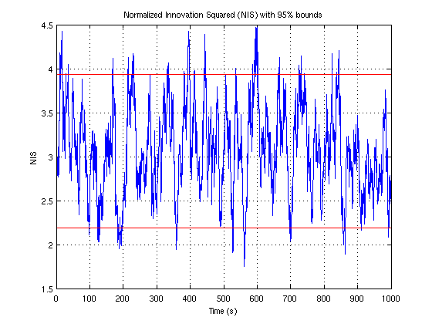
Covert Post-Capture Ship Control
Truth
Own ship
estimate
No alarms triggered by Chi-square-type test
Stable covert post-captue ship control is possible provided the spoofer can estimate the ship’s rhumb line

Slide 29
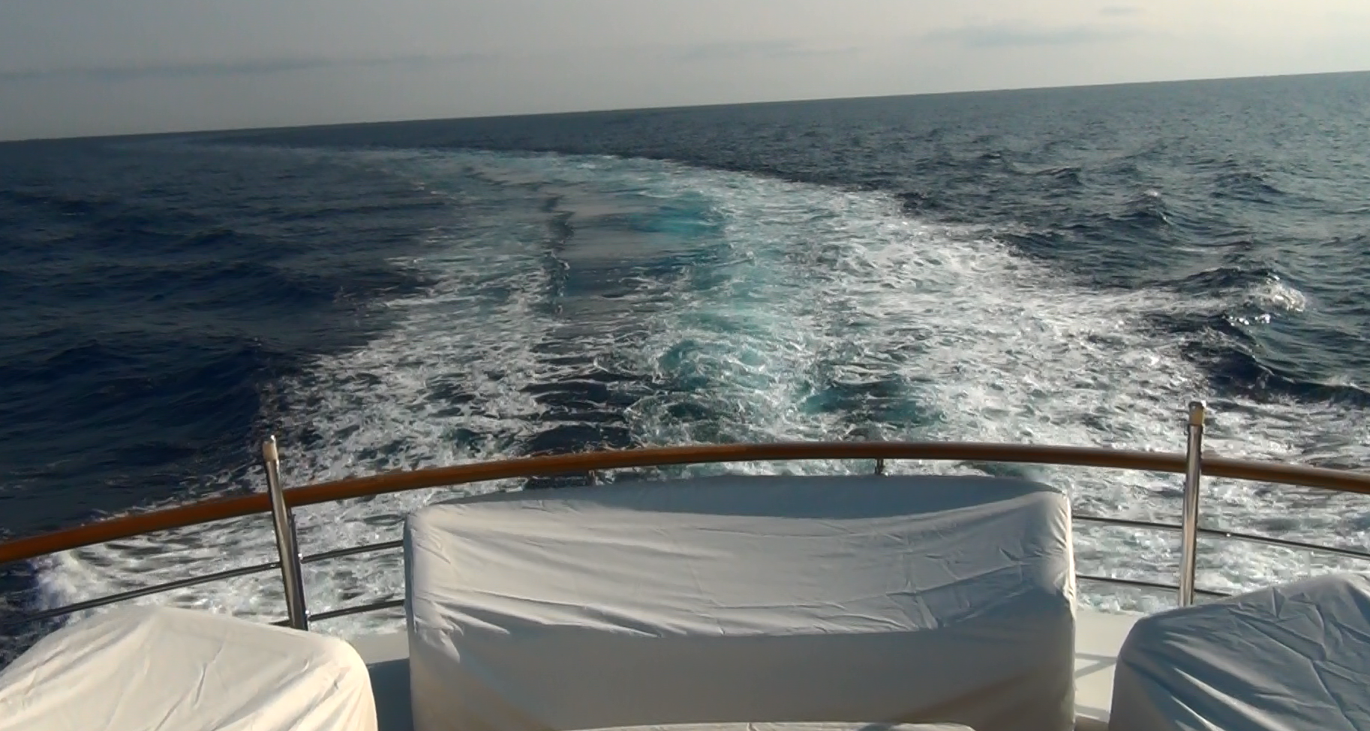

Slide 30
Civil GNSS Spoofing Defenses
Cryptographic
Non-Cryptographic
SSSC on L1C
(Scott)
J/N Sensing
(Ward, Scott, UC Boulder, Calgary)
Stand-Alone
SSSC or NMA on WAAS
(Scott, UT)
Sensor Diversity Defense
(DARPA, BAE, UT, GLA)
NMA on L2C, L5, or L1C
(UT, MITRE, Scott, GPSD)
Single-Antenna Spatial Correlation
(Cornell, Calgary)
Correlation Anomaly Defense
(UT, TENCAP, Ledvina, Torino)
P(Y) Cross-Correlation
(Stanford, Cornell)
Multi-Element Antenna Defense
(Keys, Montgomery, DLR, Stanford)
Networked
Mobility Trace Analysis
(UT)

Slide 31
The greatest challenge in PNT security will be providing proof of location or time to a skeptical second party. This problem scales differently than attacks against non-complicit PNT sensing: A single rogue actor with an inexpensive receiver network (“Dr. No”) could sell forged GNSS-based proofs of location and time to thousands of subscribers. Such subversion may not even be illegal ...

Slide 32
Beyond the Password:
Risk-Based User Authentication:
Graphic courtesy Deloitte/WSJ
Trustworthy proof of location is central to
risk-based user authentication

Slide 33
City-level: Where do you live?
Mobility Trace Analysis
Cell-level: What are your
daily patterns?
Coarse GPS/WiFi-level:
On what street are you travelling?
Decimeter-level:
Are you driving unusually today?

Slide 34
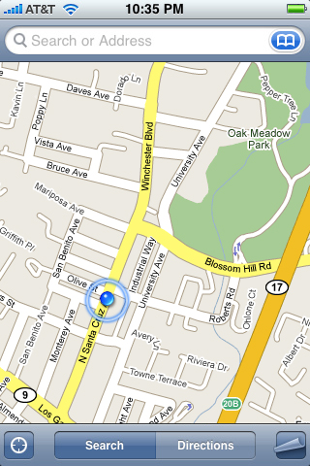

Slide 35
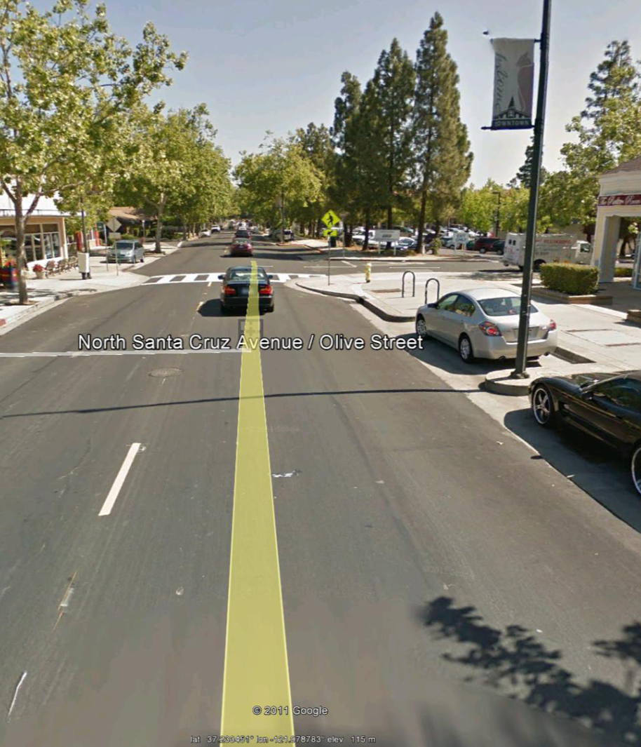

Slide 37
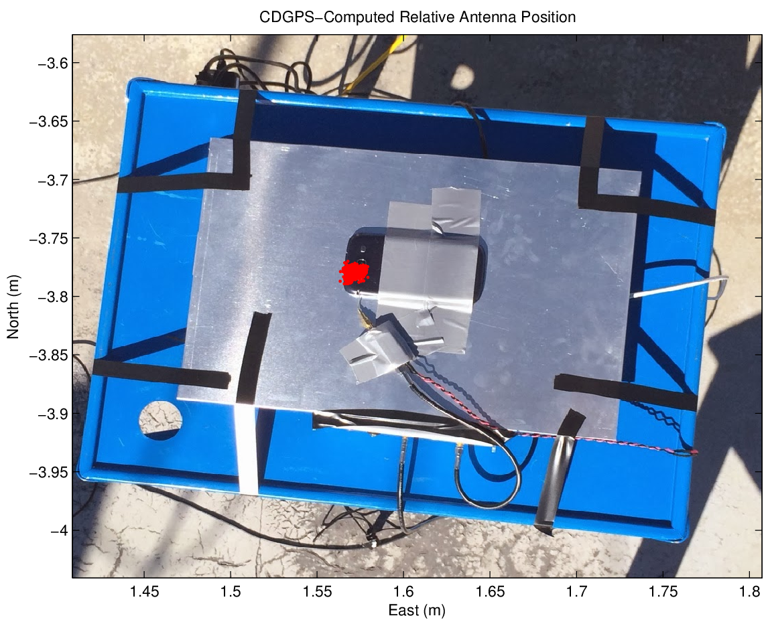
Nobember 2013: The University of Texas Radionavigation Lab
achieves cm-accurate CDGPS positioning via smartphone antenna.
Note that large backplane helps but may not be necessary. Many challenges remain, but this first result has profound significance.

Slide 39
radionavlab.ae.utexas.edu

Slide 40
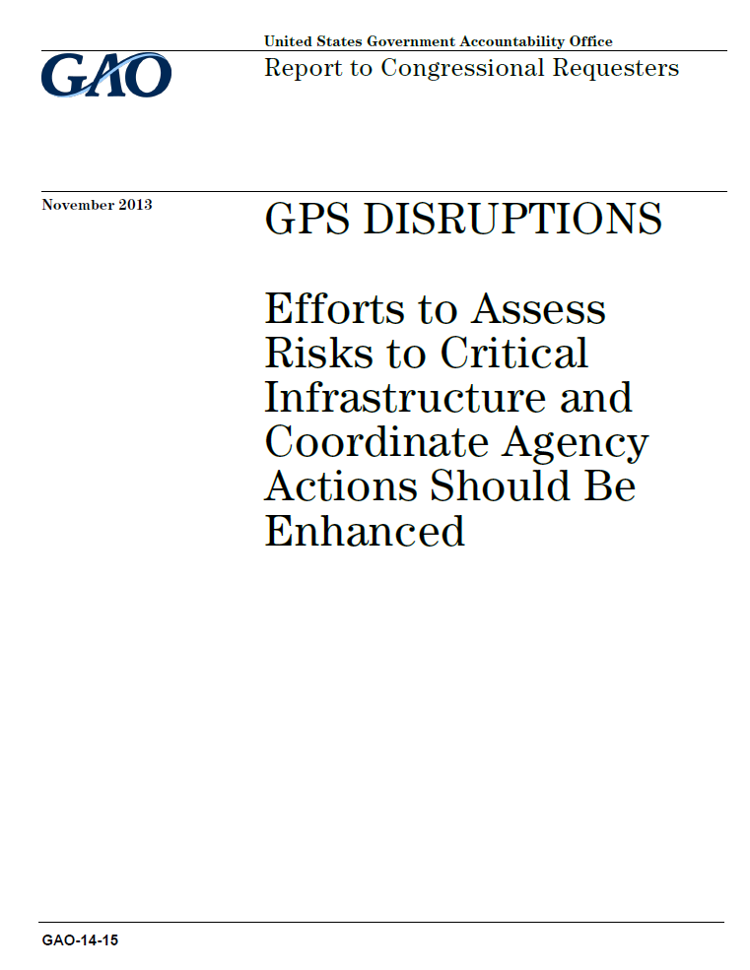
“[D]ue to resource constraints and other reasons, the [DHS and DOT]
have made limited progress in meeting [NSPD-39], and many tasks
remain incomplete, including identifying GPS backup requirements
and determining suitability of backup capabilities.”
“[O]verall, the requirements of NSPD-39 remain unfulfilled.”

Slide 41
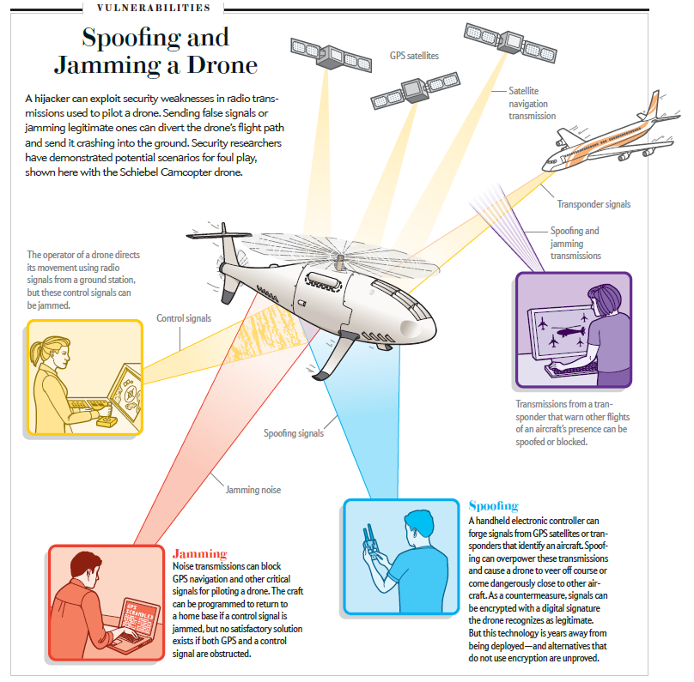
Wesson and Humphreys, Scientific American, Nov. 2013

Slide 42
Questions on Marine Spoofing (1/2)
Does the attacker have to be aboard the target vessel? No. We launched the attack from onboard the WROD only for convenience. So long as the target’s approximate position is known, the attacker can be miles away.
Won’t there be a discrepancy between the gyrocompass heading and the GPS-produced Course Over Ground? Yes, but a subtle spoofer can make a small heading offset look like the effect of an ocean current.

Slide 43
Questions on Marine Spoofing (2/2)
Wouldn’t GPS deception be revealed by a consistency check between radar returns and objects on the ECDIS? Quite possibly. This cross-check is a valuable defense. But it’s not much use in the open seas, and, sadly, maritime radar can be spoofed too.
But I could simply use a sextant and a clock to determine my location, true? Yes, but what’s sinister about GPS deception is that you probably won’t know you’re being spoofed. And a sextant isn’t accurate to better than a few nm. And do you remember how to work it?

