Slide 1
The Implementation of the Cornell Ionospheric Scintillation Model into the Spirent GNSS Simulator
Marcio Aquino, Zeynep Elmas, Chris Hill, Terry Moore
Institute of Engineering Surveying & Space Geodesy
The University of Nottingham, Nottingham, UK
Stuart Smith, Mahiuddin Mirza, Mark Holbrow
Spirent Communications - Positioning Technology, Paignton, UK
www.nottingham.ac.uk/iessg

Slide 2
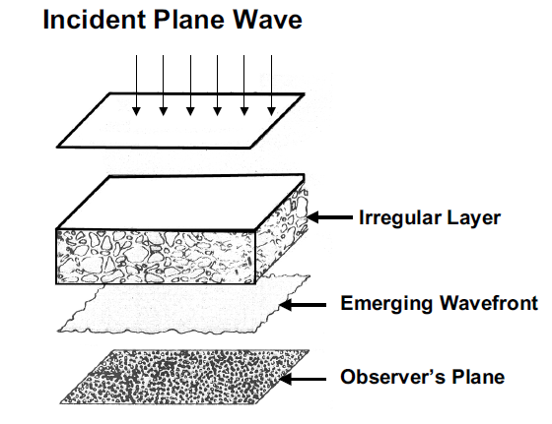
Ionospheric Diffractive
Effects on GNSS signals
Small scale plasma / electron density irregularities
Fluctuations in the phase and amplitude
of the received signal
Ionospheric Scintillation
Scintillation indices σ_{φ} and S4
σφ : sd of the measured phase
S4 : sd of the received signal power normalized by the average signal power
Notes:
Incoming signal wave front suffers random phase perturbs tru these random irregs of density – these perturbed wave fronts form the observed intensity fluctuations/pattern at the receiver end. There is the relative motion of the LoS signal and the irregularity so the intensity pattern (intensity flucts) moves.
also in polarization, angle of arrival etc.
Scintillation on the signal amplitude decreases C/N ratio of the received signal, this increases the noise in the receiver – thus “amplitude scintillation” can be modelled in terms of the receiver noise; indeed such is the adoption in the Conker model to account for the amplitude scintillation; in this case, as shown later, measure of the intensity fluctuations can be used to determine this noise due to scintillation affecting the signal power.
2

Slide 3
Ionospheric Scintillation
Effects on GNSS receivers
Geographic and temporal variation in scintillation occurrence
Code and phase tracking loop performance can be degraded
Variance of the error at DLL / PLL output (tracking jitter) increases during scintillation
  Good measure of the effect of scintillation on a receiver
DLL
PLL
  Rapid intensity fluctuations
  Affects accurate code phase alignment
  Difficulty in acquisition
  Rapid phase fluctuations
  Affects accurate phase estimation
  Cycle slips, loss of lock,
  difficulty in tracking
Notes:
Scintillatin occurence has a geographic and temporal variation; it is not a homogeneous distribution but a localized effect due to density gradients. Its strength can vary according to the 11-year solar cycle, season, geomagnetic conditions, receiver location,
Different scint levels (e.g. weak, moderate, severe) are related to different values of these indices, e.g. in general S4=0.7 refers to strong amplitude scintillation and σ_{φ} =0.2 to weak phase scintillation
.
Several epochs to be missed and requiring the carrier phase ambiguity search to be reset - a time consuming process
cycle slips more likely due to phase scintillation
during strong amplitude scintillation, the received signal power can be much less than the receiver threshold (referred to as power fades) thus signal acquisition can be difficult and even loss of lock can occur due to deep power fades.
Fluctuations in the signal phase put stress on the phase tracking loop of a receiver;
scintillation does not affect all satellites in view simultaneously, the effect on each rec-sat link is expected to vary; this invokes giving different weights to observations according to the scintillation effect experienced on each link.
Also, scintillation on a link does not always mean that the signal will be lost – this depends on many factors starting with the strength of the scintillation, geometry of the receiver-irregularity-satellite, and other environmental factors. It is possible to lose lock to 3-4 satellites during strong scintillation; even complete outage in an area is possible during strong scintillation such that for a few minutes any GNSS service can be unavailable. However, it is possible that e.g. the positioning accuracy will be degraded. Another issue is related to jamming, which becomes easier during scintillation since the receiver tracking loops become more vulnerable during such times.
In the case of scintillation, variance of the tracking loop error can be calculated by models sensitive to scintillation – as the model suggested by Conker et al. Can be used to calculate this variance.
3

Slide 4
Variance of the Signal
Tracking Loop Error
Model suggested by Conker et al (2003)
p (spectral slope)
T (spectral strength of phase noise at 1 Hz)
Advantages
  Available, easy to implement
  Applicable to new signals
Drawbacks
  Limited to weak-moderate scintillation levels
  Spectral parameters p and T are needed
  Phase & amplitude scintillation modelled as independent
p=1.4
T
Notes:
Scintillation effect on signal ampl mod’d as an increase in total thermal noise;
scintillation effect on signal phase is mod’d as an additive term to overall error variance
PLL linearity i.e. Small error assumption in PLL which corresponds to weak-moderate scintillation environment
during strong scint, PLL does not perform in the linear regime thus the Model can not be applied
Strong scintillation is associated with rapid half cycle phase fluctuations occuring simultaneously with deep power fades; the phenomenon termed as “canonical fades” – so assuming them as independent events is valid for the weak-moderate scintillation assumption
This one is given for a 3rd order PLL ???? tracking the GPS L1 carrier – models for other orders of PLL and DLL are also available
What about severe scintillation which is likely for especially the high and low latitudes?
Some simulation results show that there can be an interdependency between the phase and amplitude scintillation – so the model may be more realistic if improved in this aspect
In the weak-moderate regime, phase difference between incoming and replica signal is small or changes slowly so PLL is in the linear regime
Retrieving p and T can pose a problem: can be obtained by processing the high rate data in the frequency domain YET such high rate data may not always be available + computationally intensive
4

Slide 5
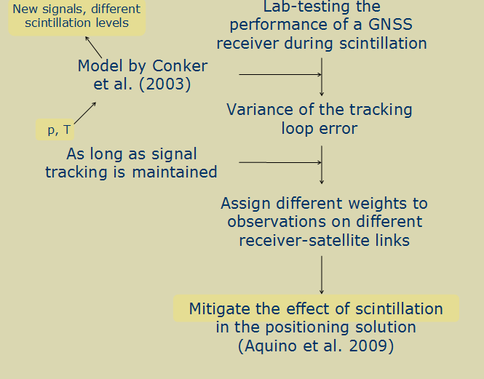
Scintillation Study Strategy
Notes:
5

Slide 6
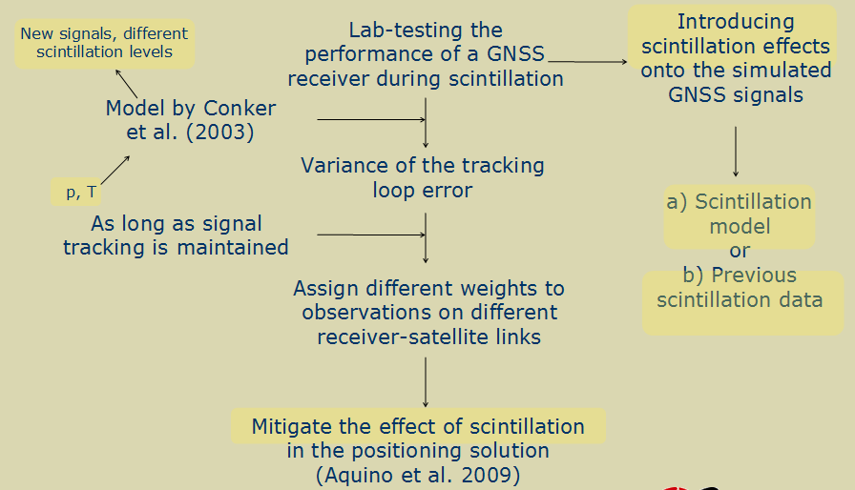
Scintillation Study Strategy
Notes:
6

Slide 7
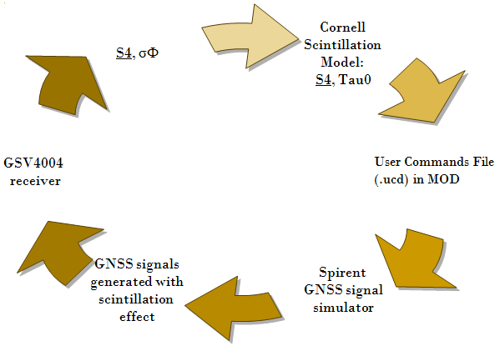
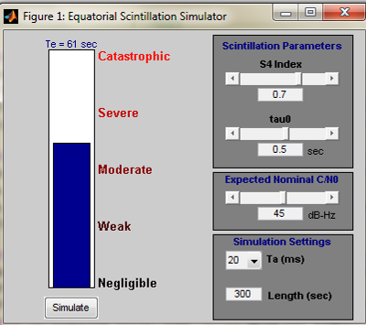
Cornell Scintillation Model
Equatorial scintillation model
Based on statistical properties of scintillation effects
start
Receiver to be tested
Notes:
Introducing intensity and carrier phase fluctuations on the generated GNSS signals
7

Slide 8
Cornell Scintillation Model
CSM can be used for testing GPS receiver phase tracking loops performance under equatorial scintillation:
  Deep fading requires signal amplitude and phase spectra to be shaped as “dependent” on each other.
Two important assumptions in CSM:
  1) Amplitude of GNSS signal due to scintillation environment follows Rice distribution
  2) “Scintillation component” of GNSS signal has a spectrum similar to that of white noise passing through a 2nd order low pass Butterworth filter.
Notes:
This scintillation data library characterizes features of severe equatorial scintillation; it includes severe complex scintillation from the WIDEBAND satellite project and from processed GPS data. It reveals strong equatorial scintillation with deep power fades (>15dB) that occur simultaneously with half-cycle phase transitions (an effect termed as “canonical fades”). CSM considers such canonical fades as the primary cause of loss of lock (LoL) in GPS receiver phase locked loops (PLLs).
1) Defence Nuclear Agency (DNA) WIDEBAND (WB) satellite experiment (operational between 1976-79 i.e. two years before the solar maximum, thus the L-band data in WB does not represent the strongest possible equatorial scintillation – which is overcome by augmenting the L-band data with unscaled WB UHF carrier data) in which the near-polar orbit satellite broadcasts 10 coherent continuous wave signals at frequencies ranging from VHF to S-band, including an L-band signal at 1239 MHz which is the signal of interest to study scintillation effects on GPS since its frequency is almost the same as that of L2. The S-band signal, due to its high frequency at 2891 MHz, is minimally affected by scintillation; this enables the S-band signal to be used as the phase reference for the receiver chain whose baseband phase and amplitude outputs are band-limited to 150 Hz and digitized at 500 Hz. This baseband phase and amplitude data (not the original high frequency signals) is referred to as the WB data in this context. Two equatorial ground stations (at 11.8⁰N and 9.4⁰N latitudes), each with a parabolic high-gain tracking antenna that yields low noise and high quality complex signal time histories, recorded the WB data. The continuous-wave received signals ensure that cycle slips occur in whole or integer multiple of whole cycle slips i.e. half-cycle slips that occur when tracking the bi-phase modulated GPS signals are not observed. Whole cycle slips occur during severe scintillation. 10 satellite passes (each pass provides about 12 minutes long continuous data) with strong scintillation are stored in the WB scintillation library at an original sampling rate of 500 Hz. No high-pass filtering is needed to remove trends from the data or low pass filtering to remove receiver noise as it is not a significant part of the WB data (Humphreys et al., 2008).
2) GPS L1 C/A code digital data (multilink GPS data), sampled at 5.7 MHz and recorded in 2003 at 22.7⁰S geomagnetic latitude along the southern boundary of the equatorial anomaly, is a several hours long strong scintillation data set that is extensively processed (details on this can be found in Humphreys et al., 2008) to eliminate as much receiver and Doppler effects on the phase and amplitude data as possible so that only the scintillation effects remain in the data and the GPS data then becomes comparable to the WB data (without half-cycle slips and free from as much variation due to receiver clock instability, PLL dynamics and Doppler shift as possible) in quality. Output data, now sampled at 100Hz after processing, is filtered to reduce receiver noise but the SNR in GPS data remains much lower than that of the WB data; anyway this does not obscure the obvious similarities between the samples of GPS and WB data like “deep power fades that occur simultaneously with abrupt, half cycle phase changes” which are seen during severe scintillation data in the library. Severe equatorial scintillation has an essential feature of large, abrupt phase changes associated with deep signal power fades. These so-called “canonical fades”, which are a universal feature of strong equatorial scintillation and cause PLL LoL in receivers.
8

Slide 9
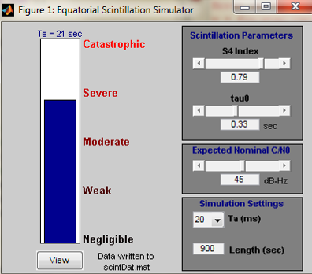
Cornell Scintillation Model
  S₄ : stdev of received signal power normalized by average signal power
  τ₀ : “τ” is the decorrelation time parameter such that at time τ₀ the autocorrelation function reduces to 1/e^{th} of its initial value
  e.g. high S₄ and low τ₀ represent severe scintillation
CSM requires two inputs to define the severity of the scintillation :
Notes:
User interface shows CSM run for S4=0.79, Tau0=0.33, accumulation interval Ta=20ms, scintillation duration of 15min.
Phase and magnitude of z(t) are “changes” in the signal due to scintillation effects.
9

Slide 10
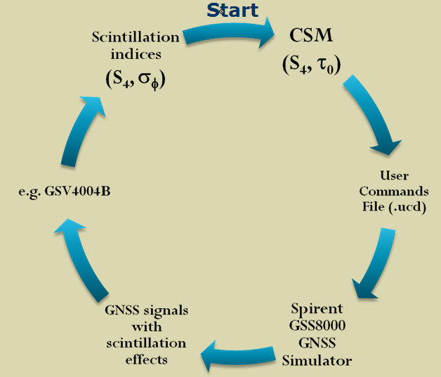
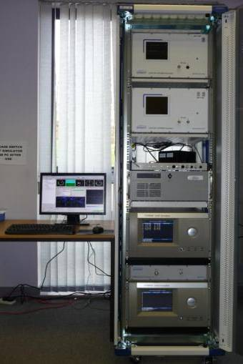

Implementation of the CSM
Scintillation time histories written in correct file format
Scintillation data recorded
Track the perturbed signals with a scintillation specific receiver
Scintillation file selected in the simulation scenario

Slide 11
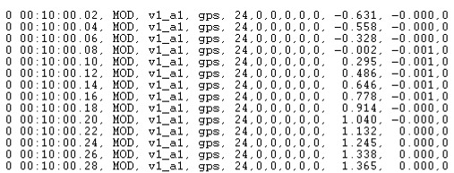
Implementation of the CSM
in the Spirent GNSS Simulator
Spirent GSS8000 GNSS Simulator changes signal level (dB) and carrier phase range offsets (m) of the generated signals according to the User Commands File with input provided by the CSM
Carrier phase range offsets (m)
Signal level changes (dB)
Notes:
MOD command allows to modify code and carrier phase to all channels / signals, and the user command file (.ucd file) allows to construct a list of MOD commands time-stamped at 50Hz rate. (SimGEN scenario iteration rate is also set appropriately [Options->General Options] from the choices of 100ms, 10ms or 4ms)
11

Slide 12
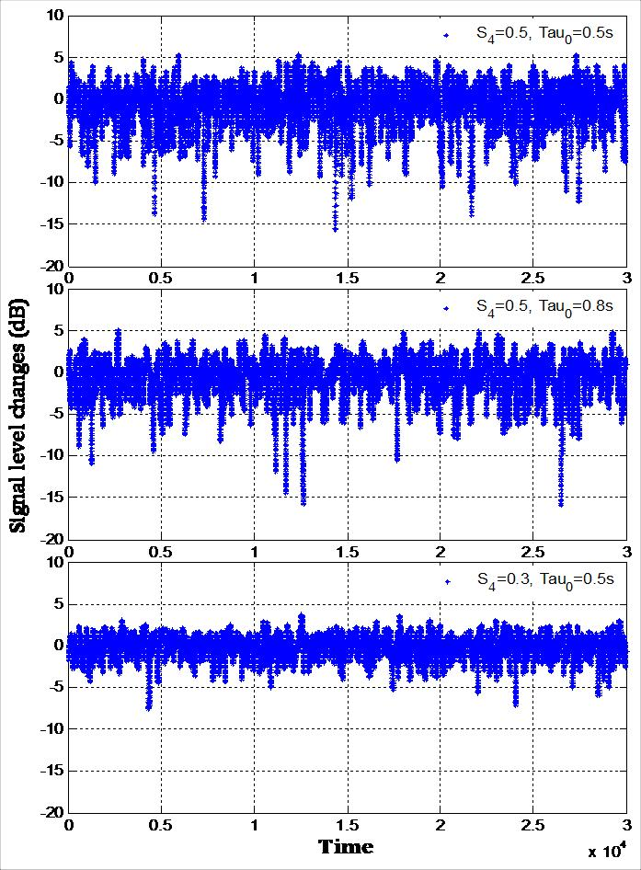
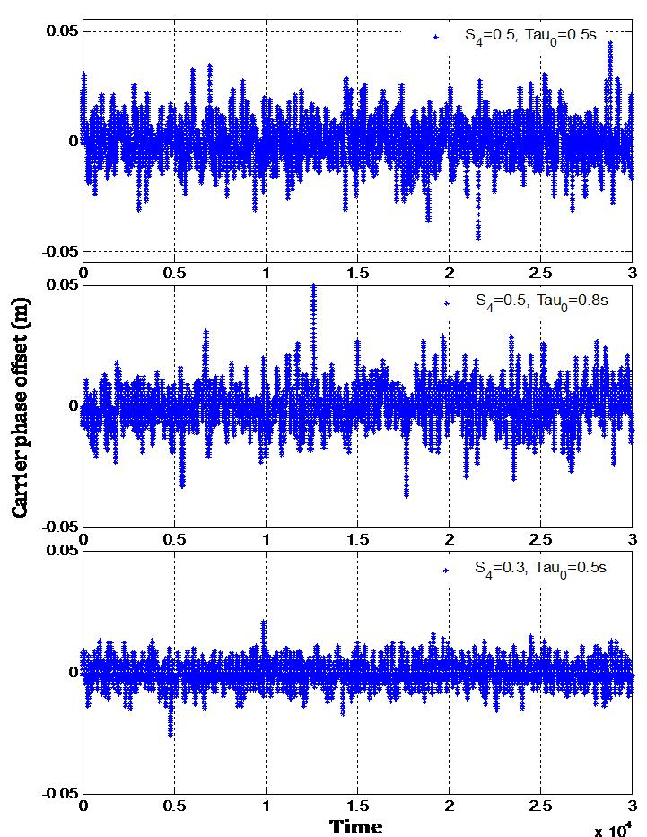
Illustration of CSM
GNSS Scintillation Simulation
Notes:
Figures show 3 separate 10-min scintillation intervals implemented on the simulator, each 10-min interval for a set of conditions given by S4 and TauZero.
Changes on signal level (left) and carrier phase range offset (right) are given in the plots
From these plots it should be understood how CSM is implemented into Spirent: through modification of signal power and carrier phase range measurements (on a specified link).
12

Slide 13
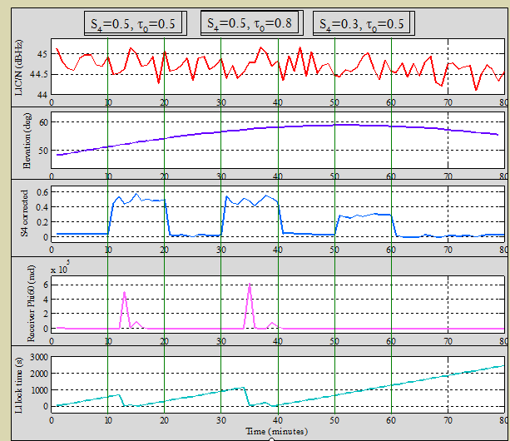

Notes:
TEST 1: Results obtained for the closed loop (slide 9) and scintillation levels in the previous slide (slide 11):
80 min simulation with no ionospheric or tropospheric delay
28 October 2005; orbits determined by Spirent GSS8000
Three 10-min scintillation intervals with decreasing scintillation strength:
Relatively Strong (minutes 10 to 20), moderate (minutes 30 to 40) and weak (minutes 50 to 60)
Results for a low latitude receiver and SV24 propagation link
Plots for receiver (GSV4004B) data on GPS L1 recorded each minute
Comments on results:
Good agreement between S4 input into CSM and S4 retrieved from receiver
Loss of lock on L1 during strong (min 10 to 20) and moderate (min 30 to 40)
Earlier loss of lock on signal during stronger scintillation
No loss of lock during weak scintillation (min 50 to 60)
Here we have some assessment of “receiver performance” as we can see a “certain” level of scintillation is causing loss of lock
13

Slide 14
CSM Performance
Three 10-minute scintillation intervals
Scintillation indices S₄ and σ_{φ} recorded by the GSV4004B receiver are plotted
(red bars show interval averages)
S₄
σ_{φ}
Notes:
Peak sigma phi values (can be seen in slide 12, 4th plot from top) were neglected since the “absolute” magnitude of these peak data points is meaningless – only sigma phi < 1 rad included for meaningful discussion
What we are assessing here (and in the previous slide) is more how CSM reproduces the scintillation levels according to our input, we are not so much assessing receiver performance yet.
14

Slide 15
Receiver Performance
Based on scintillation indices S₄ and σ_{φ} output by GSV4004 Rx, signal tracking performance can be evaluated from the variance of PLL error (Conker model, Strangeways Ff)
Notes:
Those interested should refer to the paper by Conker et al for details of their model - here results are presented only.
To use Conker models based on the phase scintillation index SigmaPhi (instead of high rate data) the method proposed by Strangeways can be applied (Strangeways 2009) – Knowledge of Fresnel frequency included in the method of Strangeways such that a physically appropriate value is taken for low latitudes in this case.
Ff=0.15-0.3 range (for the sake of presenting the variance results) taken for the low latitudes to apply the method of Strangeways (2009) – 0.15-0.25 is representative for Ff at low latitudes
Plot show variance of the PLL error (used to assess the receiver performance) during relatively strong (blue), moderate (magenta) and weak scintillation periods (green)
Scintillation indices are averaged for each 10 minute interval (neglecting very large SigmaPhi values) – only those <1rad are used in averaging
15

Slide 16
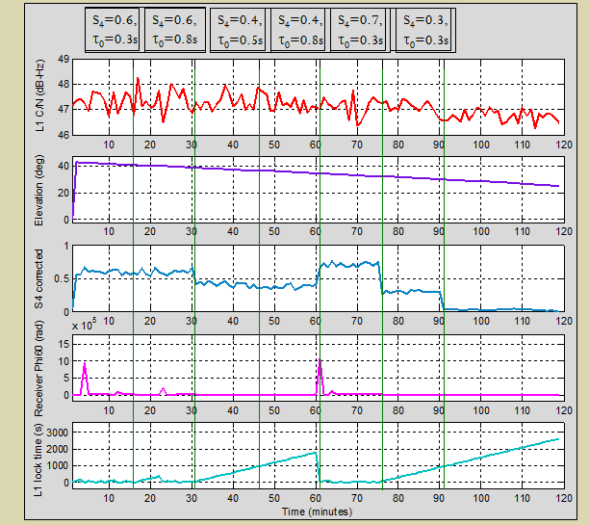
Notes:
TEST 2: Another scintillation scenario – this time background ionosphere is modelled by the Klobuchar model, and troposphere by STANAG – aimed for a more realistic scenario taking into account the background atmosphere.
Presidente Prudente station, 20 October 2009, 18:00-20:00 hours Local Time, receiver-SV23 link degraded by scintillation effects
Scintillation effects starting 1st minute, each set of scintillation parameters create a period of 15 minutes i.e. 6 scintillation periods of different scintillation strengths
Marcio: Nice test! Is there a gap with no scintillation just after minute 60 or all the implementations are continuous? It seems the peak in sigmaphi after minute 60 is due to a combinaiton of higher S4 with the change in TauZero. Zeynep: There is no gap at 60th minute, all scintillation implementations are continuous so the peak in receiver SigmaPhi (Phi60) observed at 60th minute is due to changing from scintillation indices of S4=0.4, Tau0=0.8 to S4=0.7, Tau0=0.3 i.e. changing from moderate level to strong level; receiver loses lock on tracking L1 as observed.
Marcio: It is interesting that the same TauZero (of 0.3s) for an S4 of 0.3 does not cause any problems (no high sigmaphi or loss of lock).
16

Slide 17
CSM Performance
Six 15-minute scintillation intervals
Scintillation indices S₄ and σ_{φ} recorded by the GSV4004B receiver are plotted
(red bars show interval averages).
S₄
σ_{φ}
Recorded by receiver
σ_{φ}=0.2^{r}
σ_{φ}=0.15^{r}
Notes:
Peak sigma phi values neglected since the absolute magnitude of these peak data points is meaningless – only sigma phi < 1 rad included for meaningful commenting.
For high scintillation intervals, receiver loses lock – loss of lock on L1 can be seen on 5th plot (bottom plot) in previous slide (slide 15).
When there is LoL, SigmaPhi can not be retrieved – this prevents calculation of the tracking loop error variance using the Conker model which is based on (in this case) using “average” scintillation indices for the designated scintillation intervals. The loss of lock indicates that the receiver performance is the worst possible: it simply does not track!
Next slide shows calculation of receiver PLL tracking error variance using receiver average scintillation indices – for the intervals where a sigma phi can not be assigned to the scintillation period i.e. During the first two intervals and the fifth interval, a value of 0.5 rad (as an interval representative) is taken for Sigma Phi to facilitate the variance calculations.
17

Slide 18
Receiver Performance
When σ_{φ} could not be recorded (due to loss of lock) calculation of error variance for receiver phase tracking loop using the Conker model was not possible
Only possible to calculate the PLL error variance for 3rd, 4th and 6th scintillation intervals
Notes:
3rd interval: blue, 4th interval: green, 6th interval: red – as scintillation gets slightly milder from 3rd to 4th the calculated tracking jitter also shifts downward slightly.
Although Tau0 parameter gets smaller (which increases the strength of scintillation created by CSM) in the 6th interval (red), decrease in S4 reduces the strength of scintillation (relatively) more than the increasing effect introduced by the smaller Tau0 parameter.
18

Slide 19
GNSS Vulnerability
During ionospheric scintillation, availability, reliability and accuracy of GNSS can be affected;
  Signal acquisition can be hindered,
  Code and carrier tracking can be difficult,
  Observations can degrade in accuracy.
It is of paramount importance to test GNSS receivers against degrading effects of ionospheric scintillation prior to the peak of the solar cycle
  CSM in combination with the Spirent simulator offers a potentially reliable method of testing GNSS vulnerability and receiver performance under certain limitations/conditions.
Notes:
19

Slide 20
Limitations of CSM
CSM is based on equatorial scintillation effects.
  CSM is not a global scintillation model.
In its current version, CSM is not a multi-frequency scintillation model.
  CSM is not applicable for testing multi-frequency GNSS receivers against equatorial scintillation.
Ionospheric scintillation is typically associated with localized irregularity patches.
  Effects of these patches may disagree with the statistics observed in the case of homogeneous irregularities as implemented by CSM.

Slide 21
Conclusions
CSM was able to reproduce simulated scintillation levels as verified by a specialised GPS scintillation monitor receiver
As a measure of the effect of scintillation on receiver performance so far we have only assessed its influence on the PLL tracking error variance estimated from the models of Conker et al.
It was seen that CSM can be used in combination with these tracking models for the purpose of testing receiver robustness during scintillation

Slide 22
Future Work
Through availability of real equatorial scintillation data, scintillation parameters can be obtained to create scintillation time histories with CSM
  Such scintillation effects can be implemented in a GNSS signal simulator such as Spirent GNSS signal simulator to lab-test a GNSS receiver’s signal tracking performance
  Different PLL models can be tested (e.g. different loop order, bandwidth)
  Insights into expected receiver performance for different scintillation levels.
  Implementing scintillation effects for all receiver-satellite links to assess implication on positioning and navigation.

Slide 23
Professor Terry Moore
Director of IESSG
The University of Nottingham
Innovation Park, Triumph Road
Nottingham
NG7 2TU
UK
Telephone: +44 (0) 115 951 3886
Fax: +44 (0) 115 951 3881
Email: terry.moore@nottingham.ac.uk
WWW: www.nottingham.ac.uk/iessg

