Slide 1
Toughening Techniques for GPS Receivers: Navigation Message Authentication
Todd Humphreys | Aerospace Engineering
The University of Texas at Austin
PNT Advisory Board 15th Meeting | June 11, 2015

Slide 2
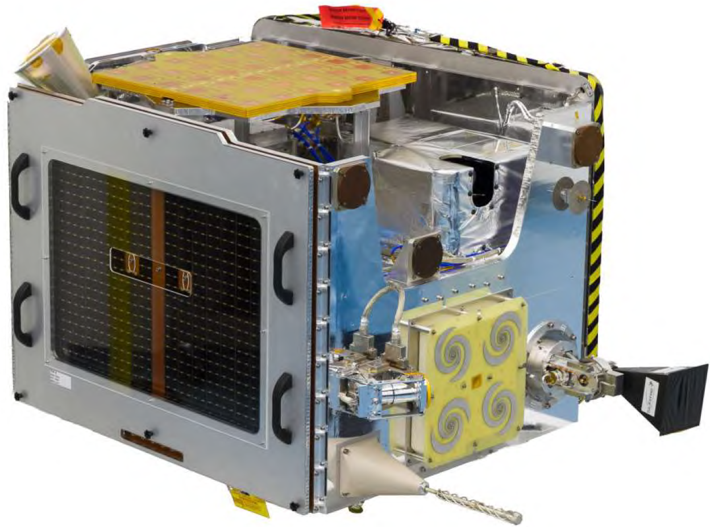
TechDemoSat-1, launched July, 2014
(SSTL, University of Surrey)

Slide 3
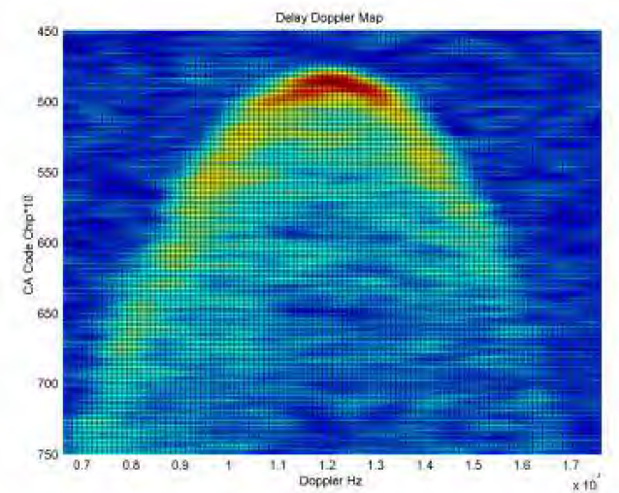
Delay-Doppler map used to measure sea state, detect ice edge, possibly measure soil moisture

Slide 4
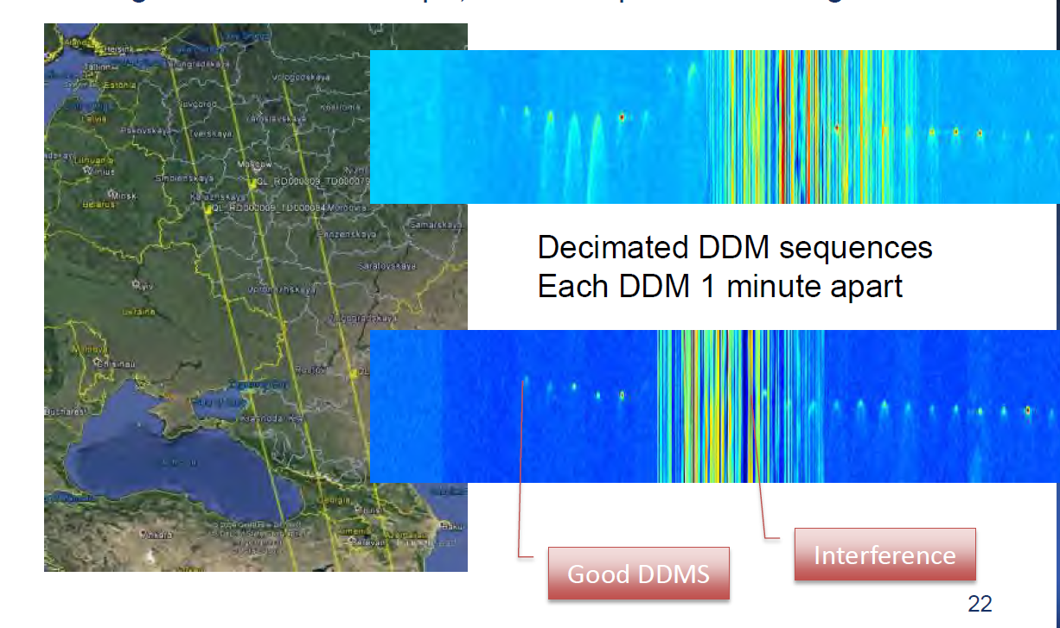
From Martin Unwin (SSTL)
Autumn 2014: DDMs over eastern Europe exhibit striping corruption. Cause: structured interference in GPS L1 band with structure similar to C/A code. Similar patterns manifest elsewhere around globe.

Slide 5
Civil GPS spoofing has been demonstrated in the laboratory and in controlled field tests; deliberate hostile spoofing has been detected in the wild.
At present, civil GPS spoofing is a rare, minor nuisance.
But experiments demonstrate that spoofing effects can be serious, especially for critical infrastructure.

Slide 6
Is the threat of civil GPS spoofing serious enough to warrant a change to the GPS signal-in-space?

Slide 7
Q1: How effective are receiver-side spoofing defenses?
Q2: How effective are SIS-side spoofing defenses?
Q3: By how much would such defenses increase receiver cost?

Slide 8
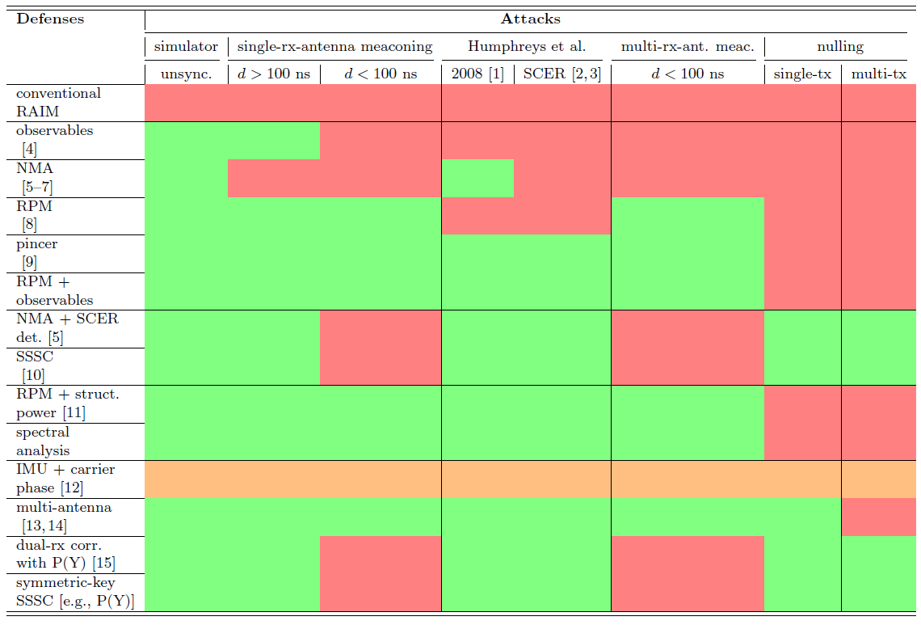

Slide 9
Increasing cost of attack
Increasing receiver-side cost of defense

Slide 10
requires SIS modification
------------------------------ requires platform motion --------------------------------------

Slide 11
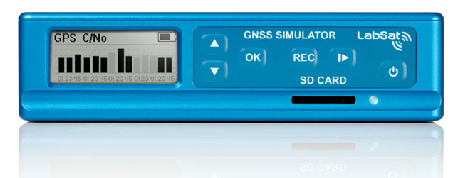
requires SIS modification
Inexpensive (< $5k) COTS signal simulator/record-and-replay devices enable low-cost unsynchronized spoofing and meaconing
------------------------------ requires platform motion --------------------------------------

Slide 12
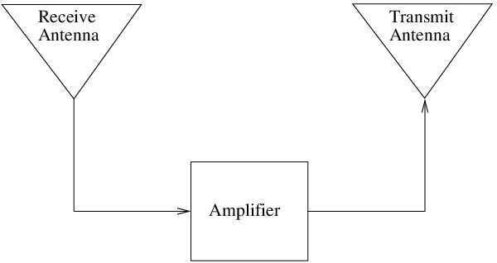
requires SIS modification
Synchronized (d < 100 ns) meaconing possible with a simple setup: rx antenna → amplifier → tx antenna
Variable delay requires:
downconversion → A2D → FPGA → D2A → upconversion
------------------------------ requires platform motion --------------------------------------

Slide 13
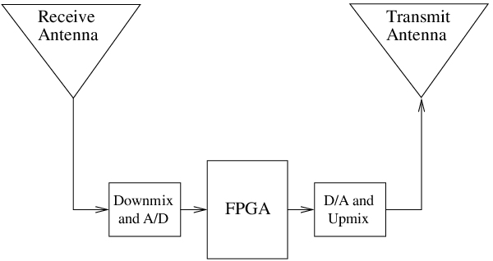
requires SIS modification
Synchronized (d < 100 ns) meaconing possible with a simple setup: rx antenna → amplifier → tx antenna
Variable delay requires:
downconversion → A2D → FPGA → D2A → upconversion
------------------------------ requires platform motion --------------------------------------

Slide 14
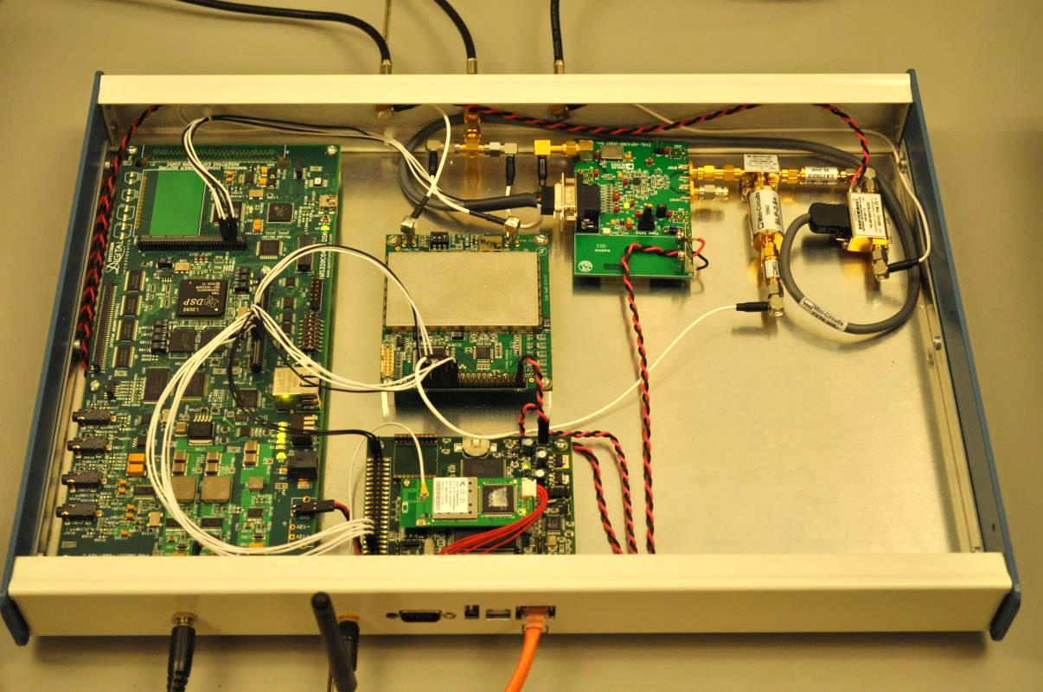
requires SIS modification
<10 ns code phase alignment
data bit prediction
carrier frequency locking
31 dB output power range
C/N0 matching
------------------------------ requires platform motion --------------------------------------

Slide 15
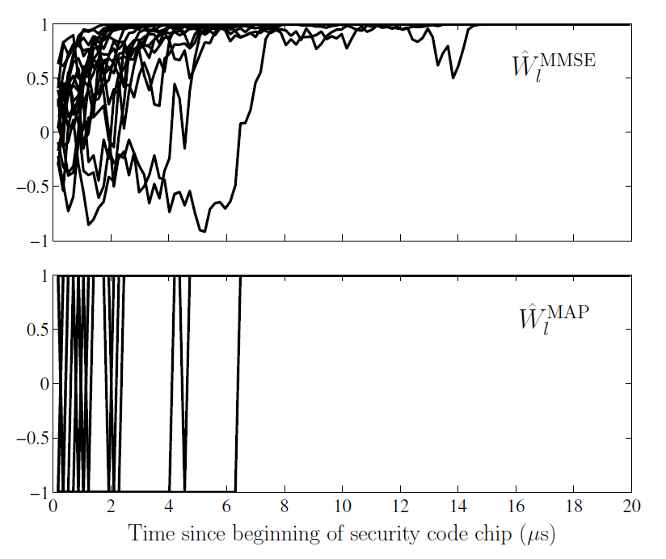
requires SIS modification
on-the-fly estimation of an unpredictable security code
------------------------------ requires platform motion --------------------------------------

Slide 16
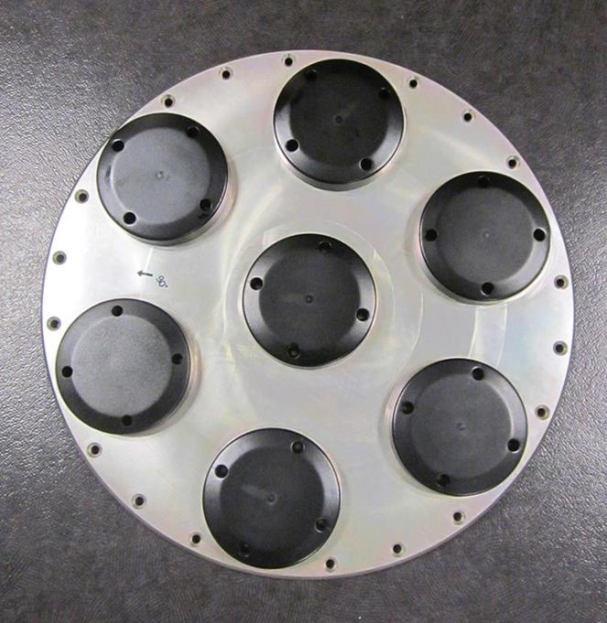
requires SIS modification
Each antenna’s RF signal is independently digitized. The resulting complex digital streams are weighted and summed to achieve simultaneous beam steering toward any number of SVs. The SV-specific signals are time-shifted and summed to create the false signal ensemble.
------------------------------ requires platform motion --------------------------------------

Slide 17
requires SIS modification
A nulling attack annihilates the authentic signal with an antipodal spoofing signal. Thereafter, no vestige of the authentic signal remains to interact with further spoofing. The attack can begin instantaneously at a data bit boundary or emerge gradually as shown by the phasor interaction in the video.
------------------------------ requires platform motion --------------------------------------

Slide 18
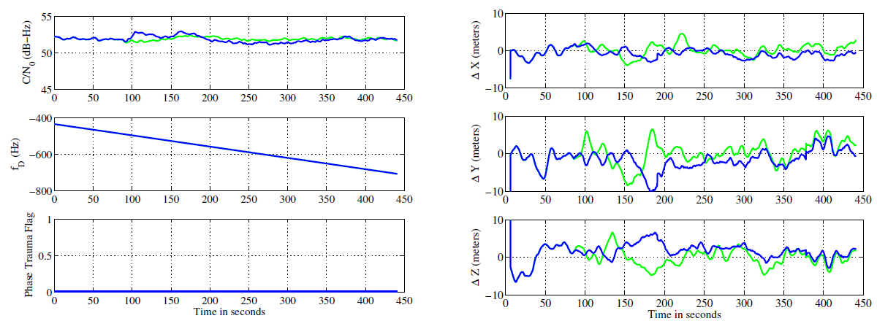
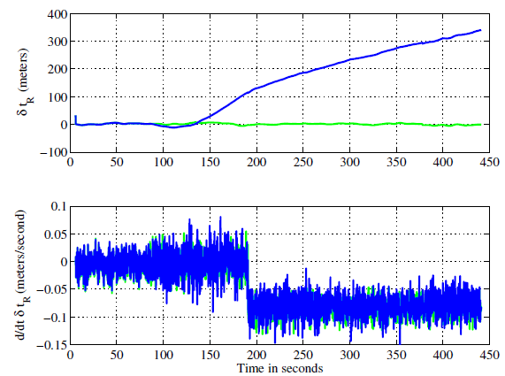
requires SIS modification
Standard GNSS pseudorange, Doppler, carrier phase, and signal strength observables can be analyzed to detect a spoofing attack. Detection is more powerful for static receivers.
------------------------------ requires platform motion --------------------------------------

Slide 19
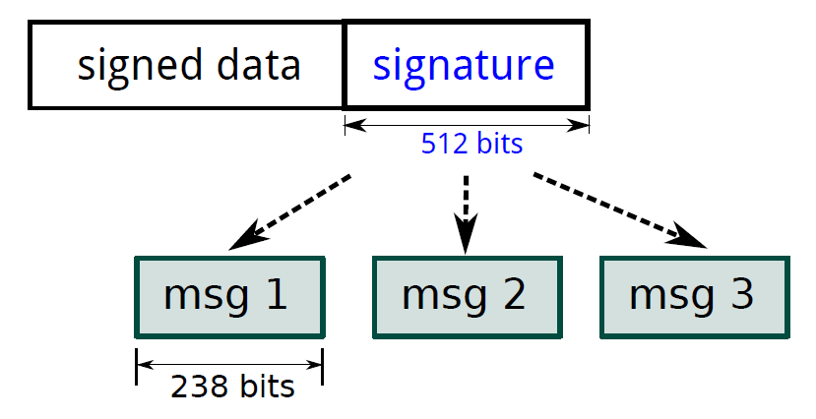
requires SIS modification
Signatures interleaved within navigation data stream. Authenticates origin of data.
No need for secret keys to be stored in the receiver.
------------------------------ requires platform motion --------------------------------------

Slide 20
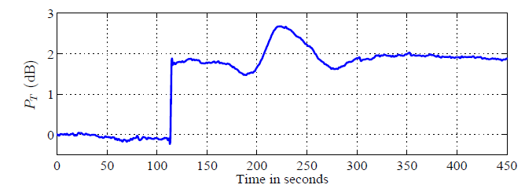
requires SIS modification
Received power monitoring: continuous measurement of the total in-band received power. Requires access to automatic gain control instantaneous setpoint.
------------------------------ requires platform motion --------------------------------------

Slide 21
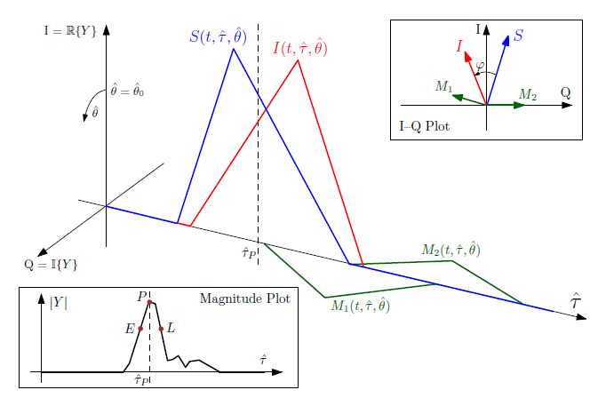
requires SIS modification
------------------------------ requires platform motion --------------------------------------
The Pincer defense: Exploit the attacker’s difficulty in preventing distortion when spoofing signals are approximately power-matched to authentic signals; amounts to trapping the spoofer between (1) a received power monitor, and (2) a distortion monitor.

Slide 22
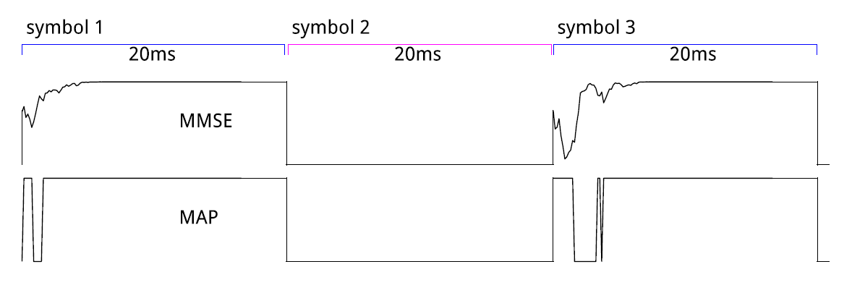
requires SIS modification
NMA + SCER detection exploits the attacker’s inability to accurately estimate the security code chip values during the first few microseconds after an unpredictable transition.
------------------------------ requires platform motion --------------------------------------

Slide 23
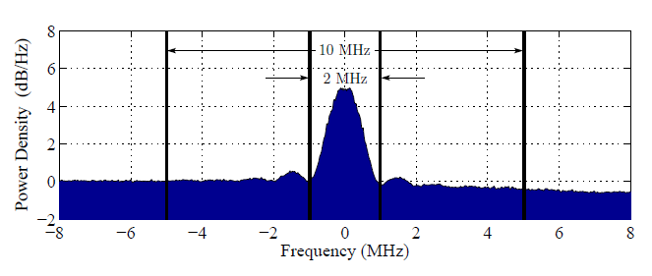
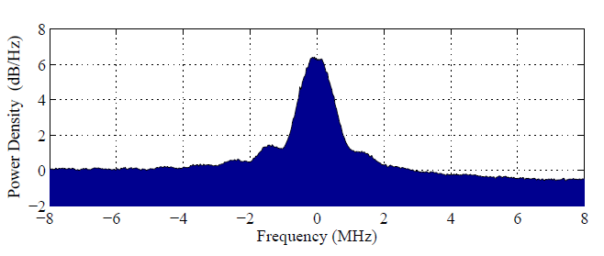
requires SIS modification
nominal
nominal
spoofed
------------------------------ requires platform motion --------------------------------------
Power spectrum analysis is valuable diagnostic for all types of RFI

Slide 24
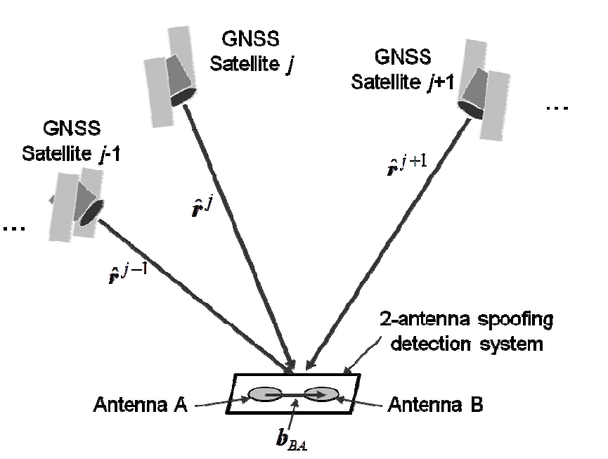
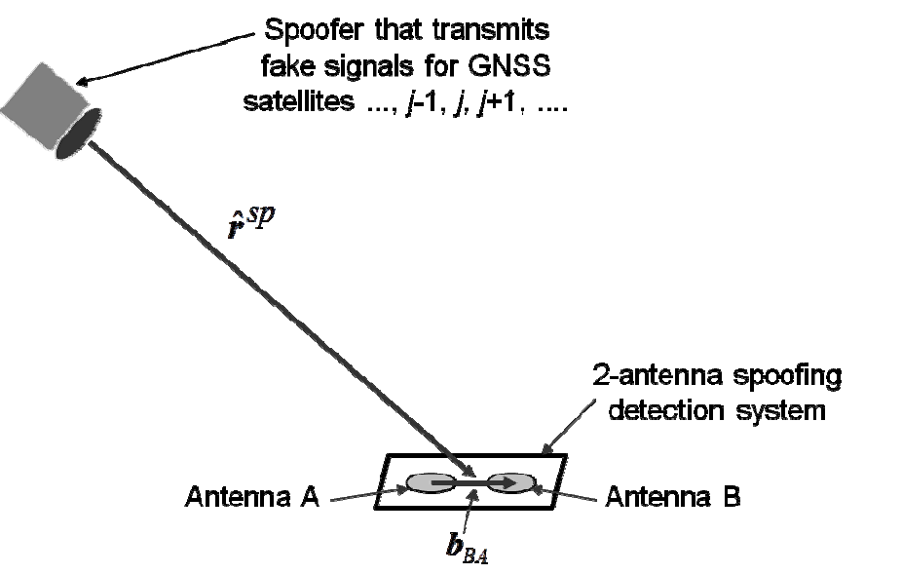
requires SIS modification
t
Psiaki et al., 2014
Spoofing signal arriving from a single spatial direction are easily distinguished from spatially diverse authentic GNSS signals.
------------------------------ requires platform motion --------------------------------------

Slide 25
requires SIS modification
------------------------------ requires platform motion --------------------------------------

Slide 26
NMA + SCER detection offers substantial PNT security at low cost
NMA has been advocated for over a decade:
Scott (2003) [10]
Internal MITRE memoranda
Wesson (2012) [5]
Kerns (2014) [6]
No surprise that Europe is moving forward with NMA on Galileo [7]

Slide 27
NMA on Galileo
Basic Design
To be included on E1B open service
High rate: 20 security bits per second avg.
Based on TESLA (keys successively revealed after use period)
Status
Draft blueprint complete
Over-the-air testing took place in summer 2014
Journal paper forthcoming

Slide 28
NMA on GPS
May 2015: The University of Texas completed a 2-year contract with the GPSD to develop a blueprint for NMA on GPS.
Basic Design
Targeted to CNAV on L2C and L5
Low rate: <1 security bit per second avg.
Hybrid of TESLA and digital signature scheme (e.g., ECDSA, BLS)
Status
Draft blueprint complete
Optimized scheduling across constellation
Receiver demonstrates NMA + SCER det.
Journal paper forthcoming

Slide 29
NMA on GPS L2C and L5
Case For
Low cost to user (software update)
Substantial improvement in PNT security for GPS users worldwide; patches a serious vulnerability in civil GPS
Case Against
Narrow uplink pipe leads to long time between authentication (9 minutes; compare Galileo at 10-20 seconds)
Response from industry: “If it’s not on L1, it’s not much use.”
Bad time to be adding requirements to OCX

Slide 30
Recommendations
Implement NMA on WAAS quadrature channel; provide example for other SBAS. Much higher SBAS data rate (250 bps) will support short time between authentication.
Digitally sign GPS LNAV data, then broadcast signatures over WAAS quadrature channel: cross authentication.
Encourage GNSS mfrs. to adopt simple receiver-autonomous defenses such as Pincer.
Plan for NMA on L1C.

Slide 31
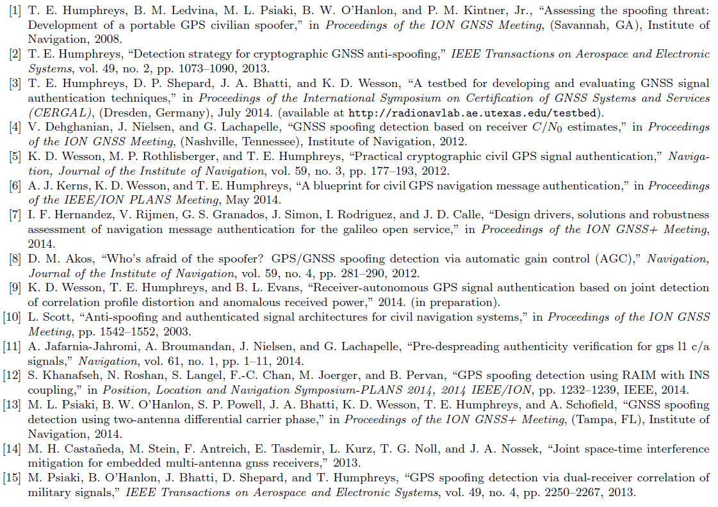

Slide 32
radionavlab.ae.utexas.edu

